Slide 1
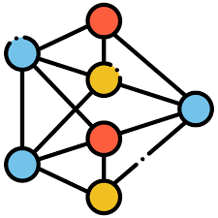













































Clean Pool $P_{c}$
Stage II: Loss-Entropy-based Early-stopping
$$O_{3}$$
0.84
Dataset $D_{noisy}$
$$O_{7}$$
1.21
Sorted $P_{m}$
$$O_{1}$$
0.97
Identified set $R$
$$O_{1}$$
$$O_{16}$$
3.12
$$O_{8}$$
1.02
$$O_{19}$$
2.87
$$O_{16}$$
3.12
$$O_{2}$$
$$O_{4}$$
$$O_{19}$$
$$O_{1}$$
0.67
Train on clean pool
STOP ?
Yes
$$O_{18}$$
2.05
Add top-k
2.87
$$O_{8}$$
$$O_{18}$$
2.05
$$O_{7}$$
$$O_{10}$$
1.66
$$O_{13}$$
1.99
. . .
$$O_{3}$$
$$O_{6}$$
$$O_{11}$$
1.96
$$O_{20}$$
$$O_{2}$$
1.53
$$O_{5}$$
. . .
No
$$O_{10}$$
$$O_{11}$$
Train few epochs
$$O_{9}$$
$$O_{15}$$
Dirty Pool $P_{m}$
$$O_{12}$$
$$O_{14}$$
$$O_{11}$$
1.96
$$O_{13}$$
$$O_{18}$$
2.05
$$O_{16}$$
$$O_{19}$$
Stage III: Influence Evaluation
$$O_{13}$$
1.99
$$O_{18}$$
$$O_{17}$$
$$O_{16}$$
3.12
$$O_{19}$$
2.87
Stage I: Loss-based Identification
Delete detected top-k from $D_{noisy}$

Slide 2




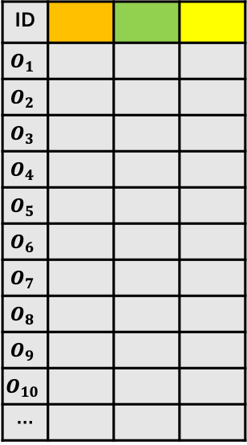
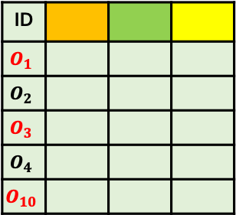
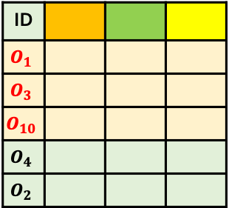
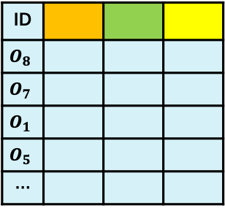




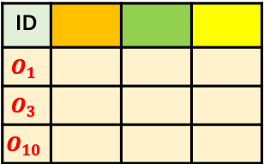
Loss-Based Sample Selection
Loss-Entropy Early-stopping
Misclassified Pool Generation
Clean Pool $D_{c}$
Dataset $D_{noisy}$
No
ID
$$O_{8}$$
$$O_{7}$$
$$O_{1}$$
$$O_{5}$$
…
Misclassified Set $R$
ID
$$O_{1}$$
$$O_{2}$$
$$O_{3}$$
$$O_{4}$$
$$O_{5}$$
$$O_{6}$$
$$O_{7}$$
$$O_{8}$$
$$O_{9}$$
$$O_{10}$$
…
Network 2
$$f(.,θ_{2})$$
Loss Entropy
ID
$$O_{1}$$
$$O_{3}$$
$$O_{10}$$
Yes
Network 1
$$f(.,θ_{1})$$
STOP ?
Small Loss
Influence Evaluation
Influence Evaluation
Large Loss
ID
$$O_{1}$$
$$O_{2}$$
$$O_{3}$$
$$O_{4}$$
$$O_{10}$$
ID
$$O_{1}$$
$$O_{3}$$
$$O_{10}$$
$$O_{4}$$
$$O_{2}$$
$$∇𝓛_{2}(.,θ_{2})$$
Add top-k
Dirty Pool $D_{m}$
Sorted $D_{m}$

