Slide 1
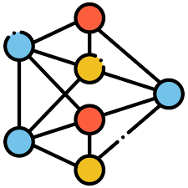




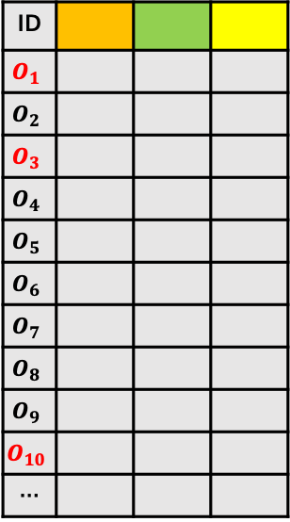
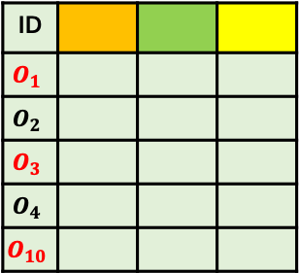
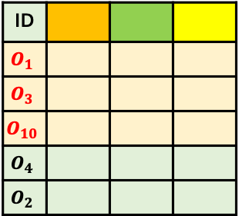
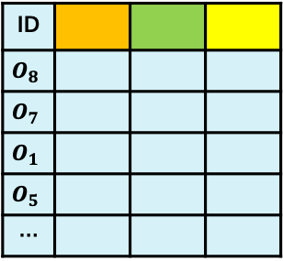




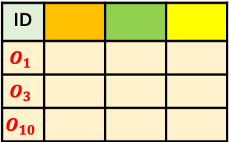
Loss-Based Sample Selection
Loss-Entropy Early-stopping
Misclassified Pool Generation
Clean Pool $D_{c}$
Dataset $D_{noisy}$
No
ID
$$O_{8}$$
$$O_{7}$$
$$O_{1}$$
$$O_{5}$$
…
Misclassified Set $R$
ID
$$O_{1}$$
$$O_{2}$$
$$O_{3}$$
$$O_{4}$$
$$O_{5}$$
$$O_{6}$$
$$O_{7}$$
$$O_{8}$$
$$O_{9}$$
$$O_{10}$$
…
Network 2
$$f(.,θ_{2})$$
Loss Entropy
ID
$$O_{1}$$
$$O_{3}$$
$$O_{10}$$
Yes
Network 1
$$f(.,θ_{1})$$
STOP ?
Small Loss
Influence Evaluation
Large Loss
ID
$$O_{1}$$
$$O_{2}$$
$$O_{3}$$
$$O_{4}$$
$$O_{10}$$
ID
$$O_{1}$$
$$O_{3}$$
$$O_{10}$$
$$O_{4}$$
$$O_{2}$$
$$∇𝓛_{2}(.,θ_{2})$$
Add top-k
Dirty Pool $D_{m}$
Sorted $D_{m}$

Slide 2

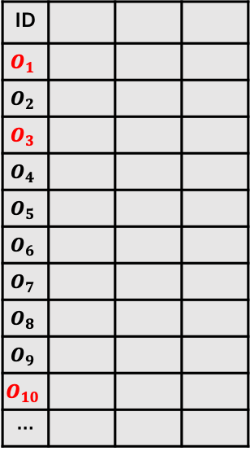
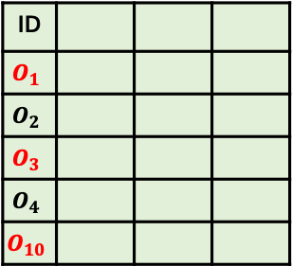

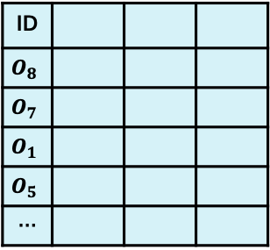


Loss-Based Sample Selection
Contrastive Label Correction
Misclassification Detection
Clean Pool $D_{c}$
Dataset $D_{noisy}$
Misclassified Set $R$
ID
$$O_{8}$$
$$O_{7}$$
$$O_{1}$$
$$O_{5}$$
…
ID
$$O_{1}$$
$$O_{2}$$
$$O_{3}$$
$$O_{4}$$
$$O_{5}$$
$$O_{6}$$
$$O_{7}$$
$$O_{8}$$
$$O_{9}$$
$$O_{10}$$
…
Network 2
$$f(.,θ_{1})$$
ID
$$O_{1}$$
$$O_{3}$$
$$O_{10}$$
Network 1
$$f(.,θ_{1})$$
Small Loss
Large Loss
ID
$$O_{1}$$
$$O_{2}$$
$$O_{3}$$
$$O_{4}$$
$$O_{10}$$
Dirty Pool $D_{m}$

