Slide 1
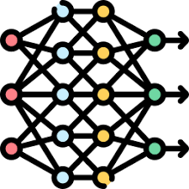





Rule 1
Rule 2
Rule 3
R4
R5
R3
Rule 4
R1
R2
Rule 5
Outlier
Labeled
$$D_{train}$$
LOF prediction
$$D_{noisy}$$
STAIR Interpretation
Rule Set $R_{noisy}$
Inlier
Misclassified Outliers Identification
False Outlier
Rule 1
False Inlier
Rule 2
Rule 3
R4
Rule 4
R3
R5
R1
R2
Rule 5
Label Cleaning
Cleaned Data
$$D_{cleaned}$$
STAIR Interpretation
Rule Set $R_{cleaned}$

Slide 2
Misclassified Identification

