Slide 1
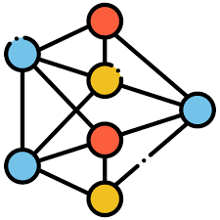






Outlier
False Outlier
Inlier
False Inlier
Dataset
$D_{train}$
Rule Set
$R_{noisy}$
LOF Detection
$$D_{noisy}$$
Rule Set $R_{cleaned}$
Rule 1
Rule 1
Rule 2
Rule 2
Rule 3
Rule 3
Rule 4
Rule 4
Rule 5
Rule 5
LOF Detection
Misclassification Identification
R4
R5
R4
R3
R3
R5
R1
R1
R2
R2
LOF Detection
$$D_{noisy}$$
STAIR Interpretation
Cleaned Data
$$D_{noisy}$$
STAIR Interpretation
Outlier Summarization without Misclassification Identification
Outlier Summarization with Misclassification Identification

Slide 2















LOF Detection
Misclassification Identification
Outlier Summarization
Rule 1
$$R_{1}$$
$$R_{5}$$
$$R_{1}$$
$$R_{5}$$
$$R_{2}$$
$$R_{2}$$
Rule 2
Rule 3
$$R_{3}$$
$$R_{4}$$
$$R_{5}$$
$$R_{4}$$
$$R_{4}$$
$$R_{1}$$
$$R_{2}$$
Rule 4
$$R_{3}$$
$$R_{3}$$
STAIR Rule Tree
Rule 5
Outlier
False Outlier
Inlier
False Inlier

