Slide 1
Strategy Draft
3D Editable Scene Generator
Core thesis
Value is in scene reconstruction and editable spatial scaffolding
Best use cases prioritize layout correctness over mesh beauty
Winning products combine generation, editability, and workflow fit
Best business use cases, competitive context, and what we should train for
What matters most
Object presence
Relative positioning
Scale coherence
Primitive usefulness
Editability
May 20, 2026
1

Slide 2
FRAMING
What Unites The Best Use Cases
Text prompt → scene
Image → scene
Shared value
Not the goal
Use when the setup is imagined, planned, or not yet built.
Use when the physical setup already exists and needs to be reconstructed, documented, or edited.
Create a usable spatial scaffold so humans can plan, train, communicate, or reconfigure.
Perfect hero-quality meshes are less important than layout and editability.
The strongest use cases are united by four needs:
Scene layout matters more than final mesh beauty
Users need editable outputs, not a static render
The result must help people act: plan, train, communicate, or reconfigure
Primitives are often enough if object presence and positioning are correct
Core value
Recreate the setup so humans can work with it.
2

Slide 3
PROMPT-FIRST
Best Business Use Cases For Text
Trade show booth / showroom planning
Retail display and merchandising concepts
Office / reception / workspace planning
Training and simulation environments
Previs / virtual production
Create booth concepts before anything is built. Test furniture, signage, and traffic flow.
Generate shelf zones, promo islands, and store corners from a brief. Explore planogram directions quickly.
Generate room layouts from a functional description for stakeholder review.
Create cashier, reception, classroom, service desk, or emergency scenarios from text.
Turn scripts or shot descriptions into editable 3D setups for camera planning and scene blocking.
Text-to-scene is strongest when the target setup does not exist yet.
Planning a new space
Exploring alternatives
Converting operational intent into a visual layout
Building training or simulation environments from description
Text is best for
first-draft blockouts
scenario design
workflow explanation
internal alignment before execution
3

Slide 4
IMAGE-FIRST
Best Business Use Cases For Image
Image-to-scene is strongest when the physical setup already exists.
Current-state capture
Layout learning
Before/after redesign
Operational memory and retrieval
Strongest pattern: real-world setup → editable digital twin lite
1. Interior / room reconstruction
2. Retail shelf / aisle reconstruction
3. Equipment compartment and vehicle layout training
4. Operational workstations
5. Showroom / booth / display reconstruction
Recreate a room from a photo. Test furniture, layout, and redesign ideas.
Rebuild shelf layouts from photos. Check facings, placement, and promo structure.
Reconstruct fire trucks, ambulances, field-service vans, or cabinets.
Packing stations, reception desks, service counters, workshop bays.
Capture a real setup from photos and reuse it for redesign, review, or training.
4

Slide 5
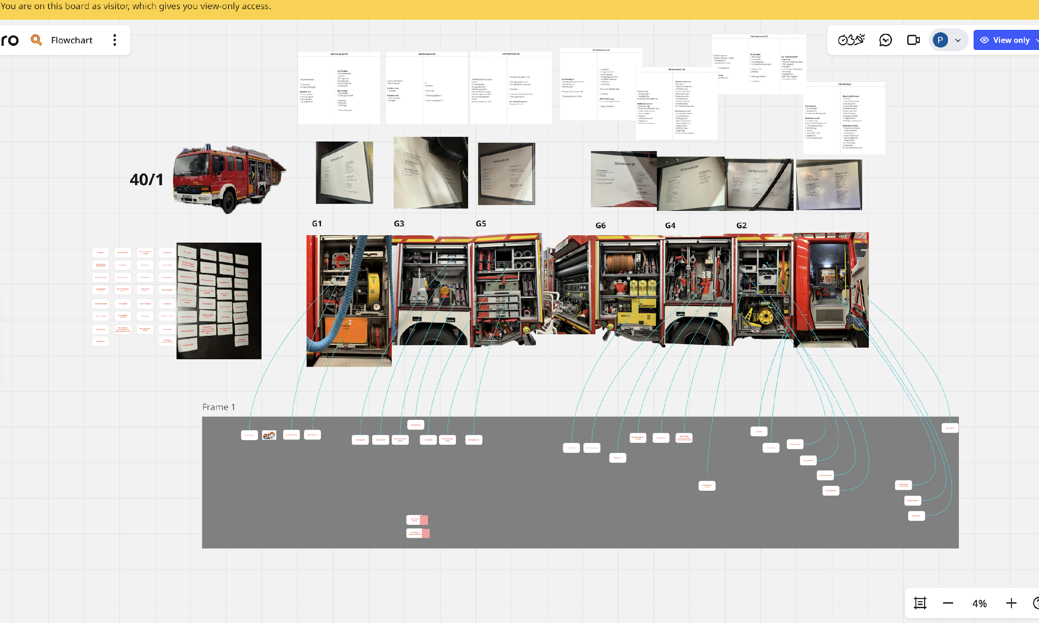
PROOF POINT
Real Use Case: Fire Brigade In Oberhaching
A real example comes from a volunteer fire brigade in Oberhaching.
Firefighters need to repeatedly learn where each item is stored in specific fire trucks
There is no universal standard layout across brigades
Different brigades can have different trucks and different compartment setups
Sergey currently uses a manual Miro board with photos, lists, and labels
The value is not visual polish. The value is spatial memory, retrieval speed, and vehicle-specific training.
5

Slide 6
GENERALIZATION
Why This Use Case Matters
Why it is strong
What it can support
Why it extends beyond fire brigades
Real user solving the problem manually.
Layout accuracy matters more than visual fidelity.
Primitive scene reconstruction is already useful.
Training new members.
Refresh training.
Vehicle-specific memory drills.
Cross-crew familiarization.
Interactive retrieval simulations.
Same pattern appears in ambulances, service vans, industrial cabinets, workshop stations, and operational storage environments.
This is a broader category opportunity:
Operational equipment layout reconstruction
Workspace inventory and retrieval training
6

Slide 7
THREE LAYERS
Competitive Landscape
Asset-first tools
World / editable scene platforms
Workflow-first editable scene systems
Open technical pressure
Meshy
Tripo
Trellis3D
Strength: object generation
Weakness: weaker full-scene ownership
Marble
SpAItial
Strength: scene generation, editing, expansion, composition
PentoPix
Strength: practical production workflows, camera/layout control, editable scene assembly
WorldGen
Tencent HunyuanWorld
These matter more as technical/open signals than as commercial adoption leaders.
What competitors suggest
The market is moving from beautiful 3D output toward editable, explorable, exportable scene structure
The winner may not be the best pure generator
The winner may be the product that best combines layout reconstruction, editability, workflow fit, and export
7

Slide 8
MARKET MATURITY
Commercial And Social Signals Are Still Weak
The category currently has stronger technical momentum than mature market validation.
Weak or no G2 / Trustpilot footprint
Limited public customer-count disclosure
Few strong case studies with repeatable production metrics
Thin evidence of broad enterprise deployment
Modest or unclear official social traction for many players
Marble
SpAItial
Strongest product and funding signals, but still limited classic SaaS review proof.
Strong frontier positioning, but social and commercial proof are still early.
PentoPix
WorldGen / HunyuanWorld
Practical workflow positioning, but review-platform and large-scale customer proof are still thin.
Matter more as technical and open-model signals than as mature commercial adoption signals.
Strategic takeaway: room remains for a player that combines real workflow usefulness with clearer customer proof.
8

Slide 9
TRAINING PRIORITIES
What We Should Train Our Model For
Object presence
Relative positioning
Scale coherence
Orientation
Primitive usefulness
Editability
Scene completeness
We should not train for best-looking final meshes or parity with dedicated text-to-3D object systems.
Ugly but structurally right should win over pretty but spatially wrong.
9

Slide 10
EXECUTION
Priority Training Targets And Evaluation
Highest-priority scene families
What to emphasize in training
Suggested evaluation weighting
Retail shelf / aisle layouts
Room and reception layouts
Equipment-in-compartments scenes
Workstation and counter setups
Booth / showroom scenes
Bounded spaces
Repeated objects
Compartments and shelves
Object-to-container relations
Left/right and front/back consistency
Editable scene structure
Relative positioning 35%
Object presence 20%
Scale coherence 15%
Primitive usefulness 20%
Editability 10%
Main takeaway
The strongest near-term value is scene reconstruction and editable spatial scaffolding for real business workflows.
10

