Slide 1

NEURALINK

Slide 2

Project work team
Hamdy Salah Kamil Esmail
Group : 1
Section : 5
Hamdy Soliman Sapet Soliman
Hossam Hassan Saad Eldin Mahmoud
Hossam Walid Mahmoud Abd Elalim
Khaled Mohsen Hashem Sayed

Slide 3
01
CONTENTS
Project Charter
02
Project Scope
03
Work Breakdown Structure
*
The rest of the project

Slide 4
Project Charter
01
Report Presentation
The project management charter authorizes the project to exist and gives the project manager the authority to use organizational resources to implement the project

Slide 5
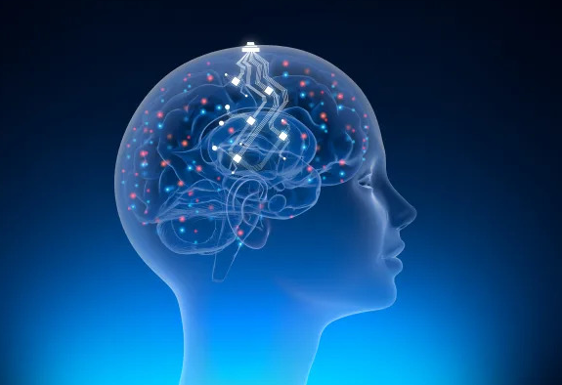
Business case
Business case
The Newralink chip is a coin-sized computer chip
grown in a human brain, indicating an early step. Towards achieving the goal of treating diseases that affect humans by implanting the same type of segments, according to Reuters.
The newralink sensor is about eight millimeters in diameter or smaller than the tip of the finger
implanted in the skull, and connected to smallwires. With the help of a sophisticated robot, flexible
filaments or wires more accurate than human hair are implanted in areas responsible for movement and sensation functions in the brain.

Slide 6
Features
2
1
Treatment of spinal cord injuries and paralysis
Treatment of diseases such as Alzheimer's and dementia
4
3
Control small things such as a computer keyboard or a mousse indicator
Treatment of memory and hearing loss, depression and insomnia

Slide 7
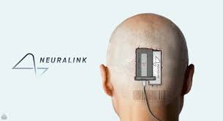
NEURALINK
C
Project scope
the brain chip allow People to Control Phones and other devices with their minds
D
B
it help People with neurological Conditions Control their paralyzed Limbs by Certain
Neuro connections.
it help to Cure neurological Conditions and disorders and it also help in the treatment
of dementia, Al Zheimer and Verious spinal Cord injuries
A
the brain chip can cure memory loss, depression, hearing loss and insomnia, and it Will Work as a Fitbit in the human brains

Slide 8
Key Deliverobles
This Chip Considered a revolutionary brain-machine interface that could blur the
lines between humanity and technology, this device will "sew" up to 1024 thin electrodes 5
microns wide extremely tightly into a person's brain
When the chip is attached to someone's head, it is not visible, which means that no one can
tell if someone else installed it or not and This chip can read all your brain activity,What
makes it able to plan and anticipate a person's jobs? In the future, scientists seek to develop it
to make it able to cancel the feeling of pain.

Slide 9
project resources
as advertised
1) Neuralink Company
2) Tesla Motors Company
3) A team of artificial intelligence programmers price, but this price may decrease in the future and become available to all users
Staff : A team of artificial intelligence programmer

Slide 10
Timeline and Constraints
Timeline:
1) Neuralink project was launched in 2016 .
2) In the period from 2016 to 2019, the Elon chip was tested on many animals, some of which failed, and some of them succeeded.
3) Elon Musk stated in 2019 that it will be tested in humans by the end of 2020
.Constraints;
1) Some experiments on animals such as monkeys and pigs failed and posed a threat to their lives .
2) The chip may be infected with some viruses, which affects the person carrying the chip .
3) The slow pace of science and research just can't keep up with Musk's timelines.

Slide 11
Budget , Assumption and High level risks
Budget :
$200 million (includes project licenses, developers, designers, training and experiments)
Assumption:
Some scientists assume that Elon Musk's chip will achieve great success and will be the greatest
achievement in human history, but it has not been tested on people and prove the validity of their conversations. On the monkeys, and the words of the scientists proved correct, but when trying it on some pigs, it failed and the lives of some of these pigs were destroyed.
High level risks:
this chip may be exposed to hacked, causing the leakage of a large number of users of this chip, and this is the biggest risk of the project.

Slide 12
Project Scope
02
Report Presentation
Project scope is a detailed outline of all aspects of a project, including all related activities, resources, timelines, and deliverables, as well as the project’s boundaries.

Slide 13
Project scope Description
In an unprecedented attempt in human history to provide the human brain
with additional technological capabilities to enable it to perform computer
operations, Elon Musk launched for the first time a chip implanted in the
brain that connects it to a computer, which he says will allow in the future
to grant additional supernatural abilities to see, hear, and even control
feelings and store dreams.

Slide 14
Project scope Constraints
1
2
3
4
Some experiments on animals such as monkeys
and pigs failed and posed a threat to their lives.
The chip may be infected with some viruses, which affects the person carrying the chip
A small robot attaches thread-like electrodes to
specific areas of the brain. The sewing robot is said to cost between $10 and $20 million in start-up cash, but can now be made for about $500,000.
The slow pace of science and research just can't keep up with Musk's timelines.

Slide 15
Project assumption
Not long ago, the whole world expected that there would not, and would not, be technological means that would help man and protect him from
diseases and give him some other advantages, but Elon Musk succeeded in putting an end to these dreams and turned them into a living reality, as he presented the world with a neuralink chip.

Slide 16
Product Acceptance Criteria
One of the criteria for accepting the product is that it does not affect
human health and human capabilities in dealing with nature and making decisions.

Slide 17
This project is considered one of the largest projects of its time, as this
project includes the most important problems of this generation and
contains solutions to many problems.
Project Exclusions
Project Deliverables
And certainly, if you see it soon, it is necessary that it be usable by the
human brain, as we know that it has so far been tested on the animal brain only.
The technology will initially have a medical focus, such as helping people deal with brain and spinal cord injuries or birth defects.

Slide 18
Work Breakdown Structure
Report Presentation
03

Slide 19
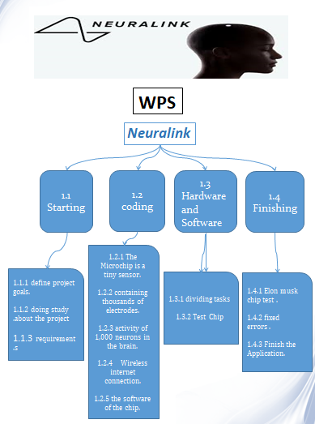

Slide 20
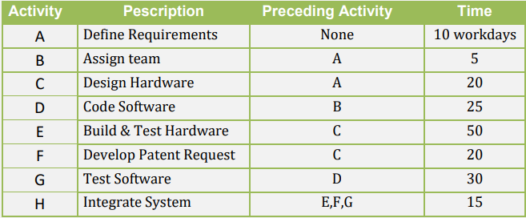
Resource Constrained

Slide 21
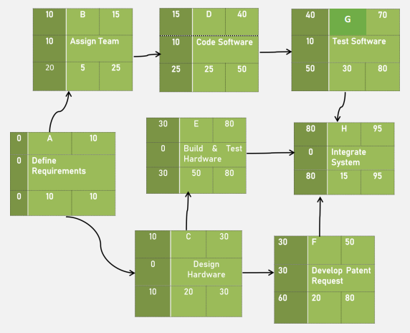
Resource Constrained

Slide 22
THANKS
BUSINESS TEMPLATE

