Slide 1
ENGI 301 Mechanical Split Flap Proposal
Mon 09/25
Peter Tizora

Slide 2
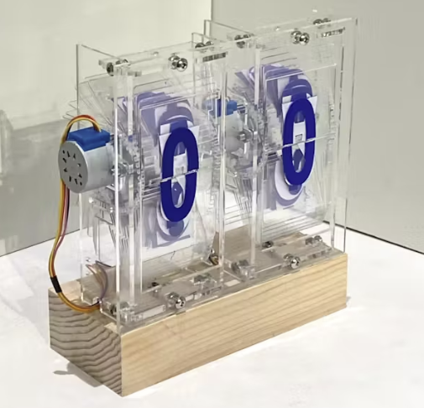
Background Information
I am proposing to build a mechanical split flap device that can display the date
- https://www.hackster.io/jyx1/engi-301-split-flap-ddebac
- https://scottbez1.github.io/splitflap/
- https://github.com/scottbez1/splitflap
- One most important improvement is that my display will keep track of the
date and display it on the flaps. Unlike the original project mine will include
an LCD screen for showing month and year.
I chose this project because I have always been fascinated by mechanical displays.

Slide 3
System Block Diagram
LCD Screen
GPIO
PWM
Stepper Motor
PWM
Stepper Motor
PWM
Stepper Motor

Slide 4
Power Block Diagram
LCD Screen
1.8 V
3.3 V
Stepper Motor
3.3 V
Stepper Motor
3.3 V
Stepper Motor

Slide 5
Components / Budget
Component | Need to Buy | Cost
Stepper Motor | 5 | 30
Stepper Motor Driver | 1 | 10
Level Shifter | 1 | 2
USB-A to Mini-USB Cable | 1 | 5
LCD Display | 1 | 10
Acrylic | 2 | 15

