Slide 1
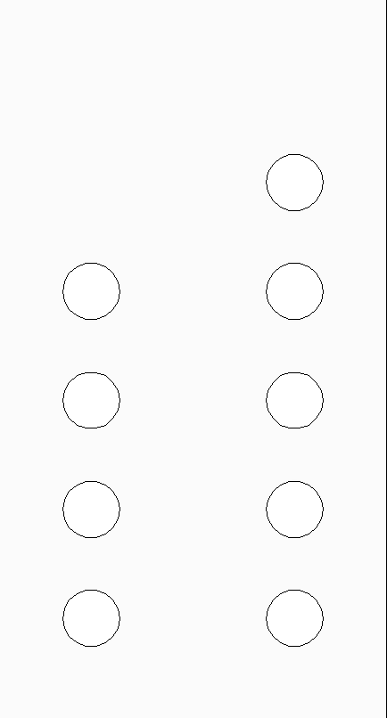

TRIGGER
DAC4
SADC4
DAC3
SADC3
DAC2
SADC2
DAC1
SADC1
JULIAIII BREAKOUT BOX

