Slide 1
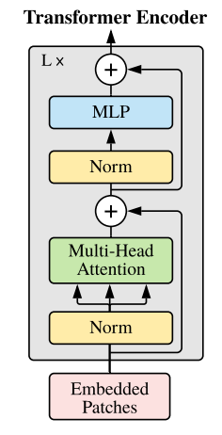
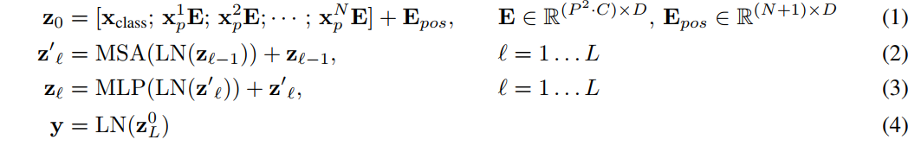
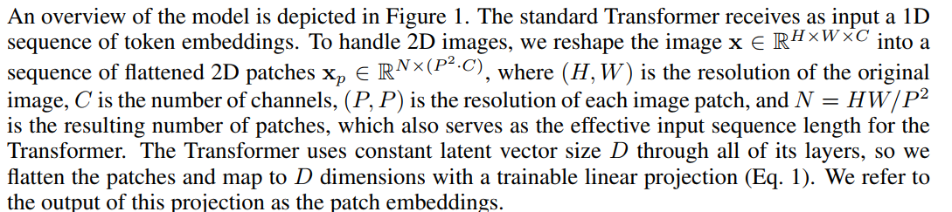
3
2
1

Slide 2
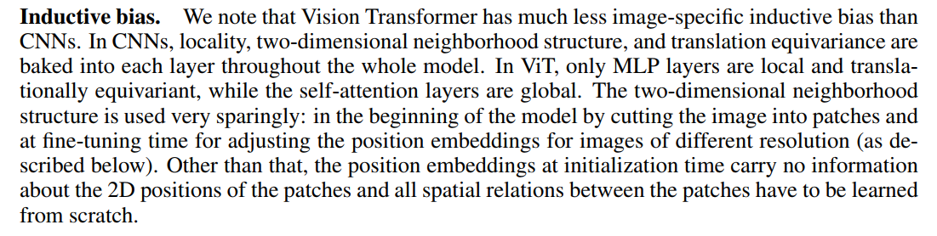
https://moon-walker.medium.com/transformer%EB%8A%94-inductive-bias%EC%9D%B4-%EB%B6%80%EC%A1%B1%ED%95%98%EB%8B%A4%EB%9D%BC%EB%8A%94-%EC%9D%98%EB%AF%B8%EB%8A%94-%EB%AC%B4%EC%97%87%EC%9D%BC%EA%B9%8C-4f6005d32558

Slide 3
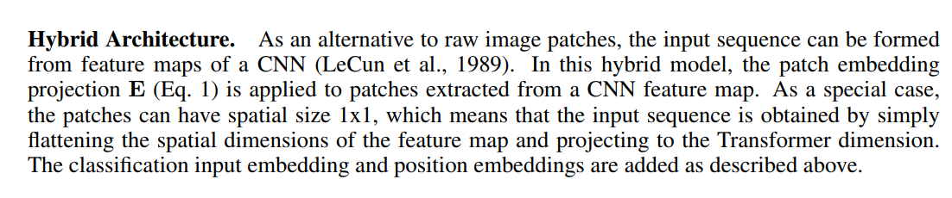

Slide 4
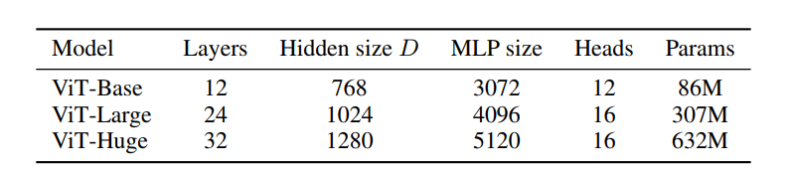
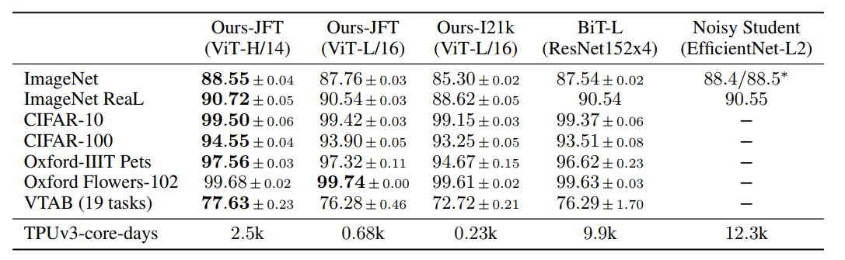

Slide 5
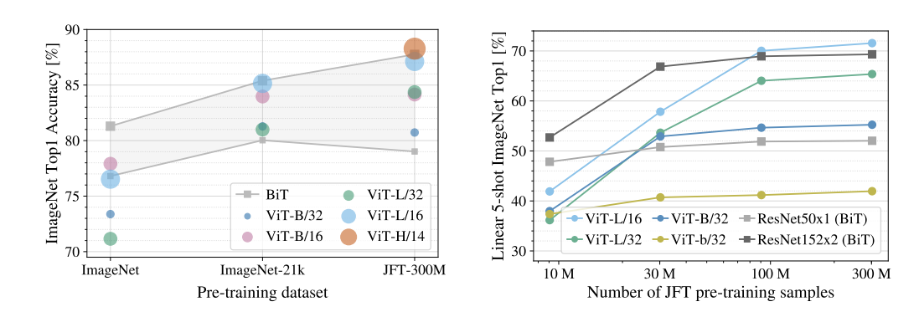

Slide 6
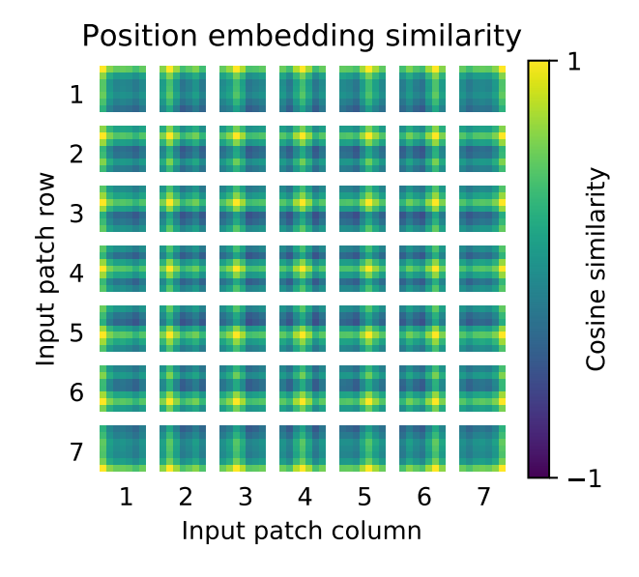
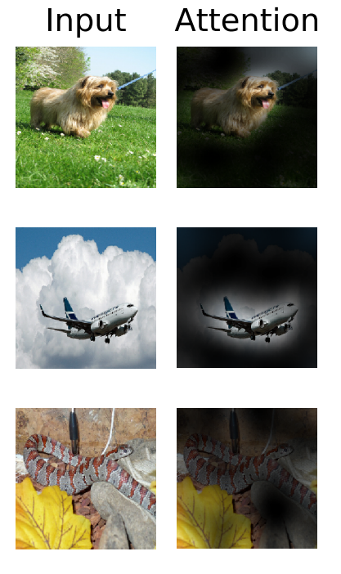

Slide 7
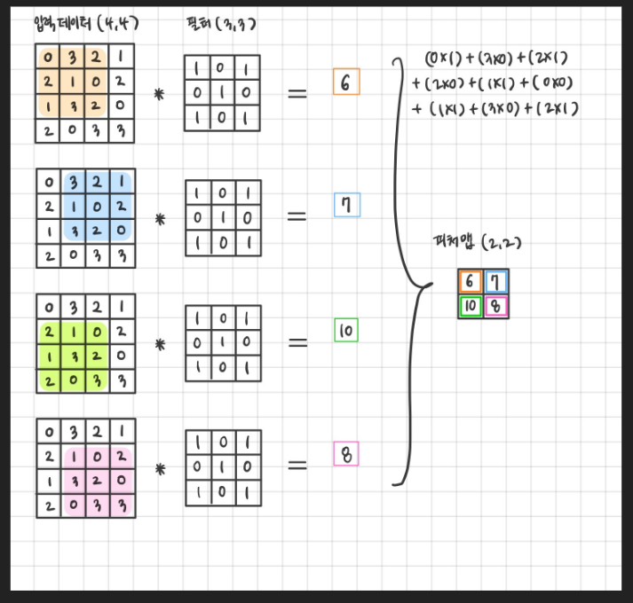
https://www.dinolabs.ai/237
https://www.dinolabs.ai/238

