Slide 1
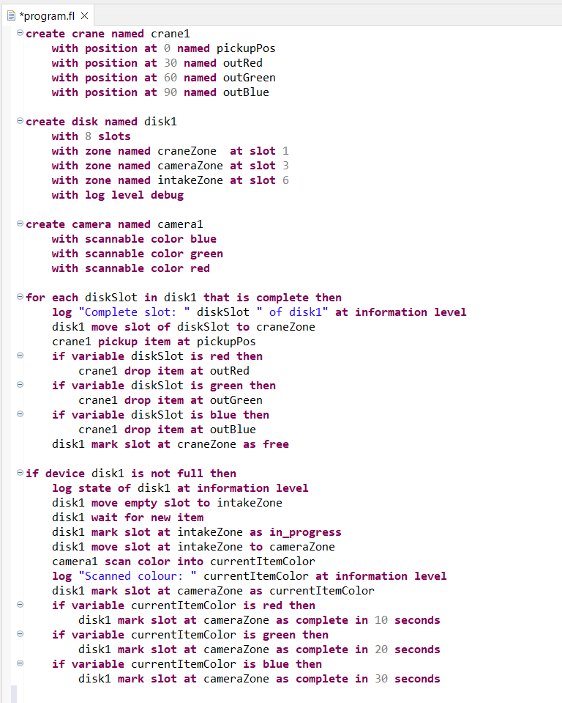

Logging levels and statements in DSL
Log level ->
By Peter Brændgaard pebra18
Log variable ->
Log state ->
Log variable ->

Slide 2
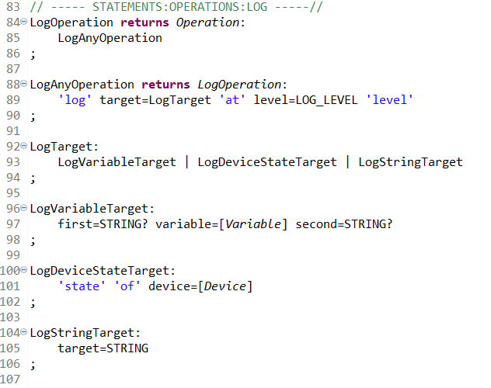



Xtext
Log statements
Device log levels

Slide 3
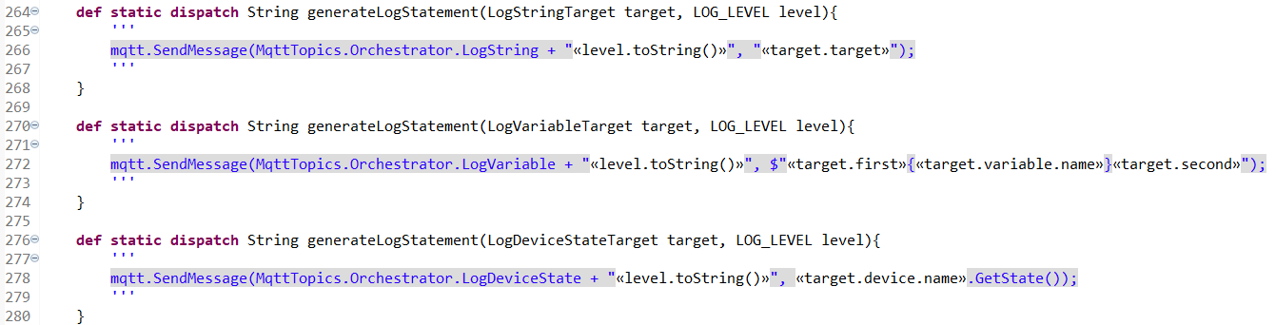
Code generation (Orchestrator)

Slide 4
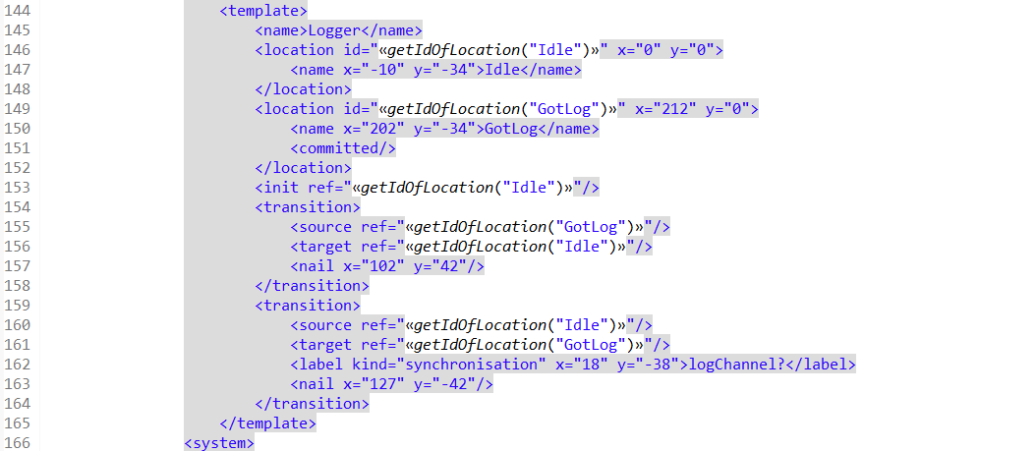
Code generation Uppaal

Slide 5
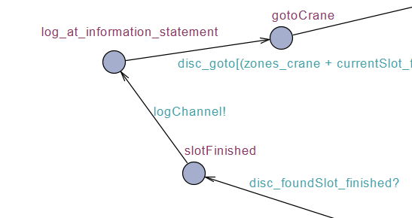
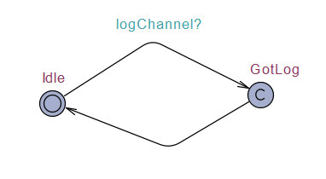
Uppaal
Master controller
Logger

Slide 6
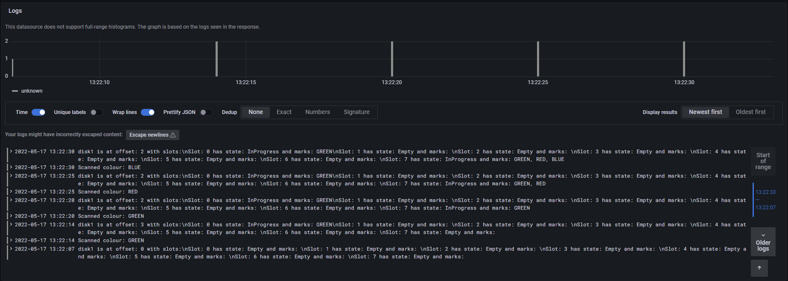
Grafana

