Slide 1
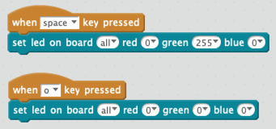
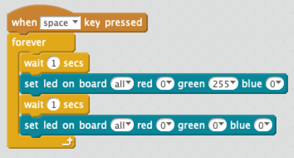
Lab 1: Turn LED On
Lab 2: Flash LED (Blink Lab)
The on board LED will turn green when you press the space bar. Note the yellow flash that indicates the event happened. The “o” key will turn the LED off.
Can you chance the color?
The on board LED will flash green when you press the space bar.
Can you chance the speed that the LED flashes? Note that the wait can contain a decimal value like 0.1 or 0.05.
Advanced – why is there a limit on how fast the LEDs flash? (hint – is the command stream is a limiting factor)

Slide 2
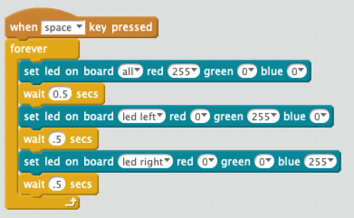
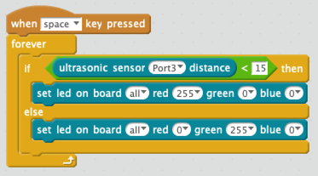
Lab 3: Left and Right LEDs
Lab 4: Conditional Ping
We can change just the right or left LEDs. Can you make both turn red, then the left green, then the right blue?
Robots can sense the world around them and then change their behavior. Can you make the color change based on what is in front of the robot?
How is this lab like a stoplight? What does green show?

Slide 3
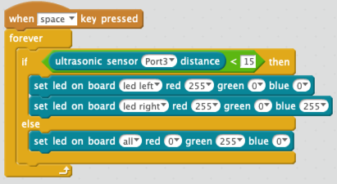
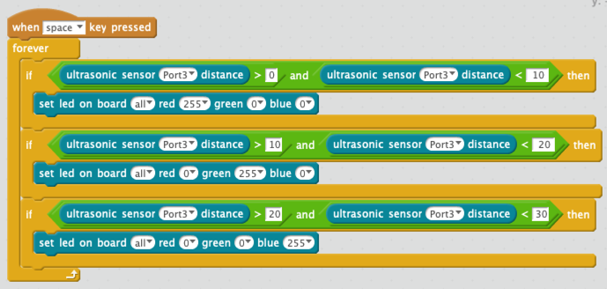
Lab 5: Green Means Go!
Lab 6: Rainbow Colors
What if you wanted your distance to change the color to more than two colors? Here is an example that uses the and block to test if the sensor is within a range.
Hint: to write this faster, use the duplicate (right click) to copy the if/then block.
How many colors can you make?
Green means there is nothing in front of us. It means go forward. But then block is detecting an obstacle in from of us. Lets turn the different LEDs on to show that we need to turn to avoid a crash!

Slide 4
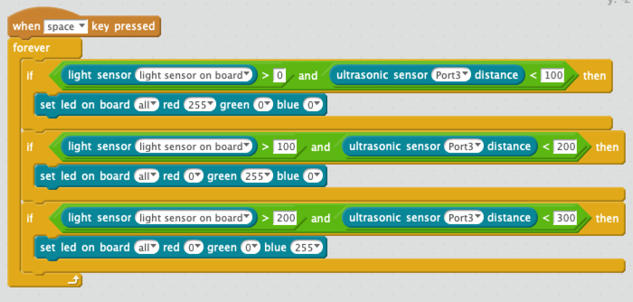
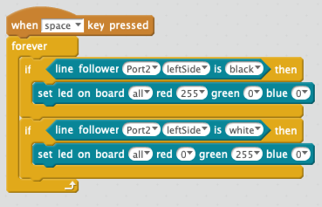
7: Light Sensor Lab
Lab 8: Line Follower Lab
The mBot has a light sensor on the top. The program above will change the LED color based on how much light is hitting the robot.
Do you think the LEDs will change the value of the light sensor?
The mBot has a two line followers on the bottom of the robot. There are robot blocks that return true or false if the robot is above a white or black object. Run the program above and note when the blue LEDs on the mBot turn on and off. How far above white paper do the sensors need to be to work?

Slide 5
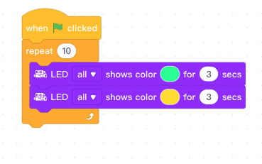
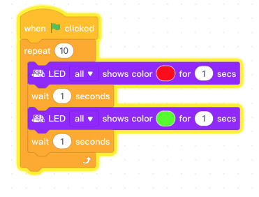
9: Green and yellow Lights
Lab 10: 2 Colors x 10 times
When the space key is pressed, both LEDs will switch between yellow and green for 10 times, for 3 seconds each.
Lights up the specified LED the specified color
When the space key is pressed, both LEDs will switch between red and green for 10 times, with the time gap of 1 second.

Slide 6
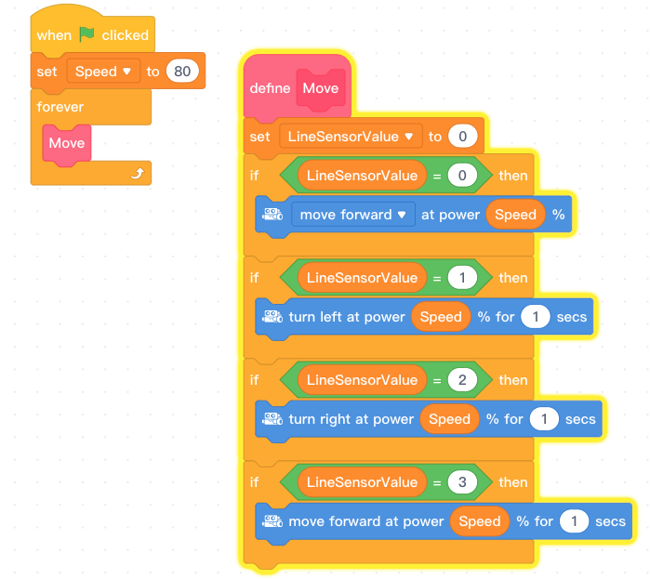
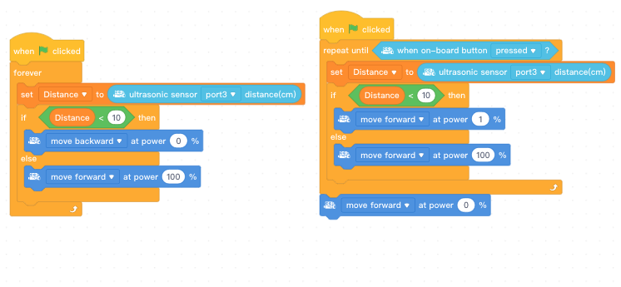
Lab 10: Follow The Straight Light
Lab 11: Red Light Green Light
mBot moves forward as it is sensing black, or limited reflected light.
mBot turns left as the left LED only, senses black, or limited reflected light.
mBot turns left as the right LED only, senses black, or limited reflected light.
1. Make a block named "Move"
2. Make the following variables: "Speed" and "Line Sensor Value"
mBot runs forwards, then stops at a fixed distance from an obstacle. When obstacle is removed, mBot continues to run forward.

Slide 7
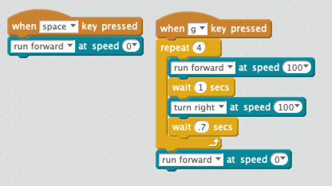
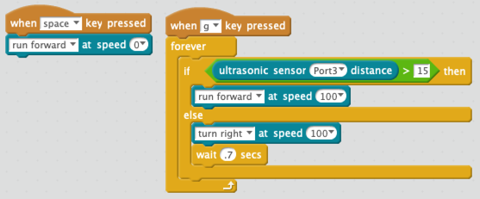
Lab 9: Drive in a Square
Lab 10: Collision Avoidance
Before we do this lab, put your robot on the floor but be sure you avoid stepping on it. This way it will not drive off the table and crash.
This lab requires your robot to drive in a square. You must press “g” for it to start. The space bar will stop both motors.
Make the robot go forward until it gets close to an obstacle. Then turn right.
Can you make the robot back up first and then turn when there is an obstacle in front of it?

Slide 8
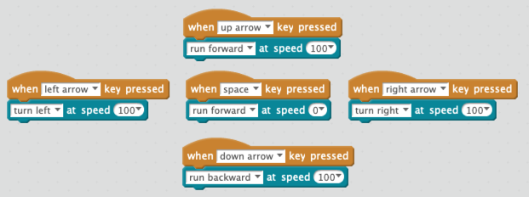
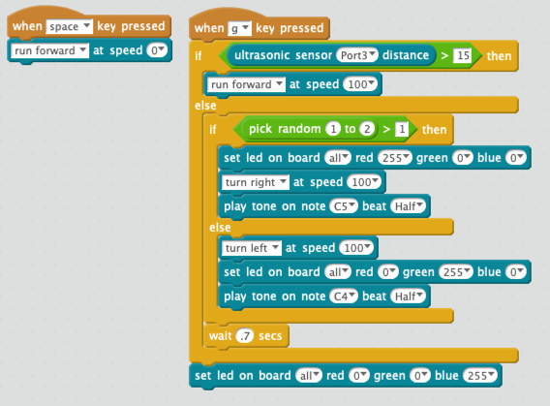
Lab 11: Remote Control
Lab 12: Collision Avoidance With Lights and Sound
Create events for each of the keys up arrow, left-arrow, space, right arrow and down arrow. Associate these events with run forward, turn left, turn right, run backward and stop.
To save time, you can use the right click “duplicate” function to copy the first block of code to the other four.
Modify the collision avoidance lab to do the following:
Randomly go right or left when an object is detected
Change the LED to red if you are turning right and green if you are turning left
Play a different tone for each direction

