Slide 1
PC Proxy Tracer Analysis
Peter Mills
2011-5-20

Slide 2
1. Preliminaries
Tangent model
Singular vectors and Lyapunov exponents
Outline
2. Tracer Correlation
Traditional proxy analysis
Correlation with PCs
Lyapunov spectrum
3. PC Proxy
Description
Simulation results
4. Conclusion
Summary
Outlook
References

Slide 3
1. Preliminaries
Tangent model
Consider a system of ODEs:
Linearize this about x:

Slide 4
Tangent model
Define H such that:

Slide 5
Singular vectors
(also called principal components (PCs) or empirical orthogonal functions (EOFs))
Decompose H as follows:
U is an orthonormal matrix of “right” singular vectors
V is an orthonormal matrix “left” singular vectors
S is a diagonal matrix of singular values
(Tang et al. 2006, Press et al. 1992)

Slide 6
Lyapunov exponents
The time averages of the singular values are the Lyapunov exponents:
If λ1 is greater than zero, the system is said to be chaotic
For most systems:
(Ott 1993)

Slide 7
Singular vectors
An Eulerian tracer simulation is linear
(the tangent vector is simply the dynamics)
Where
q(0) is the initial tracer field
q(tN) is the final tracer field

Slide 8
2. Tracer correlation
Two different tracers integrated over a long time with the same wind fields will become correlated
Can be used to infer global fields of long-lived tracers (such as O3) based on only a few sparse measurements
(Randall et al. 2002, Allen & Nakamura 1999)

Slide 9
Tracer correlation: extreme example
Zonally symmetric versus meridionally symmetric initial field

Slide 10
Correlation with first principal component

Slide 11
Lyapunov spectrum

Slide 12
Principal Component Proxy
Description
Generate matrices A1, A2, A3...
Find the left singular vectors of Hj for lead time, j
Generate right singular vectors from {Ai}
Correlate measurements with right singular vectors
**note: we use only a small subset of singular vectors with largest associated singular values

Slide 13
PC proxy description
Where:
qk is the measured tracer value at lead time k
Hk is the matrix mapping for lead time k
vi is the ith singular vector
wk is a vector of interpolation coefficients
ci is a fitted coefficient
**note: H is nxn where n is the number of grid points in the simulation; meanwhile, m<<n

Slide 14
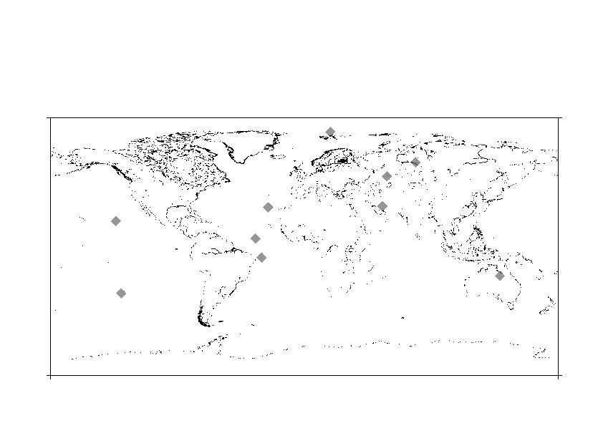
Simulation results
Used top 5 singular vectors at a lead time of 2 months
Chose 10 random points over 1 day period at approximate lead time
Interpolated tracer values at these points from zonally-symmetric-initialized tracer
Performed PC proxy using these values

Slide 15
Simulation: original versus reconstructed

Slide 16
Conclusions
Summary
Based on the tracer dynamics, PC proxy analysis was able to reconstitute a simulated passive tracer to high accuracy from only 10 sparse measurement locations using only 5 singular vectors

Slide 17
Outlook
Test the method with actual satellite measurements such as from the Polar Ozone and Aerosol Measurement (POAM) III instrument
Currently the method is only performed in two dimensions; can it scale to 3-D?
For sources and sinks: if we analyze these from the difference between two retrieved fields, there are at most 2*m degrees of freedom
Eigenvalue decomposition?

Slide 18
Outlook
Retrieving sources and sinks:
Where Σi is the source term at time i

Slide 19
References
Allen, DR and N Nakamura (2003). “Tracer Equivalent Latitude: A Diagnostic Tool for Isentropic Transport Studies.” Journal of the Atmospheric Sciences, 60: 287-303.
Ott, E (1993) Chaos in Dynamical Systems. Cambridge University Press.
Press, WH, SA Teukolsky, WT Vetterling and BP Flannery (1992). Numerical Recipes in C, 2nd ed. Cambridge University Press.
Randal, CE et al. (2002). “Reconstruction of three-dimensional ozone fields using POAM III during SOLVE.” Journal of Geophysical Research 107 (D20): 8299-8312.
Tang, Y, R Kleeman and S Miller (2006) “ENSO Predictability of a Fully Coupled GCM Model Using Singular Vector Analysis.” Journal of Climate 19 (14): 3361-3377.

