Slide 1
Health Analysis
The effects of Unhealthy Behaviors
to Mental Health Conditions
Sandrine Poissonnet Project USC Data Science Bootcamp
Nicole Young January 28th, 2019
Maaike Rutten

Slide 2


The Dataset
Three data sets joined on a common geographic element provide a comprehensive look of health outcomes, demographic and geographic profiles in the United States
Data Source #1: findings from CDC’s 500 Cities: Local data for better health. This is a census track study delivered in csv format measuring estimates of chronic disease risk factors, health outcomes, and clinical preventative service use for the largest 500 cities in the United States. The data set response range encompasses 32% of the total US population qualified by the 2010 US census.
The Result of the study is a modeled estimate of the prevalence of 27 health outcomes and health indicators with a geographic distribution of each cities disease burden
The Dataset was compiled from geocoded health surveys combined with a multi-level regression & poststratification which links survey results to population and socioeconomic data
Data Source #2: 2016 American Community Survey | US Census Bureau. This is an annual ongoing survey that provides vital information about the US nation & its people covering 91.6% of the US population with a 94.7% response rate.
Data Source #3: US Google Map API

Slide 3
Data Strengths & Limitations
Strengths
Both Primary Data Sets were qualified by a common element (geo_id) which is a standard geographic census track identifier
Both Data Sets are parts of long standing scientific studies which lends to data consistency and integrity
The resulting outputs from the underlying statistic methodology cause the data to be succinct, definable, and uniform as evidenced by the low number of NaN values for essential fields.
Limitations
In both data sets the nature of results are qualitative in part leading to unintended bias or mis categorization. i.e. individuals may define a poor mental health day with different thresholds
A major limitation is the representation of outcomes by city as large areas of the US are unrepresented in the dataset. The qualification of 500 cities is not accurate by its definition as reporting on the absolute largest 500 cities would leave four stated with out any data represented. As a remedy the study substitutes a states largest city and its census tracks if it is otherwise unrepresented.

Slide 4
Research Questions
Where are the highest prevalence rates of poor mental health found?
Poor being qualified at >14 days out of 30
Are there behavioral and/or socioeconomic factors which are statistically significantly correlated to a high prevalence rate of poor mental health? If so what are they?
Can we build a sound statistical model based from correlated factors to predict if an area will have a high prevalence rate of poor mental health?

Slide 5
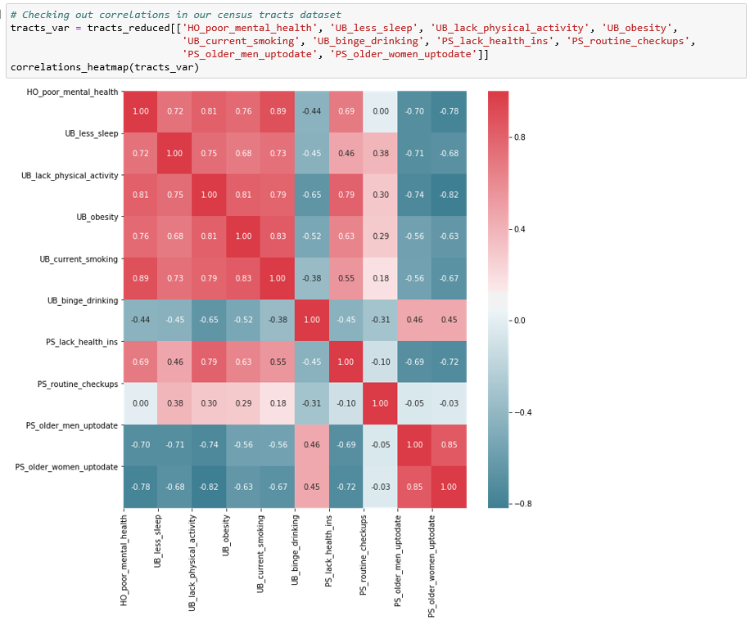
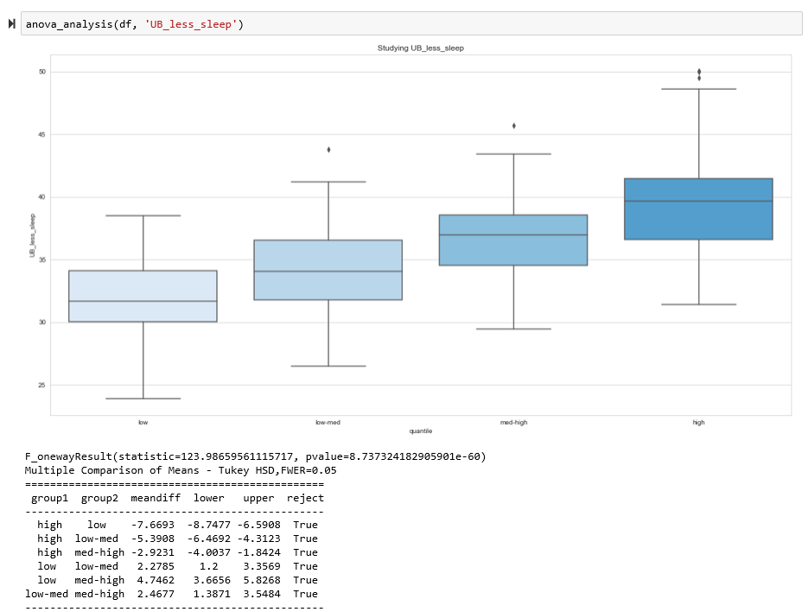
Data Munging & Methods
Joining of two primary data sets on common “geo_id” field into a master data frame
Examined the correlation of factors to reduce insignificant data and removed from the working dataframe along with NaN values
Quartile binning of outcomes by score
ANOVA & Turkey Range Testing for variable & bin validation

Slide 6
Summary of findings
This dataset might give an distorted picture to the question where the highest prevalence rates of poor mental health can be found.
The behavioral factors which are statistically most significant correlated to a high prevalence rate of poor mental health are smoking, lack of sleep and health checkup for elderly.
The socioeconomic factors which are statistically most significantly correlated to a high prevalence rate of poor mental health are income and education.
A statistical model based on correlated factors to predict if an area will have a high prevalence rate of poor mental health can be presented

Slide 7
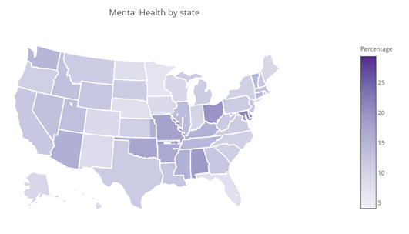
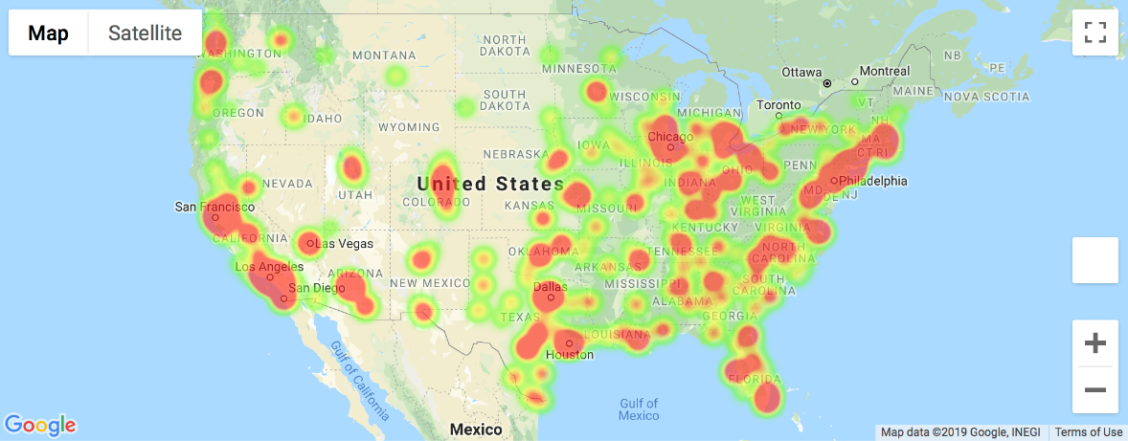
Question 1: Where are the highest prevalence rates of poor mental health found?
The limitation of the dataset: only the largest cities are taken into account can skew the perception of the prevalence of health out comes as evidenced in the following two visualizations:
Heat zones for poor mental health

Slide 8
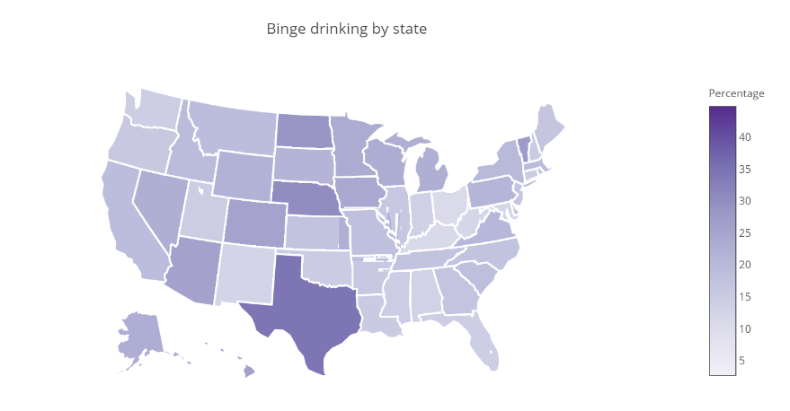
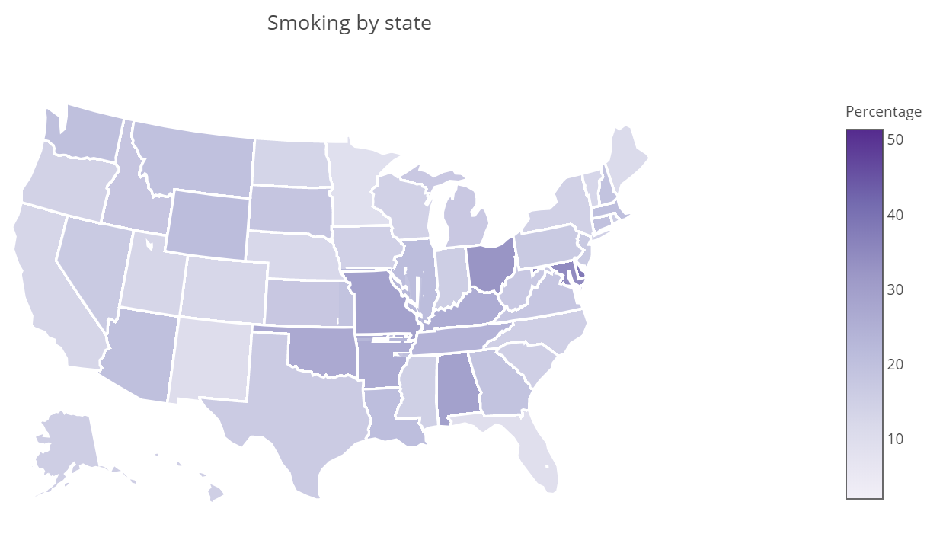
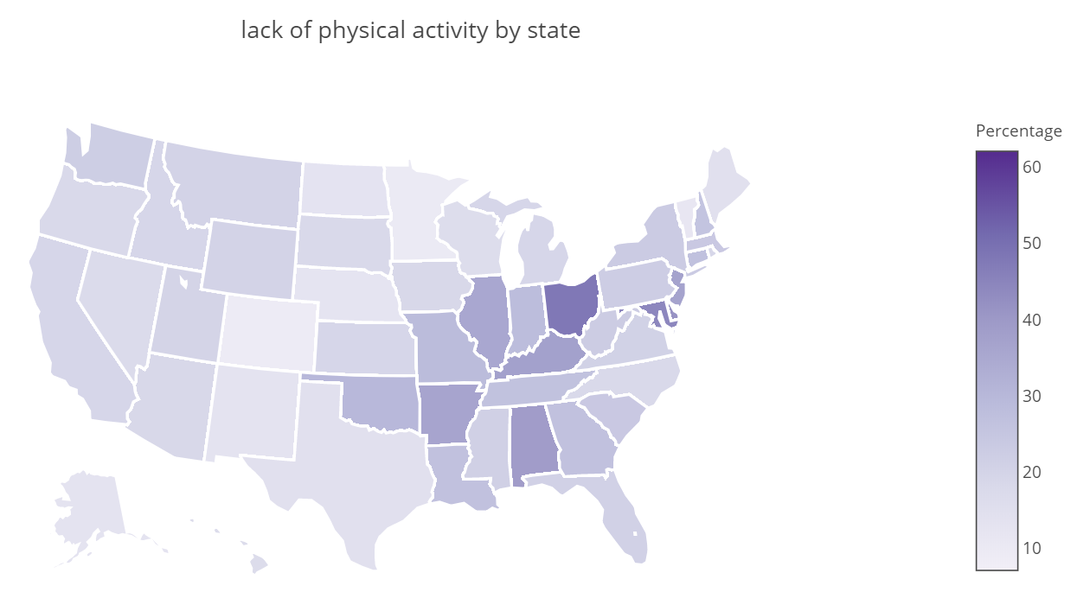
Occurrence of unhealthy behaviors per state

Slide 9
Question 2: Are there behavioral and/or socioeconomic factors which are statistically significantly correlated to a high prevalence rate of poor mental health? If so what are they?
Binning into 4 groups by mental health scores.
The cities with the 25% highest score of persons with a poor mental health (meaning: high score is not desirable), next 25%, next 25%, last group: with lowest score (least people with poor mental health).
Create boxplots and do statistical tests to check on various indicators by mental health:
Correlation with unhealthy behaviors:
Binge-drinking
Lack of sleep
Smoking
Lack of physical activity
Obesity

Slide 10
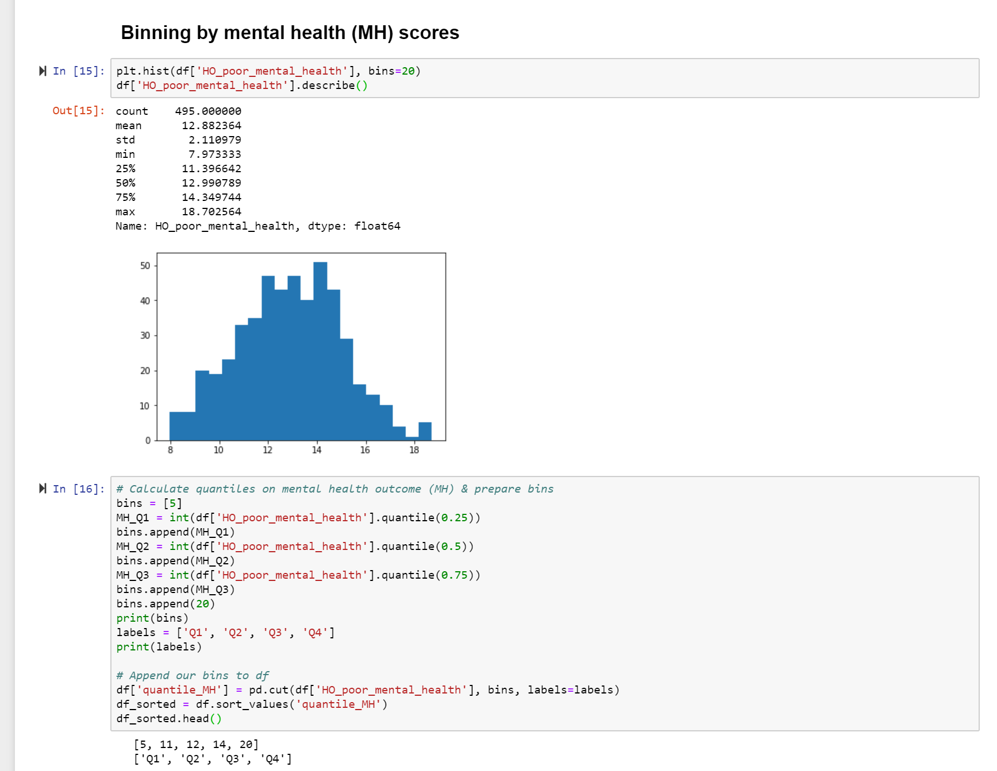
Question 1: What types of unhealthy behavior have significant effects on the mental health and to what extent?

Slide 11
Correlation mental health & Smoking
Add Box plot (exists, only fine tuning)
Add text conclusion

Slide 12
Correlation mental health & lack of sleep
Add Box plot (exists, only fine tuning)
Add text conclusion

Slide 13
Correlation mental health & obesity
Add Box plot (exists, only fine tuning)
Add text conclusion

Slide 14
Correlation mental health & lack of physical activity
Add Box plot (exists, only fine tuning)
Add text conclusion

Slide 15
Conclusion correlation Mental health & unhealthy behavior
Add chart with all unhealthy behaviors combined (we still have to make this chart).
Conclusion summary all unhealthy behaviors

Slide 16
Question 3: Can we build a sound statistical model based from correlated factors to predict if an area will have a high prevalence rate of poor mental health?

Slide 17
Regression model for behavioral factors

Slide 18
Regression model for socioeconomic factors

Slide 19
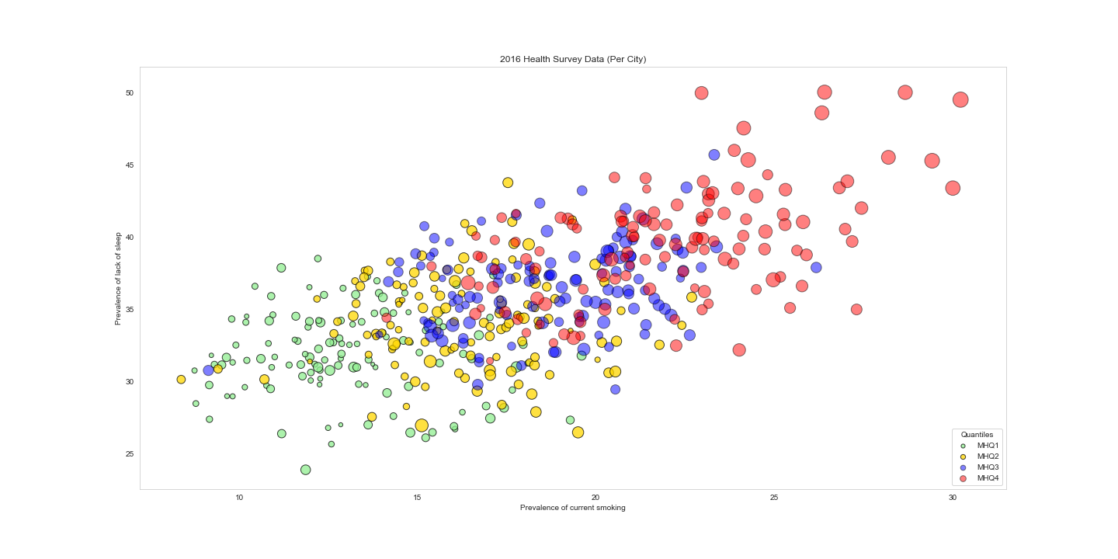
Combined Regression model for predicting mental health outcomes

Slide 20
Major Findings & Additional Research
According to this dataset some states and some areas have a higher prevalence a poor mental health than others. A deeper dive into this states and areas specifically could give interesting information on the specific reasons and could show if the nature of the dataset influences this.
Poor mental health correlates with all the researched unhealthy behaviors and some socioeconomic factors, research on other health outcomes could be done (f.e. poor physical health ) to look for similar correlations.
Income and education correlate with the prevalence of poor mental health: the higher the income or education, the lower the % of persons with a poor mental health. Finding the conversion point could be interesting.
The lack of health insurance correlates with poor mental health, but correlates with other factors, which factors are these? Income? Education?

