Slide 1
Making Sense of the Mental Health Outcome
GROUP PROJECT #1 – USC Data Analytics Bootcamp
500 Cities CDC Project:
Sandrine Poissonnet – Maaike Rutten – Nicole Young
January 28th, 2019

Slide 2


The Data
Two data sets joined on a common geographic element provide a comprehensive look of health outcomes, demographic and geographic profiles in the United States
Data Source #1: findings from CDC’s 500 Cities: Local data for better health. This is a census track study delivered in csv format measuring estimates of chronic disease risk factors, health outcomes, and clinical preventative service use for the largest 500 cities in the United States. The data set response range encompasses 32% of the total US population qualified by the 2010 US census.
Data Source #2: 2016 American Community Survey | US Census Bureau. This is an annual ongoing survey that provides vital information about the US nation & its people covering 91.6% of the US population with a 94.7% response rate.
Data Source #3: US Google Map API & Plot.ly API

Slide 3
Data Strengths & Limitations
Strengths
Both Primary Data Sets were qualified by a common element (geo_id) which is a standard geographic census track identifier
Both Data Sets are parts of long standing scientific studies which lends to data consistency and integrity
The resulting outputs from the underlying statistic methodology cause the data to be succinct, definable, and uniform as evidenced by the low number of NaN values for essential fields.
Limitations
In both data sets the nature of results are qualitative in part leading to unintended bias or mis categorization. i.e. individuals may define a poor mental health day with different thresholds
A major limitation is the representation of outcomes by city. Large areas of the US are absent from the dataset due to a lack of a qualifying city. The description of 500 cities is inaccurate by definition as reporting on the absolute largest 500 cities would leave four states without representation. As a remedy the study substitutes a state’s largest city and its census tracks if it is otherwise unrepresented.
This dataset might give a distorted picture to the question where the highest prevalence rates of poor mental health can be found.

Slide 4
Research Questions
Where are the highest prevalence rates of poor mental health found?
Poor being qualified as mental health reported as poor for at least 14 of 30 days among adults (over 18 years old)
What factors in our combined dataset are statistically significantly correlated to a high prevalence rate of poor mental health? Specifically:
What health behavior and preventative services, if any, correlate with the prevalence of poor mental health?
What socio-economic characteristics, if any, correlate with the prevalence of poor mental health?
Which factors can we retain to predict the prevalence of poor mental health?

Slide 5
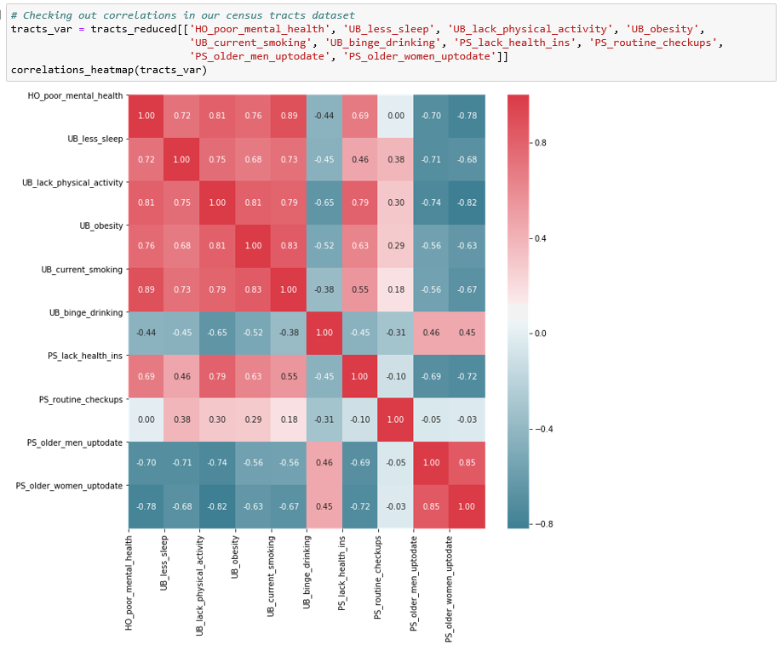
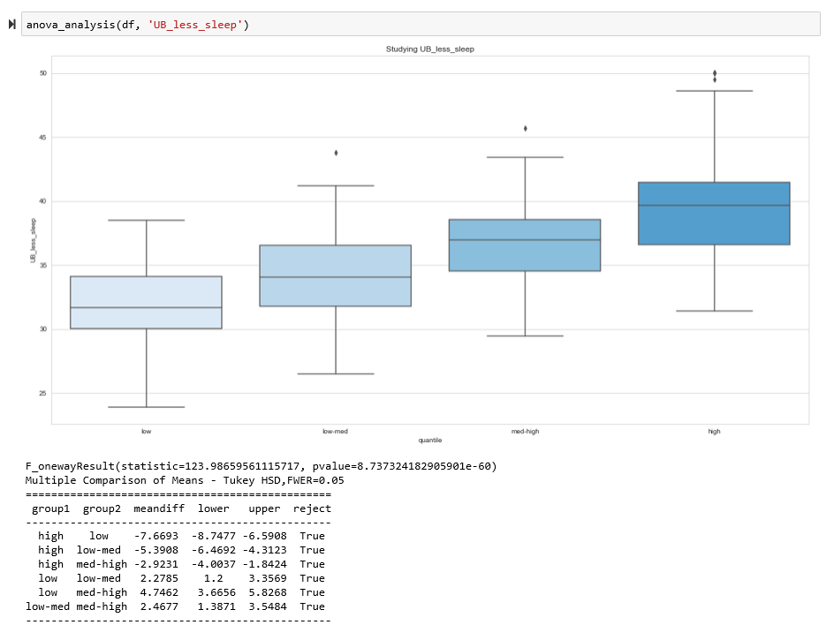
Data Munging & Methods
Joining of two primary data sets on common “geo_id” field into a master data frame
Examined the correlation of factors to reduce insignificant data and removed from the working dataframe along with NaN values
Aggregating by cities & binning by quartiles on prevalence of poor mental health
ANOVA & Turkey Range Testing for variable & bin validation

Slide 6
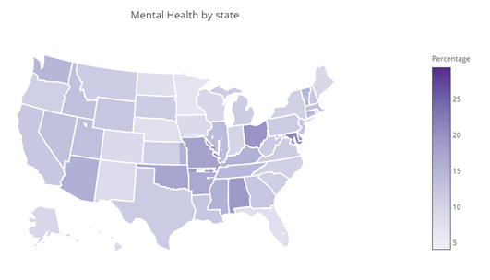
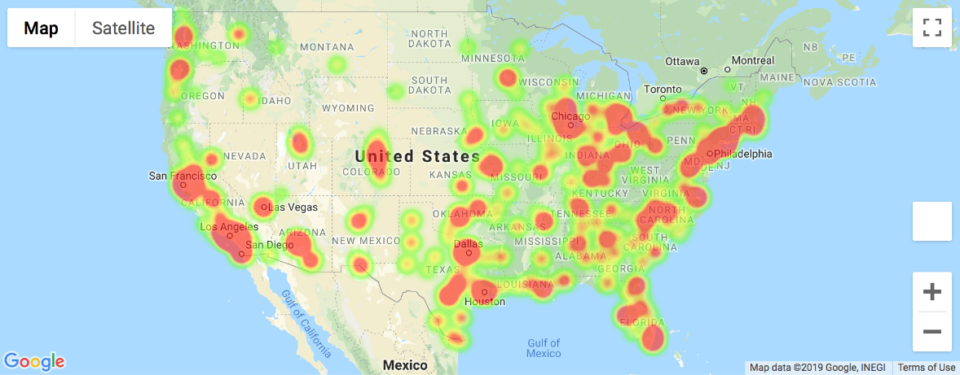
Question 1: Where are the highest prevalence rates of poor mental health found?
The limitation of the dataset: only the largest cities are taken into account can skew the perception of the prevalence of health out comes as evidenced in the following two visualizations:
Heat zones for poor mental health

Slide 7
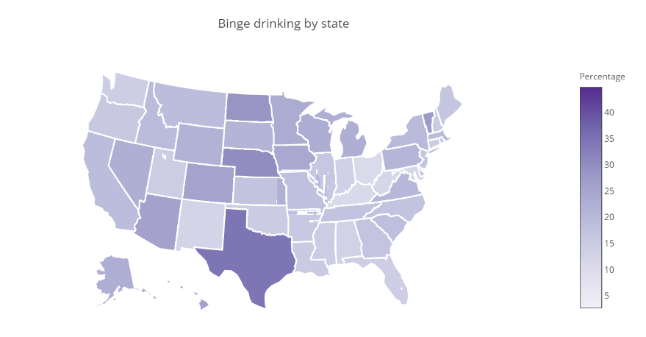
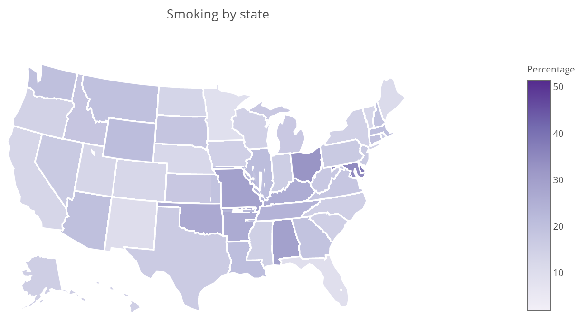
Occurrence of variable behaviors by state

Slide 8
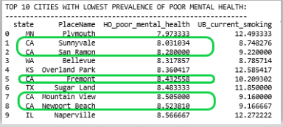
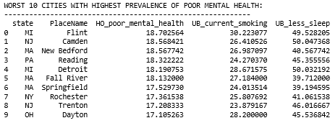
Geographical Prevalence Findings

Slide 9
Question 2: What factors in our combined dataset are statistically significantly correlated to the prevalence of poor mental health?
Socioeconomic Indicators
Income
Education
Health Indicators
Binge Drinking
Smoking
Lack of Sleep
Lack of Physical Activity
Obesity
Age
Health Insurance

Slide 10
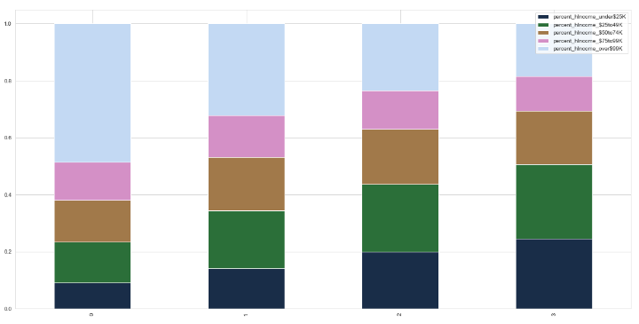
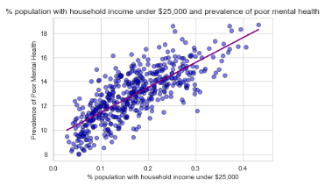
Correlation socioeconomic factors & mental health outcome

Slide 11
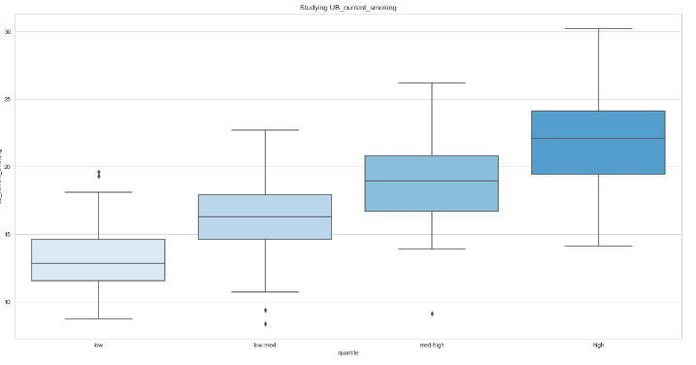
Correlation health indicators & mental health outcome
Significant Correlations were found on all Variables tested
Let’s look at our notebook!

Slide 12
Question 3: Can we build a predictive model for the prevalence of poor mental health?
All of the 8 health indicators and many of the socioeconomic variables studied are statistically significantly correlated with the prevalence of poor mental health.
Which ones, if any, can we use to predict the prevalence of poor mental health?
Identifying variables that significantly impact the prevalence of poor mental health can help inform future health campaigns and policy making.
Method used:
Multiple regression analysis
Data divided into a training set (80%) and a test set (20%)
Multiple iterations to eliminate non statistically significant variables (p-value > 0.05), as well as issues of multicollinearity

Slide 13
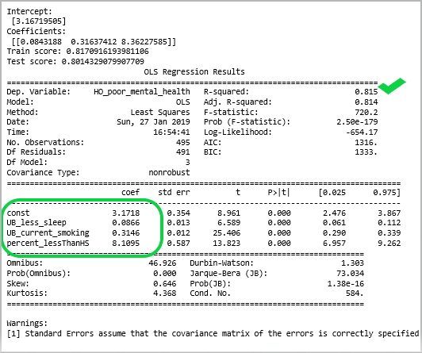
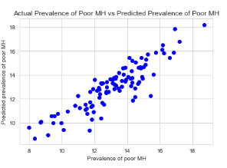
The Model:
Two unhealthy behaviors and one socio-economic factor explain 81.5% of the variance in the prevalence of poor mental health.
Model Fit:
Train score = 81.7%
Test score = 80.1%
(70% is generally considered good)

Slide 14
Summary of findings, in words…
The health indicators which best predict the prevalence of poor mental health are:
Smoking
Lack of Sleep
Check ups for Women 65+
The socioeconomic factors which best predict the prevalence of poor mental health are:
Education
Income
% of population 65+
Gender
Predictive model integrates both sets of variable and explains 81.5% of the variance in prevalence of mental health. After eliminating non statistically significant variables and adjusting for multicollinearity, our final model includes three variables as follows:
MH estimate = 3.17 + 0.09 Lack_Sleep + 0.31 Smoking + 8.11 No_HSdegree

Slide 15
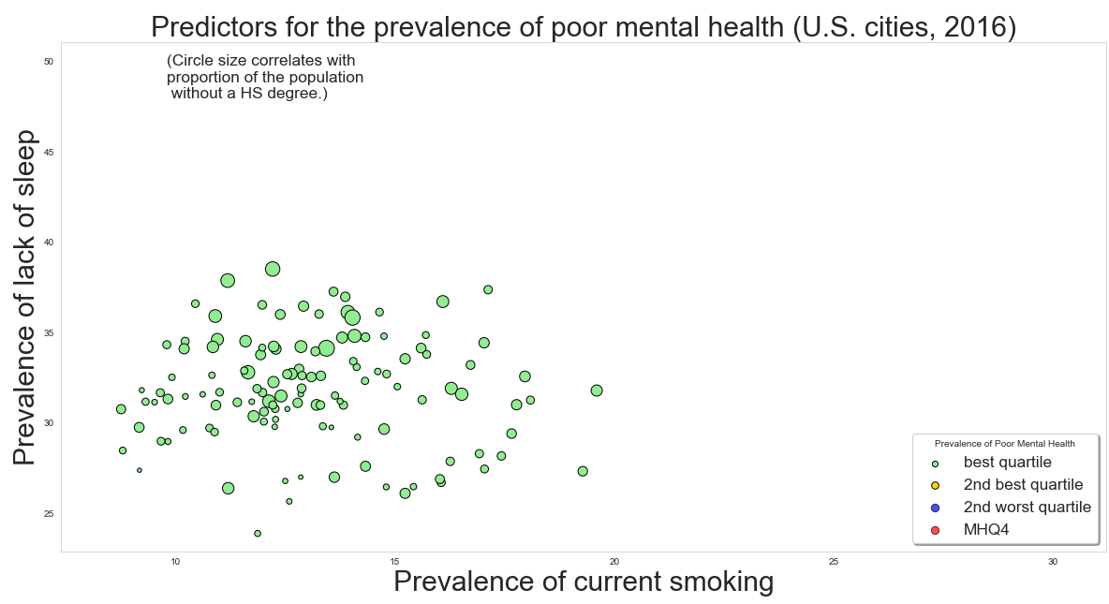
Summary of findings, in a graph…

Slide 16
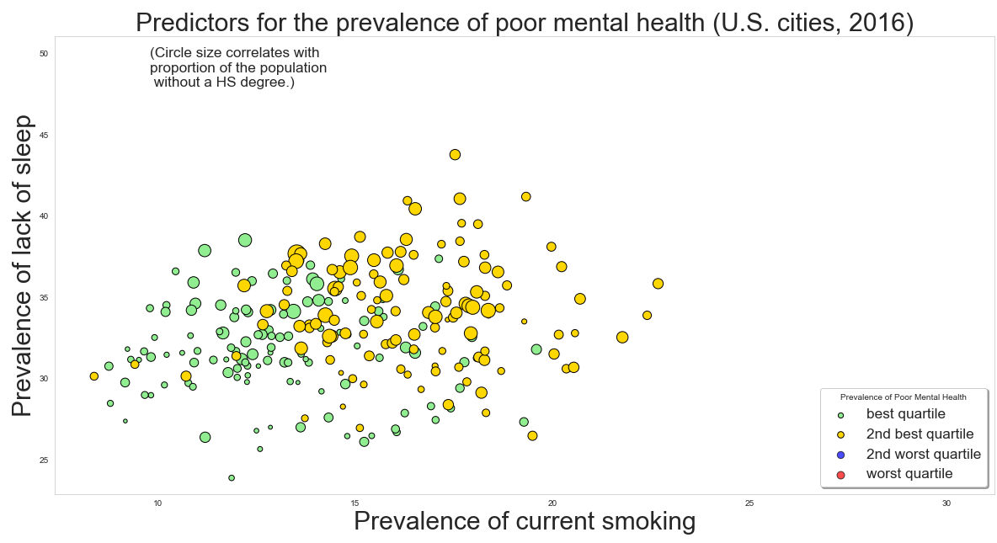
Summary of findings, in a graph…

Slide 17
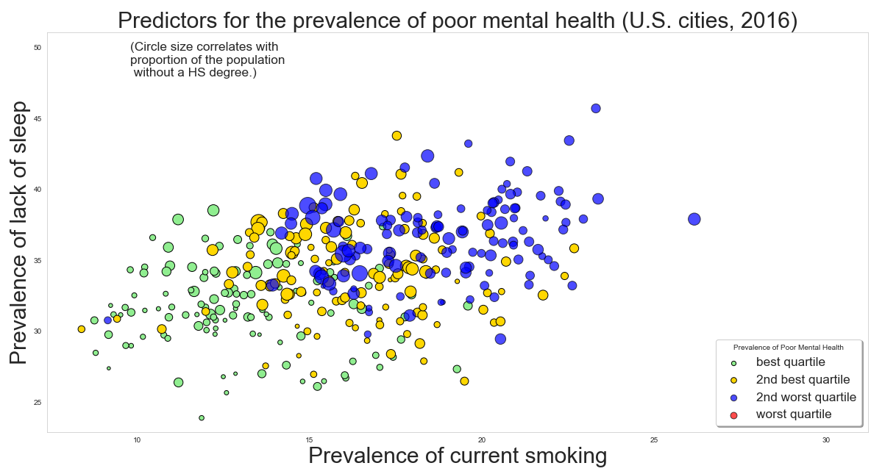
Summary of findings, in a graph…

Slide 18
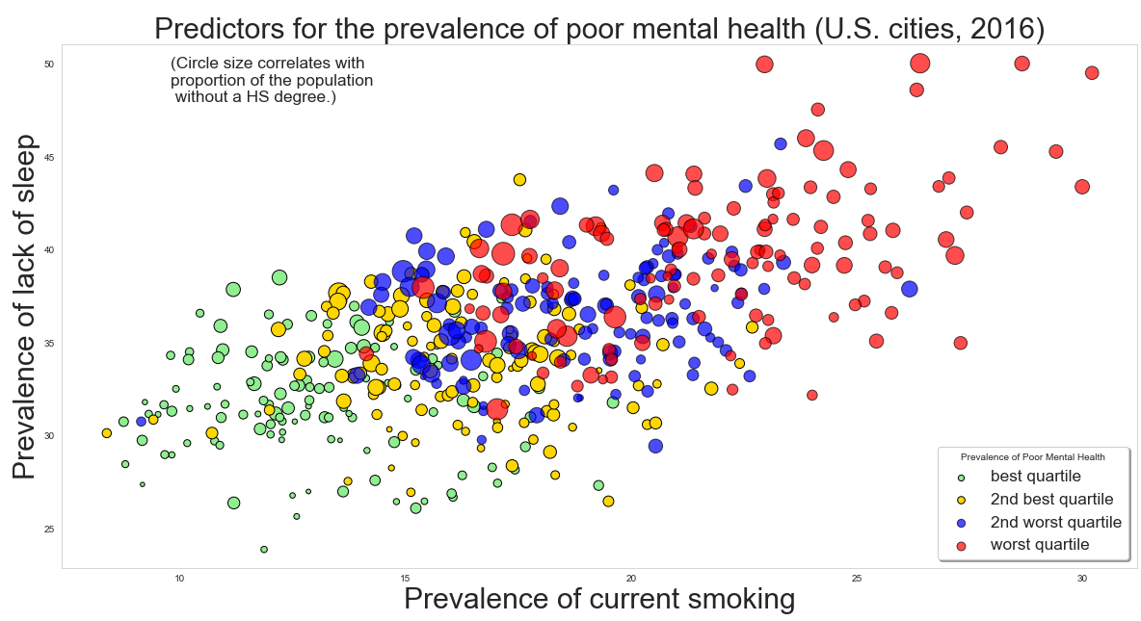
Summary of findings, in a graph…

Slide 19
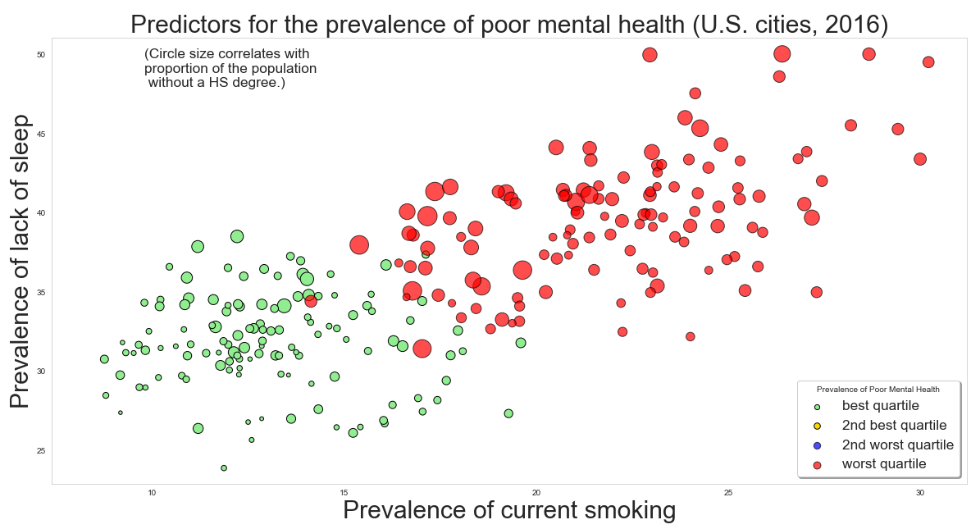
Summary of findings, in a graph…

Slide 20
Ideas for additional analysis
Further analysis could be used to identify exact tipping points for health indicators and socioeconomic factors which could be used to identify at risk populations.
A deeper dive into census track level data (as opposed to data aggregated by cities) could strengthen the predictive model and provide actionable insights.
Some states and areas have a higher prevalence of poor mental health than others (see contrast between top 10 cities and worst 10 cities. A closer look at characteristics of those areas as well as examining correlation with outside data sources such as weather, type of employment, etc. might also help improve our predictive model.
The 500 Cities study carries information on 13 unique health outcomes, the model is equipped to be applied to each health outcome individually with the prescribed methodology.

