Slide 1
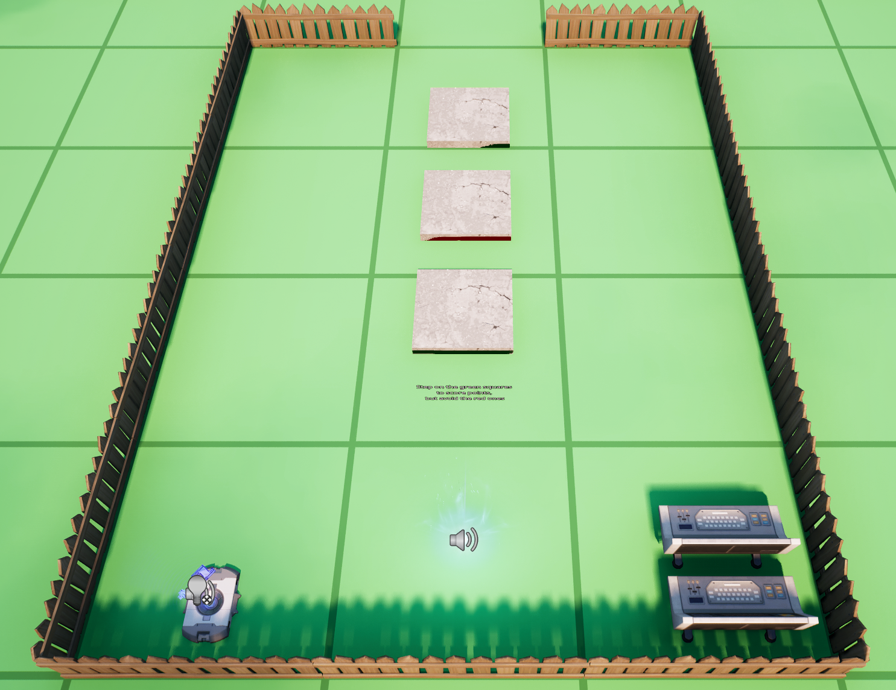
TileG2
CubeG2
TileR
TileG1
CubeG1
GameScore
ScoreManager

