Slide 1
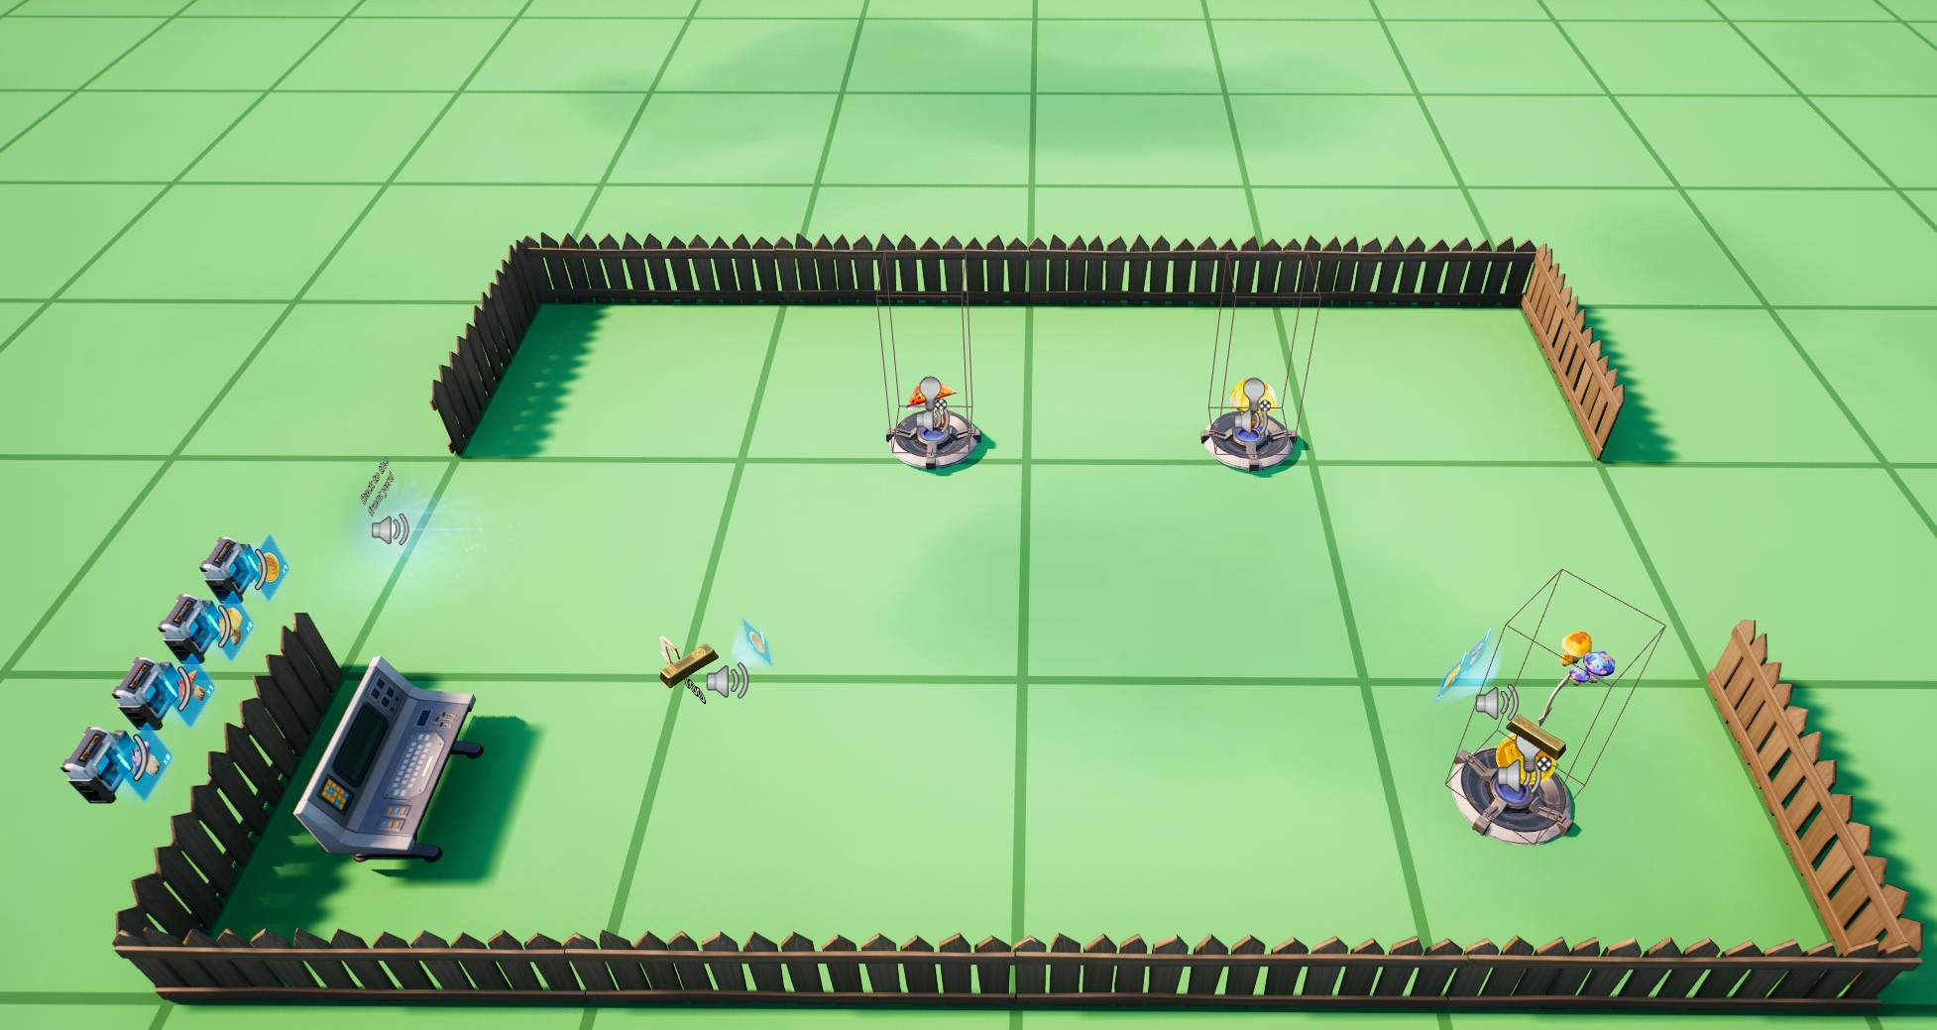
MushroomSpawner1
MushroomSpawner2
ConditionalButtonGold
ConditionalButtonExchange1
ConditionalButtonYellow
GoldSpawner
ConditionalButtonExchange2
ConditionalButtonRed
GoldBar
ConditionalButtonBlue

