Slide 1
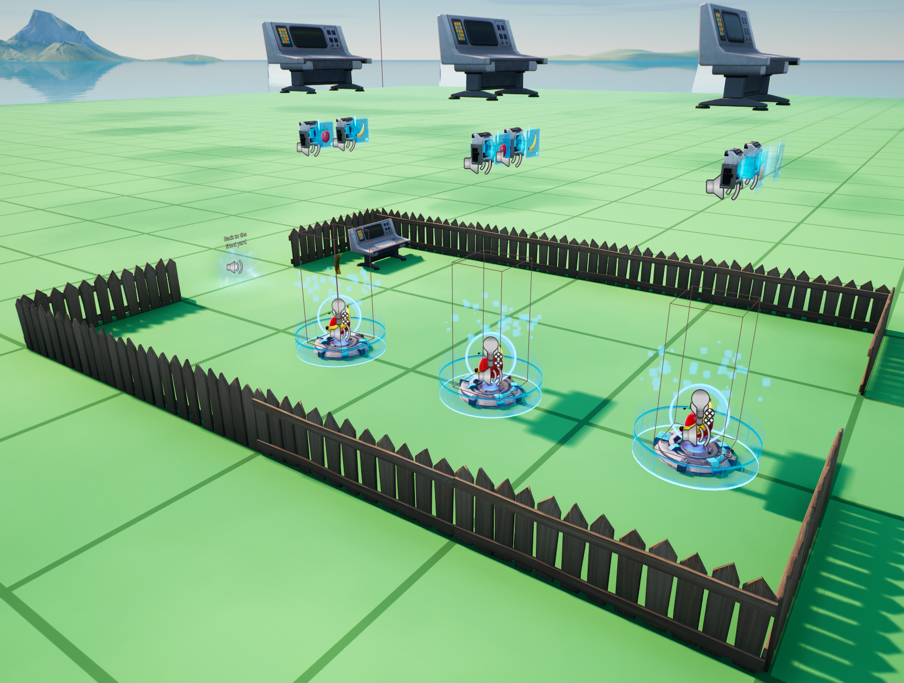
SpawnAndStoreDevices (instances of spawn_and_store_device)
ConditionalButtons
CaptureArea
Spawners
ConditionalButtonExchange1
ConditionalButtonExchange2
MarkerProp
ConditionalButtonBlue

