Slide 1
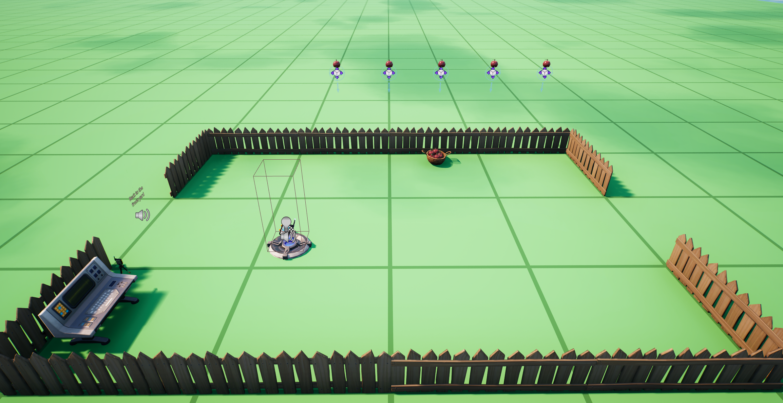
AppleProps[4]
AppleProps[3]
AppleMovers[1]
AppleMovers[3]
AppleMovers[0]
AppleMovers[2]
AppleMovers[4]
Basket

