Slide 1
Econometrics 2 - Lecture 4
Lag Structures, Cointegration

Slide 2
Contents
Dynamic Models
Lag Structures
Lag Structure: Estimation
ADL Models
Models for Expectations
Models with Non-stationary Variables
Cointegration
Test for Cointegration
Error-correction Model
April 5, 2013
Hackl, Econometrics 2, Lecture 4

Slide 3
The Lüdeke Model for Germany
Consumption function
C_{t} = α₁ + α₂Y_{t} + α₃C_{t-1} + ε_{1t}
Investment function
I_{t} = β₁ + β₂Y_{t} + β₃P_{t-1} + ε_{2t}
Import function
M_{t} = γ₁ + γ₂Y_{t} + γ₃ M_{t-1} + ε_{3t}
Identity relation
Y_{t} = C_{t} + I_{t} - M_{t-1} + G_{t}
with C: private consumption, Y: GDP, I: investments, P: profits, M: imports, G: governmental spending
Variables:
Endogenous: C, Y, I, M
Exogenous, predetermined: G, P₋₁, C₋₁, M₋₁
April 5, 2013
Hackl, Econometrics 2, Lecture 4

Slide 4
Econometric Models
Basis is the multiple linear regression model
Model extensions
Dynamic models, i.e., contain lagged variables
Systems of regression relations, i.e., models describe more than one dependent variable
Example: Lüdeke Model
four dynamic equations (with lagged variables P₋₁, C₋₁, M₋₁)
for the four dependent variables C, Y, I, M
April 5, 2013
Hackl, Econometrics 2, Lecture 4

Slide 5
Dynamic Models: Examples
Demand model: describes the quantity Q demanded of a product as a function of its price P and the income Y of households
Demand is determined by
Current price and current income (static model):
    Q_{t} = β₁ + β₂P_{t} + β₃Y_{t} + ε_{t}
Current price and income of the previous period (dynamic model):
Q_{t} = β₁ + β₂P_{t} + β₃Y_{t-1} + ε_{t}
Current price and demand of the previous period (dynamic autoregressive model):
Q_{t} = β₁ + β₂P_{t} + β₃Q_{t-1} + ε_{t}
April 5, 2013
Hackl, Econometrics 2, Lecture 4

Slide 6
The Dynamic of Processes
Static processes: immediate reaction to changes in regressors, the adjustment of the dependent variables to the realizations of the independent variables will be completed within the current period, the process seems to be always in equilibrium
Static models are often inappropriate
Some processes are determined by the past, e.g., energy consumption depends on past investments into energy-consuming systems and equipment
Actors in economic processes may respond delayed, e.g., time for decision-making and procurement processes exceeds the observation period
Expectations: e.g., consumption depends not only on current income but also on the income expectations; modeling the expectation may be based on past development
April 5, 2013
Hackl, Econometrics 2, Lecture 4

Slide 7
Elements of Dynamic Models
Lag structures, distributed lags: linear combinations of current and past values of a variable
Models for expectations: based on lag structures, e.g., adaptive expectation model, partial adjustment model
Autoregressive distributed lag (ADL) model: a simple but widely applicable model consisting of an autoregressive part and of a finite lag structure of the independent variables
April 5, 2013
Hackl, Econometrics 2, Lecture 4

Slide 8
Contents
Dynamic Models
Lag Structures
Lag Structure: Estimation
ADL Models
Models for Expectations
Models with Non-stationary Variables
Cointegration
Test for Cointegration
Error-correction Model
April 5, 2013
Hackl, Econometrics 2, Lecture 4

Slide 9
Example: Demand Functions
Demand for durable consumer goods: demand Q depends on the price P and on the income Y of the current and two previous periods:
Q_{t} = α + β₀Y_{t} + β₁Y_{t-1} + β₂Y_{t-2} + γP_{t} + ε_{t}
Demand for energy:
Q_{t} = α + βP_{t} + γK_{t} + u_{t}
with P: price of energy, K: energy-related capital stock
K_{t} = θ₀ + θ₁P_{t-1} + θ₂P_{t-2} + … + δY_{t} + v_{t}
with Y: income; substitution of K results in
Q_{t} = α₀ + α₁Y_{t} + β₀P_{t} + β₁P_{t-1} + β₂P_{t-1} + … + ε_{t}
with ε_{t} = u_{t} + γv_{t}, α₀ = α + γθ₀, α₁ = γδ, β₀ = β, β_{i} = γθ_{i}, i = 1, 2, …
April 5, 2013
Hackl, Econometrics 2, Lecture 4

Slide 10
Models with Lag Structures
Distributed lag model: describes the delayed effect of one or more regressors on the dependent variable; e.g.,
DL(s) model
Y_{t} = δ + Σ^{s}_{i=0} φ_{i}X_{t-i} + ε_{t}
distributed lag of order s model
Topics of interest
  Estimation of coefficients
  Interpretation of parameters
April 5, 2013
Hackl, Econometrics 2, Lecture 4

Slide 11
Example: Consumption Function
Data for Austria (1990:1 – 2009:2), logarithmic differences (relative changes):
Ĉ = 0.009 + 0.621Y
with t(Y) = 2.288, R² = 0.335
DL(2) model, same data:
Ĉ = 0.006 + 0.504Y – 0.026Y₋₁ + 0.274Y₋₂
with t(Y) = 3.79, t(Y₋₁) = – 0.18, t(Y₋₂) = 2.11, R² = 0.370
Effect of income on consumption:
Short term effect, i.e., effect in the current period:
ΔC = 0.504, given a change in income ΔY = 1
Overall effect, i.e., cumulative current and future effects
ΔC = 0.504 – 0.026 + 0.274 = 0.752, given a change ΔY = 1
April 5, 2013
Hackl, Econometrics 2, Lecture 4

Slide 12
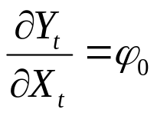
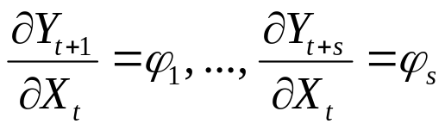
Multiplier
Describes the effect of a change in explanatory variable X_{t} by ΔX = 1 on current and future values of the dependent variable Y
DL(s) model: Y_{t} = δ + φ₀X_{t} + φ₁X_{t-1} + … + φ_{s}X_{t-s} + ε_{t}
Short run or impact multiplier
  effect of the change in the same period, immediate effect of ΔX = 1 on Y: ΔY = φ₀
Long run multiplier
  Effect of ΔX = 1 after 1, …, s periods:
  Cumulated effect of ΔX = 1 at t over all future on Y: ΔY = φ₀ + … + φ_{s}
April 5, 2013
Hackl, Econometrics 2, Lecture 4

Slide 13
Equilibrium Multiplier
If after a change ΔX an equilibrium occurs within a finite time: Long run multiplier is called equilibrium multiplier
DL(s) model
Y_{t} = δ + φ₀X_{t} + φ₁X_{t-1} + … + φ_{s}X_{t-s} + ε_{t}
equilibrium after s periods
No equilibrium for models with an infinite lag structure
April 5, 2013
Hackl, Econometrics 2, Lecture 4

Slide 14
Average Lag Time
Characteristics of lag structure φ₀X_{t} + φ₁X_{t-1} + … + φ_{s}X_{t-s}
Portion of equilibrium effect in the adaptation process
  At the end of the period t:
  w₀ = φ₀/(φ₀ + φ₁ + … + φ_{s})
  At the end of the period t +1:
  w₀ + w₁ = (φ₀ + φ₁)/(φ₀ + φ₁ + … + φ_{s})
  Etc.
With weights w_{i} = φ_{i}/(φ₀ + φ₁ + … + φ_{s})
Average lag time: Σ_{i} i w_{i}
Median lag time: time till 50% of the equilibrium effect is reached, i.e., minimal s* with
w₀ + … w_{s*} ≥ 0.5
April 5, 2013
Hackl, Econometrics 2, Lecture 4

Slide 15
Consumption Function
For ΔY = 1, the function
Ĉ = 0.006 + 0.504Y – 0.026Y₋₁ + 0.274Y₋₂
gives
Short run effect: 0.504
Overall effect: 0.752
Equilibrium effect : 0.752
Average lag time: 0.694 quarters, i.e., ~ 2.3 months
Median lag time: s* = 0; cumulative sums of weights are 0.671, 0.636, 1.000
April 5, 2013
Hackl, Econometrics 2, Lecture 4

Slide 16
Contents
Dynamic Models
Lag Structures
Lag Structure: Estimation
ADL Models
Models for Expectations
Models with Non-stationary Variables
Cointegration
Test for Cointegration
Error-correction Model
April 5, 2013
Hackl, Econometrics 2, Lecture 4

Slide 17
Lag Structures: Estimation
DL(s) model: problems with OLS estimation
Loss of observations: for a sample size N, only N-s observations are available for estimation; infinite lag structure!
Multicollinearity
Order s (mostly) not known
Consequences:
Misspecification
Large standard errors of estimates
Low power of tests
Issues:
Choice of s
Models for the lag structure with smaller number of parameters, e.g., polynomial structure
April 5, 2013
Hackl, Econometrics 2, Lecture 4

Slide 18
Consumption Function
Fitted function
Ĉ = 0.006 + 0.504Y – 0.026Y₋₁ + 0.274Y₋₂
with p-value for coefficient ofY₋₂: 0.039, adj.R² = 0.342, AIC = -5.204
s | AIC | p-Wert | adj.R²
1 | -5.179 | 0.333 | 0.316
2 | -5.204 | 0.039 | 0.342
3 | -5.190 | 0.231 | 0.344
4 | -5.303 | 0.271 | 0.370
5 | -5.264 | 0.476 | 0.364
6 | -5.241 | 0.536 | 0.356
7 | -5.205 | 0.884 | 0.342
Models for s ≤ 7
April 5, 2013
Hackl, Econometrics 2, Lecture 4

Slide 19
Koyck’s Lag Structure
Specifies the lag structure of the DL(s) model
Y_{t} = δ + Σ^{s}_{i=0} φ_{i}X_{t-i} + ε_{t}
as an infinite, geometric series (geometric lag structure)
φ_{i} = λ₀(1 - λ)λ^{i}
For 0 < λ < 1
Σ^{s}_{i=0} φ_{i} = λ₀
Short run multiplier: λ₀(1 - λ)
Equilibrium effect: λ₀
Average lag time: λ/(1 - λ)
Stability condition 0 < λ < 1
  for λ > 1, the φ_{i} and the contributions to the multiplier are exponentially growing
λ | 0.1 | 0.3 | 0.5 | 0.7
λ/(1-λ) | 0.10 | 0.43 | 1.00 | 2.33
April 5, 2013
Hackl, Econometrics 2, Lecture 4

Slide 20
The Koyck Model
The DL (distributed lag) or MA (moving average) form of the Koyck model
Y_{t} = δ + λ₀(1 – λ) Σ_{i} λ^{i}X_{t-i} + ε_{t}
AR (autoregressive) form
Y_{t} = δ(1 – λ) + λY_{t-1} + λ₀(1 – λ)X_{t} + u_{t}
with u_{t} = ε_{t} – λε_{t-1}
April 5, 2013
Hackl, Econometrics 2, Lecture 4

Slide 21
Consumption Function
Model with smallest AIC:
Ĉ = 0.003 + 0.595Y – 0.016Y₋₁ + 0.107Y₋₂ + 0.003Y₋₃
+ 0.148Y₋₄
with adj.R² = 0.370, AIC = -5.303, DW = 1.41
Koyck model in AR form
Ĉ = 0.004 + 0.286 C₋₁ + 0.556Y
with adj.R² = 0.388, AIC = -5.290, DW = 1.91
April 5, 2013
Hackl, Econometrics 2, Lecture 4

Slide 22
Koyck Model: Estimation Problems
Parameters to be estimated: δ, λ₀, and λ; problems are
DL form (Y_{t} = δ + λ₀(1 – λ) Σ_{i} λ^{i}X_{t-i} + ε_{t})
  Historical values X₀, X₋₁, … are unknown
  Non-linear estimation problem
AR form (Y_{t} = δ(1 – λ) + λY_{t-1} + λ₀(1 – λ)X_{t} + u_{t})
  Non-linear estimation problem
  Lagged, endogenous variable used as regressor
  Correlated error terms
April 5, 2013
Hackl, Econometrics 2, Lecture 4

Slide 23
Contents
Dynamic Models
Lag Structures
Lag Structure: Estimation
ADL Models
Models for Expectations
Models with Non-stationary Variables
Cointegration
Test for Cointegration
Error-correction Model
April 5, 2013
Hackl, Econometrics 2, Lecture 4

Slide 24
The ADL(1,1) Model
The autoregressive distributed lag (ADL) model: autoregressive model with lag structure, e.g., the ADL(1,1) model
Y_{t} = δ + θY_{t-1} + φ₀X_{t} + φ₁X_{t-1} + ε_{t}
The error correction model:
ΔY_{t} = – (1 – θ)(Y_{t-1} – α – βX_{t-1}) + φ₀ ΔX_{t} + ε_{t}
obtained from the ADL(1,1) model with
α = δ/(1 – θ)
β = (φ₀+φ₁)/(1 – θ)
Example:
Sales S_{t} are determined
  by advertising A_{t} and A_{t-1}, but also
  by S_{t-1}:
  S_{t} = μ + θS_{t-1} + β₀A_{t} + β₁A_{t-1} + ε_{t}
  ΔS_{t} = – (1 – θ)[S_{t-1} – μ/(1 – θ) – (β₀+β₀₁)/(1 – θ)A_{t-1}] + β₀ΔA_{t} + ε_{t}
April 5, 2013
Hackl, Econometrics 2, Lecture 4

Slide 25
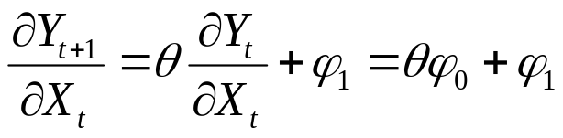
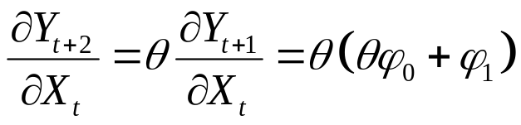
Multiplier
ADL(1,1) model: Y_{t} = δ + θY_{t-1} + φ₀X_{t} + φ₁X_{t-1} + ε_{t}
Effect of a change ΔX = 1 at time t
Impact multiplier: ΔY = φ₀; see the DL(s) model
Long run multiplier
  Effect after one period
  Effect after two periods
  Cumulated effect over all future on Y
  φ₀ + (θφ₀ + φ₁) + θ(θφ₀ + φ₁) + … = (φ₀ + φ₁)/(1 – θ)
  decreasing effects requires |θ|<1, stability condition
April 5, 2013
Hackl, Econometrics 2, Lecture 4

Slide 26
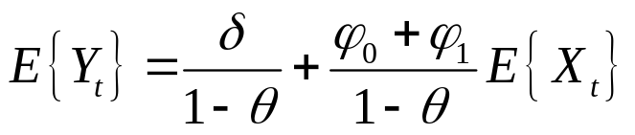
ADL(1,1) Model: Equilibrium
Equilibrium relation of the ADL(1,1) model:
Equilibrium at time t means: E{Y_{t}} = E{Y_{t-1}}, E{X_{t} } = E{X_{t-1}}
E{Y_{t}} = δ + θ E{Y_{t}} + φ₀ E{X_{t}} + φ₁ E{X_{t}}
or, given the stability condition |θ|<1,
Equilibrium relation:
E{Y_{t}} = α + β E{X_{t}}
with α = δ/(1 – θ), β = (φ₀ + φ₁)/(1 – θ)
Long run multiplier: change ΔX = 1 of the equilibrium value of X increases the equilibrium value of Y by (φ₀ + φ₁)/(1 – θ)
April 5, 2013
Hackl, Econometrics 2, Lecture 4

Slide 27
The Error Correction Model
ADL(1,1) model, written as error correction model
ΔY_{t} = φ₀ ΔX_{t} – (1 – θ)(Y_{t-1} – α – βX_{t-1}) + ε_{t}
  Effects on ΔY
    due to changes ΔX
    due to equilibrium error, i.e., Y_{t-1} – α – βX_{t-1}
Negative adjustment: Y_{t-1} < E{Y_{t-1}} = α + βX_{t-1}, i.e., a negative equilibrium error, increases Y_{t} by – (1 – θ)(Y_{t-1} – α – βX_{t-1})
Adjustment parameter: (1 – θ)
    Determines speed of adjustment
April 5, 2013
Hackl, Econometrics 2, Lecture 4

Slide 28
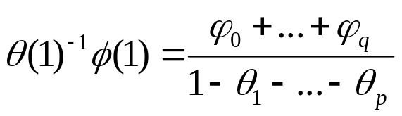
The ADL(p,q) Model
ADL(p,q): generalizes the ADL(1,1) model
θ(L)Y_{t} = δ + Φ(L)X_{t} + ε_{t}
with lag polynomials
θ(L) = 1 - θ₁L - … - θ_{p}L^{p} , Φ(L) = φ₀ + φ₁L + … + φ_{q}L^{q}
Given invertibility of θ(L), i.e., θ₁ + … + θ_{p} < 1,
Y_{t} = θ(1)⁻¹δ + θ(L)⁻¹Φ(L)X_{t} + θ(L)⁻¹ε_{t}
The coefficients of θ(L)⁻¹Φ(L) describe the dynamic effects of X on current and future values of Y
equilibrium multiplier
ADL(0,q): coincides with the DL(q) model; θ(L) = 1
April 5, 2013
Hackl, Econometrics 2, Lecture 4

Slide 29
ADL Model: Estimation
ADL(p,q) model
error terms ε_{t}: white noise, independent of X_{t}, …, X_{t-q} and Y_{t-1}, …, X_{t-p}
OLS estimators are consistent
April 5, 2013
Hackl, Econometrics 2, Lecture 4

Slide 30
Contents
Dynamic Models
Lag Structures
Lag Structure: Estimation
ADL Models
Models for Expectations
Models with Non-stationary Variables
Cointegration
Test for Cointegration
Error-correction Model
April 5, 2013
Hackl, Econometrics 2, Lecture 4

Slide 31
Expectations in Economic Processes
Expectations play important role in economic processes
Examples:
Consumption depends not only on current income but also on the income expectations; modeling the expectation may be based on past development
Investments depend upon expected profits
Interest rates depend upon expected development of the financial market
Etc.
Expectations
cannot be observed, but
can be modeled using assumptions on the mechanism of adapting expectations
April 5, 2013
Hackl, Econometrics 2, Lecture 4

Slide 32
Models for Adapting Expectations
Naive model of adapting expectations: the (for the next period) expected value equals the actual value
Model of adaptive expectation
Partial adjustment model
The latter two models are based on Koyck’s lag structure
April 5, 2013
Hackl, Econometrics 2, Lecture 4

Slide 33
Adaptive Expectation: Concept
Models of adaptive expectation: describe the actual value Y_{t} as function of the value Xe_{t+1} of the regressor X that is expected for the next period
Y_{t} = α + βXe_{t+1} + ε_{t}
Example: Investments are a function of the expected profits
Concepts for Xe_{t+1}:
Naive expectation: Xe_{t+1} = X_{t}
More realistic is a weighted sum of in the past realized profits
Xe_{t+1} = β₀X_{t} + β₁X_{t-1} + …
  Geometrically decreasing weights β_{i}
β_{i} = (1-λ) λ^{i}
with 0 < λ < 1
April 5, 2013
Hackl, Econometrics 2, Lecture 4

Slide 34
Adaptive Mechanism for the Expectation
With β_{i} = (1- λ) λ^{i}, the expected value Xe_{t+1} = β₀X_{t} + β₁X_{t-1} + … results in
Xe_{t+1} = λXe_{t} + (1 – λ)X_{t}
or
Xe_{t+1} - Xe_{t} = (1 – λ)(X_{t} - Xe_{t})
Interpretation: the change of expectation between t and t+1 is proportional to the actual „error in expectation”, i.e., the deviation between the actual expectation and the actually realized value
Extent of the change (adaptation): 100(1 – λ)% of the error
λ: adaptation parameter
April 5, 2013
Hackl, Econometrics 2, Lecture 4

Slide 35
Models of Adaptive Expectation
Adaptive expectation model (AR form)
Y_{t} = α(1 – λ) + λY_{t-1} + β(1 – λ)X_{t} + v_{t}
with v_{t} = ε_{t} – λε_{t-1}; an ADL(1,0) model
DL form
Y_{t} = α + β(1 – λ)X_{t} + β(1 – λ) λ X_{t-1} + … + ε_{t}
Example: Investments (I) as function of the expected profits P^{e}_{t+1} and interest rate (r)
I_{t} = α + βP^{e}_{t+1} + γr_{t} + ε_{t}
Assumption of adapted expectation for the profits P^{e}_{t+1}:
P^{e}_{t+1} = λP^{e}_{t} + (1 – λ)P_{t}
with adaptation parameter λ (0 < λ < 1)
AR form of the investment function (v_{t} = ε_{t} – λε_{t-1}):
I_{t} = α(1 – λ) + λI_{t-1} + β(1 – λ)P_{t} + γr_{t} – λγr_{t-1} + v_{t}
April 5, 2013
Hackl, Econometrics 2, Lecture 4

Slide 36
Consumption Function
Consumption as function of the expected income
C_{t} = α + βY^{e}_{t+1} + ε_{t}
expected income derived under the assumption of adapted expectation
Y^{e}_{t+1} = λY^{e}_{t} + (1 – λ)Y_{t}
AR form is
C_{t} = α(1 – λ) + λC_{t-1} + β(1 – λ)Y_{t} + v_{t}
with v_{t} = ε_{t} – λε_{t-1}
Example: the estimated model is
Ĉ = 0.004 + 0.286C₋₁ + 0.556Y
adj.R² = 0.388, AIC = -5.29, DW = 1.91
April 5, 2013
Hackl, Econometrics 2, Lecture 4

Slide 37
Partial Adjustment Model
Describes the process of adapting to a desired or planned value Y*_{t} as a function of regressor X_{t}
Y*_{t} = α + βX_{t} + η_{t}
(Partial) adjustment of the actual Y_{t} according to
Y_{t} – Y_{t-1} = (1 - θ)(Y*_{t} – Y_{t-1})
adaptation parameter θ with 0 < θ < 1
Actual Y_{t}: weighted average of Y*_{t} and Y_{t-1}
Y_{t} = (1 - θ)Y*_{t} + θY_{t-1}
AR form of the model
Y_{t} = (1 - θ)α + θY_{t-1} + (1 - θ)βX_{t} + (1 – θ)η_{t}
= δ + θY_{t-1} + φ₀X_{t} + ε_{t}
which is an ADL(1,0) model
April 5, 2013
Hackl, Econometrics 2, Lecture 4

Slide 38
Example: Desired Stock Level
Stock level K and revenues S
The desired (optimal) stock level K* depends of the revenues S
K*_{t} = α + βS_{t} + η_{t}
Actual stock level K_{t-1} in period t-1: deviates from K*_{t}: K*_{t} – K_{t-1}
(Partial) adjustment strategy according to
K_{t} – K_{t-1} = (1 – θ)(K*_{t} – K_{t-1})
adaptation parameter θ with 0 < θ < 1
Substitution for K*_{t} gives the AR form of the model
K_{t} = K_{t-1} + (1 – θ)α + (1 – θ)βS_{t} – (1 – θ)K_{t-1} + (1 – θ)η_{t}
= δ + θK_{t-1} + φ₀S_{t} + ε_{t}
δ = (1 – θ)α, φ₀ = (1 – θ)β, ε_{t} = (1 – θ)η_{t}
Model for K_{t} is an ADL(1,0) model
April 5, 2013
Hackl, Econometrics 2, Lecture 4

Slide 39
Models in AR Form
Models in ADL(1,0) form
Koyck’s model
Y_{t} = α (1 – λ) + λY_{t-1} + β(1 – λ)X_{t} + v_{t}
with v_{t} = ε_{t} – λε_{t-1}
Model of adaptive expectation
Y_{t} = α(1 – λ) + λY_{t-1} + β(1 – λ)X_{t} + v_{t}
with v_{t} = ε_{t} – λε_{t-1}
Partial adjustment model
Y_{t} = (1 - θ)α + θY_{t-1} + (1 - θ)βX_{t} + ε_{t}
Error terms are
White noise for partial adjustment model
Autocorrelated for the other two models
April 5, 2013
Hackl, Econometrics 2, Lecture 4

Slide 40
Contents
Dynamic Models
Lag Structures
Lag Structure: Estimation
ADL Models
Models for Expectations
Models with Non-stationary Variables
Cointegration
Test for Cointegration
Error-correction Model
April 5, 2013
Hackl, Econometrics 2, Lecture 4

Slide 41
Regression and Time Series
Stationarity of variables is a crucial prerequisite for
  estimation methods
  testing procedures
applied to regression models
Specifying a relation between non-stationary variables may result in a nonsense or spurious regression
April 5, 2013
Hackl, Econometrics 2, Lecture 4

Slide 42
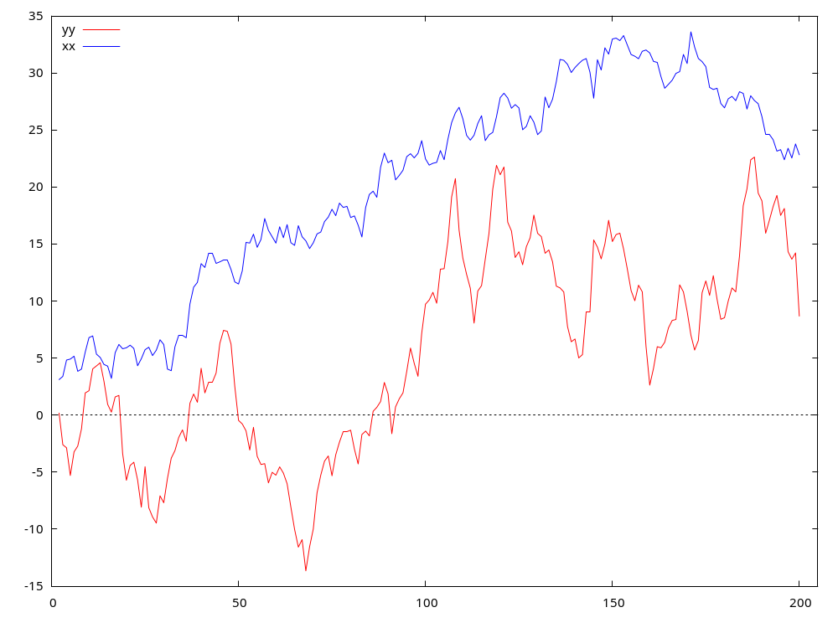
An Illustration
Independent random walks: Y_{t} = Y_{t-1} + ε_{yt}, X_{t} = X_{t-1} + ε_{xt}
ε_{yt}, ε_{xt}: independent white noises with variances σ_{y}² = 2, σ_{x}² = 1
Fitting the model
Y_{t} = α + βX_{t} + ε_{t}
gives
Ŷ_{t} = - 8.18 + 0.68X_{t}
t-statistic for X: t = 17.1
p-value = 1.2 E-40
R² = 0.50, DW = 0.11
April 5, 2013
Hackl, Econometrics 2, Lecture 4

Slide 43
Models in Non-stationary Time Series
Given that X_{t} ~ I(1), Y_{t} ~ I(1) and the model
Y_{t} = α + βX_{t} + ε_{t}
it follows in general that ε_{t} ~ I(1), i.e., the error terms are non- stationary
Consequences for OLS estimation of α and β
(Asymptotic) distributions of t- and F -statistics are different from those under stationarity
R² indicates explanatory potential
Highly autocorrelated residuals, DW statistic converges for growing N to zero
Nonsense or spurious regression (Granger & Newbold, 1974)
Non-stationary time series are trended; causes an apparent relationship
April 5, 2013
Hackl, Econometrics 2, Lecture 4

Slide 44
Avoiding Spurious Regression
Identification of non-stationarity: unit-root tests
Models for non-stationary variables
  Elimination of stochastic trends: specifying the model for differences
  Inclusion of lagged variables may result in stationary error terms
  Explained and explanatory variables may have a common stochastic trend, are cointegrated: equilibrium relation, error-correction models
April 5, 2013
Hackl, Econometrics 2, Lecture 4

Slide 45
An Example: ADL(1,1) Model
ADL(1,1) model with Y_{t} ~ I(1), X_{t} ~ I(1)
Y_{t} = δ + θY_{t-1} + φ₀X_{t} + φ₁X_{t-1} + ε_{t}
The error terms are stationary if θ =1, φ₀ = φ₁ = 0
  ε_{t} = Y_{t} – (δ + θY_{t-1} + φ₀X_{t} + φ₁X_{t-1}) ~ I(0)
Common trend implies an equilibrium relation, i.e.,
Y_{t-1} – βX_{t-1} ~ I(0)
error-correction form of the ADL(1,1) model
  ΔY_{t} = φ₀ΔX_{t} – (1 – θ)(Y_{t-1} – α – βX_{t-1}) + ε_{t}
April 5, 2013
Hackl, Econometrics 2, Lecture 4

Slide 46
Contents
Dynamic Models
Lag Structures
Lag Structure: Estimation
ADL Models
Models for Expectations
Models with Non-stationary Variables
Cointegration
Test for Cointegration
Error-correction Model
April 5, 2013
Hackl, Econometrics 2, Lecture 4

Slide 47
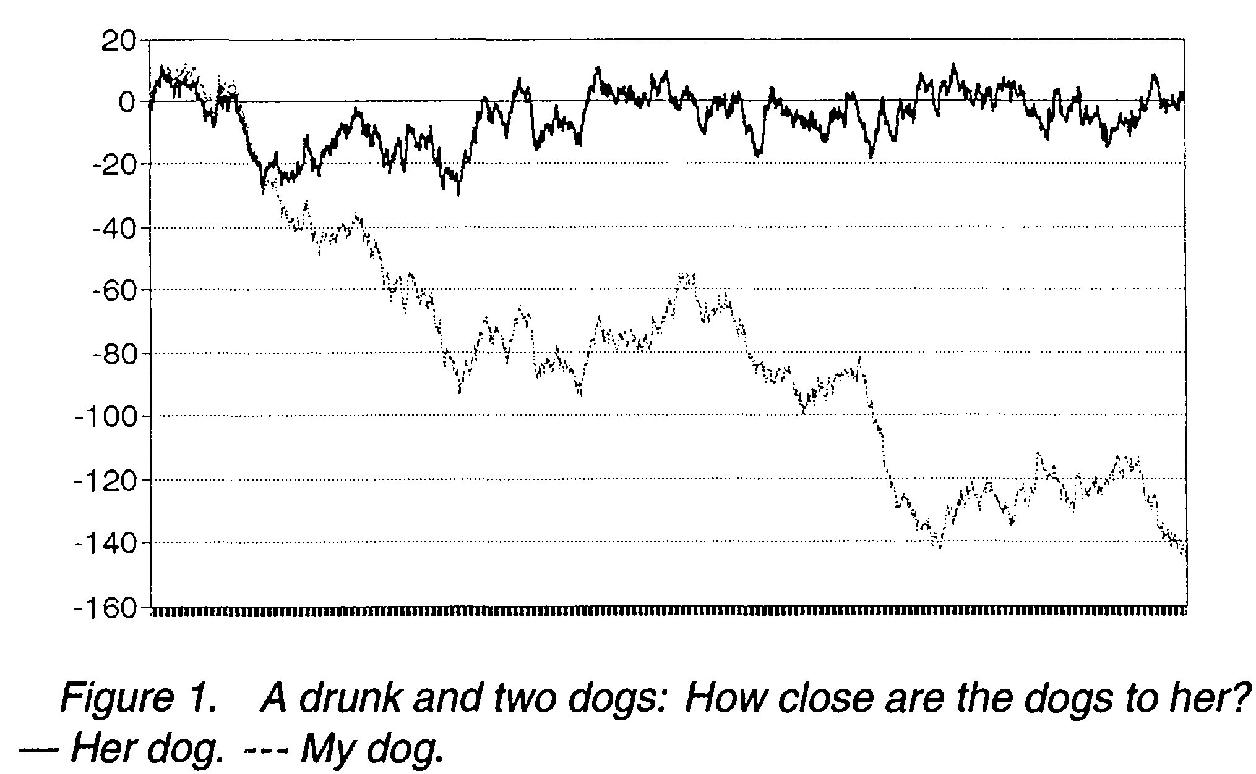
The Drunk and her Dog
M. P. Murray, A drunk and her dog: An illustration of cointegration and error correction. The American Statistician, 48 (1997), 37-39
drunk: x_{t} – x_{t-1} = u_{t}
dog: y_{t} – y_{t-1} = w_{t}
Cointegration:
x_{t}–x_{t-1} = u_{t}+c(y_{t-1}–x_{t-1})
y_{t}–y_{t-1} = w_{t}+d(x_{t-1}–y_{t-1})
April 5, 2013
Hackl, Econometrics 2, Lecture 4

Slide 48
Cointegrated Variables
Non-stationary variables X, Y:
X_{t} ~ I(1), Y_{t} ~ I(1)
if a β exists such that
Z_{t} = Y_{t} - βX_{t} ~ I(0)
X_{t} and Y_{t} have a common stochastic trend
X_{t} and Y_{t} are called “cointegrated”
β: cointegration parameter
(1, - β)’: cointegration vector
Cointegration implies a long-run equilibrium; cf. Granger’s Representation Theorem
April 5, 2013
Hackl, Econometrics 2, Lecture 4

Slide 49
Error-correction Model
Granger’s Representation Theorem (Engle & Granger, 1987): If a set of variables is cointegrated, then an error-correction (EC) relation of the variables exists
non-stationary processes Y_{t} ~ I(1), X_{t} ~ I(1) with cointegrating vector (1, -β)’: error-correction representation
θ(L)ΔY_{t} = δ + Φ(L)ΔX_{t-1} - γ(Y_{t-1} – βX_{t-1}) + α(L)ε_{t}
with white noise ε_{t}, lag polynomials θ(L) (with θ₀=1), Φ(L), and α(L)
Error-correction model: describes
  the short-run behaviour
  consistently with the long-run equilibrium
Long-run equilibrium: Y_{t} = βX_{t}, deviations from equilibrium: Y_{t} – βX_{t}
Converse statement: if Y_{t} ~ I(1), X_{t} ~ I(1) have an error-correction representation, then they are cointegrated
April 5, 2013
Hackl, Econometrics 2, Lecture 4

Slide 50
Long-run Equilibrium
Equilibrium defined by
Y_{t} = α + βX_{t}
Equilibrium error: z_{t} = Y_{t} - βX_{t} - α = Z_{t} - α
Two cases:
z_{t} ~ I(0): equilibrium error stationary, fluctuating around zero
  Y_{t}, βX_{t} cointegrated
  Y_{t} = α + βX_{t} describes an equilibrium
z_{t} ~ I(1), Y_{t}, βX_{t} not integrated
  z_{t} ~ I(1) non-stationary process
  Y_{t} = α + βX_{t} does not describe an equilibrium, spurious regression
Cointegration, i.e., existence of an equilibrium vector, implies a long-run equilibrium relation
April 5, 2013
Hackl, Econometrics 2, Lecture 4

Slide 51
Example: Purchasing Power Parity (PPP)
Verbeek’s dataset PPP: price indices and exchange rates for France and Italy, monthly, T = 186 (1/1981-6/1996)
Variables: LNIT (log price index Italy), LNFR (log price index France), LNX (log exchange rate France/Italy)
LNIT, LNFR, LNX non-stationary (DF-test)
LNP_{t} = LNIT_{t} – LNFR_{t}, i.e., log of price index ratio, non-stationary
Purchasing power parity (PPP): exchange rate between the currencies (Franc, Lira) equals the ratio of price levels of the countries
Relative PPP: equality fulfilled only in the long run; equilibrium or cointegrating relation
LNX_{t} = α + β LNP_{t} + ε_{t}
April 5, 2013
Hackl, Econometrics 2, Lecture 4

Slide 52
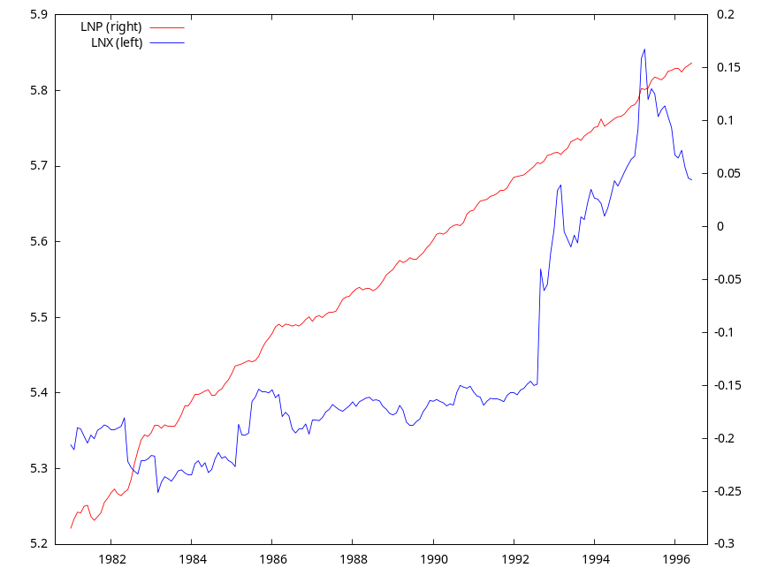
PPP: The Variables
Test for unit roots (non-
stationarity) of
LNX (log exchange rate
France/Italy)
LNP = LNIT – LNFR, i.e.,
the log of the price
index ratio France/Italy
Results from DF tests:
 |  | const. | +trend
LNP | DF stat | -0.99 | -2.96
 | p-value | 0.76 | 0.14
LNX | DF stat | -0.33 | -1.90
 | p-value | 0.92 | 0.65
DF test indicates:
LNX ~ I(1), LNP ~ I(1)
April 5, 2013
Hackl, Econometrics 2, Lecture 4

Slide 53
PPP: Equilibrium Relations
As discussed by Verbeek:
If PPP holds in long run, real exchange rate is stationary
LNX_{t} – (LNIT_{t} – LNFR_{t}) = ε_{t}
Change of relative prices corresponds to the change of exchange rate, i.e., short run deviations are stationary
LNX_{t} – β (LNIT_{t} – LNFR_{t}) = ε_{t}
Generalization of case 2:
LNX_{t} = α + β₁ LNIT_{t} – β₂ LNFR_{t} + ε_{t}
with ε_{t} ~ I(0)
April 5, 2013
Hackl, Econometrics 2, Lecture 4

Slide 54
PPP: Equilibrium Relation 2
OLS estimation of
LNX_{t} = α + β LNP_{t} + ε_{t}
Model 2: OLS, using observations 1981:01-1996:06 (T = 186)
Dependent variable: LNX
coefficient std. error t-ratio p-value
---------------------------------------------------------
const 5,48720 0,00677678 809,7 0,0000 ***
LNP 0,982213 0,0513277 19,14 1,24e-045 ***
Mean dependent var 5,439818 S.D. dependent var 0,148368
Sum squared resid 1,361936 S.E. of regression 0,086034
R-squared 0,665570 Adjusted R-squared 0,663753
F(1, 184) 366,1905 P-value(F) 1,24e-45
Log-likelihood 193,3435 Akaike criterion -382,6870
Schwarz criterion -376,2355 Hannan-Quinn -380,0726
rho 0,967239 Durbin-Watson 0,055469
April 5, 2013
Hackl, Econometrics 2, Lecture 4

Slide 55
Estimation of Cointegration Parameter
Cointegrating relation, X_{t} ~ I(1), Y_{t} ~ I(1), ε_{t} ~ I(0)
Y_{t} = βX_{t} + ε_{t}
OLS estimate b of β
Estimate b is super consistent
  Converges faster to β than standard asymptotic theory says
  Converges to β in spite of omission of relevant regressors (short-term dynamics)
  For b ≠ β: non-stationary OLS residuals with much larger variance than for b close to β
  Bias of b may be substantial!
Non-standard theory
  Asymptotic distribution of √T(b- β) degenerate, not normal (cf. standard theory)
  t-statistic may be misleading
April 5, 2013
Hackl, Econometrics 2, Lecture 4

Slide 56
Estimation of Spurious Regression Parameter
Non-stationary processes X_{t} ~ I(1), Y_{t} ~ I(1)
Y_{t} = βX_{t} + ε_{t}
Spurious regression, ε_{t} ~ I(1)
OLS estimate b of β
Non-standard distribution
Large values of R², t-statistic
Highly autocorrelated residuals
DW statistic close to zero
Remedy: add lagged regressors, e.g., Y_{t-1}
For Y_{t} = δ + θY_{t-1} + φ₀X_{t} + φ₁X_{t-1} + ε_{t}, parameter values can be found such that ε_{t} ~ I(0)
Consistent estimates
April 5, 2013
Hackl, Econometrics 2, Lecture 4

Slide 57
Contents
Dynamic Models
Lag Structures
Lag Structure: Estimation
ADL Models
Models for Expectations
Models with Non-stationary Variables
Cointegration
Test for Cointegration
Error-correction Model
April 5, 2013
Hackl, Econometrics 2, Lecture 4

Slide 58
Identification of Cointegration
Information about cointegration
Economic theory
Visual inspection of data
Statistical tests
April 5, 2013
Hackl, Econometrics 2, Lecture 4

Slide 59
Testing for Cointegration
Non-stationary variables X_{t} ~ I(1), Y_{t} ~ I(1)
Y_{t} = α + βX_{t} + ε_{t}
X_{t} and Y_{t} are cointegrated: ε_{t} ~ I(0)
X_{t} and Y_{t} are not cointegrated: ε_{t} ~ I(1)
Tests for cointegration:
If β is known, unit root test based on differences Y_{t} - βX_{t}
Test procedures
  Unit root test (DF or ADF) based on residuals e_{t}
  Cointegrating regression Durbin-Watson (CRDW) test: DW statistic
  Johansen technique: extends the cointegration technique to the multivariate case
April 5, 2013
Hackl, Econometrics 2, Lecture 4

Slide 60
DF Test for Cointegration
Non-stationary variables X_{t} ~ I(1), Y_{t} ~ I(1)
Y_{t} = α + βX_{t} + ε_{t}
X_{t} and Y_{t} are cointegrated: ε_{t} ~ I(0)
Residuals e_{t} show pattern similar to ε_{t}, e_{t} ~ I(0), residuals are stationary
Tests for cointegration based on residuals e_{t}
Δe_{t} = γ₀ + γ₁e_{t-1} + u_{t}
H₀: γ₁ = 0, i.e., residuals have a unit root, e_{t} ~ I(1)
H₀ implies
  X_{t} and Y_{t} are not cointegrated
  Rejection of H₀ suggests that X_{t} and Y_{t} are cointegrated
April 5, 2013
Hackl, Econometrics 2, Lecture 4

Slide 61
DF Test for Cointegration, cont’d
Critical values of DF test for residuals
are smaller than those of DF test for observations
depend upon (see Verbeek, Tab. 9.2)
  number of elements of cointegrating vector (including left-hand side), K
  number of observations T
  significance level
some asymptotic
critical values for the DF-
test with constant term
 | 1% | 5%
Observations | -3.43 | -2.86
Residuals, K=2 | -3.90 | -3.34
April 5, 2013
Hackl, Econometrics 2, Lecture 4

Slide 62
Cointegrating Regression Durbin-Watson (CRDW) Test
Non-stationary variables X_{t} ~ I(1), Y_{t} ~ I(1)
Y_{t} = α + βX_{t} + ε_{t}
Cointegrating regression Durbin-Watson (CRDW) test: DW statistic from OLS-fitting Y_{t} = α + βX_{t} + ε_{t}
H₀: residuals e_{t} have a unit root, i.e., e_{t} ~ I(1), i.e., X_{t} and Y_{t} are not cointegrated
DW statistic converges with growing T to zero for not cointegrated variables
April 5, 2013
Hackl, Econometrics 2, Lecture 4

Slide 63
CRDW Test, cont’d
Rule of thumb
  If CRDW < R², cointegration likely to be false; do not reject H₀
  If CRDW > R², cointegration may occur; reject H₀
Critical values from Monte Carlo simulations, which depend upon (see Verbeek, Tab. 9.3)
  Number of regressors plus 1 (dependent variable)
  Number of observations T
  Significance level
some 5% critical values
for the CRDW- test
K+1 | T = 50 | T = 100
2 | 0.72 | 0.38
3 | 0.89 | 0.48
4 | 1.05 | 0.58
April 5, 2013
Hackl, Econometrics 2, Lecture 4

Slide 64
PPP: Equilibrium Relation 2
OLS estimation of
LNX_{t} = α + β LNP_{t} + ε_{t}
DF test statistic for residuals (constant): -1.90, p-value: 0.33
H₀ cannot be rejected: no evidence for cointegration
Model 2: OLS, using observations 1981:01-1996:06 (T = 186)
Dependent variable: LNX
coefficient std. error t-ratio p-value
---------------------------------------------------------
const 5,48720 0,00677678 809,7 0,0000 ***
LNP 0,982213 0,0513277 19,14 1,24e-045 ***
Mean dependent var 5,439818 S.D. dependent var 0,148368
Sum squared resid 1,361936 S.E. of regression 0,086034
R-squared 0,665570 Adjusted R-squared 0,663753
F(1, 184) 366,1905 P-value(F) 1,24e-45
Log-likelihood 193,3435 Akaike criterion -382,6870
Schwarz criterion -376,2355 Hannan-Quinn -380,0726
rho 0,967239 Durbin-Watson 0,055469
April 5, 2013
Hackl, Econometrics 2, Lecture 4

Slide 65
Testing for Cointegration, cont’d
Residuals from LNX_{t} = α + β LNP_{t} + ε_{t}:
Tests for cointegration, H₀: residuals have unit root, no cointegration
  DF test statistic (with constant): -1.90, 5% critical value: -3.37
  CRDW test: DW statistic: 0.055 < 0.20, the 5% critical value for two variables, 200 observations
  DF test, rule of thump: 0.055 < 0.665 = R²
Both tests suggest: H₀ cannot be rejected, no evidence for cointegration
Time series plot indicates non-stationary residuals (see next slide)
Same result for equilibrium relations 1 and 3; reasons could be:
Time series too short
No PPP between France and Italy
Attention: equilibrium relation 3 has three variables; two cointegration relations are possible
April 5, 2013
Hackl, Econometrics 2, Lecture 4

Slide 66
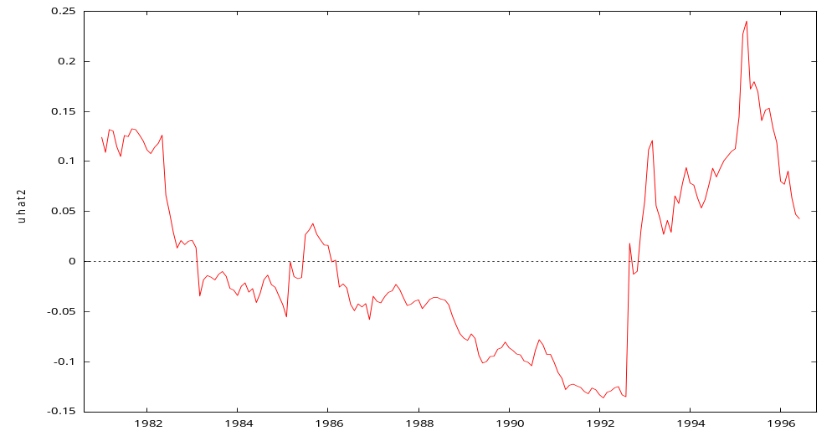
Testing for Cointegration
Residuals from LNX_{t} = α + β LNP_{t} + ε_{t}:
Time series plot indicates non-stationarity of residuals
  Time series plot
  of residuals
April 5, 2013
Hackl, Econometrics 2, Lecture 4

Slide 67
Cointegration Test in GRETL
Model > Time series > Cointegration tests > Engle-Granger
Performs the
  DL test for each of the variables
  Estimation of the cointegrating regression
  DF test for the residuals of the cointegrating regression
Model > Time series > Cointegration tests > Johansen
See next lecture
April 5, 2013
Hackl, Econometrics 2, Lecture 4

Slide 68
Contents
Dynamic Models
Lag Structures
Lag Structure: Estimation
ADL Models
Models for Expectations
Models with Non-stationary Variables
Cointegration
Test for Cointegration
Error-correction Model
April 5, 2013
Hackl, Econometrics 2, Lecture 4

Slide 69
Error-correction Model
Granger’s Representation Theorem (Engle & Granger, 1987): If a set of variables is cointegrated, then an error-correction relation of the variables exists
non-stationary processes Y_{t} ~ I(1), X_{t} ~ I(1) with cointegrating vector (1, -β)’: error-correction representation
θ(L)ΔY_{t} = δ + Φ(L)ΔX_{t-1} - γ(Y_{t-1} – βX_{t-1}) + α(L)ε_{t}
with lag polynomials θ(L) (with θ₀=1), Φ(L), and α(L)
E.g., ΔY_{t} = δ + φ₁ΔX_{t-1} - γ(Y_{t-1} – βX_{t-1}) + ε_{t}
Error-correction model: describes
the short-run behavior
consistently with the long-run equilibrium
Converse statement: if Y_{t} ~ I(1), X_{t} ~ I(1) have an error-correction representation, then they are cointegrated
April 5, 2013
Hackl, Econometrics 2, Lecture 4

Slide 70
EC Model and Equilibrium Relation
The EC model
ΔY_{t} = δ + φ₁ΔX_{t-1} - γ(Y_{t-1} – βX_{t-1}) + ε_{t}
is a special case of
θ(L)ΔY_{t} = δ + Φ(L)ΔX_{t-1} - γ(Y_{t-1} – βX_{t-1}) + α(L)ε_{t}
with θ(L) = 1, Φ(L) = φ₁L, and α(L) = 1
“No change” steady state equilibrium: for ΔY_{t} = ΔX_{t-1} = 0
Y_{t} – βX_{t} = δ/γ or Y_{t} = α + βX_{t} if α = δ/γ
the EC model can be written as
ΔY_{t} = φ₁ΔX_{t-1} – γ(Y_{t-1} – α – βX_{t-1}) + ε_{t}
Steady state growth: If α = δ/γ + λ, λ ≠ 0,
ΔY_{t} = λ + φ₁ΔX_{t-1} – γ(Y_{t-1} – α – βX_{t-1}) + ε_{t}
deterministic trends for Y_{t} and X_{t}, long run equilibrium corresponding to growth paths ΔY_{t} = ΔX_{t-1} = λ/(1 - φ₁)
April 5, 2013
Hackl, Econometrics 2, Lecture 4

Slide 71
Analysis of EC Models
Model specification
Unit-root testing
Testing for cointegration
Specification of EC-model: choice of orders of lag polynomials, specification analysis
Estimation of model parameters
April 5, 2013
Hackl, Econometrics 2, Lecture 4

Slide 72
EC Model: Estimation
Model for cointegrated variables X_{t}, Y_{t}
ΔY_{t} = δ + φ₁ΔX_{t-1} - γ(Y_{t-1} – βX_{t-1}) + ε_{t} (A)
with cointegrating relation
Y_{t-1} = βX_{t-1} + u_{t} (B)
Cointegration vector (1, - β)’ known: OLS estimation of δ, φ₁, and γ from (A), standard properties
Unknown cointegration vector (1, –β)’:
  Parameter β from (B) super consistently estimated by OLS
  OLS estimation of δ, φ₁, and γ from (A) is not affected by use of the estimate for β
April 5, 2013
Hackl, Econometrics 2, Lecture 4

Slide 73
Your Homework
Use Verbeek’s data set INCOME containing quarterly data INCOME (total disposable income) and CONSUM (consumer expenditures) for 1/1971 to 2/1985 in the UK.
  For sd_CONSUM (seasonal difference of CONSUM), specify a DL(s) model in sd_INCOME and choose an appropriate s (< 8), using (i) R² and (ii) BIC.
  Assuming that DL(4) is an appropriate lag structure, calculate (i) the short run and (ii) the long run multiplier as well as (iii) the average and (iv) the median lag time.
  Specify a consumption function with the actual expected income as explanatory variable; estimate the AR form of the model under the assumption of adaptive expectation for the income.
  Test (i) whether CONSUM and INCOME are I(1); (ii) estimate the simple linear regression of CONSUM on INCOME and test (iii) whether this is an equilibrium relation; show (iv) the corresponding time series plots.
April 5, 2013
Hackl, Econometrics 2, Lecture 4

Slide 74
Your Homework, cont’d
Generate 500 random numbers (a) from a random walk with trend: x_{t} = 0.1 +x_{t-1} + ε_{t}; and (b) from an AR(1) process: y_{t} = 0.2 + 0.7y_{t-1} + η_{t}; for ε_{t} and η_{t} use Monte Carlo random numbers from N(0,1). Estimate regressions of x_{t} and y_{t} on t; report the values for R².
April 5, 2013
Hackl, Econometrics 2, Lecture 4

