Slide 1
Introduction and Setting up the REPL

Slide 2
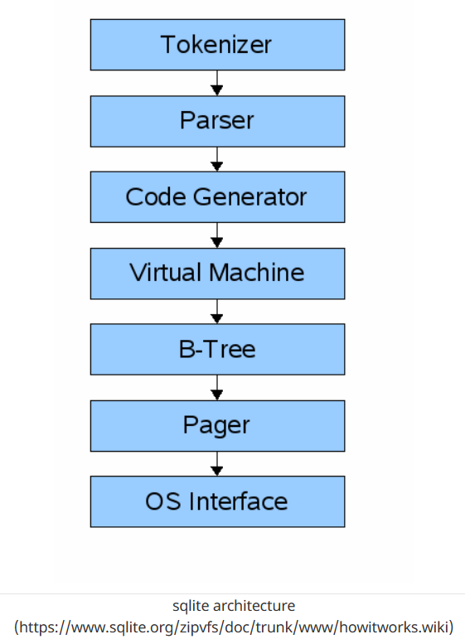
Front-end
Back-end
Notes:
The input to the front-end is a SQL query. the output is sqlite virtual machine bytecode (essentially a compiled program that can operate on the database).
The virtual machine takes bytecode generated by the front-end as instructions. It can then perform operations on one or more tables or indexes, each of which is stored in a data structure called a B-tree. The VM is essentially a big switch statement on the type of bytecode instruction.
Each B-tree consists of many nodes. Each node is one page in length. The B-tree can retrieve a page from disk or save it back to disk by issuing commands to the pager.
The pager receives commands to read or write pages of data. It is responsible for reading/writing at appropriate offsets in the database file. It also keeps a cache of recently-accessed pages in memory, and determines when those pages need to be written back to disk.
The os interface is the layer that differs depending on which operating system sqlite was compiled for. In this tutorial, I’m not going to support multiple platforms.

Slide 3
Let’s start a demo

