Slide 1
Economics of crime
A cross-sectional analysis of Toronto neigbourhoods
Gabriel Blumenstock, Felix Degenhardt, Haseeb Warsi

Slide 2
Outline
Introduction
  What is economics of crime?
  Focus of this presentation
Data structure
Regressions
  Procedure
  Results
Outlook

Slide 3
What is economics of crime
Evolved in the 1970s and is a broad discipline since then
Investigation on both behavioral (e.g. Becker 1968) as well as socio-economic aspects (e.g. Buannano 2003)
Includes Major econometric investigations: time-series (e.g. Corman and Mocan 2000), panel-data (e.g. Cornwell and Trumbull 1994) and cross-sectional analysis (e.g. Kelly 2000)

Slide 4
Focus of this presentation
Cross-sectional analysis of the effects of Toronto neighbourhood characteristics on the crime rate
Combination of 2014 – 2017 crime statistics and 2016 Census Data

Slide 5
Data structure
More than 130,000 observations of Toronto crime occasions between 2014 – 2017
Around 15 major characteristics of each of the 140 Toronto neighbourhoods
Transformation to count data with both characteristics and crime per neighbourhood

Slide 6
Data structure
Hood_ID | Assault | Auto Theft | Break & Enter | . . . | % youth | % low income | % immi- grants
1 | 0.0068 | 0.0083 | 0.0037 | . . . | 16.34 | 54.72 | 58.46
2 | 0.0066 | 0.0012 | 0.0010 | . . . | 15.90 | 56.44 | 65.48
. . . | . . . | . . . | . . . | . . . | . . . | . . . | . . .
139 | 0.0087 | 0.00047 | 0.0019 | . . . | 14.11 | 53.08 | 54.60
140 | 0.0039 | 0.0005 | 0.0017 | . . . | 10.78 | 38.87 | 32.43

Slide 7
Initial Findings

Slide 8
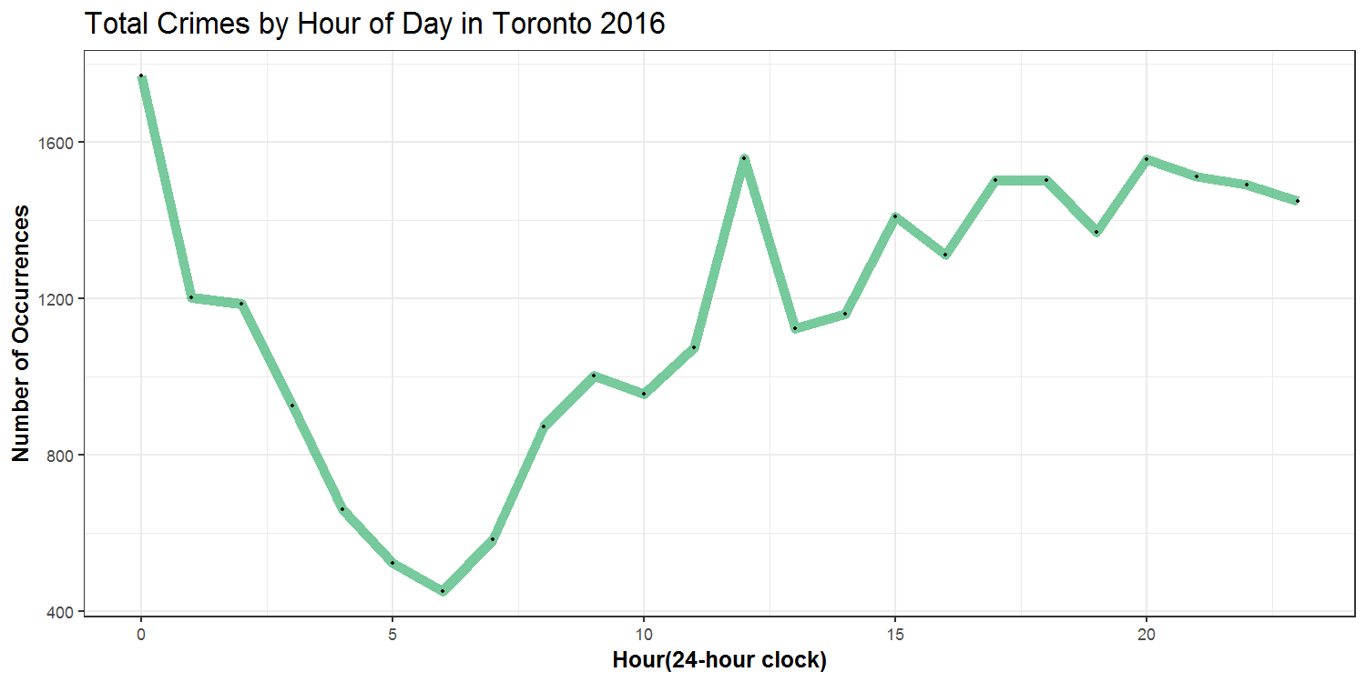
Crime by Time of Day

Slide 9
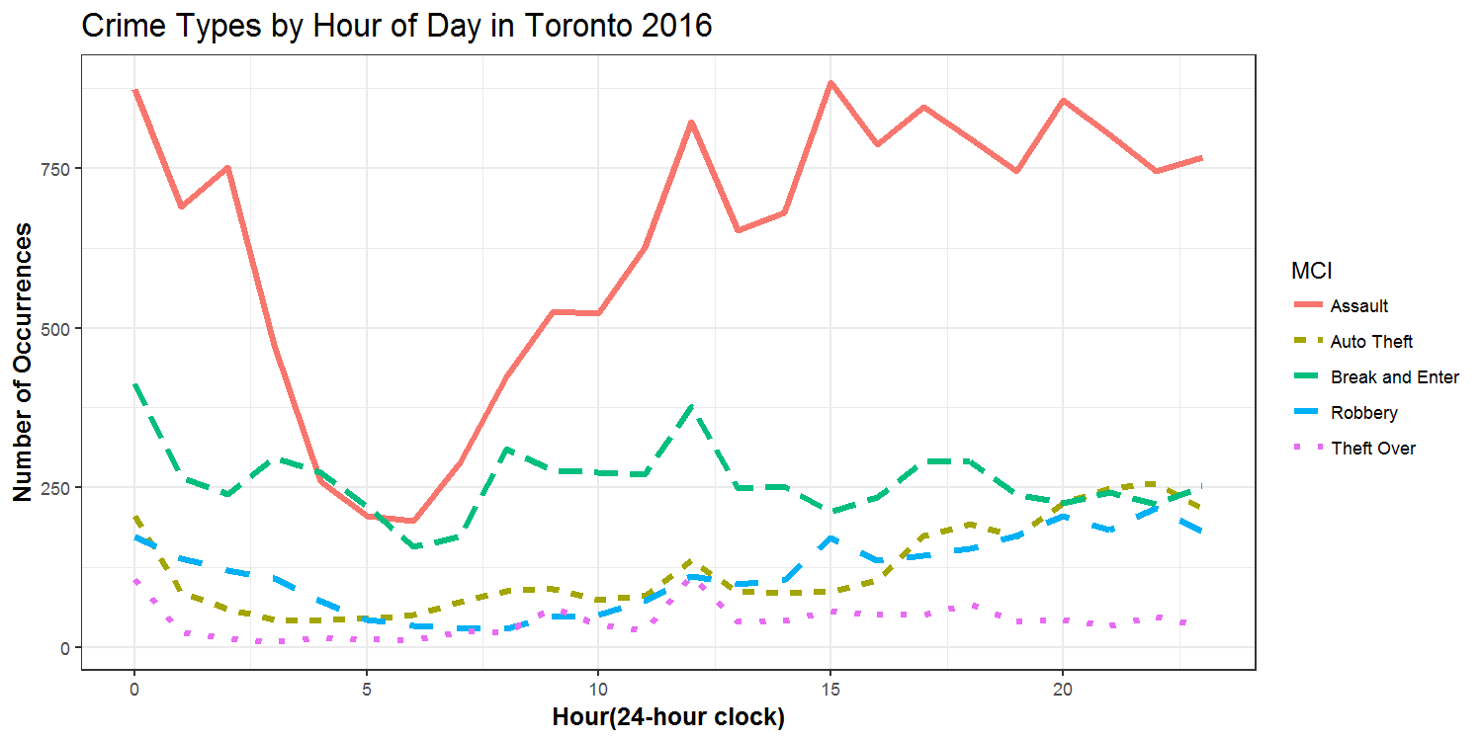
Crime by Time of Day

Slide 10
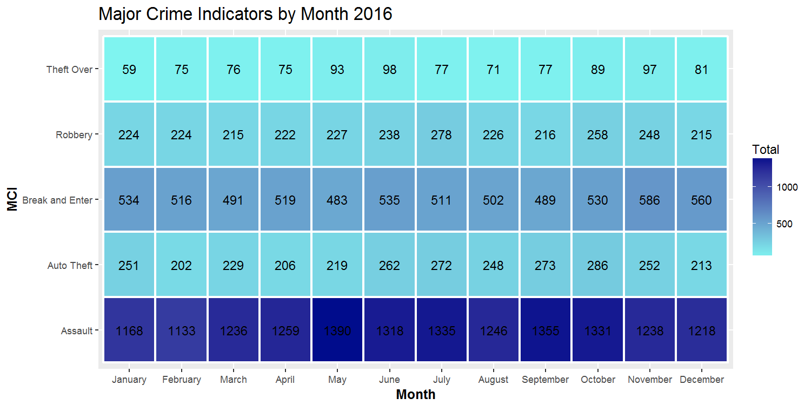
Crime by Month

Slide 11
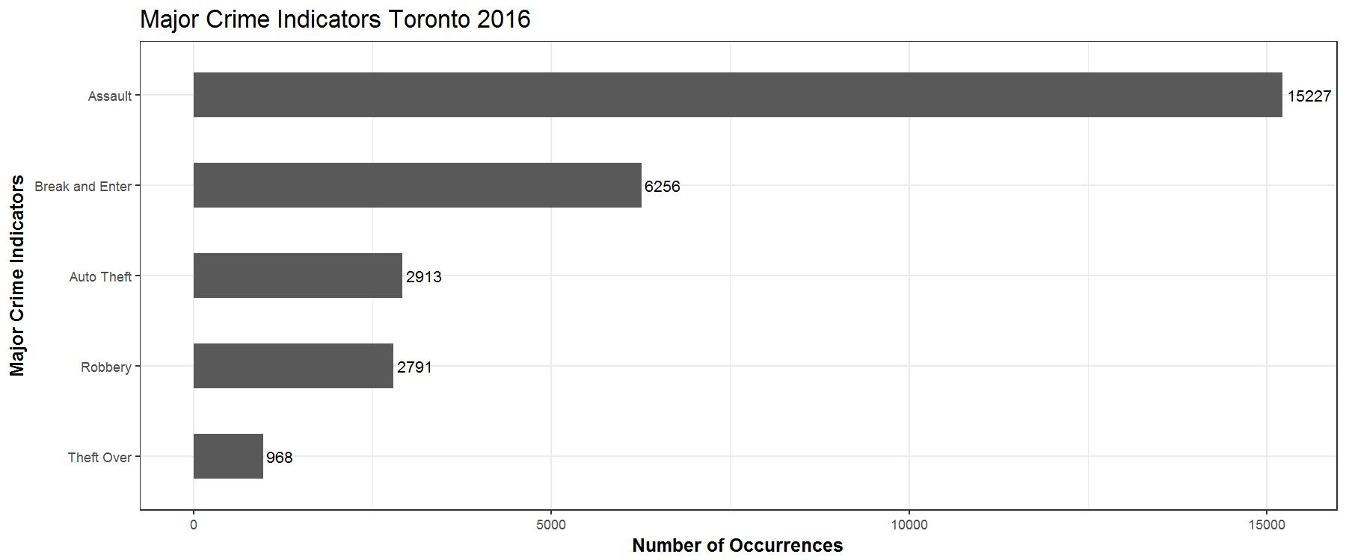
Major Crime Indicators

Slide 12
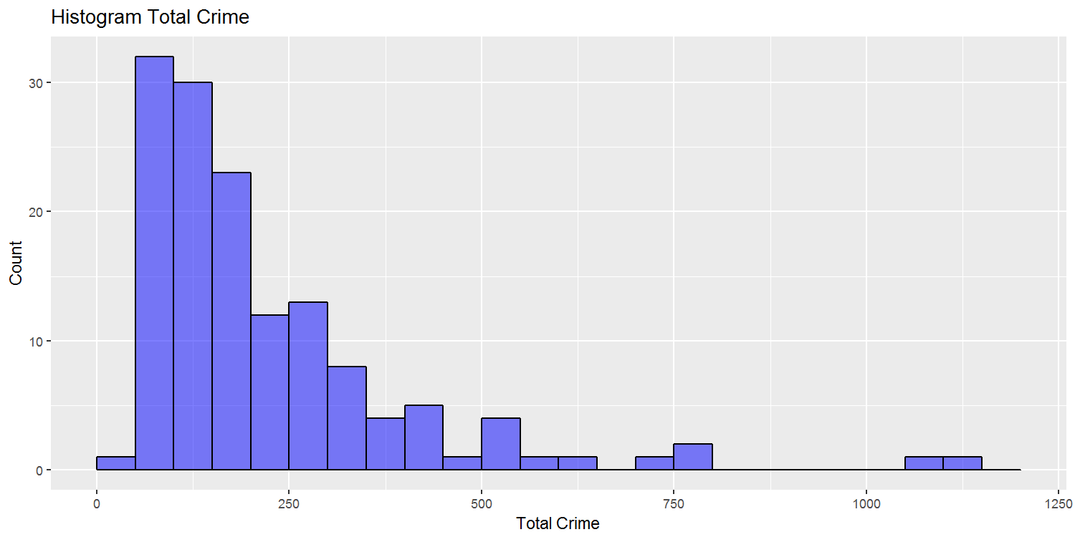
Major Crime Indicators

Slide 13
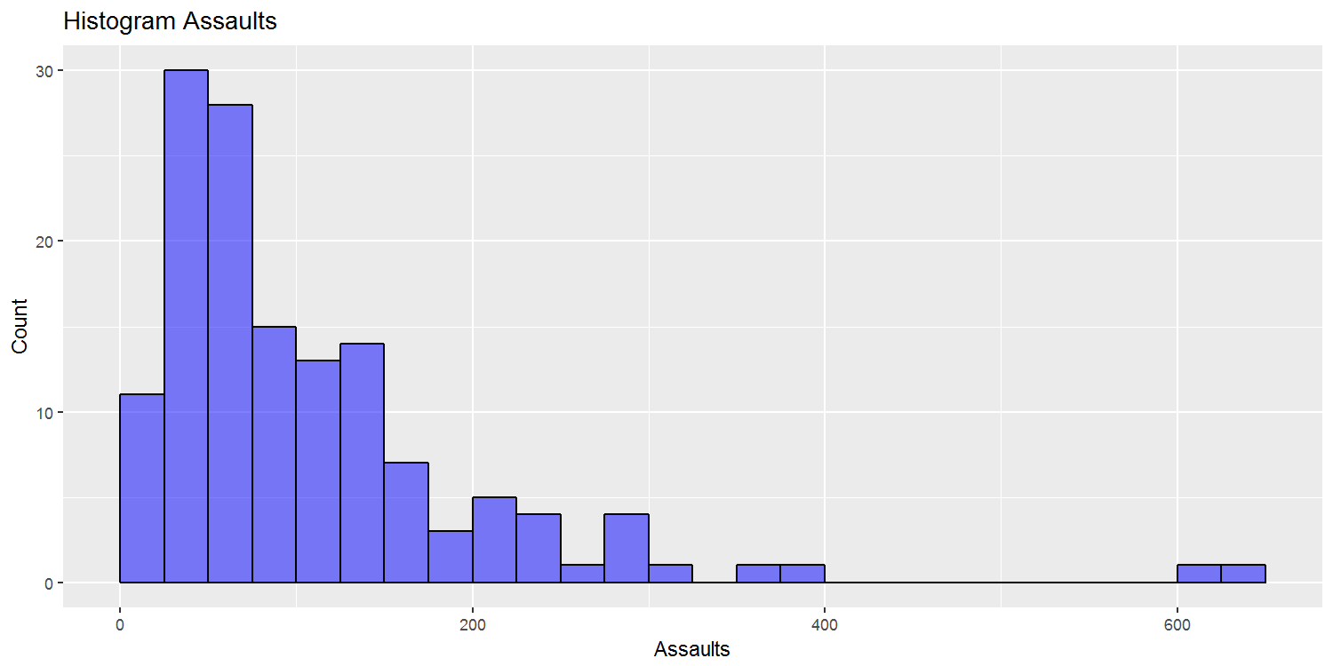
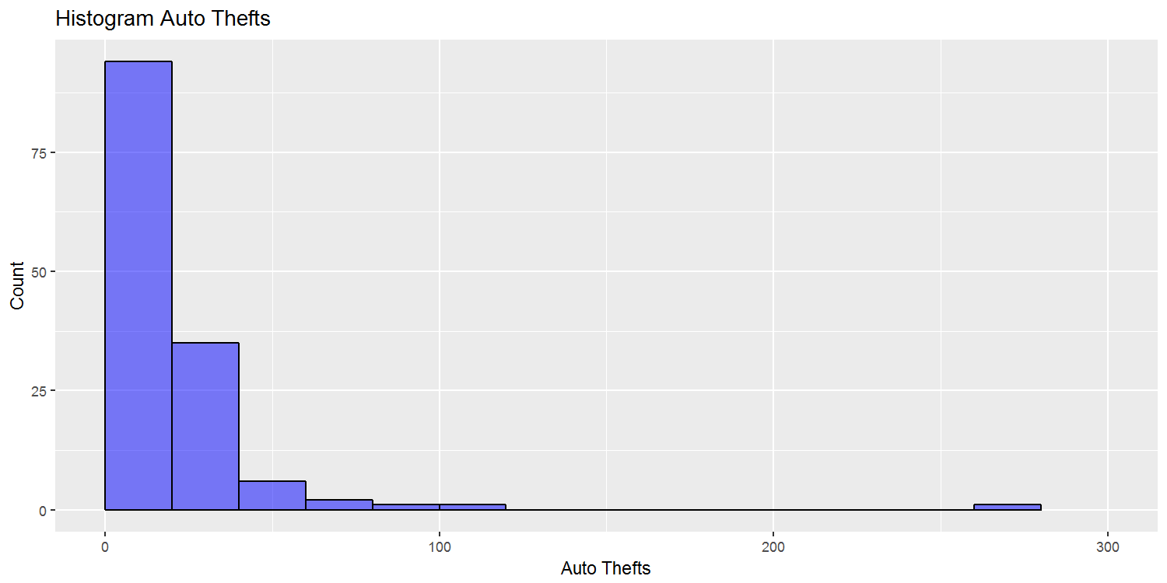
Major Crime Indicators

Slide 14
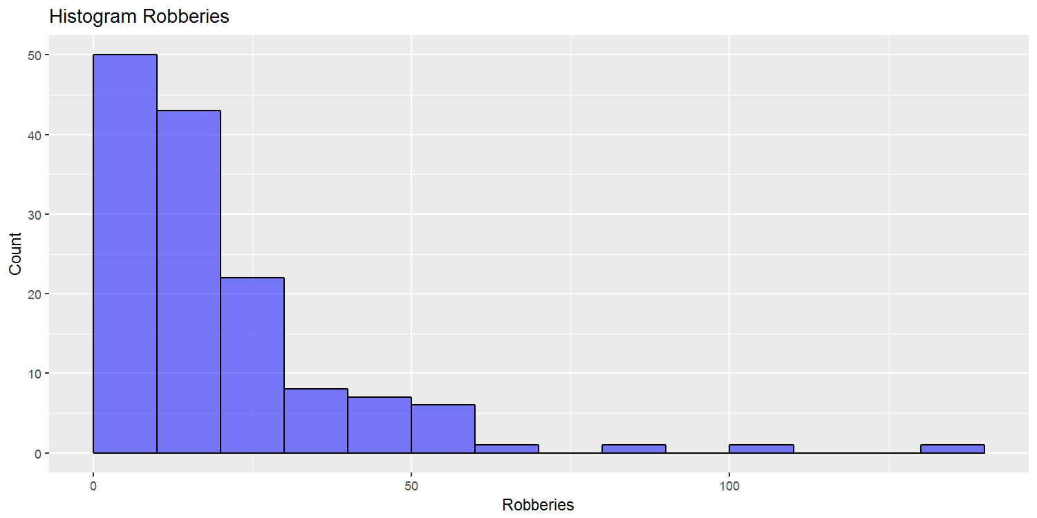
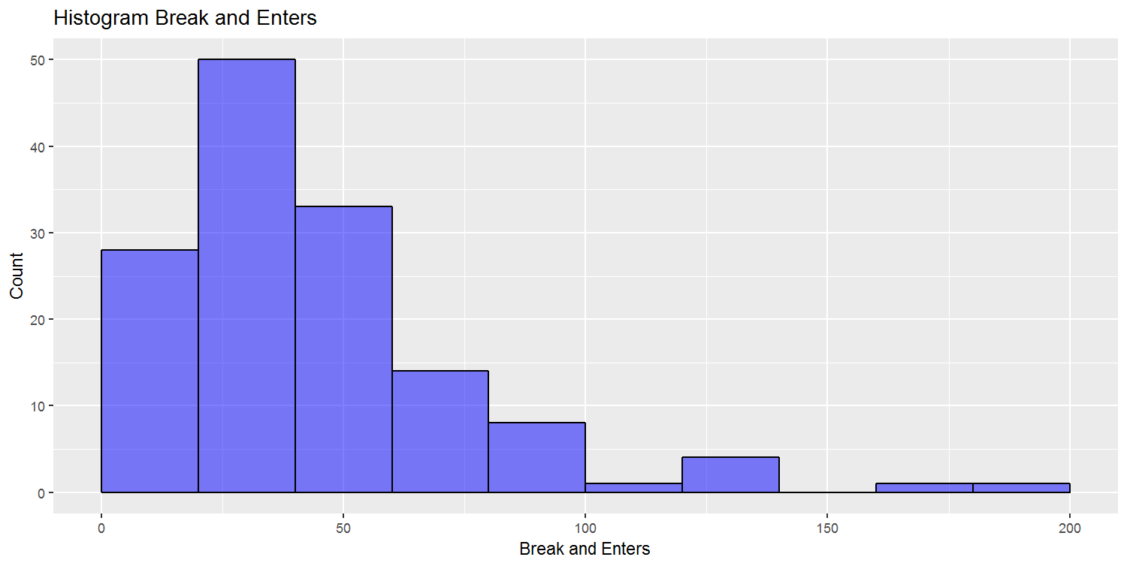
Major Crime Indicators

Slide 15
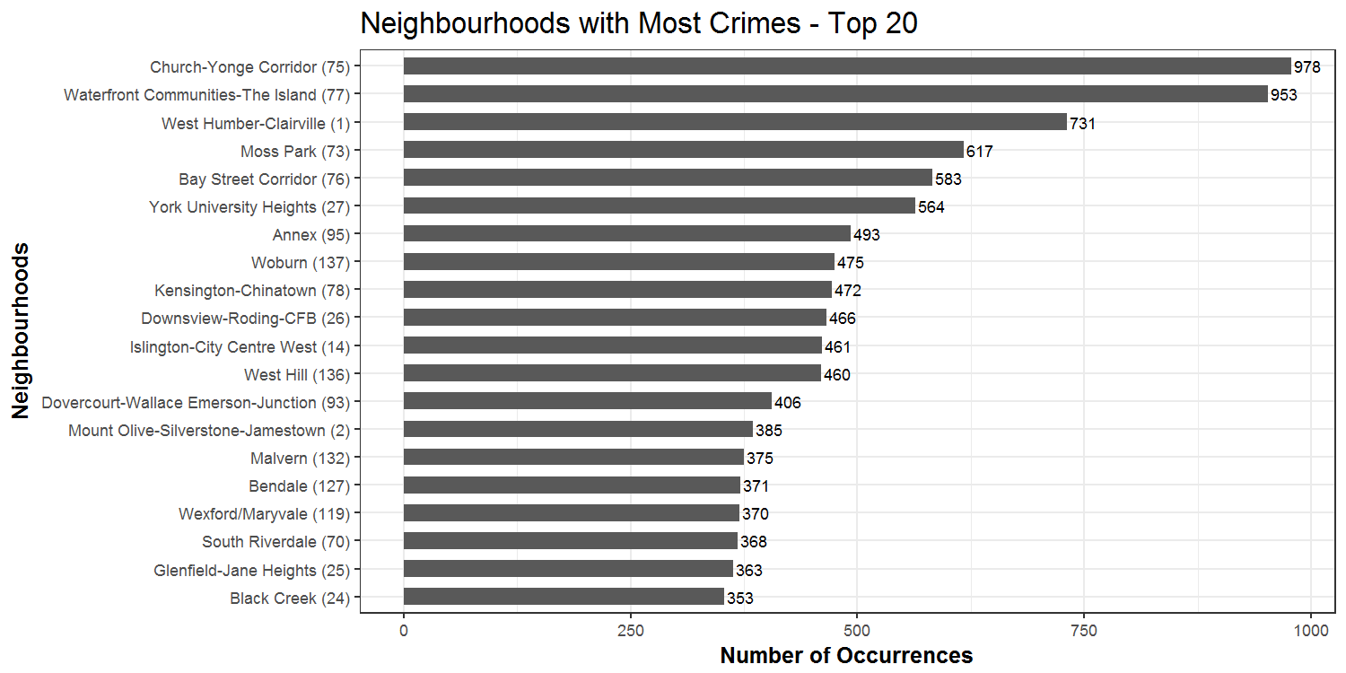
Most Dangerous Neighbourhoods

Slide 16
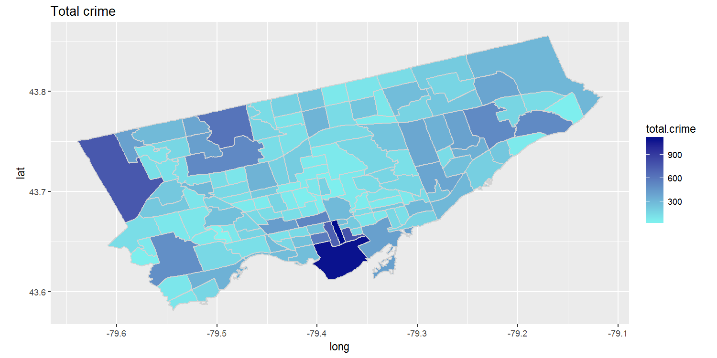
Most Dangerous Neighbourhoods

Slide 17
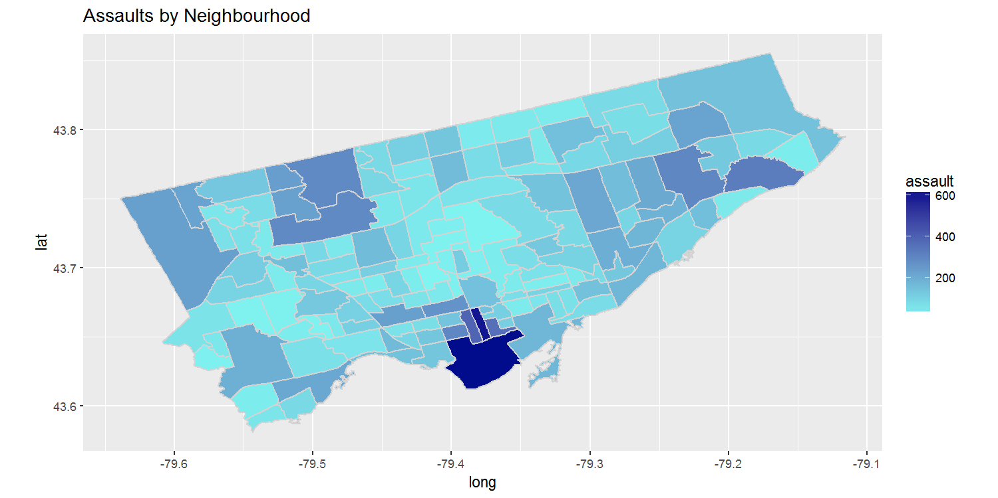
Most Dangerous Neighbourhoods

Slide 18
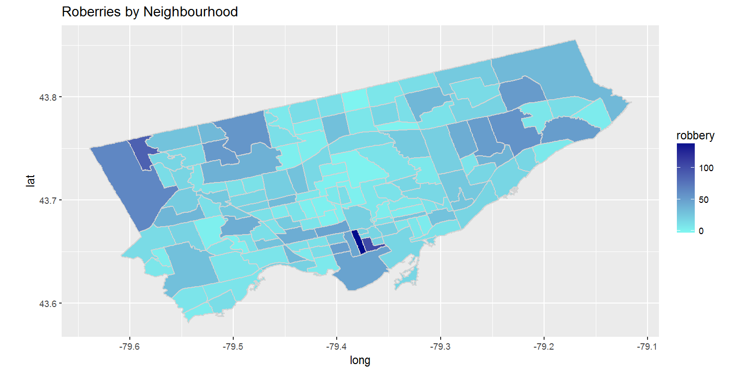
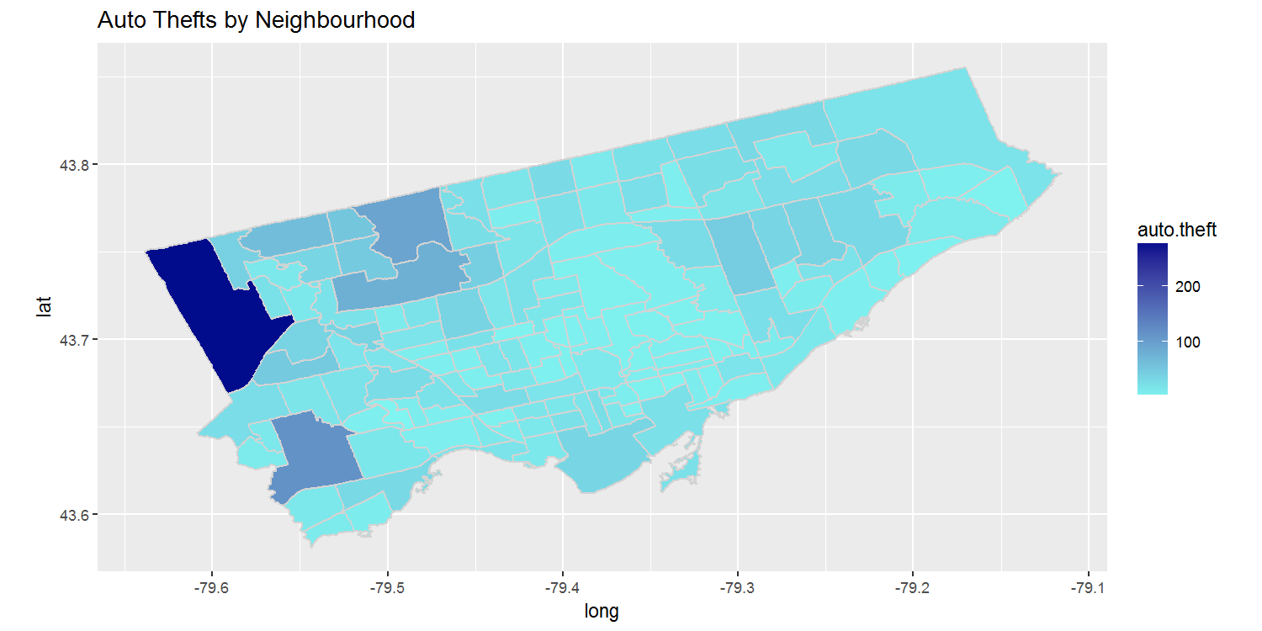
Most Dangerous Neighbourhoods

Slide 19
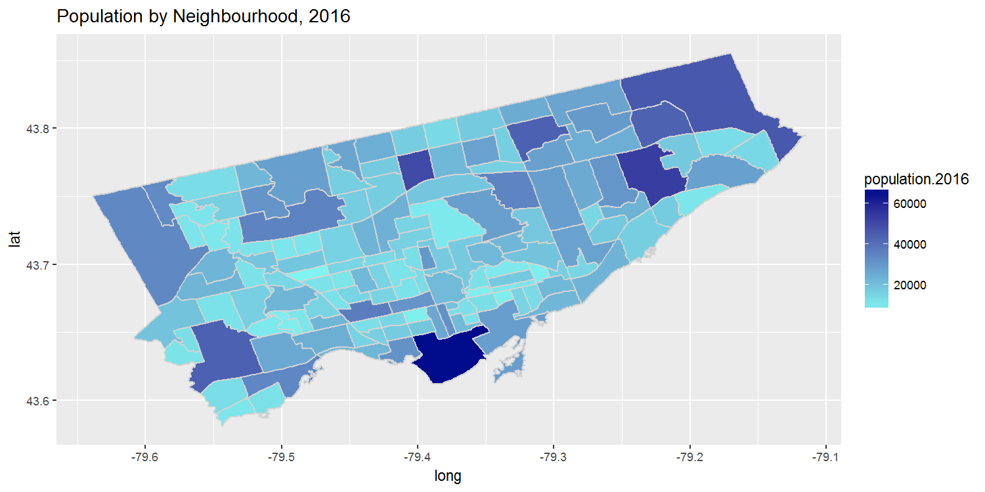
Neighbourhood
Characteristics

Slide 20
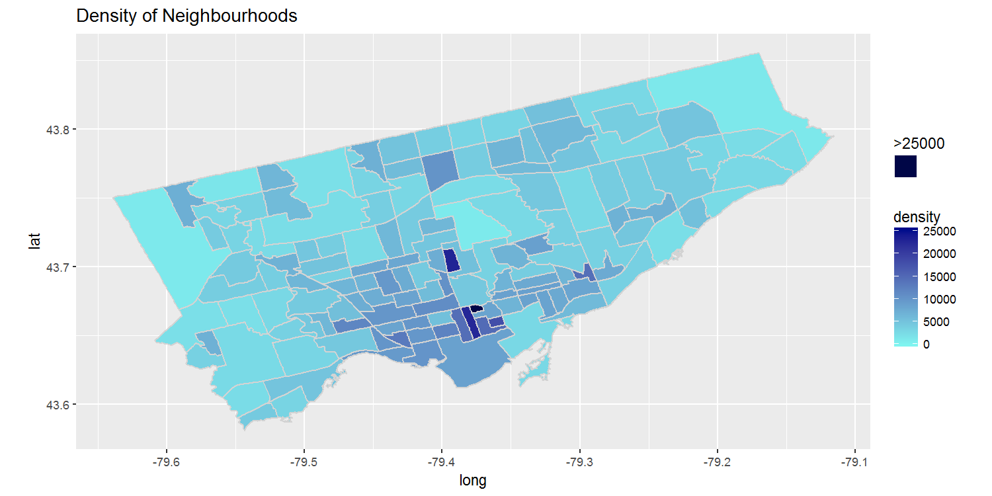
Neighbourhood
Characteristics

Slide 21
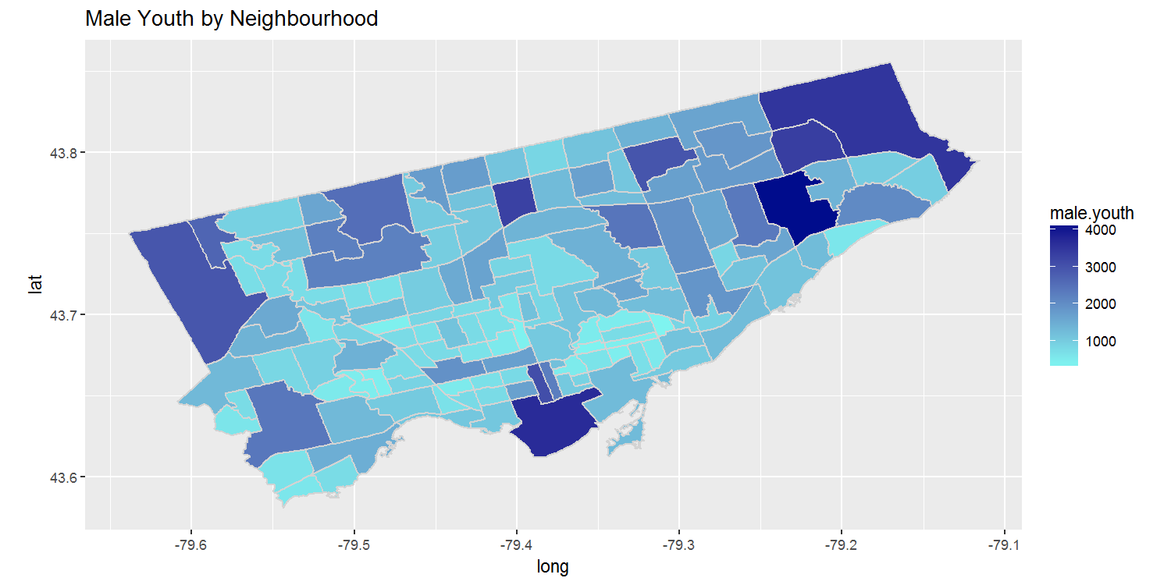
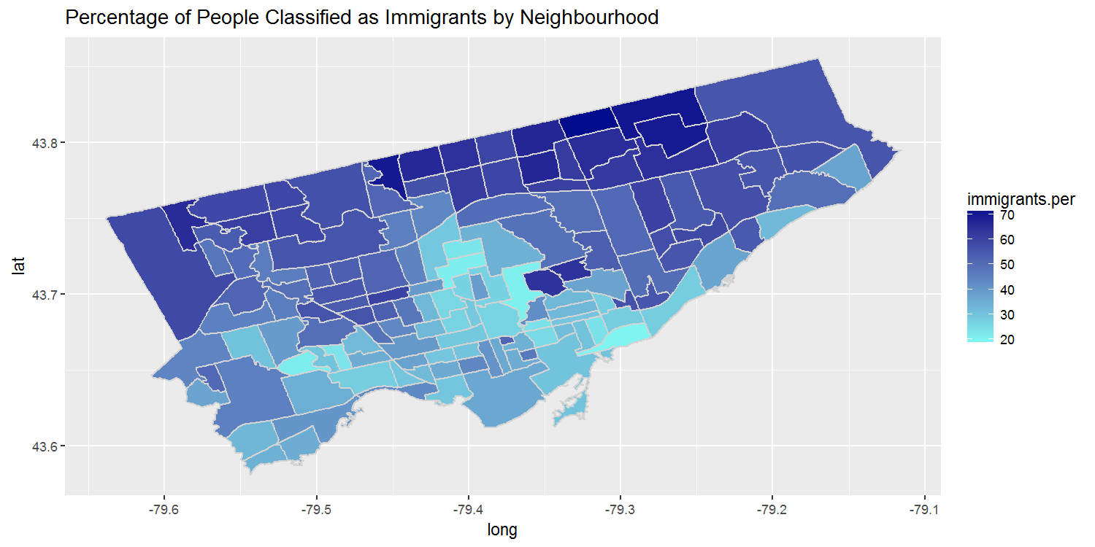
Neighbourhood
Characteristics

Slide 22
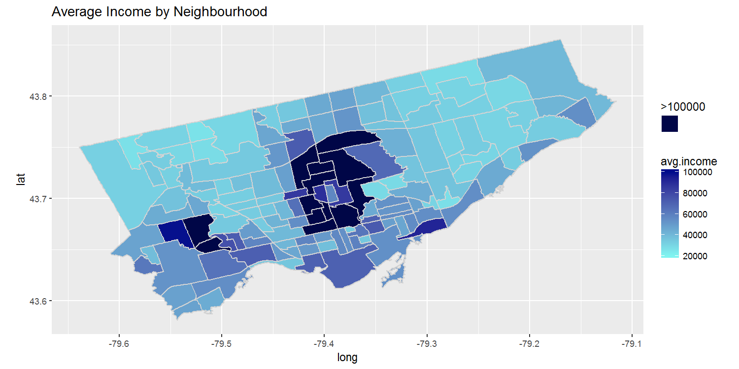
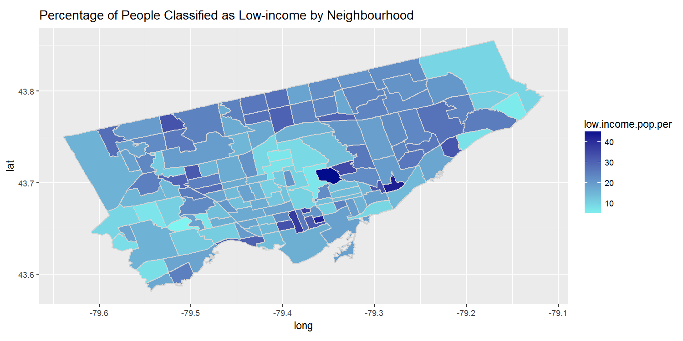
Neighbourhood
Characteristics

Slide 23
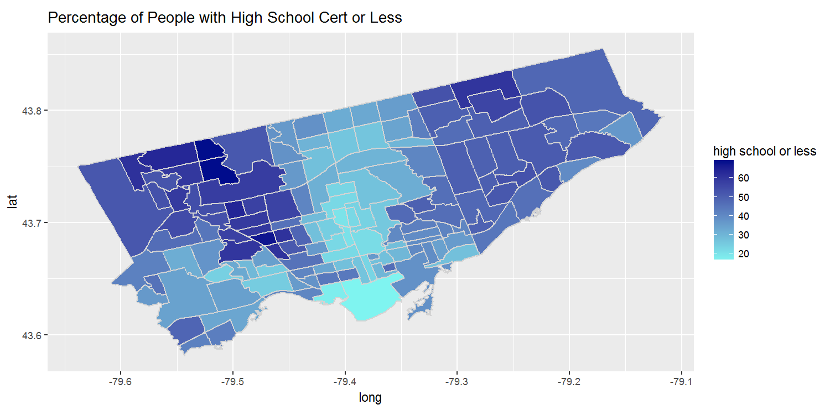
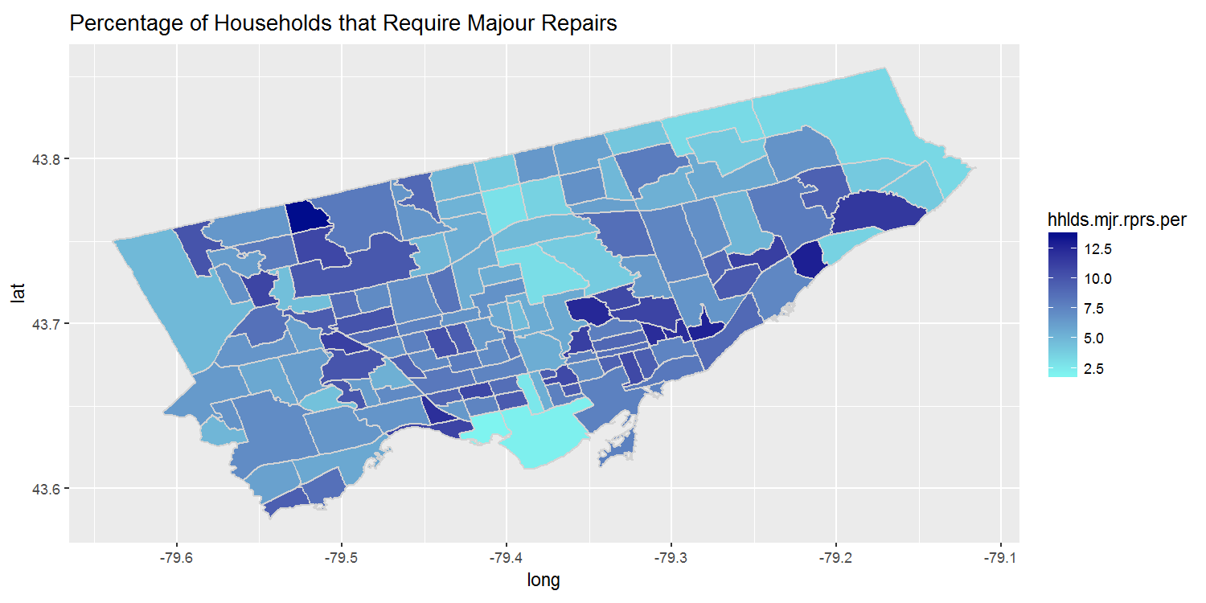
Neighbourhood
Characteristics

Slide 24

Grouping
Using k-means
where,
V = {v₁,v₂,…….,v_{c}} be the set of centers
‘||x_{i} - v_{j}||’ is the Euclidean distance between x_{i} and v_{j.}
‘c_{i}’ is the number of data points in i^{th} cluster.
‘c’ is the number of cluster centers.

Slide 25
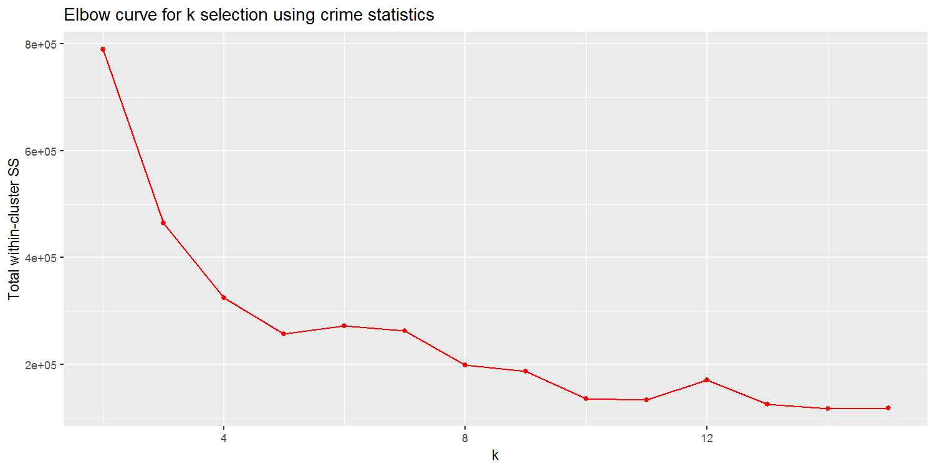
Grouping
Using k-means

Slide 26
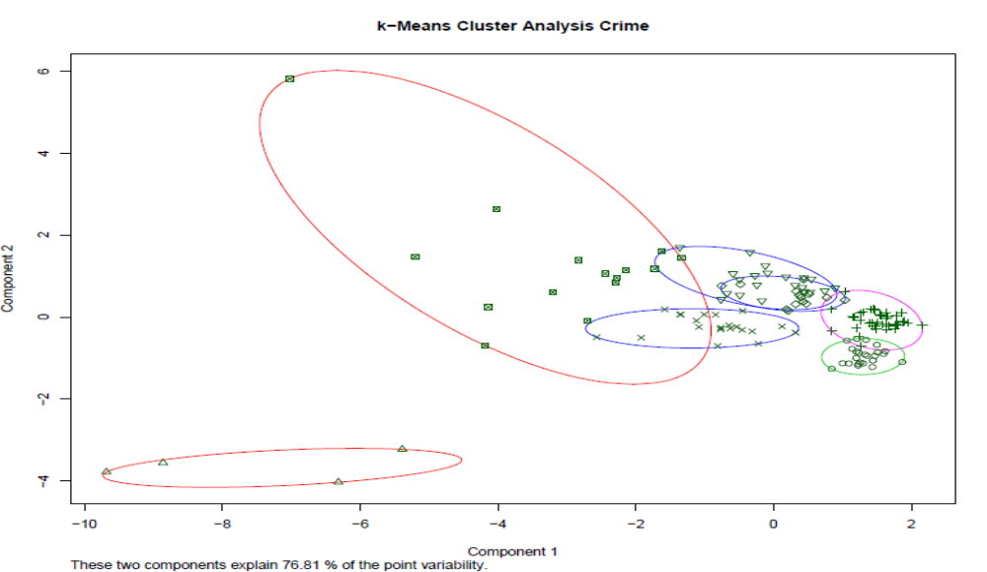
Grouping
Using k-means

Slide 27
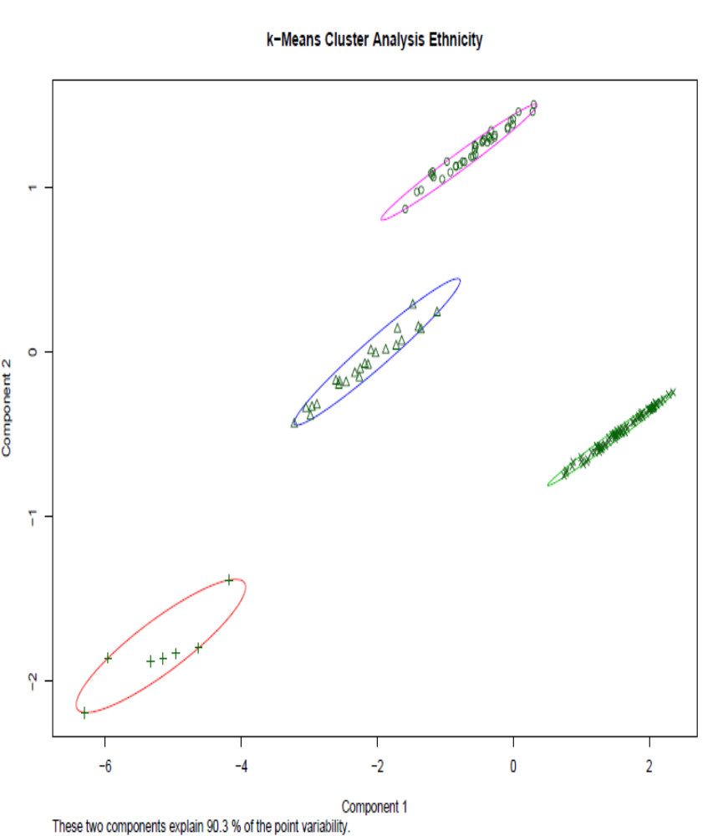
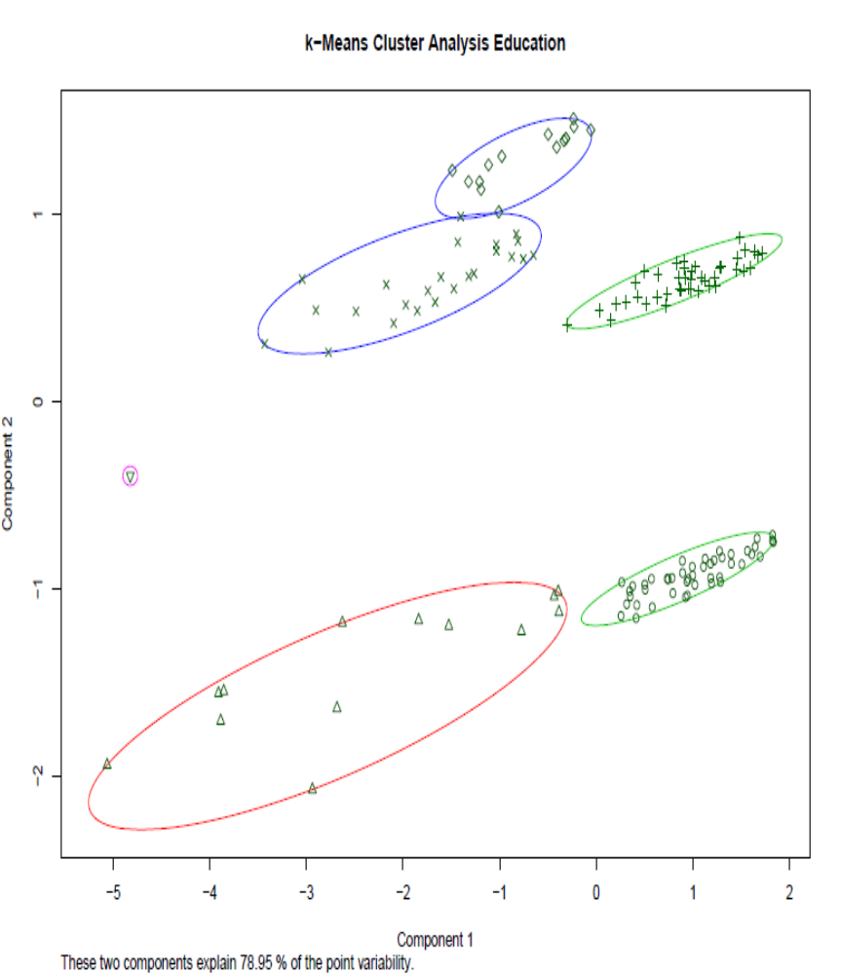
Grouping
Using k-means

Slide 28
Regression analysis
Seven types of crime -> seven regressions
Assault, Auto theft, Break and enter, Robbery, Theft over, Drug arrests, Total crime
30 possible independent variables
Selection of six variables
Male youth population, less than high school population, low income population, immigrants

Slide 29
Regression analysis
After each regression:
-> check for influential observations
-> variable selection
-> check for OLS-assumptions

Slide 30
Regression analysis
Example: Regression for robbery data

Slide 31
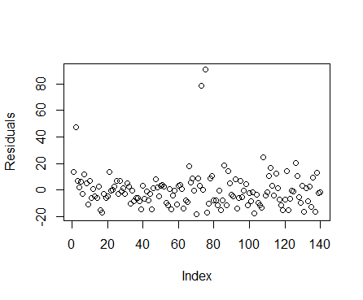
Regression analysis
Check for influential observations

Slide 32
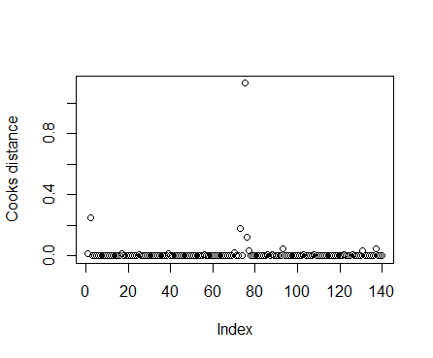
Regression analysis
Check for influential observations

Slide 33
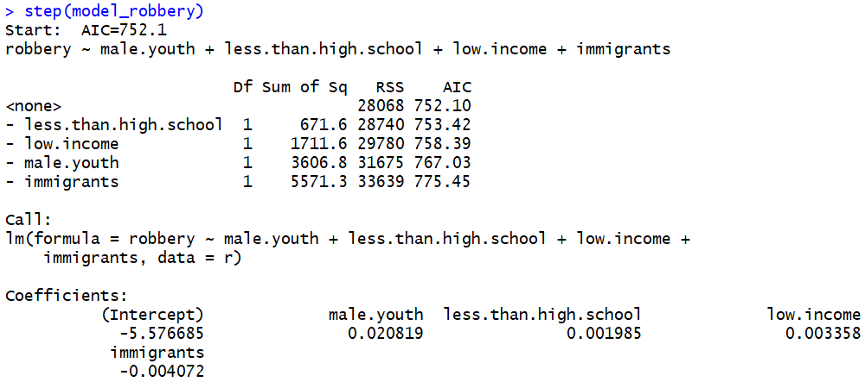
Regression analysis
Variable selection using Akaike information criterion

Slide 34
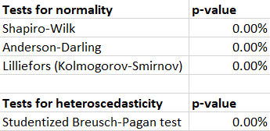
Regression analysis
Check for OLS-assumptions

Slide 35
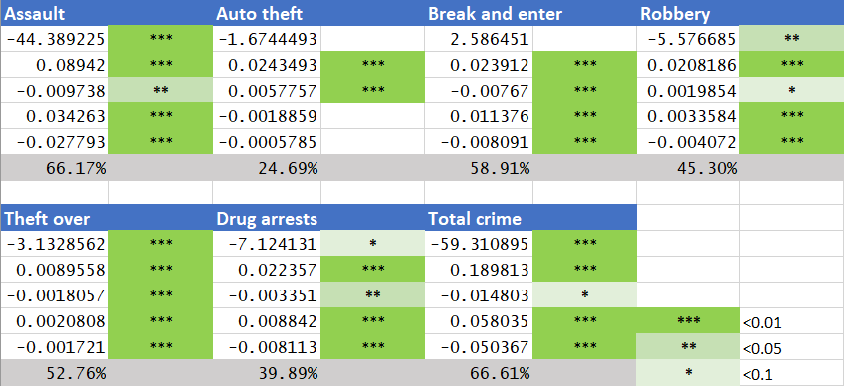
Regression analysis
Preliminary results

Slide 36
Outlook
Taking into account the spatial correlations
Finding a way to deal with count data appropriately
Implementing additional tests for verification

