Slide 1
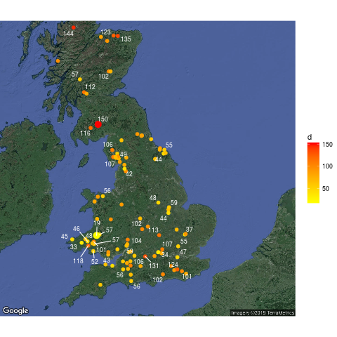

Exploring environmental factors influencing vascular plant species richness in UK Woodlands.
Species area curves S = cA^{z}
ln(S) = lnc +zlnA
Z = ∑α_{i}x_{i}
Zeta diversity curves – average number of shared species across multiple plots
Richness ~ heterogeneity/area
Bunce and Shaw, 1971
Repeated 2003, Kirby et al, Long term ecological change in British woodland (1971 -2001)

Slide 2
What factors influence richness?
Shape – core forest habitats contain poorly dispersing species (Kimberley et al 2014)
Heterogeneity – Plantation management (Hartley et al 2002)
Small scale disturbance is the most important factor for species richness in tropical forests (Philips 1994)
Habitat heterogeneity more important than area in Hungarian reserves (Baldi and Sadler 2008)
Species richness is best predicted by soil pH (Lobel et al 2006)
Patch age in Belgium (Honnay et al 1999)
Ancient woodland have more species, recent wood in contact with ancient woods have more species (Peterken and Game 1984)
Species richness increased after cessation of fertilizer use on grasslands (Pallet et al 2015)
Woodland species richness is greater on more fertile soils (Conwell and Grubb 2003)
Past land use, grazing, connectivity, species pool, anthropogenic...

Slide 3
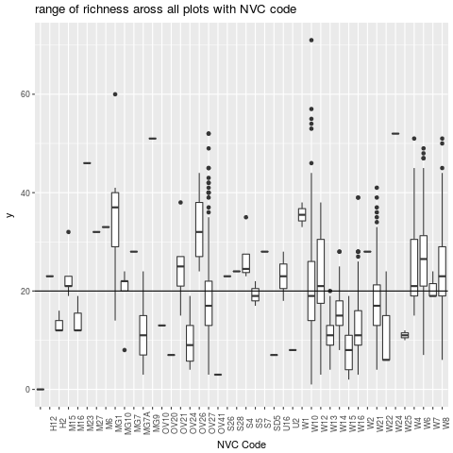
Its all about heterogeneity, and some other things...
Range of richnesses with NVC code

Slide 4
Site
Plot, x16 per Site
Nests:
4m²
25m²,
50m²,
100m²,
200m²

Slide 5
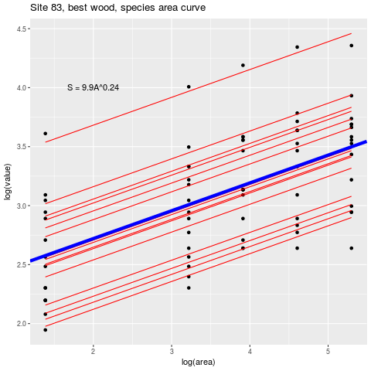
What variables do I have:
NESTS – area

Slide 6
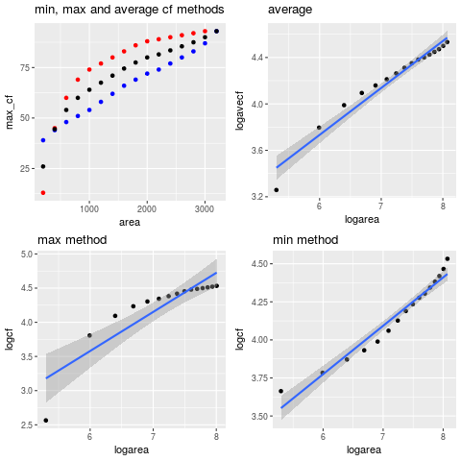
What variables do I have:
PLOTS–area and pH, Soil Organic Matter, Live Basal Area,
Tree Density, mean dbh, NVC code.

Slide 7
What variables do I have
SITES – area and perimeter, altitude, long/lat, surrounding land use(modified), designations(modified), site descriptors(modified), any averaged plot variables
Look at which variables correlate with richness
Nest level, deviation of random intercepts
Plot level Species Area Curves
ln(c) = ∑β_{i}x_{i}
Z = ∑α_{i}x_{i}

Slide 8
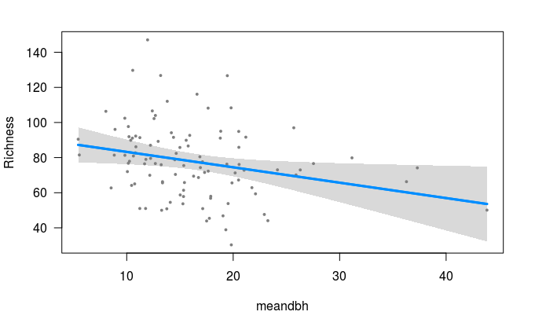
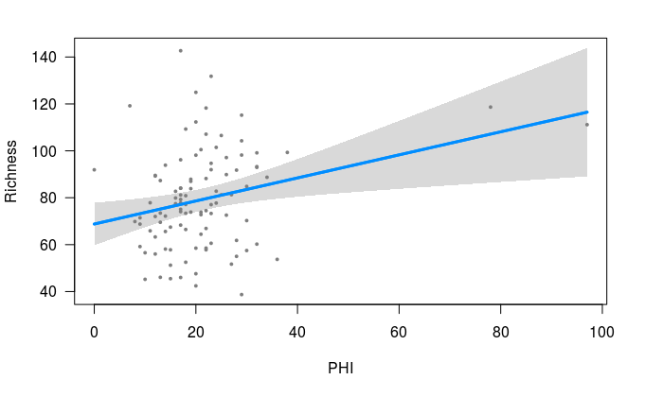
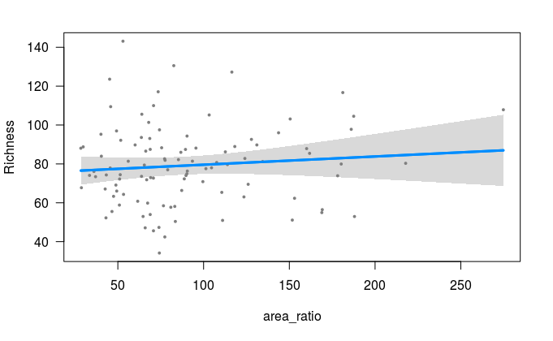
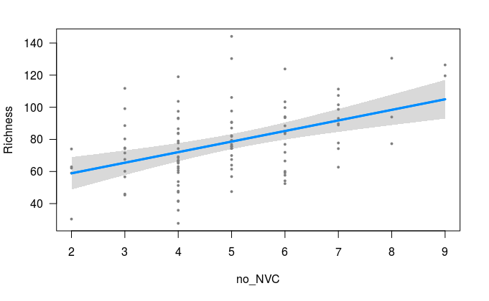
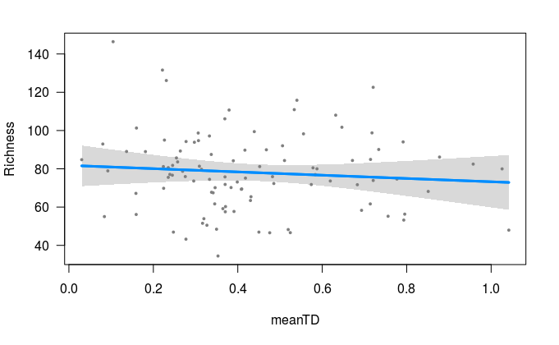
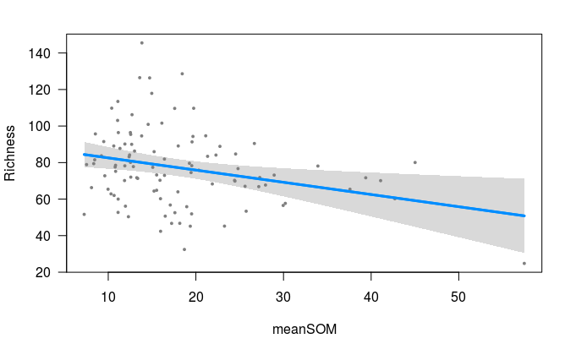
Which variables are correlated with richness?
Mean dbh
Positive Heterogeneity Indices
Area-ratio (area/perimeter)
Number of NVC codes
Mean tree density
Mean soil organic matter

Slide 9
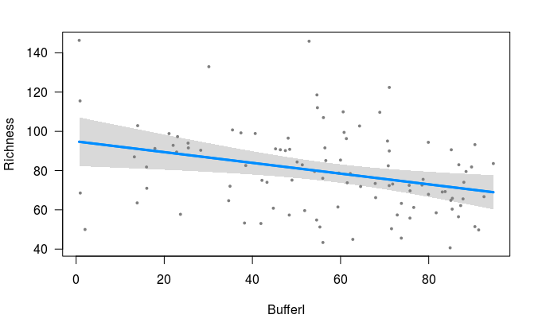
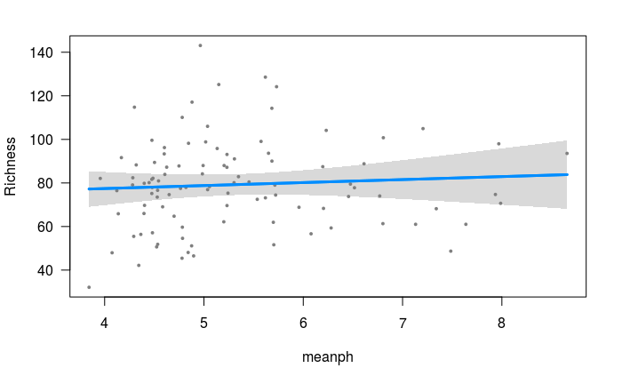
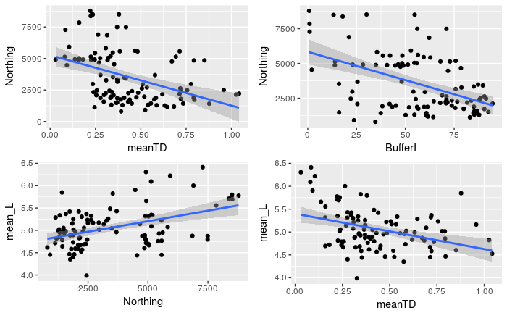
On the reserves bench?
Arable/urban/hort buffer
Mean pH
Mean TD
Northing
Buffer

