Slide 1
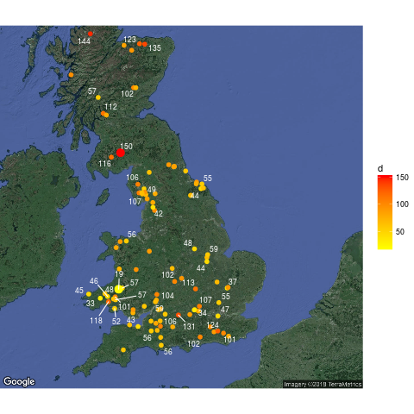

Exploring environmental factors influencing vascular plant species richness in UK Woodlands.
103 woods
16 plots in each wood
5 nests in each plot, 4, 10,25,50,100,200 m2
Bunce and Shaw, 1971
Repeated 2003, Kirby et al, Long Term Ecological change in British woodland (1971 -2001)

Slide 2
What factors influence richness?
Shape – core forest habitats contain poorly dispersing species (Kimberley et al 2014)
Heterogeneity – Plantation management (Hartley et al 2002)
Small scale disturbance is the most important factor for species richness in tropical forests (Philips 1994)
Habitat heterogeneity more important than area in Hungarian reserves (Baldi and Sadler 2008)
Patch age in Belgium (Honnay et al 1999)
Ancient woodland have more species, recent wood in contact with ancient woods have more species (Peterken and Game 1984)
Past land use, grazing, connectivity, species pool, anthropogenic...

Slide 3
Bunce survey shows reduction in richness from 1971 – 2000 associated with
Increase in live basal area
Reduction in open habitats
Reduced number of saplings
Increase in Beech, Yew, Holly
Shift to shaded assemblages
Where 1987 storm tracked, species richness increased

Slide 4
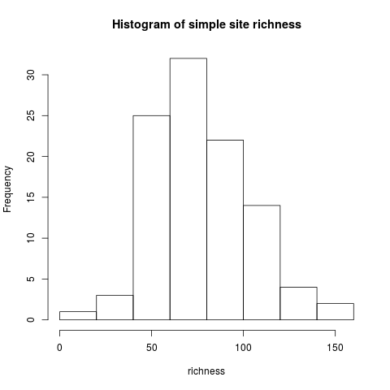

Slide 5
Comparison of best and worse sites
 | Site 78 R = 19 | Site 83 R = 150
Mean DBH | 19.04 No plots = 0 | 11.96 6 plots = 0
altitude | 262 | 108
Area (ha) | 14 | 6.8
Perimeter | 1700 | 1270
%Positive buffer zones | 45/43/51 | 44/46/42
Positive site codes | 10 | 17
Negative site codes | 2 | 3
Designations | AW | SSSI/SAC
Live basal area (m2) | 14.03 | 7.25
 | Site 78 | Site 83
NVC code | W15,W16 | W10,OV27,MG7,W6
SOM | 12.98 | 13.84
pH | 4-5.1 | 4 - 5
Aspect | 13/16 E to W | 13/14 plots ESE to WSW
MSG | 3/5 | 3/5
W6 Alnus glutinosa, Urtica dioica Wet woodland
W10Quercu robur, Pteridium aquilinum, Rubus fruticosus
OV27 Epilobium angustifolium community Open habitat community
MG7 Lolium perenne leys and grasslands Mesotrophic grasslands
W15 Fagus sylvatica/Deschampia flexuosa
W16 Quercus spp, Betula spp D.flexuosa

Slide 6
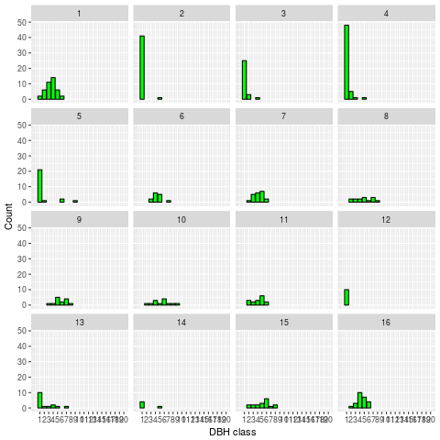
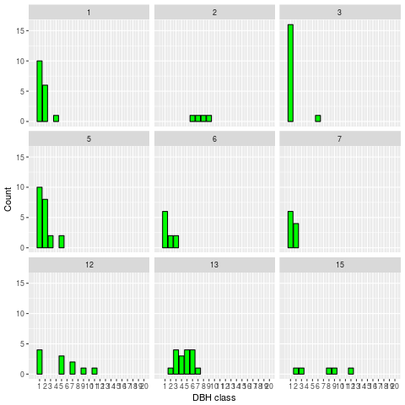
DBH distributions
Site 78 (bad)
Site 83 (good)

