Slide 1
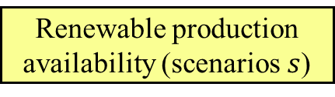
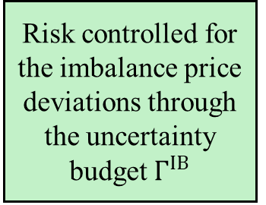
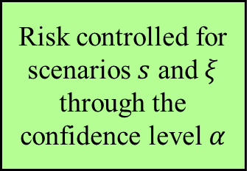

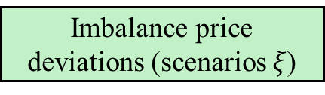

Stochastic programming
Renewable production availability (scenarios $s$)
Risk controlled for the imbalance price deviations through the uncertainty budget $Γ^{IB}$
$Dr\check{a}skovi\acute{c}$ et al. (2025)
Robust optimization
Imbalance price deviations
Stochastic programming
Renewable production availability (scenarios $s$)
Risk controlled for scenarios $s$ and $ξ$ through the confidence level $α$
This paper
Robust optimization
Imbalance price deviations (scenarios $ξ$)

