Slide 1
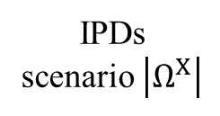

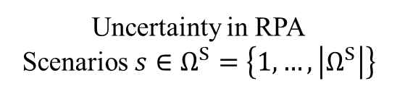
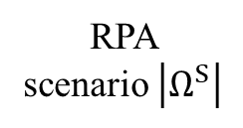



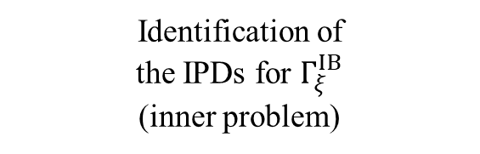






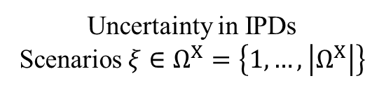

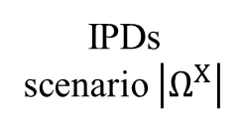

Uncertainty in RPA
Scenarios $s∈Ω^{S}=\left\{1, …,\left|Ω^{S}\right|\right\}$
Uncertainty in IPDs
Scenarios $ξ∈Ω^{X}=\left\{1, …,\left|Ω^{X}\right|\right\}$
IPDs scenario 1
$$π_{ξ=1}^{X}$$
$$Γ_{ξ=1}^{IB}$$
$$π_{s=1}^{S}$$
RPA scenario 1
$$π_{ξ=\left|Ω^{X}\right|}^{X}$$
IPDs
scenario $\left|Ω^{X}\right|$
$$RES_{t,s=1}^{R,IB}$$
$$Γ_{ξ=\left|Ω^{X}\right|}^{IB}$$
$$π_{s=\left|Ω^{S}\right|}^{S}$$
IPDs scenario 1
$$π_{ξ=1}^{X}$$
RPA
scenario $\left|Ω^{S}\right|$
$$Γ_{ξ=1}^{IB}$$
$$RES_{t,s=\left|Ω^{S}\right|}^{R,IB}$$
$$π_{ξ=\left|Ω^{X}\right|}^{X}$$
IPDs
scenario $\left|Ω^{X}\right|$
$$Γ_{ξ=\left|Ω^{X}\right|}^{IB}$$
Day-ahead market scheduling
(1st stage)
Imbalance rescheduling
(2nd stage)
Identification of
the IPDs for $Γ_{ξ}^{IB}$
(inner problem)

