Slide 1
Virtual Cursors for XML Joins
Beverly Yang (Stanford)
Marcus Fontoura, Eugene Shekita
Sridhar Rajagopalan, Kevin Beyer
CIKM’2004

Slide 2
Motivation
article
//article//section[
//title contains(‘Query Processing’) AND
//figure//caption contains(‘XML’)]
section
title
figure
“Query Processing”
caption
“XML”
In an index-based method, 8 tags and text elements need to be verified to process this query
Virtual cursors allows us to reduce the size of the input data by looking only at leaf nodes

Slide 3
Our Contributions
Virtual cursors improve runtime performance by more than an order of magnitude by eliminating I/O
Virtual cursors can be used by existing algorithms for structural and holistic twig joins
Overhead of path indices and ancestor information is subsumed by the advantages of virtual cursors

Slide 4
Agenda
Background
Virtual cursors algorithm
Experimental results
Conclusions

Slide 5
Position Encoding
Scheme #1: Begin/End/Level
  Begin: preorder position of tag/text
  End: preorder position of last descendent
  Level: depth
  Containment: X contains Y iff
  X.begin < Y.begin <= X.end (assuming well-formed)
R
(0,7,0)
(1,5,1)
A1
B3
(6,7,1)
(3,5,2)
B1
B2
C2
(7,7,2)
(2,2,2)
(4,4,3)
C1
D1
(5,5,3)

Slide 6
Position Encoding
Scheme #2: Dewey
  Position of element E = {position of parent}.n, where E is the nth child of its parent
  Containment: X contains Y iff X is a prefix of Y
R
(1)
(1.1)
A1
B3
(1.2)
(1.1.2)
B1
B2
C2
(1.2.1)
(1.1.1)
(1.1.2.1)
C1
D1
(1.1.2.2)

Slide 7
Position Encoding
Begin/End/Level
  Typically more compact
  Fewer implementation issues
Dewey
  Encodes positions of all ancestors

Slide 8
Path Index
Path ID
/R 1
/R/A 2
/R/A/B 3
/R/A/B/C 4
/R/A/B/D 5
/R/B 6
/R/B/C 7
R
A1
B3
B1
B2
C2
C1
D1
Path Pattern -> Set of matching path IDs
/R/B -> {6}
//R//C -> {4, 7}
Notes:
Describe how we actually use path index to speed up processing later…
Maybe point out the obvious usage, e.g., for path queries
Point out how every position (e.g., B2) is associated with a single path id (e.g., 3)
Mention tradeoffs?
Cons: Space of path table AND postings, time to process index
Pros: enables path twig join and virtual iterators, which can have enormous benefits

Slide 9
Basic Access Path
Inverted lists
  Posting: <Token, Location, Data>
  Token = <term/tag>
  Location = <DocumentID, Position>
  Data = <>
Supported methods on cursor:
  C_{B}.advance()
  C_{B}.fwdBeyond(Position p)
  C_{B}.fwdToAncestor(Position p)
R
A1
B3
B1
B2
C2
C1
D1
B1
B2
B3
C1
C2

Slide 10
Joins in XML
Structural (Containment) Joins
Twig Joins
A
||
B
B
||
C
B
||
D
A
||
B
A
||
B
||
C
||
||
C
D
Notes:
Many xml queries are branching expressions, therefore efficiently processing twig joins is an important aspect of any xml query processor

Slide 11
LocateExtension
“Extension” (w.r.t. query node q) – a solution for the subquery rooted at q
Input: q
Result: the cursors of all descendants of q point to an extension for q
A
A
||
B
B1
B3
D1
||
||
C1
X1
X2
D2
C
D
C2

Slide 12
LocateExtension
While (not end(q) && not hasExtension(q)) {
(p, c) = PickBrokenEdge(q);
ZigZagJoin(p, c);
}
A
A
||
B
B1
B3
D1
||
||
C1
X1
X2
D2
C
D
C2

Slide 13
Virtual Cursors
Observe
  Every useful position in a non-leaf query node is an ancestor of some leaf position
GetAncestors()
  Given a position P, return all ancestor positions of P
  Data: A1 – B1 – A2 – C1
  getAncestors(C1) = {A1, B1, A2}
  Dewey: already encoded in position
  Begin/End/Level: not simple, extra work is needed

Slide 14
Join Points
GetLevels()
  Input: Path ID, tag
  Output: all ancestor levels at which this tag occurs
  Path: A – B – A – C
  PathID = 3
  GetLevels(3, “A”) = {1, 3}

Slide 15
Virtual Cursor Algorithm
VirtualFwdToAncestor(Position p)
//C is the implicit parameter “this”
AncArray = GetAncestors(p);
LevelArray = GetLevels(p.PID, C.token)
for (i=1; i < AncArray.length(); i++) {
if (AncArray[i] < C.pCur)
continue;
if (AncArray[i].level not in LevelArray)
continue;
C.pCur = AncArray[i];
return C.pCur;
}
return invalidPosition;

Slide 16
Example
C_{A}.VirtualFwdToAncestor(B₁)
root
A_{x}
A_{y}
Position
ZERO
A₁
A₉₉
A₁₀₀
B₁
B₂
  GetAncestors(B1) = {root, A_{y}, A₉₉}
  Path root-A-A-B has PathID x, GetLevels(x, A) = {2, 3}
  For i = 1, AncArray[1].level = 1, which is not in LevelArray = {2, 3}
  For i = 2, both conditions hold, first answer for //A//B

Slide 17
LocateExtension Revisited
While (not end(q) && not hasExtension(q)) {
l = PickBrokenLeaf(q);
A = ancestors of l under q;
amax = maxarg { Ca | a is in A };
Cl.fwdBeyond(Camax);
for each a in A
Ca.virtualFwdToAncestor(Cl);
}
While (not end(q) && not hasExtension(q)) {
(p, c) = PickBrokenEdge(q);
ZigZagJoin(p, c);
}

Slide 18
Evaluation
Proved that with exception of invalid positions, every position returned by a virtual cursor would also be returned by a physical cursor
  Typically much fewer positions are returned for virtual cursors
No additional I/O

Slide 19
Performance Analysis
employee
Structural join: employee//name
name
No PathIDs and no ancestor information
Emp
Name

Slide 20
Performance Analysis
employee
Structural join: employee//name
name
With PathIDs and no ancestor information
Emp
Name

Slide 21
Performance Analysis
employee
Structural join: employee//name
name
No PathIDs but with ancestor information
Emp
Name

Slide 22
Performance Analysis
emloypee
Structural join: employee//name
name
PathIDs and ancestor information
Emp
Name

Slide 23
Performance Analysis
emloypee
Structural join: employee//name
name
PathIDs and ancestor information with
Virtual Cursors
Name

Slide 24
Prototype
Implemented over Berkeley DB B-tree
Inverted lists
  Posting: <Token, Location, Data>
  Token = <term/tag>
  Location = <DocumentID, Position>
    Position is either BEL or Dweye
  Data = <Path ID> or <>

Slide 25
Data Sets
Xmark
  10 documents of size ~ 100MB each
Synthetic
  7 tags: A, B, …, G
  Uncorrelated, no self-nesting
  Frequency
  A = B = C = D = X
  E = X/10
  F = X/100
  G = X/1000

Slide 26
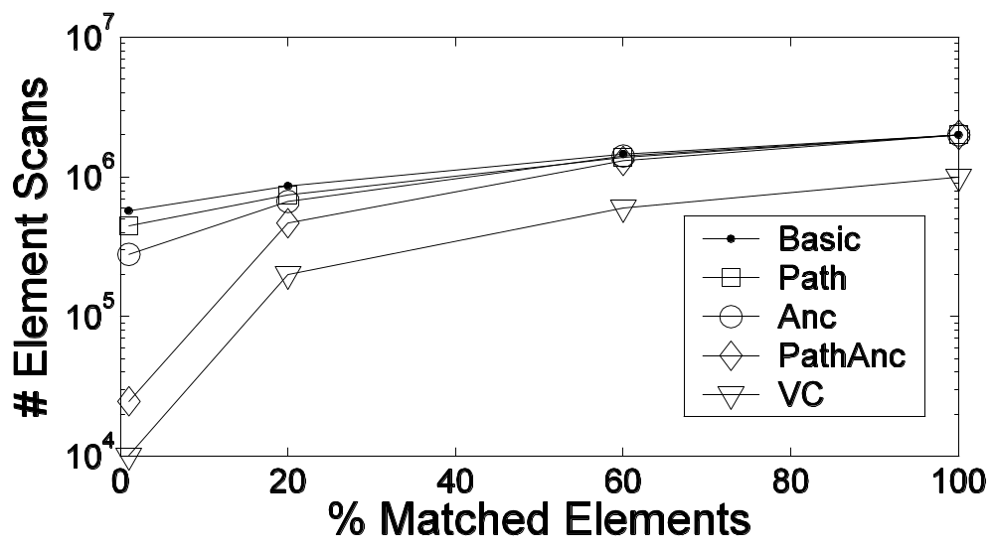
Experimental Results
//employee//name

Slide 27
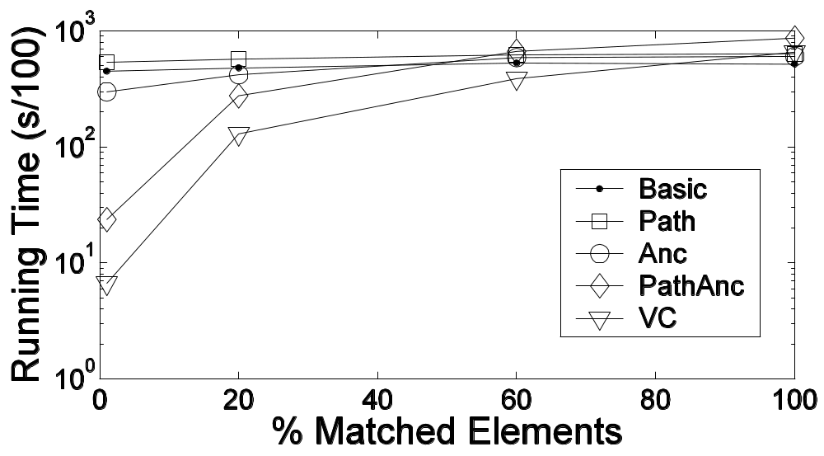
Experimental Results
//employee//name

Slide 28
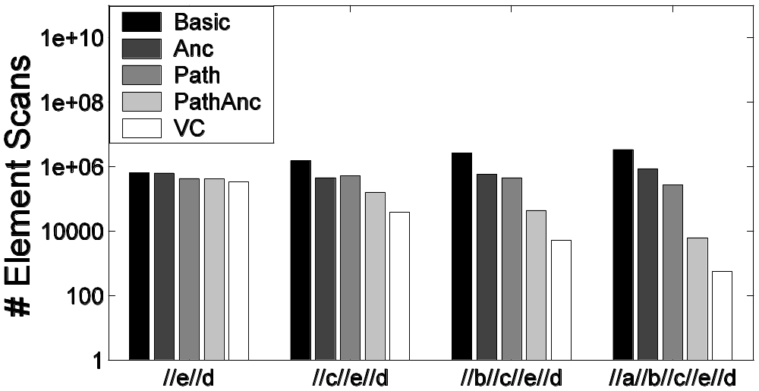
Experimental Results
//δ//e//d

Slide 29
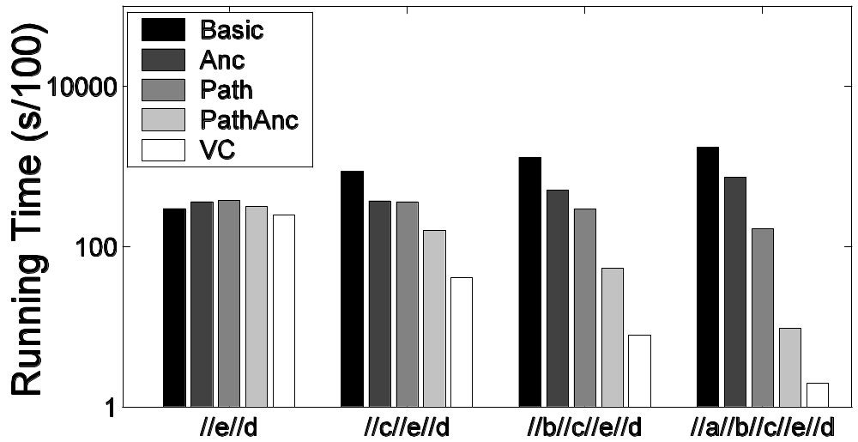
Experimental Results
//δ//e//d

Slide 30
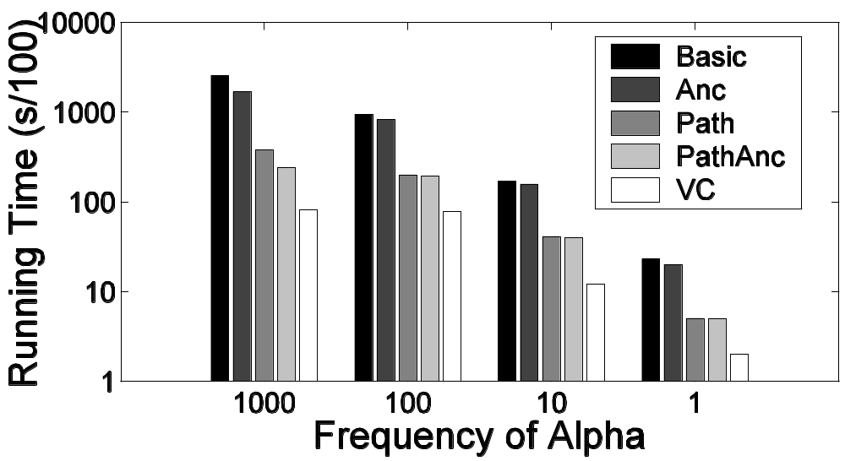
Experimental Results
//α//A//B//C

Slide 31
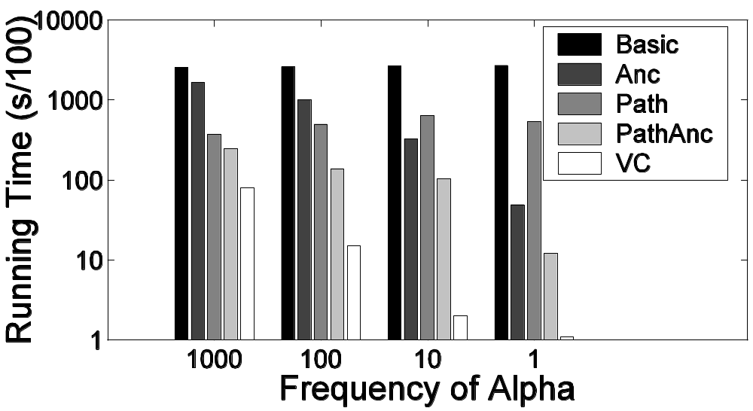
Experimental Results
//A//B//C//α

Slide 32
Experimental Results
Works better if elements in the dataset are uncorrelated
  //employee//name
Deeper queries the better for virtual cursors algorithm (more internal nodes)
Selective join at the bottom of the query the better, since we use only leaf nodes

Slide 33
Overhead of Index Features
Uncompressed (Xmark)
  BEL 463 MB, 115.4 s
  Dewey 538 MB, 117.7 s
Path index incurs in no overhead for text centric datasets (size, index build time, and runtime)
  Higher cost comes from integrating path information into the inverted index
Overall the overhead of index features is small, but grows with the dataset depth

Slide 34
Conclusion
Virtual cursors reduce the size of the input data by using only leaf nodes
Easily integrated in current structural and holistic twig join algorithms
Overhead of index features (path indices and ancestor information) is acceptable
Path indices and ancestor information combined produce better results

Slide 35
More details
http://www.almaden.ibm.com/cs/people/fontoura/papers/cikm2004.pdf

