Slide 1
Querying XML streams in DB2
Vanja Josifovski
Marcus Fontoura
Knowledge Management Dept.
IBM Almaden Research Center

Slide 2
Agenda
Motivation and background
  SQL/XML, XPath, XQuery, XML streams
TurboXPath (TXP)
  TXP role in DB2
  Design
  Evaluation results
Conclusions and future work
Other research areas

Slide 3
Motivation
Current trends in DBMS:
  New XML data type and a set of new XML-related operators
  XML-enabled integration system
  Queries over locally stored XML data and XML data streamed from external sources
  Web services and business-to-business applications
Querying XML (streams) is essential

Slide 4
SQL/XML
SQL - Part 14 - XML related specifications (SQL/XML)
  http://www.sqlx.org
New XML data type
Publishing functions
  XMLElement, XMLAttribute, XMLAgg
Querying functions
  XMLContains, XMLExtract, XMLTable (shred)

Slide 5
XPath
XML query language defined by W3C working group
  Operates over a single document (no joins)
  Single extraction point, returning a node set
XPath examples
  //customer
  //customer/@id
  //customer[birthdate=‘07/25/1970’]/name
  //customer[address[state=‘CA’]]

Slide 6
XQuery (1/2)
Also defined by W3C working group
Extends XPath for
  Processing several XML documents (joins)
  Constructing XML results
  Can return multiple node sets
FLWR (flower) is the most common type of expression

Slide 7
XQuery (2/2)
XQuery example
FOR $c IN document("doc1.xml")//customer
FOR $p IN document("doc2.xml")//profiles[cid=$c/cid()]
LET $o := $c/order
WHERE $o/date = '12/12/01'
RETURN
<result>
{$c/name} {$p/status} {$o/amount}
</result>

Slide 8
XML Streams
Applications need to store XML documents in relational databases
as XML
as relational data
Example
  Web services
Web Services
Applications
Streamed XML
DB2
XQuery
XSLT
TurboXPath

Slide 9
TXP role in DB2 (1/3)
XML Enabled
Runtime
xml fragments/
column values
context
XPath/XQuery
XML Indexing
XPath-based Interface
XML Storage
TXP
XML Streams Web Services
Textual XML
TXP
TXP

Slide 10
TXP role in DB2 (2/3)
Table accesses in traditional query evaluation pipelines
Returns virtual tables of XML columns
Example
FOR $c IN document("doc1.xml")//customer
FOR $p IN document("doc2.xml")//profiles[cid=$c/cid()]
LET $o := $c/order
WHERE $o/date = '12/12/01'
RETURN
<result>
{$c/name} {$p/status} {$o/amount}
</result>

Slide 11
TXP role in DB2 (3/3)
name
amount
status
XML generation
operators
name
amount
status
cid = cid
cid
name
amount
cid
status
doc1//customer
doc2//profile
cid
name
order
cid
status
amount
date

Slide 12
TurboXPath (TXP)
Processing of multiple XPath expressions:
  One pass over the XML document
  Document order (pre-order) traversal
  No need to build a DOM tree in memory
  Results emitted as found in the document
Efficient over:
  XML streams
  Pre-parsed XML documents

Slide 13
TXP Features (1/2)
Forward axes (child ‘/’, descendant ‘//’)
Backward axes (parent ‘..’ and ancestor)
  Query rewrites over streams
Predicates (Boolean and positional)
  /a/b[c + d > 5 or .//e]
  //a[5] - currently being implemented
‘Any’ node test
  //contributors/*/name

Slide 14
TXP Features (1/2)
Multiple extraction points (tuples):
  //customer[name and address and phone] return tuples <name, address, phone>
  Subset of FOR-LET-WHERE over a single document
  Very common case in the XQuery use doc
Current supports most of XPath 1.0
Recursive XML input documents

Slide 15
TXP Architecture
Output tuples
TXP
Tuple constructor/
Buffer management
Evaluator
Expression
parser
SAX Event
Handlers
Document
Walker
Input path
expressions
XML
stream
Pre-parsed
XML (stored)

Slide 16
TXP internals: evaluator
Parse tree - static
  Structural tree
  Predicate trees
Work array - dynamic
  State of the evaluator
  In-lined tree document
Buffers
  Results (copy or reference)
  Predicate evaluation (copy)
  Discard when not needed
parse tree
work array
r
T
r
0
a
T
a
1
b
F
(c +d > 5 or e)
b
...
2
c
T
c1
d1
c
d
e
3
c2
d
T
c3
3
c1
e1
e
T
predicate
buffers
c2
e2
*
c3
...
sibling
group
output
buffers
Query: /a/b[$c + d > 5 or .//$e]

Slide 17
Execution example (1)
Input XML
Query: //a[c]//b
<a>
<c>c1</c>
<b>b1</b>
</a>
...
initial work array with one entry
r
r
F
r
F
0
0
a
F
status flag
*
Parse tree
document level
parse tree
pointer
r
(c and b)
a
c
b
b buffers:
none

Slide 18
Execution example (2)
Input XML
Query: //a[c]//b
<a>
<c>c1</c>
<b>b1</b>
</a>
...
r
a
r
F
r
F
r
F
0
0
0
a
F
a
F
*
*
c
F
2
Parse tree
b
F
*
r
(c and b)
a
c
b
b buffers:
none

Slide 19
Execution example (3)
Input XML
Query: //a[c]//b
<a>
<c>c1</c>
<b>b1</b>
</a>
...
r
a
c
r
F
r
F
r
F
r
F
0
0
0
0
a
F
a
F
a
F
*
*
*
c
F
c
T
2
2
Parse tree
b
F
b
F
*
*
r
(c and b)
a
c
b
b buffers:
none

Slide 20
Execution example (4)
Input XML
Query: //a[c]//b
<a>
<c>c1</c>
<b>b1</b>
</a>
...
r
a
c /c
r
F
r
F
r
F
r
F
0
0
0
0
a
F
a
F
a
F
*
*
*
c
F
c
T
2
2
Parse tree
b
F
b
F
*
*
r
(c and b)
a
c
b
b buffers:
none

Slide 21
Execution example (4)
Input XML
Query: //a[c]//b
<a>
<c>c1</c>
<b>b1</b>
</a>
...
r
a
c /c b
r
F
r
F
r
F
r
F
0
0
0
0
a
F
a
F
a
F
*
*
*
c
F
c
T
2
2
Parse tree
b
F
b
F
*
*
r
(c and b)
a
c
b
b buffers:
1.<b>

Slide 22
Execution example (5)
Input XML
Query: //a[c]//b
<a>
<c>c1</c>
<b>b1</b>
</a>
...
r
a
c /c b
/b
r
F
r
F
r
F
r
F
r
F
0
0
0
0
0
a
F
a
F
a
F
a
F
*
*
*
*
c
F
c
T
c
T
2
2
2
Parse tree
b
F
b
F
b
T
*
*
*
r
(c and b)
a
c
b
b buffers:
1. <b>b1</b>

Slide 23
Execution example (6)
Input XML
Query: //a[c]//b
<a>
<c>c1</c>
<b>b1</b>
</a>
...
r
a
c /c b
/b
/a
r
F
r
F
r
F
r
F
r
F
r
T
0
0
0
0
0
0
a
F
a
F
a
F
a
F
a
T
*
*
*
*
*
c
F
c
T
c
T
2
2
2
Parse tree
b
F
b
F
b
T
*
*
*
r
(c and b)
a
c
b
b buffers:
1. <b>

Slide 24
Recursive execution example (1)
Input XML
Query: //a[c]//b
<a>
<a>
<c>c1</c>
<b>b1</b>
</a>
<b>b2</b>
</a>
<a>
...
r
r
F
r
F
0
0
a
F
*
Parse tree
r
(c and b)
a
c
b
b buffers:
none

Slide 25
Recursive execution example (2)
Input XML
Query: //a[c]//b
<a>
<a>
<c>c1</c>
<b>b1</b>
</a>
<b>b2</b>
</a>
<a>
...
r
a
r
F
r
F
r
F
0
0
0
a
F
a
F
*
*
c
F
2
Parse tree
b
F
*
r
(c and b)
a
c
b
b buffers:
none

Slide 26
Recursive execution example (3)
Input XML
Query: //a[c]//b
<a>
<a>
<c>c1</c>
<b>b1</b>
</a>
<b>b2</b>
</a>
<a>
...
r
a
a
r
F
r
F
r
F
r
F
0
0
0
0
a
F
a
F
a
F
*
*
*
c
F
c
F
2
2
Parse tree
b
F
b
F
*
*
r
c
F
3
(c and b)
a
b
F
*
c
b
b buffers:
none

Slide 27
Recursive execution example (4)
Input XML
Query: //a[c]//b
<a>
<a>
<c>c1</c>
<b>b1</b>
</a>
<b>b2</b>
</a>
<a>
...
r
a
a
c
r
F
r
F
r
F
r
F
r
F
0
0
0
0
0
a
F
a
F
a
F
a
F
*
*
*
*
c
F
c
F
c
F
2
2
2
Parse tree
b
F
b
F
b
F
*
*
*
r
c
F
c
T
3
3
(c and b)
a
b
F
b
F
*
*
c
b
b buffers:
none

Slide 28
Recursive execution example (5)
Input XML
Query: //a[c]//b
<a>
<a>
<c>c1</c>
<b>b1</b>
</a>
<b>b2</b>
</a>
<a>
...
r
a
a
c /c
r
F
r
F
r
F
r
F
r
F
0
0
0
0
0
a
F
a
F
a
F
a
F
*
*
*
*
c
F
c
F
c
F
2
2
2
Parse tree
b
F
b
F
b
F
*
*
*
r
c
F
c
T
3
3
(c and b)
a
b
F
b
F
*
*
c
b
b buffers:
none

Slide 29
Recursive execution example (6)
Input XML
Query: //a[c]//b
<a>
<a>
<c>c1</c>
<b>b1</b>
</a>
<b>b2</b>
</a>
<a>
...
r
a
a
c /c
b
r
F
r
F
r
F
r
F
r
F
r
F
0
0
0
0
0
0
a
F
a
F
a
F
a
F
a
F
*
*
*
*
*
c
F
c
F
c
F
c
F
2
2
2
2
Parse tree
b
F
b
F
b
F
b
F
*
*
*
*
r
c
F
c
T
c
T
3
3
3
(c and b)
a
b
F
b
F
b
F
*
*
*
c
b
b1 buffer
open
b buffers:
1. <b>

Slide 30
Recursive execution example (7)
Input XML
Query: //a[c]//b
<a>
<a>
<c>c1</c>
<b>b1</b>
</a>
<b>b2</b>
</a>
<a>
...
r
a
a
c /c
b
/b
r
F
r
F
r
F
r
F
r
F
r
F
r
F
0
0
0
0
0
0
0
a
F
a
F
a
F
a
F
a
F
a
F
*
*
*
*
*
*
c
F
c
F
c
F
c
F
c
F
2
2
2
2
2
Parse tree
b
F
b
F
b
F
b
F
b
T
*
*
*
*
*
r
c
F
c
T
c
T
c
T
3
3
3
3
(c and b)
a
b
F
b
F
b
F
b
T
*
*
*
*
c
b
b1 buffer
open
b buffers:
1. <b>b1</b>

Slide 31
Recursive execution example (8)
Input XML
Query: //a[c]//b
<a>
<a>
<c>c1</c>
<b>b1</b>
</a>
<b>b2</b>
</a>
<a>
...
r
a
a
c /c
b
/b
/a
r
F
r
F
r
F
r
F
r
F
r
F
r
F
r
T
0
0
0
0
0
0
0
0
a
F
a
F
a
F
a
F
a
F
a
F
a
T
*
*
*
*
*
*
*
c
F
c
F
c
F
c
F
c
F
c
F
2
2
2
2
2
2
Parse tree
b
F
b
F
b
F
b
F
b
T
b
T
*
*
*
*
*
*
r
c
F
c
T
c
T
c
T
3
3
3
3
(c and b)
a
b
F
b
F
b
F
b
T
*
*
*
*
c
b
b1 buffer
open
b1 buffer
close
b buffers:
1. <b>b1</b>

Slide 32
Recursive execution example (9)
Input XML
Query: //a[c]//b
<a>
<a>
<c>c1</c>
<b>b1</b>
</a>
<b>b2</b>
</a>
<a>
...
r
a
a
c /c
b
/b
/a
b
r
F
r
F
r
F
r
F
r
F
r
F
r
F
r
T
r
T
0
0
0
0
0
0
0
0
0
a
F
a
F
a
F
a
F
a
F
a
F
a
T
a
T
*
*
*
*
*
*
*
*
c
F
c
F
c
F
c
F
c
F
c
F
c
F
2
2
2
2
2
2
2
Parse tree
b
F
b
F
b
F
b
F
b
T
b
T
b
T
*
*
*
*
*
*
*
r
c
F
c
T
c
T
c
T
3
3
3
3
b2 buffer open
(c and b)
a
b
F
b
F
b
F
b
T
*
*
*
*
c
b
b1 buffer
open
b1 buffer
close
b buffers:
1. <b>b1</b>
2. <b>

Slide 33
Recursive execution example (10)
Input XML
Query: //a[c]//b
<a>
<a>
<c>c1</c>
<b>b1</b>
</a>
<b>b2</b>
</a>
<a>
...
r
a
a
c /c
b
/b
/a b /b
r
F
r
F
r
F
r
F
r
F
r
F
r
F
r
T
0
0
0
0
0
0
0
0
a
F
a
F
a
F
a
F
a
F
a
F
a
T
*
*
*
*
*
*
*
c
F
c
F
c
F
c
F
c
F
c
F
2
2
2
2
2
2
Parse tree
b
F
b
F
b
F
b
F
b
T
b
T
*
*
*
*
*
*
r
c
F
c
T
c
T
c
T
3
3
3
3
b2 buffer open/close
(c and b)
a
b
F
b
F
b
F
b
T
*
*
*
*
c
b
b1 buffer
open
b1 buffer
close
b buffers:
1. <b>b1</b>
2. <b>b2</b>

Slide 34
Recursive execution example (11)
Input XML
Query: //a[c]//b
<a>
<a>
<c>c1</c>
<b>b1</b>
</a>
<b>b2</b>
</a>
<a>
...
r
a
a
c /c
b
/b
/a b /b
/a
r
F
r
F
r
F
r
F
r
F
r
F
r
F
r
T
r
T
0
0
0
0
0
0
0
0
0
a
F
a
F
a
F
a
F
a
F
a
F
a
T
a
T
*
*
*
*
*
*
*
*
c
F
c
F
c
F
c
F
c
F
c
F
2
2
2
2
2
2
b2 removed
b1 emitted, removed
Parse tree
b
F
b
F
b
F
b
F
b
T
b
T
*
*
*
*
*
*
r
c
F
c
T
c
T
c
T
3
3
3
3
b2 buffer open/close
(c and b)
a
b
F
b
F
b
F
b
T
*
*
*
*
c
b
b1 buffer
open
b1 buffer
close
b buffers:
none

Slide 35
Recursive execution example (12)
Input XML
Query: //a[c]//b
<a>
<a>
<c>c1</c>
<b>b1</b>
</a>
<b>b2</b>
</a>
<a>
...
r
a
a
c /c
b
/b
/a b /b
/a
a
r
F
r
F
r
F
r
F
r
F
r
F
r
F
r
T
r
T
r
T
0
0
0
0
0
0
0
0
0
0
a
F
a
F
a
F
a
F
a
F
a
F
a
T
a
T
a
T
*
*
*
*
*
*
*
*
*
c
F
c
F
c
F
c
F
c
F
c
F
c
F
2
2
2
2
2
2
2
Parse tree
b
F
b
F
b
F
b
F
b
T
b
T
b
F
*
*
*
*
*
*
*
r
c
F
c
T
c
T
c
T
3
3
3
3
(c and b)
a
b
F
b
F
b
F
b
T
*
*
*
*
c
b
b buffers:
none

Slide 36
Predicate evaluation
Separate parse tree for the predicates, attached at an anchor node in the structure tree
Evaluated when anchor node closed
Predicate parse tree leafs point into the structure parse tree
Predicate tree is traversed and evaluated

Slide 37
Predicate Pushdown
Single value predicates can be evaluated before the anchor node is closed:
Example: /x[a>b and c = 5]
r
a
r
a
>
>
x
and
b
x
and
b
=
a
b
c
a
b
c
c
5
=
c
5

Slide 38
Tuple construction using buffer annotations
Input XML
g output buffers
Fragment
Ancestor sets
<t> 1
<g>2</g>
<a>3
<b>4</b>
<c>5</c>
</a>
<a>6
<a>7
<b>8</b>
<c>9</c>
</a>
<c>10</c>
</a>
</t>
<t>11
<g>12</g>
</t>
...
r
<g>2</g>
ASt={1}
<g>12</g>
ASt={11}
t
b/text() output buffers
g
a
Fragment
Ancestor sets
b
c
4
ASt={1}; ASa={3}
8
ASt={1}; ASa={6,7}
c/text() output buffers
Result
Fragment
Ancestor sets
g
b/text()
c/text()
5
ASt={1}; ASa={3}
<g>2</g>
4
5
9
ASt={1}; ASa={7}
<g>2</g>
8
9
9
ASt={1}; ASa={6}
<g>2</g>
8
10

Slide 39
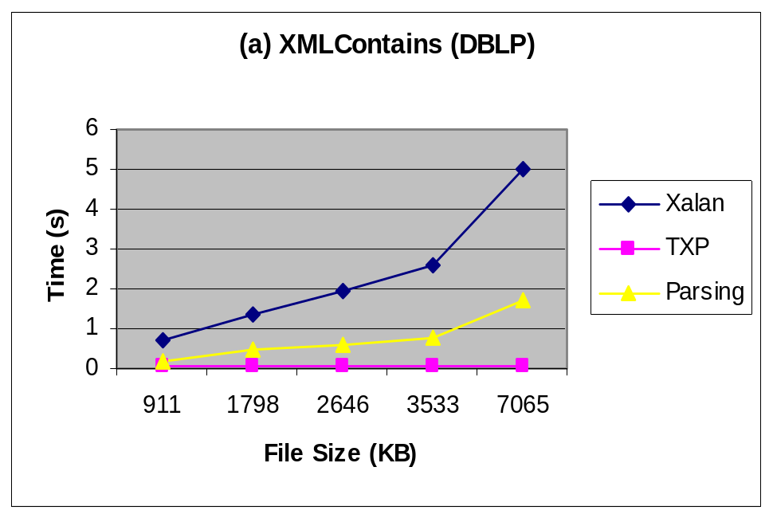
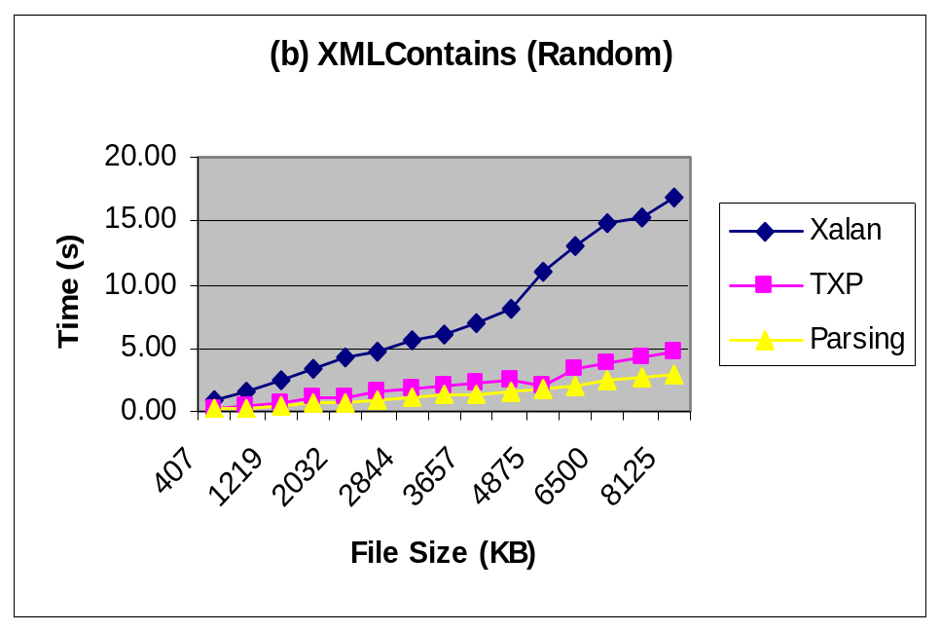
Evaluation (i)
XMLContains (Boolean query)

Slide 40
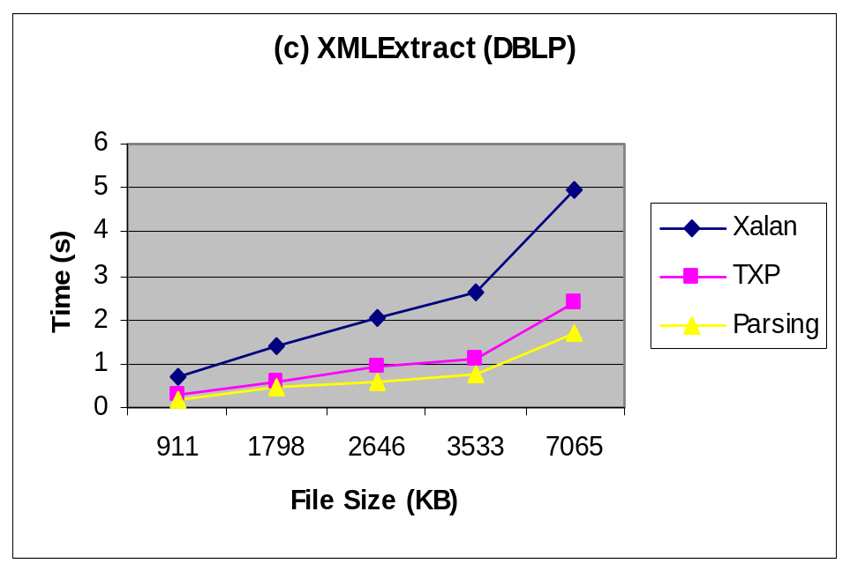
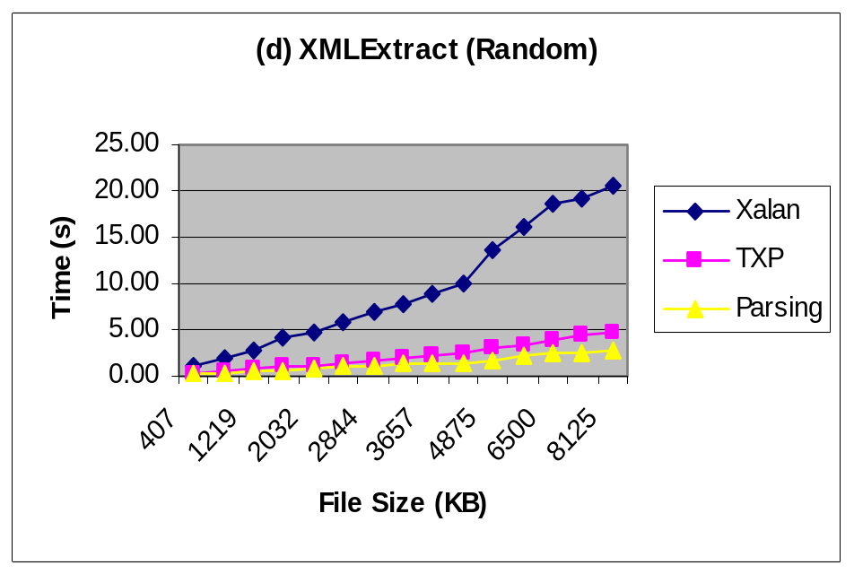
Evaluation (ii)
XMLExtract (single column extraction)

Slide 41
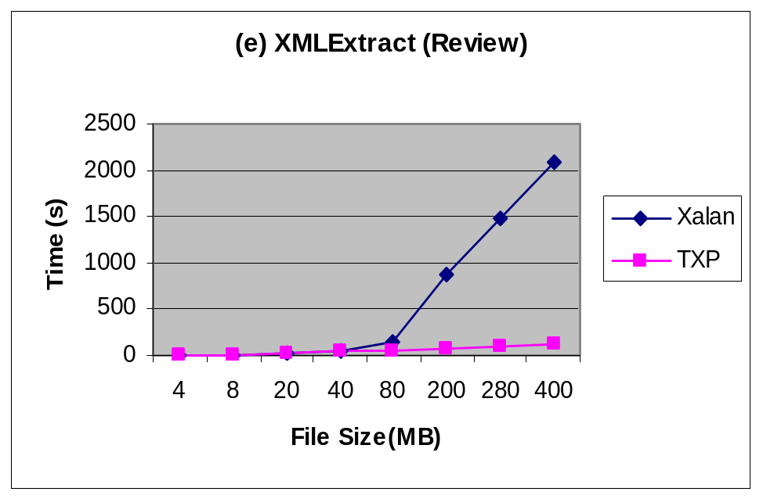
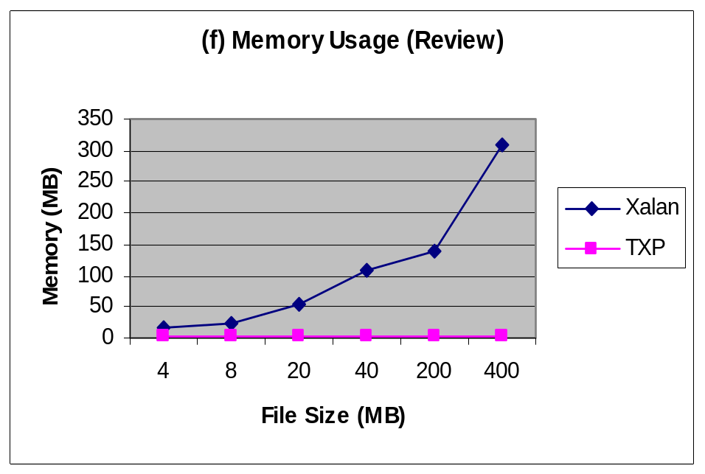
Evaluation (iii)
XMLExtract (over large files, outside DB2)

Slide 42
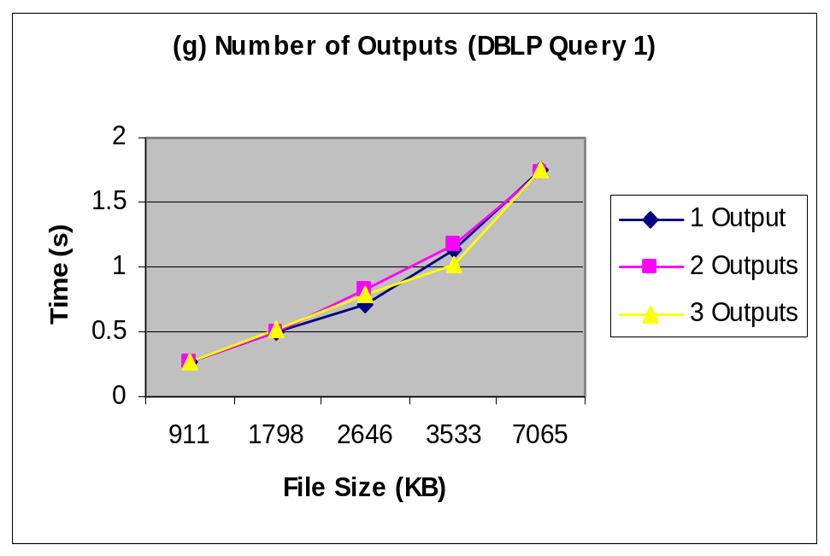
Evaluation (iv)
XMLTable (varying the number of columns)
Optimizer should generate plans that benefit from that

Slide 43
Conclusions and Future Work
TXP efficiently evaluates XPath/XQuery subset over XML streams and pre-parsed XML
  Low memory consumption
  Fast response time when compared to Xalan
Tuple construction mechanism is useful for efficiently evaluating predicates and FLWR expressions
Returns values (copy) or references (XID)
Works both over indexed (stored) XML and streamed XML using the same control structure
Deliverables for DB2: XMLWrapper, XML Storage, XML Loader/Shredder

Slide 44
Other research areas
SQL/XML
Automatic generation of taxonomies
  Lotus Discovery Server
Text indexing
  Intranet Search

Slide 45
Automatic Taxonomy Generation (1/2)
Unified model for taxonomy
  Each node (including intermediate nodes) model features that are common for the tree below
All features (including stopwords) are modeled in the taxonomy
Hybrid bottom-up and top-down scheme
Algorithm
  Start with an initial feasible solution (one level taxonomy)
  Merge nodes as appropriate (needed) to discover more abstract topics
  Split nodes as appropriate (needed) to find more refined topics

Slide 46
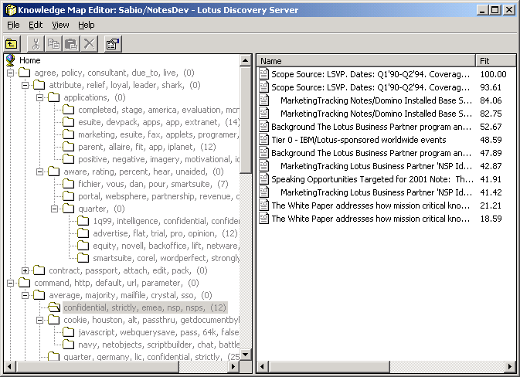
Automatic Taxonomy Generation (2/2)

