Slide 1

Yahoo! Research Overview
Marcus Fontoura
Prabhakar Raghavan, Head

Slide 2
Mission & Vision
Vision: Where the Internet’s future is invented
  with innovative economic models for advertisers, publishers and consumers.
Mission: Invent the
  Next generation Internet by defining the future media to
  Engage consumers and
  eXtend the economics for advertisers and publishers through new sciences that establish the
  Technical leadership of Yahoo!

Slide 3
How we get there
Scientific excellence
  World-recognized leadership through publications, keynotes, …
Business impact
  Tactical results from strategic behavior

Slide 4
Business needs vs. Disciplines
 | Text Retrieval | Machine Learning | Human Computer Interaction | Dist Computing | μEconomics
Advertising
Search + info
Social media
User experience

Slide 5
Business needs vs. Disciplines
 | Text Retrieval | Machine Learning | Human Computer Interaction | Dist Computing | Economics
Advertising | ✓ ✓ | ✓ ✓ | ✓ | ✓ ✓ | ✓ ✓
Search + info | ✓ ✓ | ✓ |  | ✓ ✓
Social media | ✓ | ✓ | ✓ ✓ | ✓ | ✓ ✓
User experience |  | ✓ | ✓ ✓

Slide 6
Where
LA
Silicon valley
Berkeley
New York
Barcelona, Spain
Santiago, Chile

Slide 7









http://buzz.research.yahoo.com
At Y!R, prediction market theory/science since 2002
Yahoo!,O’Reilly launched Buzz Game 3/05 @ETech
Buy “stock” in hundreds of technologies
Earn dividends based on actual search “buzz”
Exchange mechanism new invention

Slide 8
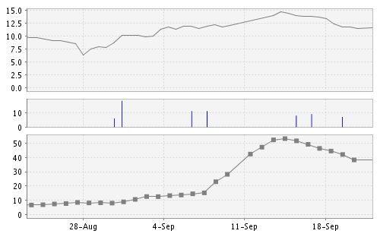
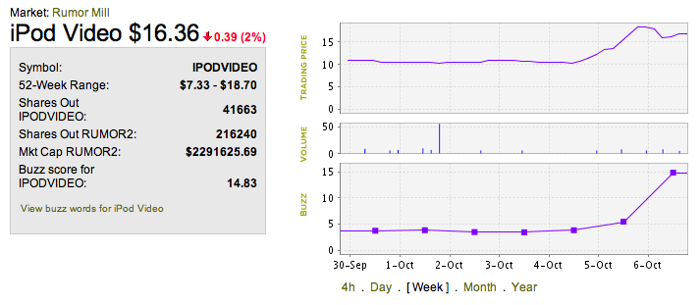
Technology forecasts
iPod phone
What’s next?
Another Apple unveiling: iPod Video?
price
10/6:
maybe not
search
buzz
10/5:
maybe
8/28: buzz gamers
begin bidding
up iPod phone
9/7: Apple
announces
Rokr
8/29: Apple
invites press
to “secret”
unveiling
9/8-9/18: searches
for iPod phone soar;
early buyers profit

Slide 9
Efficient Indexing of Shared Content in IR Systems
Andrei Broder, Nadav Eiron, Marcus Fontoura, Michael Herscovici, Ronny Lempel, John McPherson, Eugene Shekita, Runping Qi

Slide 10
Motivation
IR systems typically use inverted indices to facilitate efficient retrieval
Web, email, news, and other data contains significant amount of duplicated or shared content
Indexing duplicate content is expensive

Slide 11
Scope of Work
We assume duplicate or common content is already identified in the corpus
We concern ourselves only with the efficient indexing of such content

Slide 12
Types of Shared Content
Web duplicates:
  Very common – on the order of 40% of all pages
Email/news threads:
  Whole messages are often quoted
  Attachments are duplicated
  Identical messages in multiple mailboxes

Slide 13
Some Statistics
IBM Intranet has about 40% duplicate content. Internet crawls reveal similar statistics
In the Enron email dataset, 61% of messages are in threads. 31% quote other messages verbatim

Slide 14
Naïve Solution 1 :
Index Everything
Pros:
  Simple to implement
  Semantics are preserved
Cons:
  Index size blows up
  Performance penalty (big index + post filtering)

Slide 15
Naïve Solution 2:
Index Just One Copy
Pros:
  Best performance
  Not too difficult to implement
Cons:
  Only applies to the duplicates scenario
  Semantics are changed, and relevant results may not be returned for a query

Slide 16
The Web Duplicate Case:
Meta Data Vs. Content
Removal of web duplicates changes the semantics of the query
http://almaden.ibm.com/...
http://watson.ibm.com/...
text
text
Query: text url:watson

Slide 17
Our Solution
Content is split to shared and private parts
Shared content is indexed only once
Private content (such as metadata in the Web duplicates case) is indexed for each document
Index provides virtual cursors that simulate having all content indexed

Slide 18
Advantages
Index size, build time, and query efficiency
Precise semantics
No need for post-filtering

Slide 19
Inverted Indices
Index is sorted by term
For each term, a sorted list of documents in which it appears is maintained (postings list)
Each occurrence (posting) contains additional payload
T₁: <docid₁,payload>, <docid₂,payload>…
T₂: <docid₁,payload>, <docid₂,payload>…

Slide 20
Document Sharing Model
Each document is partitioned into private and shared content. The two types are differentiated by posting payload
Documents exist in a tree – shared content is shared with all descendents
Document IDs (and hence index order) are dictated by a DFS traversal of document trees

Slide 21
The Document Tree
Content is shared from ancestor to descendants:
<1,s>
<1, p>
1
<2, s>
<2, p>
2
4
<3, p>
3
5
6

Slide 22
Example:
Documents
Inverted index posting lists
docid = 1:
From: andrei
To: ronny, marcus
did you read it?
andrei: <1, p>
did: <1, s>, <2, s>
it: <1, s>
marcus: <1, p>, <2, p>, <2, s>, <3, p>
not: <3, s>
read: <1, s>
ronny: <1, p>,<2, p>, <3, p>
yet: <3, s>
you: <1, s>, <2, s>
docid = 2:
From: ronny
To: marcus
did you, marcus?
1
2
4
docid = 3:
From: marcus
To: ronny
not yet!
3
5
6

Slide 23
Querying Inverted Indexes
Queries contain mandatory terms, forbidden terms, and optional terms (such as +term1 –term2)
Typically a zigzag algorithm is used
Uses cursors on postings list. Cursors support two operations:
  next() – Moves to the next posting
  fwdBeyond(d) – Moves to the first posting for a document with id >= d

Slide 24
Top Level Query Algorithm
while (more results required) {
Invoke zigzag algorithm
Forward optional term cursors
Score document
Advance required/forbidden cursors
}
In our solution, this algorithm, uses virtual cursors

Slide 25
Additional Information In The Index
Tree information is encoded by two attributes for each document:
  root(d) – The docid for the document at the root of the tree containing d
  lastDescendent(d) – The highest-numbered document that is a descendent of d

Slide 26
fwdShared(d) example:
T:<1,p>, <3,p>, <5,p>, <6,s>, <8,s>
1
p
5
p
2
6
s
8
s
3
p
4
7
9
10
fwdShared(10)
fwdBeyond(lastDescendent(6)+1)
fwdBeyond(root(10))
next()

Slide 27
Virtual Cursors
Two types of cursors:
  Regular (positive) virtual cursors. These behave as if all shared content was indexed for all documents that contain it
  Negated virtual cursors, represent the complement of the postings list (used for forbidden terms)
Implemented on top of a physical cursor with the additional fwdShared method

Slide 28
Virtual Positive Cursors
Maintain a physical and logical positions. Support next() and fwdBeyond(d)
1
p
5
p
2
6
s
8
s
3
p
4
7
9
10
fwdBeyond(10)
next()

Slide 29
Virtual Negative Cursors
Support next() and fwdBeyond(d). Physical cursor ahead of logical cursor.
1
p
5
p
2
6
s
8
3
p
4
7
9
10
p
fwdBeyond(7)
next()

Slide 30
Web Duplicates Application
Trees are flat, with the masters at the root. Leaves only have private content:
docid = 1
root = 1
lastDescendant = 4
S₁
P₁
S₅
P₅
P₂
P₃
P₄
P₆
docid = 2
root = 1
lastDescendant = 2
docid = 3
root = 1
lastDescendant = 3
docid = 4
root = 1
lastDescendant = 4
docid = 6
root = 5
lastDescendant = 6

Slide 31
Build Performance Evaluation
Subsets of IBM Intranet (36-44% dups):
# docs | IS1 (GB) | IS2 (GB) | Space saved | IT1 (s) | IT2 (s) | Speedup
500K | 2.5 | 3.6 | 31% | 540 | 780 | 31%
1000K | 5.1 | 7.4 | 31% | 1020 | 1440 | 29%
1500K | 7.1 | 11.0 | 36% | 1500 | 2340 | 36%
2000K | 8.8 | 13.0 | 32% | 1800 | 2940 | 39%
2500K | 11.0 | 16.0 | 31% | 2160 | 3540 | 39%

Slide 32
Runtime Performance: Single Terms Queries

Slide 33
Runtime Performance: Two Term Queries

