Slide 1
Product Line Annotations with UML-F
Wolfgang Pree
Software Research Lab
Univ. of Salzburg
Austria
pree@acm.org
Marcus Fontoura
IBM Almaden
Research, San Jose
U.S.A.
mfontoura@acm.org
Bernhard Rumpe
Software Engineering
Munich Tech. University
Germany
rumpe@acm.org

Slide 2
Contents
Motivation
UML-F
  Presentation tags and basic modeling tags
  Tags for the essential framework construction principles
  GoF framework pattern tags
  Tags for other pattern catalogs and domain-specific patterns

Slide 3
Motivation
What is a profile?
Why UML-F?
Goals

Slide 4
What is a UML profile?
an extension of the UML standard language with specific elements
A profile provides
  new notational elements, and usually
  specializes the semantics of some elements.
  It may also restrict the use of UML elements.

Slide 5
Why UML-F?
It takes a considerable effort to learn and understand a framework. Standard UML does not offer the notational elements tailored to that purpose.
The extensions summarized as UML-F profile support framework development and adaptation. The UML-F profile focuses on pinpointing a framework’s variation points.

Slide 6
Goals of UML-F
UML-F provides the notational elements to precisely annotate and document design patterns.
UML-F is itself structured in the spirit of frameworks, i.e., an extensible profile.
UML-F comprises a lean, memonic set of notational elements.
UML-F relies on the UML standard, that is, UML-F extends UML using existing UML extension mechanisms.
The UML-F notational elements are adequate for being integrated in UML tool environments.

Slide 7
UML-F

Slide 8
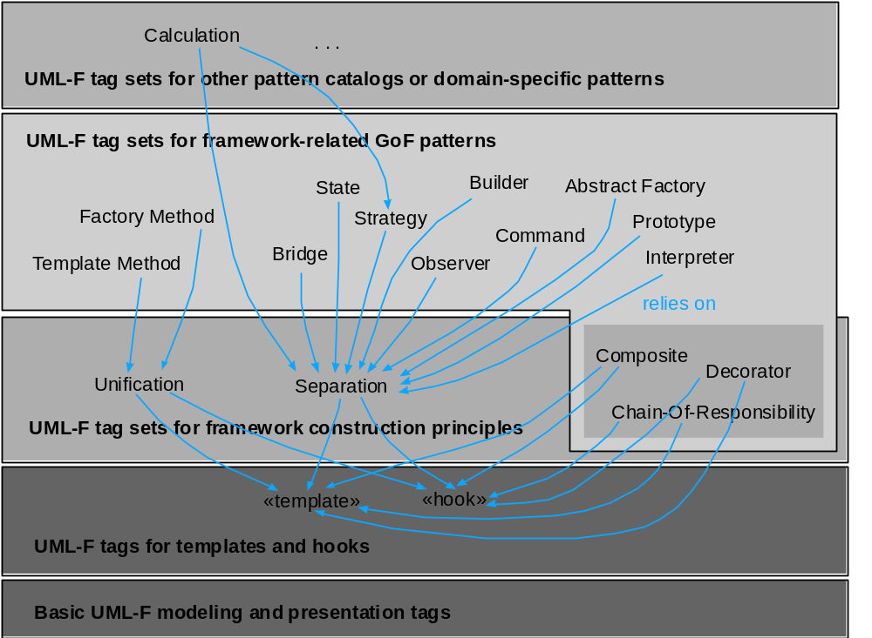
UML-F extension structure

Slide 9
UML-F diagrams
UML-F only enhances the following UML diagrams:
  class/object diagrams
  sequence diagrams

Slide 10
UML-F tag mechanism
UML 1.3/1.4 provides «stereotypes» and {tag=value} pairs
  stereotypes are restricted: no value attached, only one per model element
  Tagged value pairs are more flexible and combinable
UML-F unifies both in the “tag-mechanism”, by writing
  «tag:5» and {tag=5} interchangeably
  «tag» is short for «tag:True»
  «tag1,tag2» is OK
  Special forms of tags, e.g. “©” instead of «complete:True»
  Tag values have types (e.g. Boolean,String,Integer)

Slide 11
Presentation tags

Slide 12
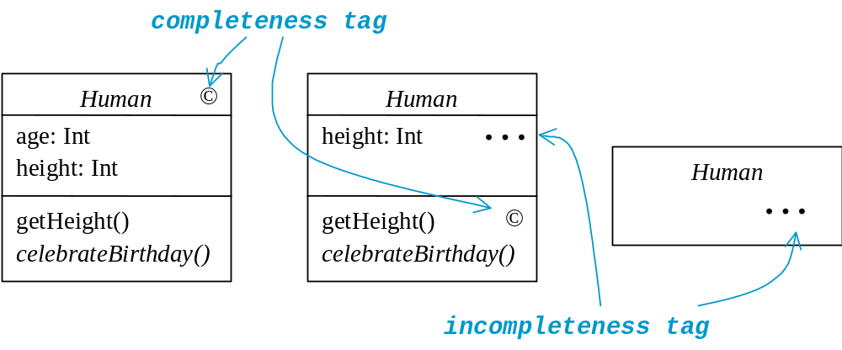
Presentation tags (I)

Slide 13
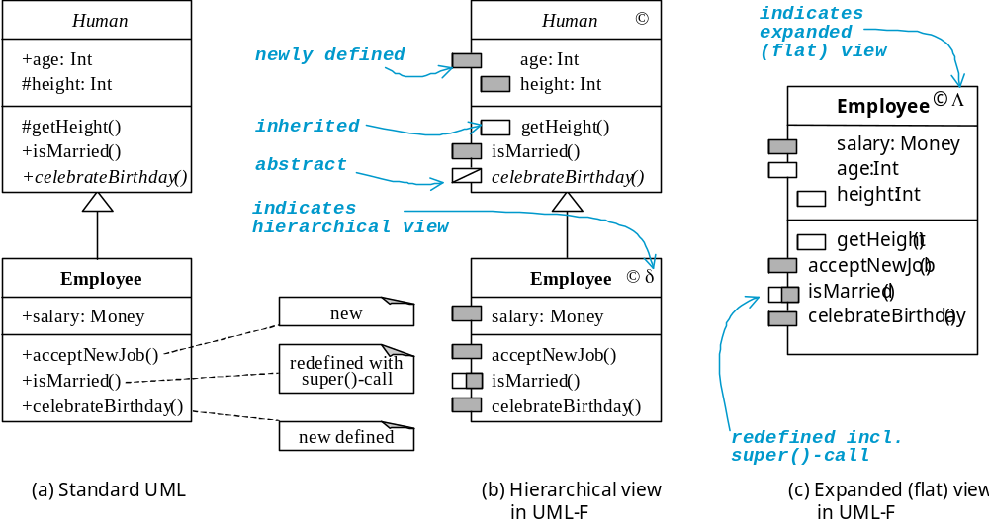
Presentation tags (II)

Slide 14
Presentation tags (III)
white rectangle: the method is inherited and not redefined
gray rectangle: the method is either newly defined, or it is inherited, but completely redefined
half gray / half white rectangle: the method is redefined, but uses the inherited method through a super() call
don’t care rectangle: the diagram does not reveal any information (can actually be either of the above three)

Slide 15
Basic modeling tags

Slide 16
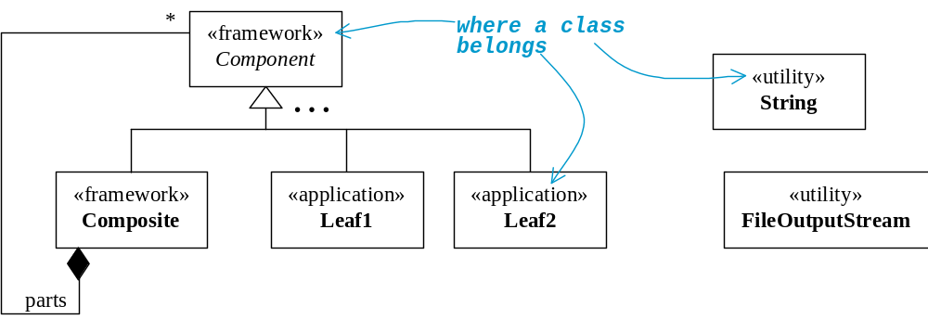
Basic modeling tags (I)

Slide 17
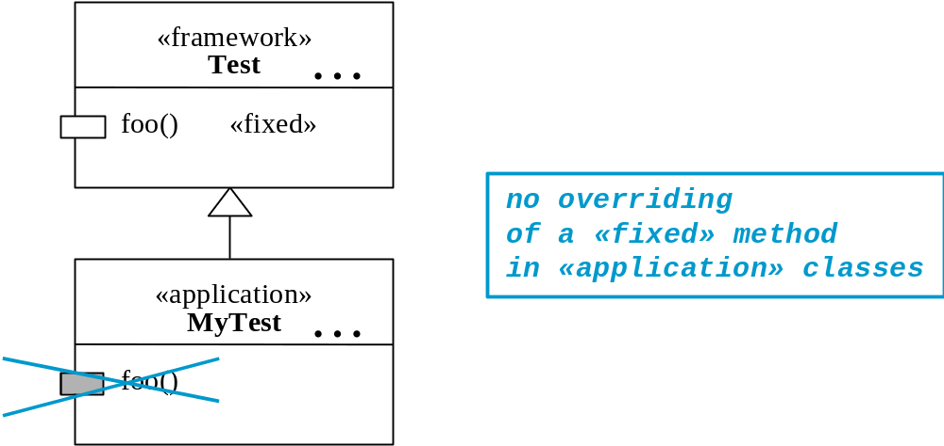
Basic modeling tags (II)

Slide 18
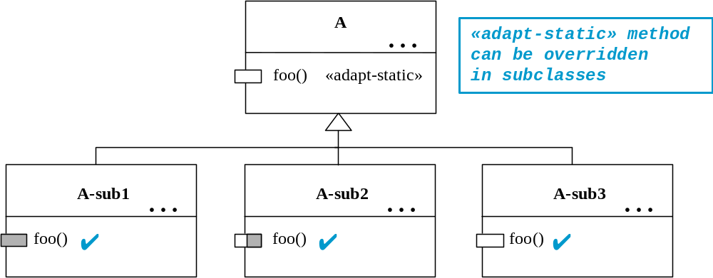
Basic modeling tags (III)

Slide 19
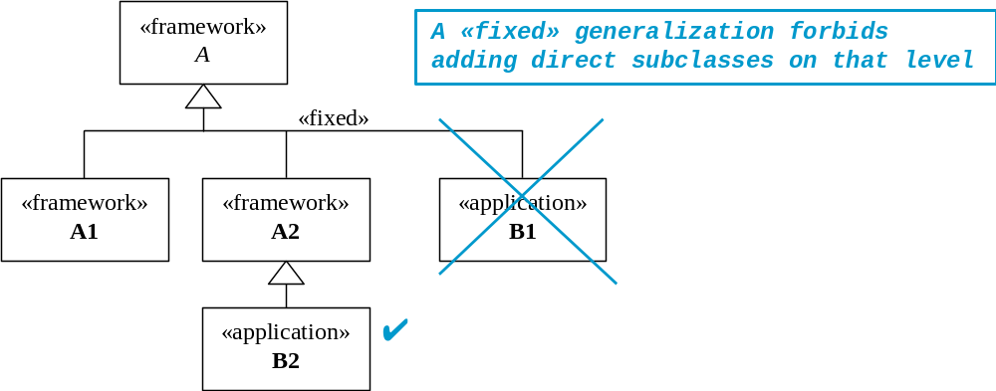
Basic modeling tags (IV)

Slide 20
UML-F tags for the essential framework construction principles

Slide 21
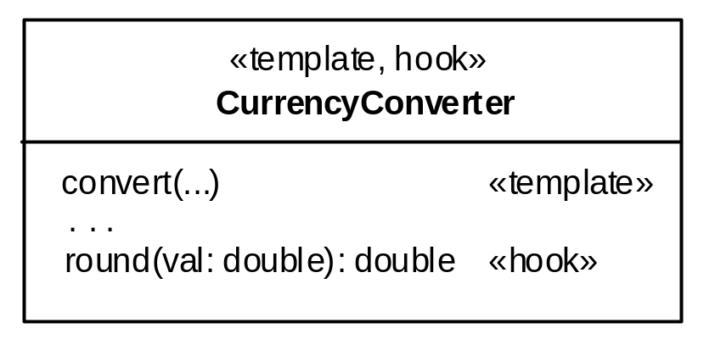
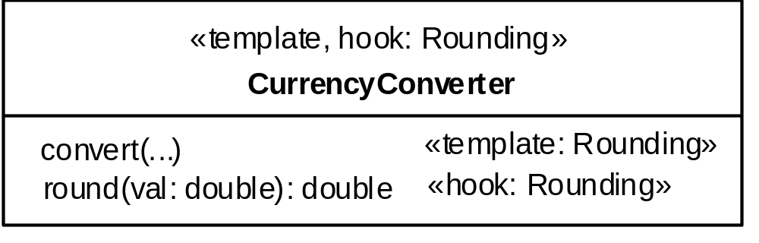
Template and hook tags (I)

Slide 22
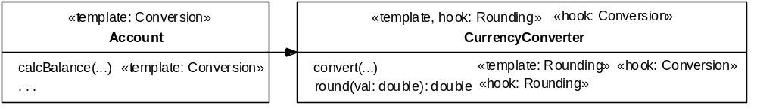
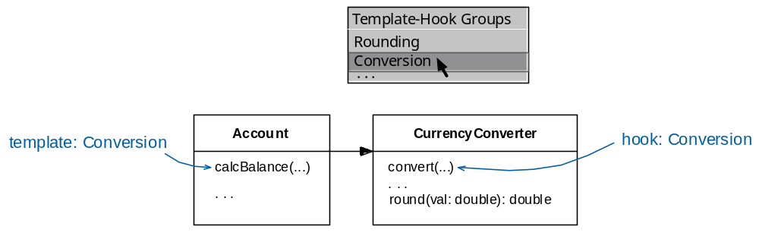
Template and hook tags (II)
possible tool support:

Slide 23
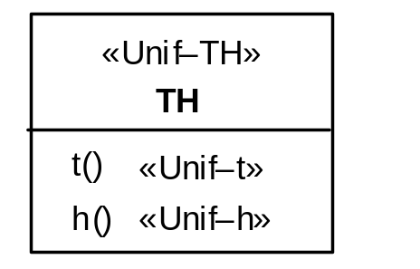
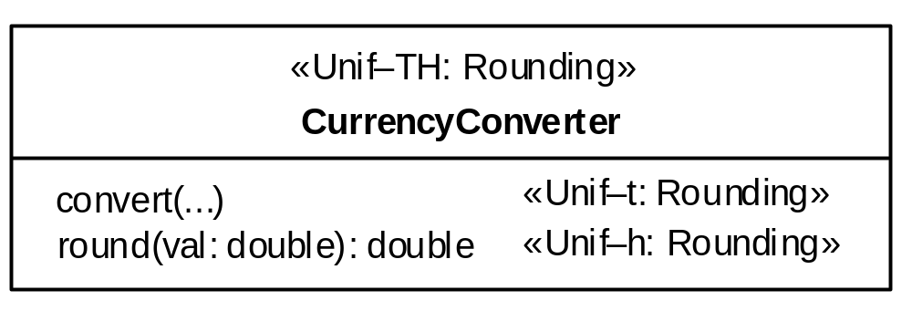
Tags for Unification (I)
tags are derived
from the structure
example:

Slide 24
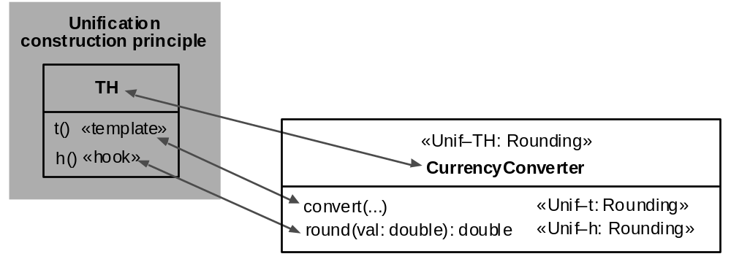
Tags for Unification (II)
rationale behind the tags:

Slide 25
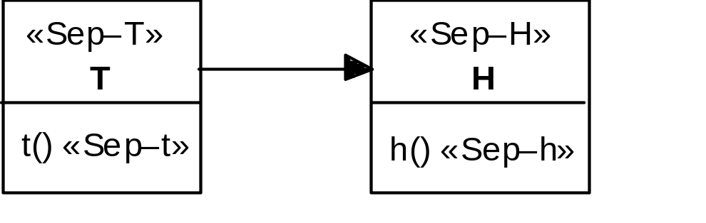
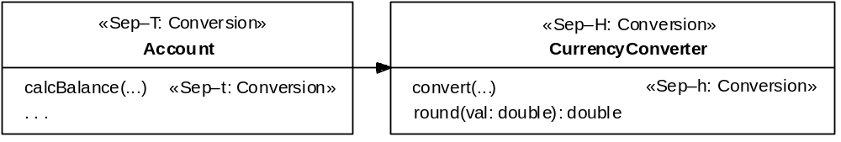
Tags for Separation
example:

Slide 26
UML-F tags for the
GoF framework patterns

Slide 27
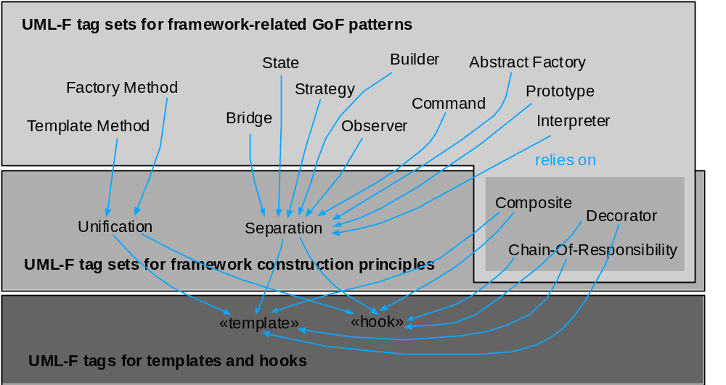
UML-F extension structure

Slide 28
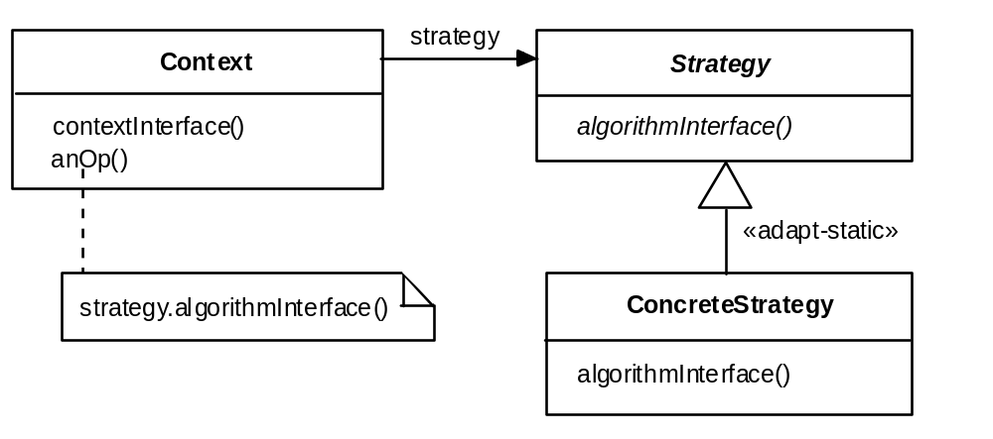
Strategy pattern (I)
Structure (according to GoF book):
«Strategy–Context», «Strategy–anOp», «Strategy–contextInterface»,
«Strategy–strategy»,
«Strategy–Strategy», «Strategy–algInt»,
«Strategy–ConcreteStrategy», «Strategy–algInt»

Slide 29
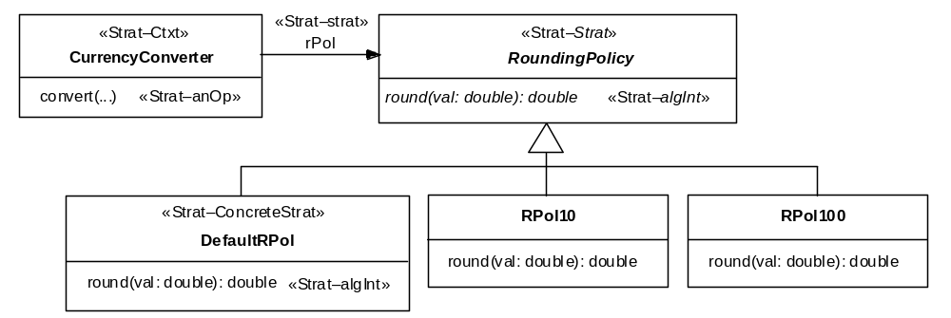
Strategy pattern (II)
Sample annotation:

Slide 30
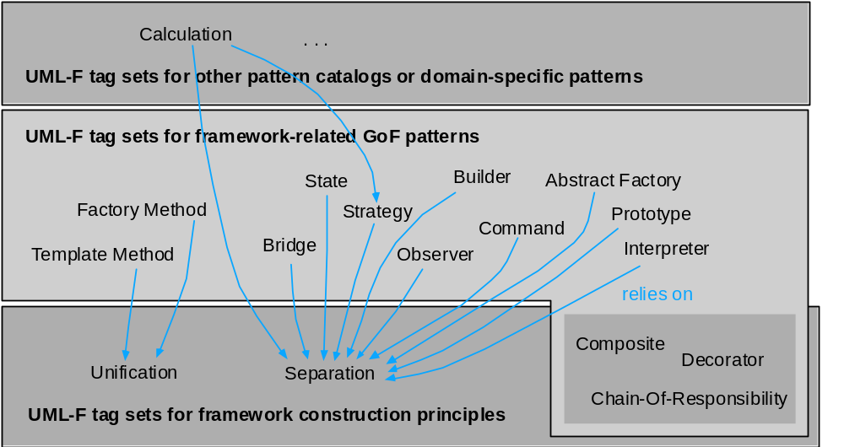
UML-F extension structure

Slide 31
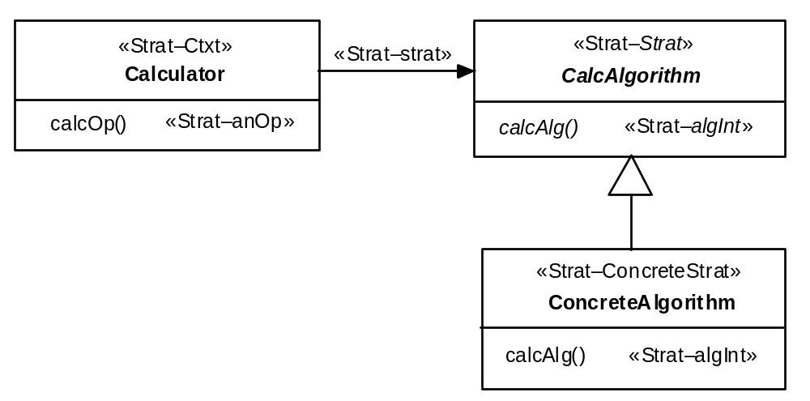
Domain-specific patterns or other catalog pattterns

