Slide 1
High Performance Index Build Algorithms for Intranet Search Engines
Marcus Fontoura fontoura@almaden.ibm.com
http://fontoura.org

Slide 2
Agenda
Trevi search engine
Problem description
Index build algorithm
Experimental results
Conclusions and future work

Slide 3
Agenda
Trevi search engine
Problem description
Index build algorithm
Experimental results
Conclusions and future work

Slide 4
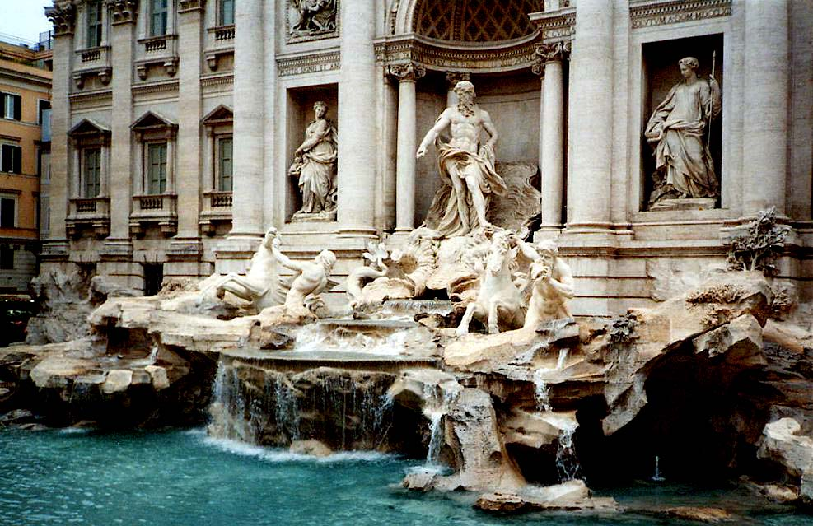
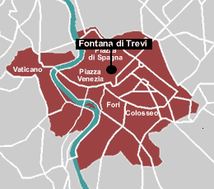
Trevi Intranet search project

Slide 5
Trevi overview
Trevi goal is to provide high quality Intranet search capability to corporate portals such as w3.ibm.com
Scalable text search engine that is being developed by a joint IBM Research and Software Group team

Slide 6
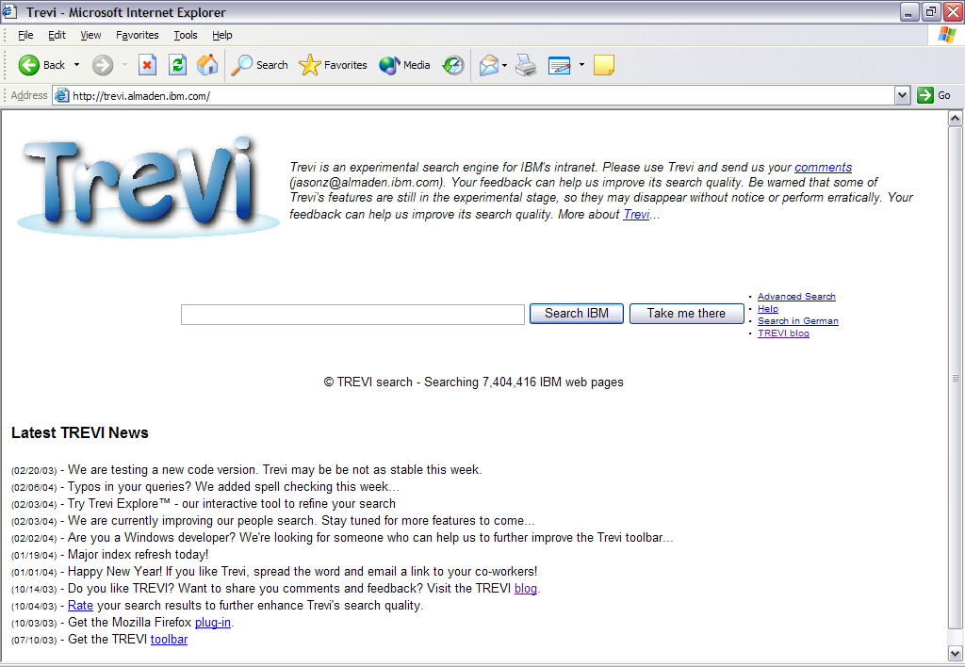

Slide 7
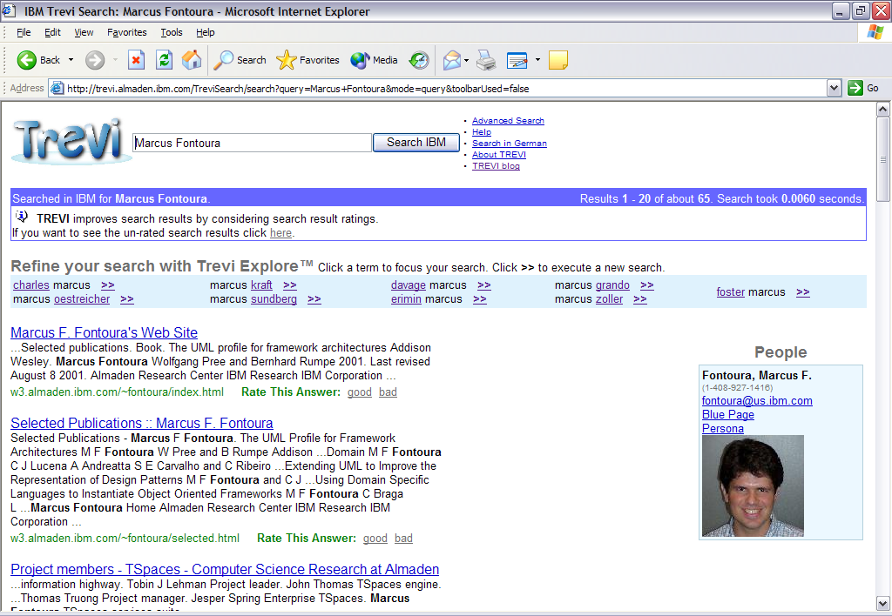

Slide 8
What is specific for Intranet search?
Integration between Intranet data and other enterprise data
Several differences in the link patterns
Size of the data set
  Entire IBM Intranet can be indexed using a single low-end machine
Index “freshness” requirements are different
“Searching the Workplace Web”, Fagin et. al., WWW’2003

Slide 9
Hardware and software architectures
data copy
Index Build
Crawler
Crawled
Documents
Store
Index
DeltaStore
DeltaIndex
Local Gigabit Switch
IP Sprayer
Query Server
data copy
Link to the global IBM Intranet
Store
Index
DeltaStore
DeltaIndex

Slide 10
Agenda
Trevi search engine
Problem description
Index build algorithm
Experimental results
Conclusions and future work

Slide 11
Problem description
Freshness requirements are more strict for enterprises
  One hour delay for the IBM Intranet
(Most of) this talk focuses on how to efficiently incorporate global analysis (GA) into the index build process

Slide 12
Global analysis (GA)
Duplicate detection
  Computes fingerprints for each page (64 bit shingle)
  Master are identified by using the (previous) static rank
Anchor text (D1: <a ref=“D2”>Trevi</a>)
  Appends anchor text tokens to documents
Static rank
  Host in-degree, i.e., number of hosts that point to a page (~ PageRank on the IBM intranet)

Slide 13
Index build requires GA
Rebuild the inverted text index and update the global analysis (GA)
  Duplicate documents are deleted from the index
  Anchor text is indexed together with the document’s content
  Static rank gives the index ordering, allowing for early termination during query evaluation
The time to rebuild the index will be dominated by the GA time, as analysis get more complex
  Semantic search

Slide 14
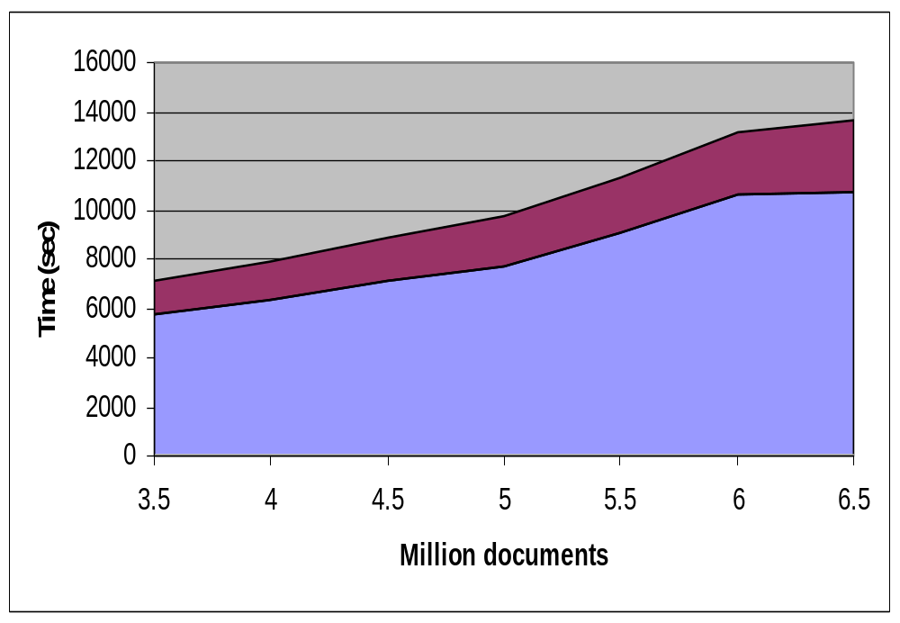
Time spent in GA for the IBM Intranet
25% of the time goes to the GA computation
Trevi GA is very efficient
We expect this difference to increase drastically

Slide 15
Agenda
Trevi search engine
Problem description
Index build algorithm
Experimental results
Conclusions and future work

Slide 16
Major data structures
Store
  Storage for the tokenized version of each document
Index
  Inverted text index over the Store
Delta store and delta index
  Small versions of the Store and Index with new and modified documents
  Allow for hourly updates of the Index content

Slide 17
Index build algorithm overview (1/2)
Index build merges the current version of the Store (Store_{i}) and with the current version of the DeltaStore and generates the new version of the Store and the new Index, Store_{i+1} and Index_{i+1}
Index
Build
Store_{i}
Store_{i+1}
DeltaStore
Index_{i+1}

Slide 18
Index build algorithm overview (2/2)
The Store and Index always move together in time
As Store_{i+1} is generated from the store and the DeltaStore garbage collection takes place
After the Index Build module has finished, Store_{i+1} and Index_{i+1} are copied to the query servers and the DeltaStore and DeltaIndex are reset
A single disk scan of Store_{i} and the DeltaStore is sufficient to do garbage collection and generate Store_{i+1} and Index_{i+1}.

Slide 19
Design is optimized for sequential scans
Use RAID for fault tolerance and I/O parallelism
2.Process documents
1.Read
3.Write
DeltaStore
Store_{i}
Store_{i+1}
Index_{i+1}
Read partition (RAID 0)
Write partition (RAID 0)

Slide 20
Garbage collection of the store
Remove duplicate, deleted (404s), and repeated pages
40% of the IBM Intranet crawl are duplicate pages
  Can lead to large improvement in index build performance

Slide 21
Garbage collection algorithm
DeltaStore
bundle
Bloom filter
D1
Store_{i+1}
D5
set
1
D6
1
bundle
0
D1
1
bundle
Store_{i}
0
copy
D5
1
D6
D3
bundle
0
D4
probe
1
D2
*
D1
bundle
0
D3
D5
D4
*
D2
* garbage collected

Slide 22
Delta index builds
The DeltaStore and the DeltaIndex also move together in time, but at a faster rate than the Store and the Index
Newly crawled documents are stored in the same manner as documents in the DeltaStore
After the Delta Index Build module has finished, DeltaStore_{j+1} and DeltaIndex_{j+1} are copied to the Query Servers
DeltaIndex
Build
DeltaStore_{j}
DeltaStore_{j+1}
Newly crawled
documents
DeltaIndex_{j+1}

Slide 23
Index build algorithm with GA
Index
Build
Store_{i}
DeltaStore
Global
Analysis
Store_{i+1}
Store_{i}
Dup_{i+1}
AnchorText_{i+1}
Index_{i+1}
DeltaStore
Rank_{i+1}
DeltaIndex
Build
DeltaStore_{j+1}
DeltaStore_{j}
Newly crawled
documents
DeltaIndex_{j+1}

Slide 24
Index build with lagging GA
Global Analysis and
DeltaIndex build can
proceed in parallel
Index
Build
Store_{i+1}
Store_{i}
Index_{i+1}
Global
Analysis
DeltaStore
GA inputs
GA_{i}
GA_{i+1}
GA_{i}
DeltaIndex
Build
DeltaStore_{j+1}
DeltaStore_{j}
Newly crawled
documents
DeltaIndex_{j+1}

Slide 25
Analysis of the lagging GA algorithm
Using current GA
IC₁
D
D
D
GA₂
IC₂
D
D
D
Using lagging GA
IC₁
GA₁
IC₂
GA₂
D
D
D
D
D
D
time
GA_{i} = global analysis i
IC_{i} = index construction i
D = generate delta index

Slide 26
Agenda
Trevi search engine
Problem description
Index build algorithm
Experimental results
Conclusions and future work

Slide 27
Goal
Show that the index build algorithm using lagging does not degrade quality
Show that it improves performance

Slide 28
Experimental setup
Built several index iterations based on a partial crawl from the IBM Intranet
Started with 3.5 million documents and added 0.5 million documents per iteration
  0.5 million documents per day is the change rate of the IBM intranet
Size of the IBM Intranet is 7.0 million documents after duplicate elimination

Slide 29
Measure “discrepancy” in results
Kendall tau distance for top-K lists
  Checks every possible pair {i, j} from the input lists and applies a penalty if the order of i and j differ (bubble sort distance)
Example
  L1 = {1, 2, 3, 4}
  L2 = {2, 4, 3, 1}
  Apply penalty for {1,2}, {1,3}, {1,4}, and {3,4}
“Comparing top-k lists”, Fagin, Kumar, and Sivakumar, SIAM J. Discrete Mathematics 17, 1 (2003)

Slide 30
Discrepancy for static ranks (1/2)
Compare the top 100K ranks among several index build iterations
Each iteration adds 500M documents to the index
  How do the ranks vary between consecutive iterations?
  How do the ranks vary over time?

Slide 31
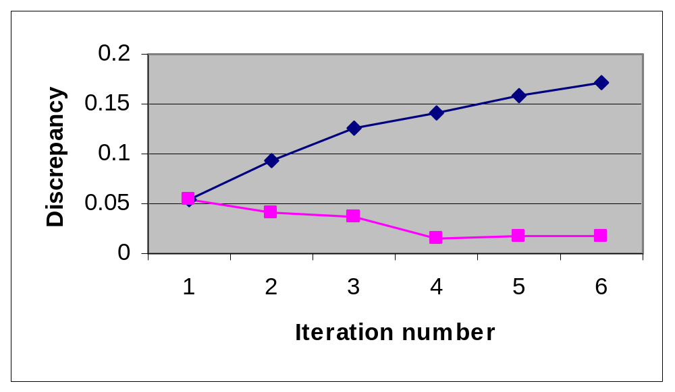
Discrepancy for static ranks (2/2)

Slide 32
Analysis of the rank discrepancy
The discrepancy decreases over time
  Most of the high-ranked pages are in the first generation index
  Crawl date is a good approximation for the static ranks in the Intranet
Link-based static ranks are very stable
“Searching the Workplace Web”, Fagin et. al., WWW’2003

Slide 33
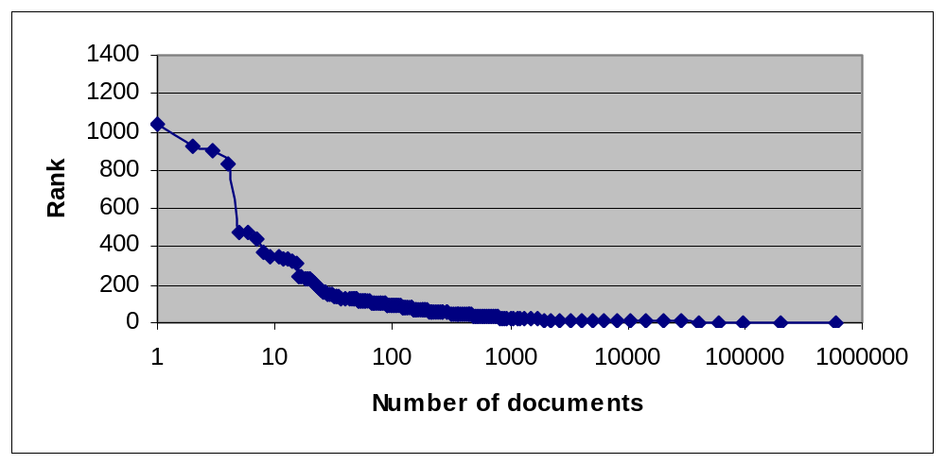
Static rank distribution for the IBM Intranet

Slide 34
Discrepancy for anchor text (1/2)
Built several iterations of anchor text indices
Compare the top 100K anchor text terms among index iterations

Slide 35
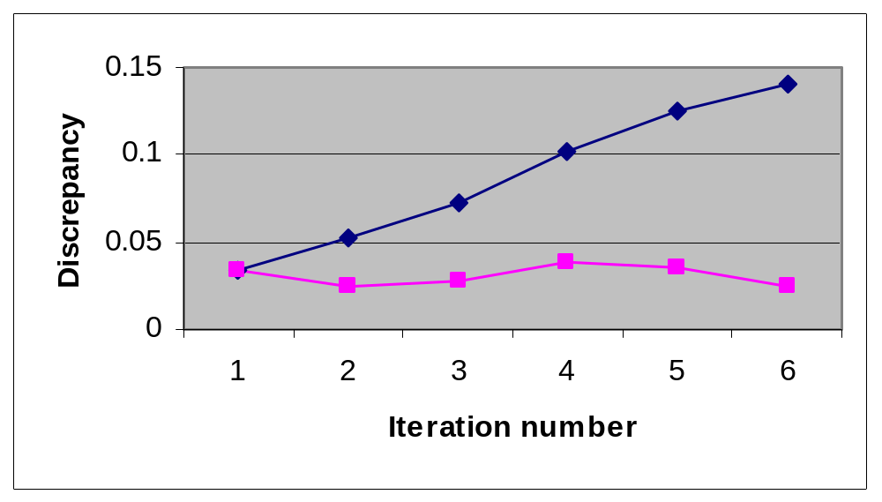
Discrepancy for anchor text (2/2)

Slide 36
Analysis of duplicate detection (1/2)
Potential loss in precision since documents added between iterations i and i+1 can be duplicates
  New documents have low static rank, so even if they are duplicates they might not appear in the results
Upper bound on the number of wrongly classified documents

Slide 37
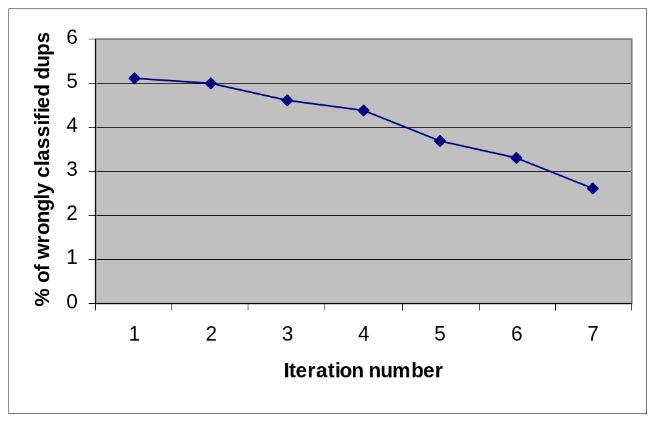
Analysis of duplicate detection (2/2)

Slide 38
Standard IR metrics for precision
180 queries from the Trevi query logs
Manually identified the “correct answers”
Measured precision @ 1 and @ 10
  P@1 varied from .639 to .65
  P@10 varied from .215 to .219
  Less than 2% change!

Slide 39
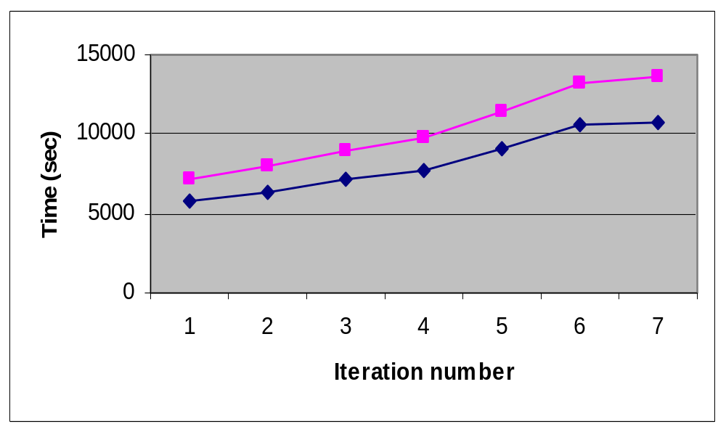
Performance improvement

Slide 40
How to improve even more?
Fast indexing algorithm!

Slide 41
What is indexing? (1/2)
Given documents:
D1: This is a test
D2: Is this a test
D3: This is not a test
Reorganize by term:
TERM DOC LOC DATA(caps)
this 1 0 1
is 1 1 0
a 1 2 0
test 1 3 0
is 2 0 1
this 2 1 0
a 2 2 0
test 2 3 0
this 3 0 1
is 3 1 0
not 3 2 0
a 3 3 0
test 3 4 0

Slide 42
What is indexing? (2/2)
Sort by <term, doc, loc>:
TERM DOC LOC DATA(caps)
a 1 2 0
a 2 2 0
a 3 3 0
is 1 1 0
is 2 0 1
is 3 1 0
not 3 2 0
test 1 3 0
test 2 3 0
test 3 4 0
this 1 0 1
this 2 1 0
this 3 0 1
In “postings list” format:
a (1,2,0),(2,2,0),(3,3,0)
is (1,1,0),(2,0,1),(3,1,0)
not (3,2,0)
test (1,3,0),(2,3,0),(3,4,0)
this (1,0,1),(2,1,0),(3,0,1)

Slide 43

Indexing algorithm
Radix sort
  Linear time sorting
  Flexibility in defining the sort criteria
  Bigger sort buffers increase performance
Pipelining load and sort phases

Slide 44
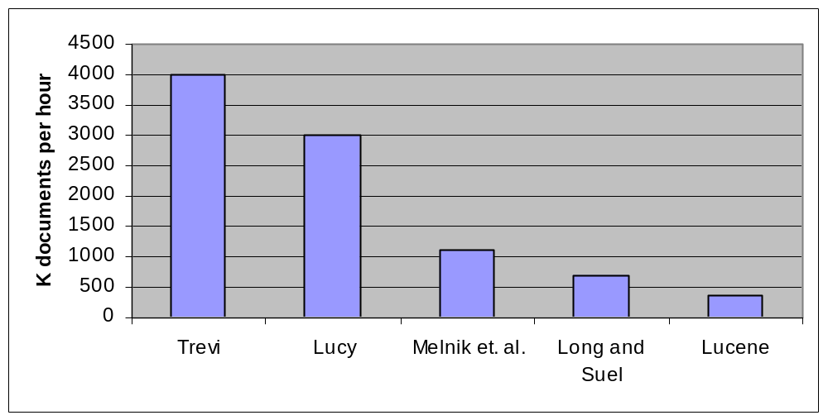
Indexing performance

Slide 45
Agenda
Trevi search engine
Problem description
Index build algorithm
Experimental results
Conclusions and future work

Slide 46
Conclusions
Trevi search engine overview
Lagging global analysis does not degrade quality
  More than 25% of performance improvement
  Even more advantageous when analysis are more complex
Superior performance when compared to several state-of-the art indexing algorithms

Slide 47
Future work
Extensible ranking architecture
  Experimentation with rank aggregation in the query runtime
Support for more complex query languages (XPath, XQuery full text)
Dynamic indexing

Slide 48

More information
See VLDB’2004 paper
http://fontoura.org
fontoura@almaden.ibm.com
Thank you!

