Slide 1
Law Governed Peer-to-Peer Auctions
Marcus Fontoura
IBM Almaden Research Center
fontoura@almaden.ibm.com
Mihail Ionescu
Naftaly Minsky
Rutgers University

Slide 2
Agenda
Online auctions
Limitations of centralized auction services
Law governed interaction
Law governed interaction and auctions
Sample auction law
Related work
Conclusions and future work

Slide 3
Online auctions
Buyers and sellers scattered across the globe interact to close deals
Faster and less expensive transactions with no geographical barrier
Forecast Research expects that in 2003 there will be a market of 14 million consumers and $19 billion in sales

Slide 4
Limitations of centralized auction services
The auction algorithm
  Several types of such algorithms can be used (like open-cry, sealed, variations, etc.)
Certification
  How to compute reputation and trust information about the auction participants
Auditing
  What needs to be audited, and by whom
The treatment of complaints
  How to handle inappropriate behavior of auction participants

Slide 5
Law governed interaction (1/4)
LGI is a message-exchange mechanism that allows an open group of distributed agents to engage in a mode of interaction governed by an explicitly specified policy, called the law of the group
The group of agents interacting via L-messages is called a community C
For each agent x in a given community has a control-state CS(x)
Agents are black box components

Slide 6
Law governed interaction (2/4)
Although the law L of a community C is global it is enforceable locally at each member of C
  L only regulates local events at individual agents
  The ruling of L for an event e at agent x depends only on e and the local control-state CS(x) of x
  The ruling of L at x can mandate only local operations to be carried out at x, such as an update of CS(x)

Slide 7
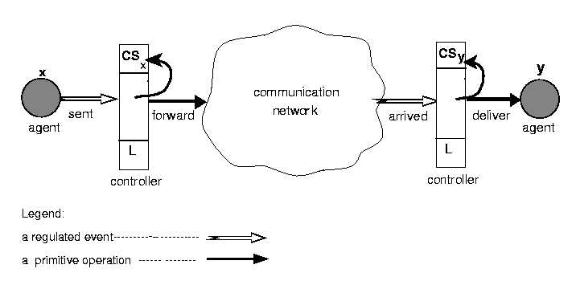
Law governed interaction (3/4)

Slide 8
Law governed interaction (4/4)
Some LGI primitives
  t@CS returns true if term t is present in the control state, and fails otherwise
  +t adds term t to the control state;
  -t removes term t from the control state;
  forward(x,m,y) sends message m from x to y; triggers at y an arrived (x,m,y) event
A law is represented as “Prolog” in Moses

Slide 9
Law governed interaction and auctions (1/4)
Auction registry
  The auction registry is a separate agent that holds the selling offers as a tuple {ProductName, Description, SellerAddress, AuctionLaw, Timeout}
Sellers and Buyers
  All the interaction between sellers and buyers is governed by LGI according to the auction policies (laws) specified in the registry tuples
The actual exchange of product and money between the buyer that wins the auction and the seller is handled offline

Slide 10
Law governed interaction and auctions (2/4)
Sellers send messages to the auction registry to insert or delete auction tuples
Buyers make requests for offers that meet some conditions
When a buyer discovers about an interesting auction, it can join the community that is conducting the auction
Buyers and sellers exchange messages according to the law specified in the auction tuple
They interact directly, in a peer-to-peer communication model

Slide 11


Law governed interaction and auctions (3/4)
Interaction among sellers, buyers, and the auction registry
Auction
registry
1. Register auction
2. Find about
auctions
3. P2P interaction
Seller
Buyer

Slide 12
Law governed interaction and auctions (4/4)
Auction
registry
Find about
auctions
Register auction K:
open-cry law
Register auction L:
sealed-bed law
Buyer 2
Find about
auctions
P2P interaction on auction L
Seller 1
Seller 2
P2P interaction on auction K
P2P interaction on auction L
Buyer 1
Auditor X
Auditor Y
Complaints agent Z

Slide 13
Sample auction law (1/5)
Initializations
R1. Directory(auditor, auditor@enterprise.com)
R2. Authority(ca,URL(http://aramis.cs.rutgers.edu:9020))
R3. InitialCS([])
Certification
R4. certified(X,certificate(issuer(ca),subject(Y),attributes([seller(N)]))) :-
do(deliver(X,certificate(issuer(ca),subject(Y),attributes([seller(N)])),X)),
do(+certified),do(+role(seller)),repealObligation(endCertified(X)),
imposeObligation(endCertified(X),100),
do(deliver(X,attributes([seller(N)],auditor)

Slide 14
Sample auction law (2/5)
Seller starts the auction
R5. sent(X,start(P,T),X) :-
certified@CS, role(seller)@CS, do(+P), do(+max(P,0)),
do(+winner(P,X)), do(imposeObligation(timeout(P),T)),
do(deliver(X,start(P,T),auditor)

Slide 15
Sample auction law (3/5)
The “open cry” auction
R6. sent(X,offer(P,M),Y) :-
certified@CS, role(buyer)@CS, do(forward(X,offer(P,M),Y)), do(deliver(X,offer(P,M,Y),auditor)
R7. arrived(X,offer(P,M),Y) :-
role(seller)@CS, max(P,Q)@CS,winner(P,Z)@CS, M>Q, not role(buyer)@CS, do(-max(P,Q)), do(+max(P,M)), do(-winner(P,Z)), do(+winner(P,X)), do(forward(Y,accepted(P,M),X)),
do(deliver(Y, accepted(P,T,X),auditor), do(forward(Y,outbid(P,M),Z)), do(deliver(Y,outbid(P,T,Z),auditor)

Slide 16
Sample auction law (4/5)
Auditing
  Auditor is an agent that is not involved in the auction but that receives copies of the messages that were exchanged
  Agents can request copies of the messages exchanged during the auction
  An auction can have more than one auditor
  An agent can choose not to participate in an auction if it does not trust its auditors
  The law imposes no restrictions in the way auditors handle the messages they receive.

Slide 17
Sample auction law (5/5)
Treatment of complaints
  An agent can complain about another agent (A) if he or she thinks that A did not have a correct behavior.
    Not sending the item once the auction is over
Prevention of the artificial increase of the price by the seller
The complaints agent can talk to the auditor to retrieve copies of all the exchanged messages and the real IDs (as are written in the certificates) of the agents

Slide 18
Related Work
Centralized auction services
  B2B
  B2C
AuctionBot
  Configurable auction policy
UDDI
  Auction registry

Slide 19
Conclusions and Future Work (1/2)
Sellers can set up their own auction policies and these policies are explicitly stated, readable by everybody, and strictly enforced by the LGI mechanism
Auctions are conducted in a totally distributed manner, through a peer-to-peer communication protocol
There is no centralized authority that can act as a trusted mediator.
Third parties, such as auditors and complaints agents, can participate on the auctioning process under a given law
This architecture is not limited to auctions, but it can be applied to any online trading model

Slide 20
Conclusions and Future Work (2/2)
Definition of laws for other types of negotiation
  Especially interested in studying the behavior of agents in the presence of several optional (and conflicting) laws
Integration with Web services
  UDDI and WSDL
Web-based user interface for the system

