Slide 1
TSpaces Services Suite:
Automating the Development and Management of Web Services
Presenter: Kevin McCurley
IBM Almaden Research Center
Contact: Marcus Fontoura fontoura@almaden.ibm.com

Slide 2
Agenda
Web services overview
TSpaces Services Suite (TSSuite)
  TSpaces overview
  TSSuite components
Example
Conclusions

Slide 3
Web services overview (1/2)
A way to build large, flexible applications dynamically, from a set of standard independent software parts
A Web service implements one or more service interfaces
A service interface describes the set of operations supported by the service.
A service broker is a registry where services can be published and be discovered by the clients
A client is a software application that uses one or more services
In general, a client uses a service broker to discover the appropriate information about the service
A client can itself be a service. In this case it is a composite service, since it uses one or more services as its components

Slide 4
Web services overview (2/2)
In recent years, Java has emerged as the dominant language for Web programming
Among the standards for Web services, UDDI, WSDL, and SOAP have gained strong industry support, and are likely to become the standard Web services stack for service brokering, description, and invocation, respectively
Service
1. Register
Interfaces
3. Invoke
2. Discover
Client
Interfaces
Broker
Database of
service interfaces

Slide 5
TSpaces Service Suite (TSSuite)
TSSuite includes a UDDI broker, the TSpaces Service API (TSSAPI), and a set of tools
The UDDI broker and the TSSAPI are developed as an extra layer over TSpaces, extending its programmatic capabilities towards Web services
The other components are tools for service developers and administrators and can be viewed as clients of the TSSuite infrastructure
Service Tools
Service
Builder
Service
Monitor
Notify
Service
Service Infrastructure
UDDI
TSSAPI
TSpaces

Slide 6
TSpaces Overview (1/3)
TSpaces is a network communication buffer with database capabilities
It enables communication between applications and devices in a network using the shared space concept from Linda
TSpaces clients communicate asynchronously through shared spaces by writing reading, and taking tuples
Each tuple is a vector of Java objects

Slide 7
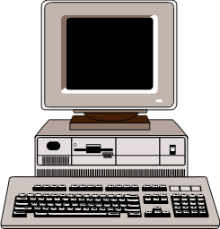
TSpaces Overview (2/3)
The basic TSpaces commands are write, read, and take
The difference between read and take is that after a take the tuple is removed from the space while read leaves a copy of the tuple in the space.
Tuples are not directed to any specific client
Tuples reside on the space until someone issues a take or until they expire.
read
write
take
write

Slide 8
TSpaces Overview (3/3)
Clients can also register for event notifications
When the event occurs (e.g. the specified tuple is written) the client is notified through a callback method
1. register for the
insert (i.e. write) of
2. write
3. callback

Slide 9
TSpaces Service API (1/3)
TSSAPI is a framework that simplifies the creation, deployment, configuration, and invocation of services
TSSAPI accomplishes this by standardizing the interfaces between services and by formalizing the types of interactions that services can support
TSSAPI uses the WSDL vocabulary for service description

Slide 10
TSpaces Service API (2/3)
Services deployed in TSpaces are invoked by writing tuples into a space, called the service activation space
The result of the operation (output message) is also written to the space
TSSAPI handles the entire interaction among the client, the service, and TSpaces, including the registration for callbacks and the invocation of the appropriate service operations

Slide 11
TSpaces Service API (3/3)
Example of a service invocation using TSSAPI
3. operation( ) =
4. write
Service
5. take or
callback
Client
2. callback
1. write
input message
Service activation
space
output message

Slide 12
TSpaces UDDI Broker (1/2)
The TSpaces UDDI broker is a SOAP service that implements all the methods in the UDDI specification
It's a lightweight implementation of UDDI that is simple to install and play with
It's main purpose is to allow the experimentation with the UDDI architecture in an straightforward manner
TSpaces is used as the “database layer”
  Information on UDDI (Universal Description, Discovery, and Integration) can be found at http://www.uddi.org

Slide 13
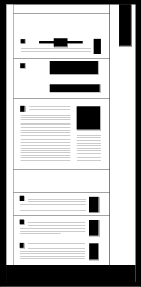
TSpaces UDDI Broker (2/2)
Clients can use the TSpaces event registration mechanism to be notified when certain kinds of services are published
  A possible scenario would be “let me know when a new bike store is available in California”
  This form of interaction with the UDDI broker is not part of the UDDI specification and can be viewed as a value-added service
SOAP call
UDDI
Client
UDDI
Broker
write/read
publish/
inquiry
SOAP
Server
UDDI space

Slide 14
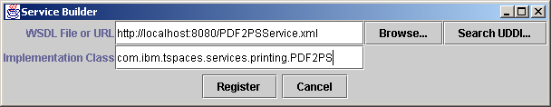
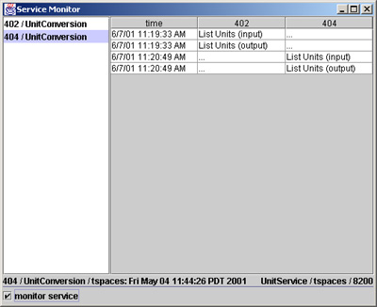
TSSuite Tools (1/2)
Service Builder
  Enables service developers to easily build, deploy, and register web services
Service Monitor
  Provides a view of service messages and allows the user to monitor or troubleshoot service logic

Slide 15
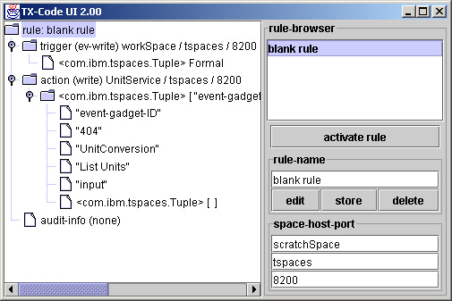
TSSuite Tools (2/2)
Notify Service
  General purpose rule-based mapping for TSpaces messages and events
  Enables code-less rewriting and routing of TSpaces messages
  Helps create composite service behaviors by generating and redirecting service messages

Slide 16
Example
9. callback
Client
File
& ID
Report
1. write
8. TSNotify rule:
move report
tuples
2. TSNotify rule:
move file & ID tuples
Print near me
activation space
5. TSNotify rule:
move file & printer
tuples
File
File &
printer
ID
List of
printers
Report
Closest printers
activation space
Intelligent print
activation space
Closest
printers
Service
Intelligent
print
Service
3. callback
4. write
6. callback
7. write

Slide 17
Conclusion
TSSuite is a framework and a toolset built on top of the TSpaces architecture to simplify the creation, deployment, discovery, and invocation of web services
Standard based: UDDI, WSDL, SOAP
Lightweight due to the database, communication, and notification capabilities of TSpaces
Available on Alphaworks
  http://www.alphaworks.ibm.com/tech/tssuite
  over 2,000 downloads

Slide 18
Questions?
Contact
  Marcus Fontoura (fontoura@almaden.ibm.com)

