Slide 1
State Machine Basics for Experiment Control
Or, How to Use a State Machine to Write a Behavior Protocol

Slide 2
What is a Finite State Machine?
Mathematical model
Depending on the type there are several definitions.
  An acceptor finite state machine is a quintuple <Σ, S, s0, δ, F>, where:
    Σ is the input alphabet (a finite non empty set of symbols).
    S is a finite non empty set of states.
    s0 is an initial state, an element of S. In a Nondeterministic finite state machine, s0 is a set of initial states.
    δ is the state transition function: δ: S x Σ → S.
    F is the set of final states, a (possibly empty) subset of S.
  A transducer finite state machine is a sextuple <Σ, Γ, S, s0, δ, ω>, where:
    Σ is the input alphabet (a finite non empty set of symbols).
    Γ is the output alphabet (a finite non empty set of symbols).
    S is a finite non empty set of states.
    s0 is the initial state, an element of S. In a Nondeterministic finite state machine, s0 is a set of initial states.
    δ is the state transition function: δ: S x Σ → S x Γ.
    ω is the output function.
    If the output function is a function of a state and input alphabet (ω: S x Σ → Γ ) that definition corresponds to the Mealy model. If the output function depends only on a state (ω: S → Γ ) that definition corresponds to the Moore model.

Slide 3

Too Abstract?
The mathematical model is a bit abstract and not concrete enough for us.

Slide 4
Informal Definition
A finite state machine (FSM) or finite automaton is a model of behavior composed of states, transitions and actions.

Slide 5
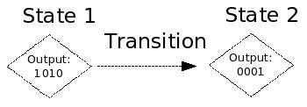
But What Does It Look Like?
FSMs can be represented as flowchart-like diagrams.
There are several styles of these, we will be using one based on the Moore model:

Slide 6
Ok, that’s nice.
No, really, despite the fact that they look like simple flowcharts, they can be used to specify control algorithms (such as one would use in an animal behavior experiment).

Slide 7
Now why’s that?
This is because state machines are composed of: inputs, outputs, and discrete states.
A state embodies a particular predicate about the system. We know exactly what the machine is up to depending on the state it is in.
Inputs and outputs belong to each state, so each step along the way we can react to events or issue stimuli.
  In a clear and well defined manner!

Slide 8
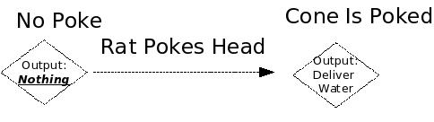
States
Each state embodies a well-defined condition that the system is in.
Think of it as a predicate or truth statement about the system.
If anything in the system changes, we go to a different state. Thus, there are as many states in the system as there are possible conditions.

Slide 9
States Part Deux
Each state has two things associated with it:
  A set of possible inputs
  A set of possible outputs

Slide 10
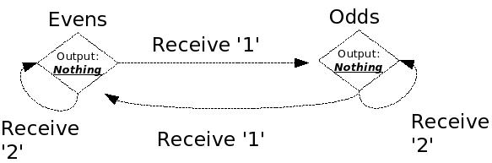
States - Inputs
Inputs to the state tell the state something has happened. Some inputs can be ignored, and others can cause state transitions that lead to the state machine going to a new state.
  Therefore, inputs are associations between physical inputs, the current state, and the next state (the state we should transition to if said input occurs).

Slide 11
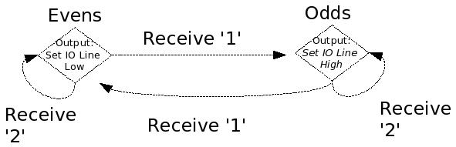
Outputs
Outputs are simply what we wish the state machine to tell the outside world (if anything) when it enters a particular state.

Slide 12
Tell me more!
Let’s take a look at a simple control algorithm: controlling a mechanical door.
We specify four states,
  opening,
  OPEN,
  closing,
  CLOSED
Four inputs:
  Command_open
  Command_close
  Sensor_opened
  Sensor_closed
One output:
  Toggle motor

Slide 13
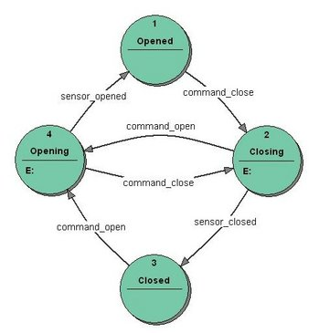
Simple Mechanical Door FSM
This is our simple state machine for controlling a mechanical door.

Slide 14
Our Holy FSM
Here at CNMC, we happen to have several conventions when it comes to how we represent states, inputs, and outputs.
Each state is numbered from 0->∞
Inputs are one of:
  a physical IO line going high (think nosecone-IN poke),
  a physical IO line going low (think nosecone-OUT poke),
  a timer expiring,
  an ‘alarm’ line going high,
  or an ‘alarm’ line going low.
Outputs are one of:
  IO lines being set high/low,
  sounds playing,
  or the starting of an alarm clock (when it expires its expiry is used as input).
Note: All outputs are done for a state when it is jumped to. So if transitioning from state 0 -> state 1, we do the outputs of state 1. However, if transitioning from state 1-> state 1 we do not do the outputs a second time since we stayed in the same state.

Slide 15
What Is The Matrix?
Since we use Matlab a lot, all of our state machines are specified using a matrix. The matrix is M x N where
  M is the number of states in the machine,
  N is:
    The number of input events
      Centerin, centerout, leftin, leftout .. alarm-in, timeout
    Plus 3 or 4, the last 3-4 columns corresponding to:
      State timeout time, IO line output, sound output, and the optional alarm trigger (if no alarms are used, omit this column)

Slide 16
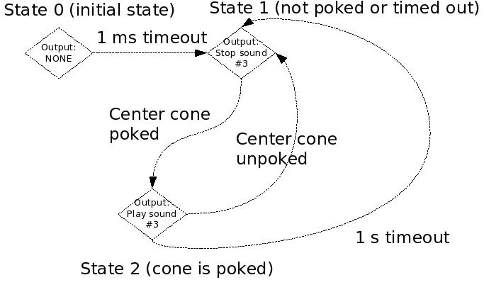
FSM Example In Diagram Form
Let’s consider a simple state machine that responds to CENTER cone pokes and plays sound #3 while the cone is poked. It stops the sound as soon as the cone is unpoked. It also stops the sound after 1s regardless.
Its state diagram is thus:

Slide 17
FSM Example In Matrix Form
Center IN (Line +1) | Center OUT (Line -1) | Timeout State | Timtout time | Continuous Output | Sound Trigger | Alarm Trigger (omitted)
0 | 0 | 1 | 0.001 | 0 | 0 | 0
2 | 1 | 1 | 0.0 | 0 | -3 | 0
2 | 1 | 2 | 1.0 | 0 | 3 | 0
Each of the input columns contains a value that is a state number to jump to when said input occurs (the state number is the row in the matrix – unlike matlab conventions, rows are 0-indexed).
Each output column is interpreted in a specific way depending on the column.
  The timeout time column is a value in seconds. The state will expire after this time. The granularity is of timeouts is 0.000166 seconds. So 1.0s really means ~1.0000166 seconds, and 0.000001 seconds is really 0.000166 seconds, etc. A timeout of 0 means never time out.
  The continuous output column is a bitmask of output line states. Since all output lines are digital, it’s ok to use a bitmask. For instance, to set line 1 high, 0 low, and 3 high we would have:
    2^1+2^3, which evaluates to 0101.
  The sound trigger column is an integer value of the sound id to play. Sound id’s are specified using as part of the Matlab LoadSound() calls that load the sounds
  The (optional) alarm trigger column is also a bitmask of alarm id’s to trigger. Normally we omit this column altogether. In more advanced state machines we use this column to trigger alarms (alarms are specified using SetSchedWaves() calls to the statemachine).

Slide 18
FSM Example as Pure Matlab Code
Sample matlab code that loads the aforementioned state matrix into the finite-state machine:
  mymatrix =
  [ 0 0 1 0.001 0 0 ;
  2 1 1 0.0 0 -3 ;
  2 1 2 1.0 0 3 ; ];
  fsm = RTLSM(‘rtlinuxrig1’);
  fsm = SetInputEvents(fsm, [ 1 -1 ]); % map first 2 event columns to IO line id’s 1 high and 1 low
  fsm = SetStateMatrix(fsm, mymatrix);
  soundmachine = LoadSound(soundmachine, 3, mysound);
  fsm = Run(fsm);

Slide 19
Footnotes on Previous
Matlab Calls
  mymatrix =
  [ 0 0 1 0.001 0 0 ;
  2 1 1 0.0 0 -3 ;
  2 1 2 1.0 0 3 ; ];
  fsm = RTLSM(‘rtlinuxrig1’);
  fsm = SetInputEvents(fsm, [ 1 -1 ]); % map first 2 event columns to IO line id’s 1 high and 1 low
  fsm = SetStateMatrix(fsm, mymatrix);
  soundmachine = LoadSound(soundmachine, 3, mysound);
  fsm = Run(fsm);
SetStateMatrix(fsm, matrix);
  Uploads a new state matrix to the RTLinux FSM via the network connection. The new state matrix takes effect immediately, and if the FSM was in the ‘running’ state, it will continue to execute the new state matrix from whatever state it was at last! If you wish to avoid this behavior you need to Halt() the FSM.
LoadSound(soundmachine, TRIG_NUM, soundfile);
  Uploads a soundfile (a 1xN or 2xN (stereo) matrix over [-1,1]) to the RTLinux Sound machine via the network connection. The sound is triggered from a state matrix by using TRIG_NUM in the sound_trig column of the state matrix. Sounds can be arbitrarily muted, or untriggered, using –TRIG_NUM.
SetInputEvents(fsm, vector);
  Defines a mapping from IO line id’s to matrix column positions. So:
    fsm = SetInputEvents(fsm, [ -1, 1, -2, 2 ]; maps the first four columns of the state matrix to IO lines 1 high, 1 low, 2 high and 2 low, respectively.
Run(fsm);
  New state machines start in the HALTED state by default. They need to be issues a Run() command to actually begin executing the state matrix they have been given. Note that state machines run indefinitely until they are issed the Halt() command.

Slide 20
Water Valve Calibrator
Let’s consider an even simpler state machine. One that is used to calibrate water valves.
  For this machine we want to iterate through the opening and closing of a valve many times. Each iteration is considered 1 run of the state machine. Thus the state machine is very simple:
    open valve and wait.
    close valve after wait time expires
Can anyone suggest a state diagram for this simple machine? The valve is on output line 0. There is no input other than the timeout expiry.

Slide 21
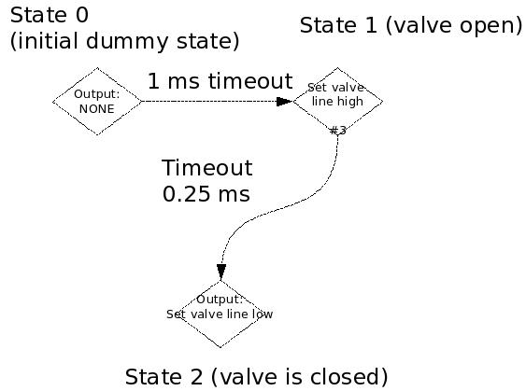
Water Valve Calibrator
Now, what would the corresponding state matrix for this machine look like?

Slide 22
Water Valve Calibrator
(State Matrix)
Timeout State | Timtout time | Continuous Output | Sound Trigger
1 | 0.001 | 0 | 0
2 | 0.025 | 1 | 0
3 | 0.0 | 0 | 0

Slide 23
Water Valve Calibrator
(Matlab Code)
Ts | To | Cont | Snd
1 | 0.001 | 0 | 0
2 | 0.025 | 1 | 0
3 | 0.0 | 0 | 0
mymat = [ 1 0.001 0 0;
2 0.025 1 0;
3 0.0 0 0; ];
fsm = RTLSM(‘rtlinuxrig1’);
fsm = SetInputEvents(fsm, [] ); % no IO line input events!
for i = 1:NUM_CALIB_LOOPS
fsm = Initialize(fsm); % clear event counter, fsm, etc
fsm = SetStateMatrix(fsm, mymat); % re-set our state matrix
fsm = ForceState(fsm, 0); % make sure we are in state 0
fsm = Run(fsm); % start the FSM
% poll state machine until it finishes and it got to state 2
while (GetEventCount(fsm) < 2)
pause(0.01); % sleep 10 ms
end;
end;
% at this point we know kept the valve open for 25ms * NUM_CALIN_LOOPS
% amount of time, thus we know how much water the valve generally gives

Slide 24
Simple Reward Protocol
Let’s specify a slightly more complex protocol:
  This time we have three possible input lines:
    the center nosecone (IO line 1)
    the left nosecone (IO line 2)
    The right nosecone (IO line 3)
  The protocol has the following basic features:
    It first tells the rat that it is ready for him by playing a tone on both left and right speakers.
    Next it waits for the rat to be ready – the rat indicates he is ready by poking into the center nosecone. Anything else is an error and the rat should be told this via an error tone.
    After the rat goes into the center (line 1), we play a tone to tell him water is available and where it is. The tone is played on the left side, indicating that the left cone is for water.
    Next, if the rat goes into the reward cone (left) we give him water. We should give him water for 1 second max. As soon as he leaves the reward cone, or the 1s timer expires, we should stop giving him water.
    Otherwise we play an error tone.
  NB: Left and right side sound playing can be controlled with a special paremeter to LoadSound(), thus we configure the side for sound playback at sound load time, rather than at runtime.

Slide 25
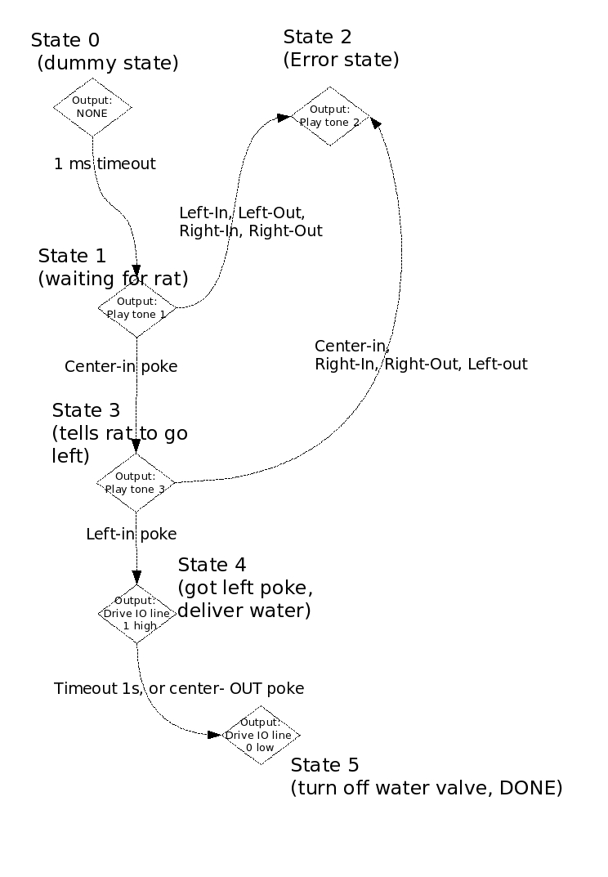
Simple Reward Protocol
Center IN (Line +1) | Center OUT (Line -1) | Left-IN (Line +2) | Left-OUT (Line -2) | Right-IN (Line +3) | Right-OUT (Line -3) | Timeout State | Timtout time | Continuous Output | Sound Trigger
0 | 0 | 0 | 0 | 0 | 0 | 1 | 0.001 | 0 | 0
3 | 2 | 2 | 2 | 2 | 2 | 1 | 0.0 | 0 | 1
2 | 2 | 2 | 2 | 2 | 2 | 2 | 0.0 | 0 | 2
2 | 2 | 4 | 2 | 2 | 2 | 3 | 0.0 | 0 | 3
4 | 4 | 4 | 5 | 4 | 4 | 5 | 1.0 | 2^0 | 0
5 | 5 | 5 | 5 | 5 | 5 | 5 | 0.0 | 0 | 0

Slide 26
Simple Reward Protocol
(Matlab code)
Center IN (Line +1) | Center OUT (Line -1) | Left-IN (Line +2) | Left-OUT (Line -2) | Right-IN (Line +3) | Right-OUT (Line -3) | Timeout State | Timtout time | Continuous Output | Sound Trigger
0 | 0 | 0 | 0 | 0 | 0 | 1 | 0.001 | 0 | 0
3 | 2 | 2 | 2 | 2 | 2 | 1 | 0.0 | 0 | 1
2 | 2 | 2 | 2 | 2 | 2 | 2 | 0.0 | 0 | 2
2 | 2 | 4 | 2 | 2 | 2 | 3 | 0.0 | 0 | 3
4 | 4 | 4 | 5 | 4 | 4 | 5 | 1.0 | 2^0 | 0
5 | 5 | 5 | 5 | 5 | 5 | 5 | 0.0 | 0 | 0
sm = RTLSoundMachine(‘rtlinuxrig1’); % construct soundmachine, connected to rtlinuxrig1
fsm = RTLSM(‘rtlinuxrig1’); % construct FSM, connected to rtlinuxrig1
sm = LoadSond(sm, 1, readySound);
sm = LoadSound(sm, 2, errorSound);
sm = LoadSound(sm, 3, waterSound, ‘left’); % specify sound is to play from left side
mymatrix = [ 0 0 0 0 0 0 0 0.001 0 0;
3 2 2 2 2 2 1 0.0 0 1; % play ready sound
2 2 2 2 2 2 2 0.0 0 2; % error state, stays put
2 2 4 2 2 2 3 0.0 0 3; % rat poked center, play watersound
4 4 4 5 4 4 4 1.0 2^0 0; % rat poked left, deliver water for 1s max
5 5 5 5 5 5 5 0.0 0 0; ]; % end state
fsm = SetInputEvents(fsm, [-1, 1, -2, 2, -3, 3 ]; % define input events for each of the first 6 columns
fsm = SetStateMatrix(fsm, mymatrix);
Run(fsm);

Slide 27
The Inter-Trial Interval
Typically, each state matrix specifies the FSM for one particular trial.
As such, new state matrices are being re-uploaded to the RTLinux box in-between trials.
In order to keep things sane, we should define a set of states that should remain constant for a particular protocol across trials
  So that swapping out a new state matrix from under a running state machine doesn’t cause confusion
By convention, we will say states 0-39 are constant, ITI states.

Slide 28
The Inter-Trial Interval
In order to illustrate considerations for the inter-trial interval, let’s look at our previous reward protocol state machine, modify it to do some trivial work during the ITI, and also adapt it to our ITI convention of constant states 0-39…

Slide 29
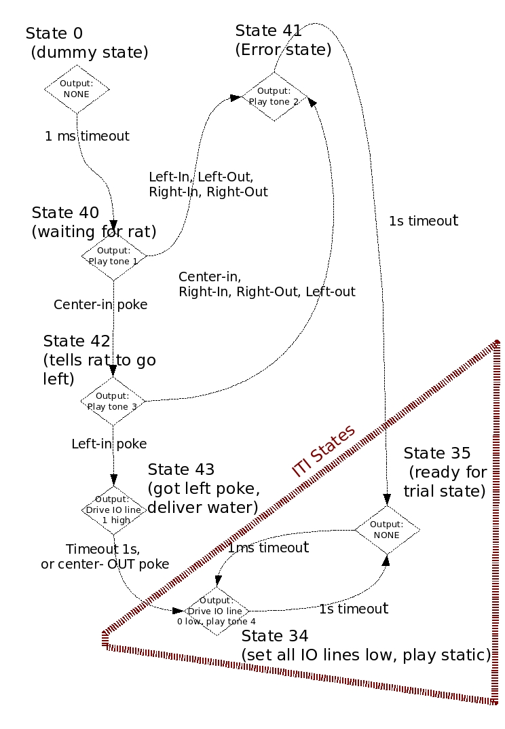
The Inter-Trial Interval
This State Machine differs from the previous in that it loops between state 35 and state 34, playing static, after the trial is done (regardless of success or failure)
We have the option now of swapping this for another state matrix to play sounds and deliver rewards on the right cone.
We say states 0-39 never change, so this is safe.

Slide 30
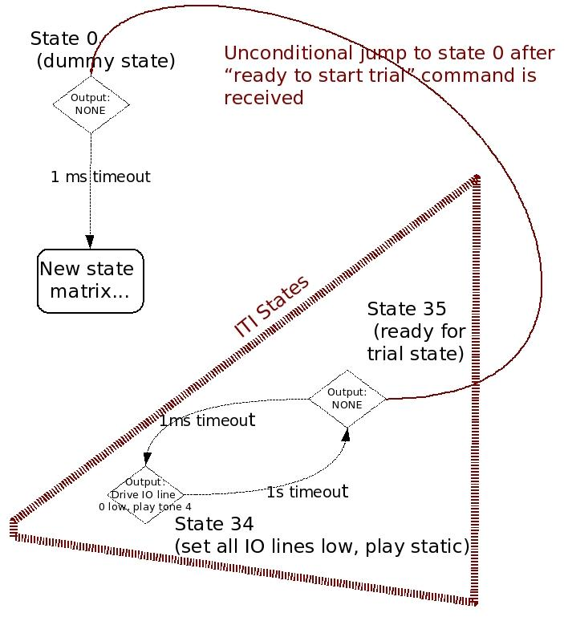
The Inter-trial Interval,
State 35
Finally, state 35 is special in that we can set a flag, after uploading a state matrix, that says “jump to state 0 the next time you hit state 35”
The code for this would be:
  … % matlab code to compute new matrix
  fsm = SetStateMatrix(fsm, matrix);
  % assumption is FSM is looping around state 35 as in the example on the right
  fsm = ReadyToStartTrial(fsm);
  % at this point, the next time the state machine goes to state 35, it will automatically jump to state 0, the universal start state

Slide 31
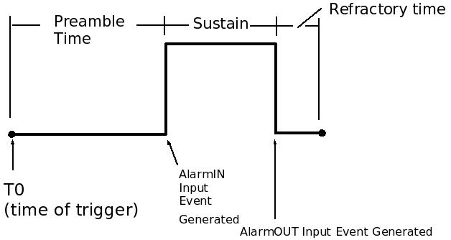
FSM Advanced Topics - Alarms
An advanced feature that we have not covered thus far:
  Alarms
    An alarm is a ‘scheduled waveform’ that gets triggered, goes high some time later, then goes low some time after that.
    Alarms get triggered on a state-by-state basis. Triggering an alarm is a type of state output and as such gets its own additional column in the state matrix.
    An alarm can be routed back as a state machine input, and/or it can be routed to physical DIO lines.
    Alarms are useful for expiring a group of states, or for implementing skip-out tolerance¹ in protocols
¹ skip-out tolerance will be discussed in a few slides ☺

Slide 32
FSM Advanced Topics - Alarms
Alarms have the following features:
  Preamble time: the time from which the alarm is triggered to when it fires (goes high).
    An alarm that goes high may set an Alarm-IN input event, a DIO line high, or both.
  Sustain time: the time from which the alarm goes high until it goes low again.
    An alarm that goes low may set an Alarm-OUT input event, a DIO line low, or both.
  Refractory time: the amount of time after the alarm has gone low until it can be triggered again (a sort of blanking time).

Slide 33
FSM Advanced Topics - Alarms and Skip-out Tolerance
Suppose in our previous simple reward example, we wanted to be more tolerant of the way rats may actually behave during an experiment.
We can implement skip-out tolerance in order or allow rats to temporarily leave a nosecone, and not have it count against them.
In order to simplify matters, and also illustrate the use of the alarm ‘virtual’ event, we will use alarms to implement skip-out tolerance.

Slide 34
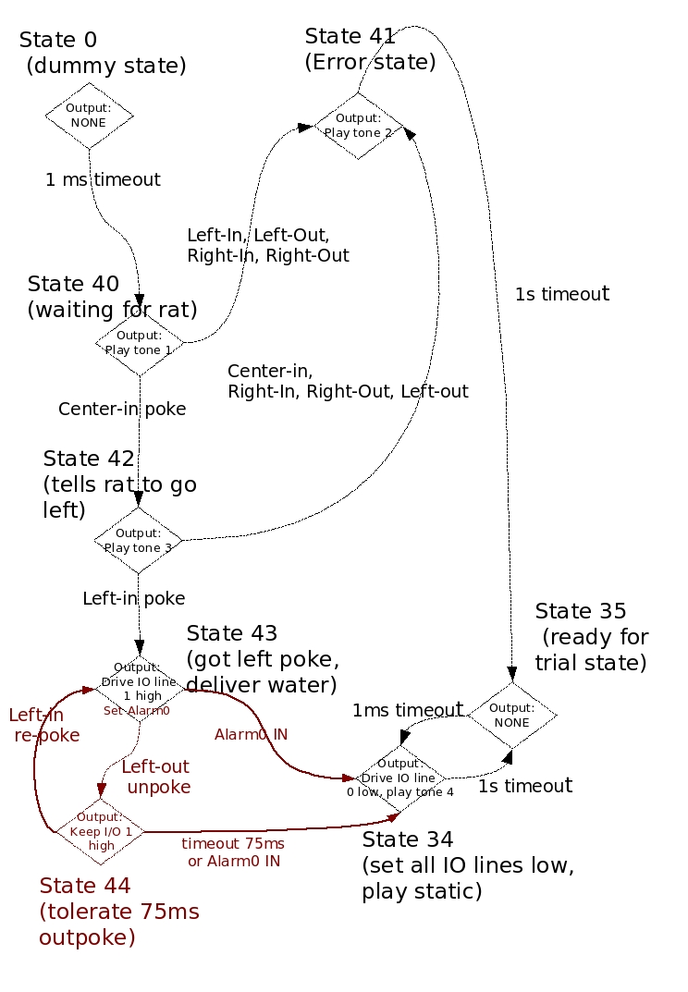
A Kinder, Gentler FSM
State 43 now starts Alarm0
  Alarm0 defined to have preamble 1s, sustain 1ms, and refraction 1ms
  Alarm0 is now our general timeout for the group of states: state 43 and state 44
We use our per-state timeout to implement skip-out tolerance of 75ms in state 44.
Thus, the rat is allowed an infinite number of out-in pokes between state 43 and 44 as long as the Alarm0 timer doesn’t expire and as long as they are OUT for less than 75ms.
End result is that even for a jittery rat, we deliver 1s of water

