Slide 1
Protocol-writing with
the Solo system:
The Basics:
The Water Valve Calibrator

Slide 2

Getting your Bearings
(or, “If only all pathways were this easy”)
Path to protocol executable: (root-dir)/ExperPort/Protocols/
Protocol object: protocolnameobj.m
Object files in: (1)/@protocolnameobj.m

Slide 3
solo_watervalveobj.m
C
P
state35.m
close.m
Call to constructor
(update files)
close.m
state35.m
The protocol file

Slide 4
C
Constructor
P
state35.m
close.m
Matlab object creation code
Delete previous SoloParamHandles (SPH) associated with the object
Protocol-nonspecific variables
Declaring a function that uses SPHs

Slide 5
Constructor: Adding UI elements
C
P
state35.m
close.m

Slide 6
Previewing Greatness to Come …

Slide 7
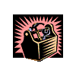
Constructor: Adding UI elements (2)
C
P
state35.m
close.m
Optional UI features (labels, tooltips)
Positioning

Slide 8
Constructor: Add Dispense Control
C
P
state35.m
close.m
Look at HandleParam/*.m for available features
e.g. HandleParam/EditParam.m

Slide 9
The constructor initialises the state matrix
C
P
state35.m
close.m
stm_script
Declaring …
… and calling
SoloFunctions
The constructor initialises
all peripheral sections of a protocol. e.g.
Deciding trial sides (SidesSection.m)
Constructing sounds (ChordSection.m)

Slide 10
Programming the state matrix:
Skeleton for specialised files
C
P
state35.m
close.m
stm_script
How a SoloFunction gets registered SPHs during each call
Adding UI elements to the main figure (controlled by this script)

Slide 11
C
P
state35.m
close.m
stm_script
Using read-only args
Using flags set in
mystartup.m
Setting a value: myvar.value = 22/7;
Getting a value: value(myvar)

Slide 12
Talking to the RPBox: send_matrix
C
P
state35.m
close.m
stm_script
…
…
…

Slide 13
state35.m: Executed at the end of trials
C
P
state35.m
close.m
stm_script
trial_finished_actions
is an SPH!
Constructor

Slide 14
Not just a pretty face: Callbacks
C
P
state35.m
close.m
stm_script
Not returning => extra state matrix generations!

Slide 15
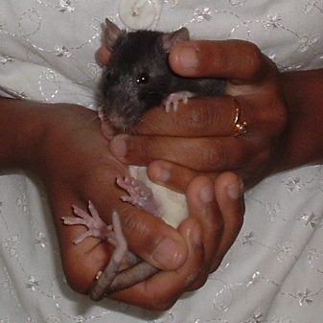
Your rats will
never
be biased
towards one drink port again!

