Slide 1


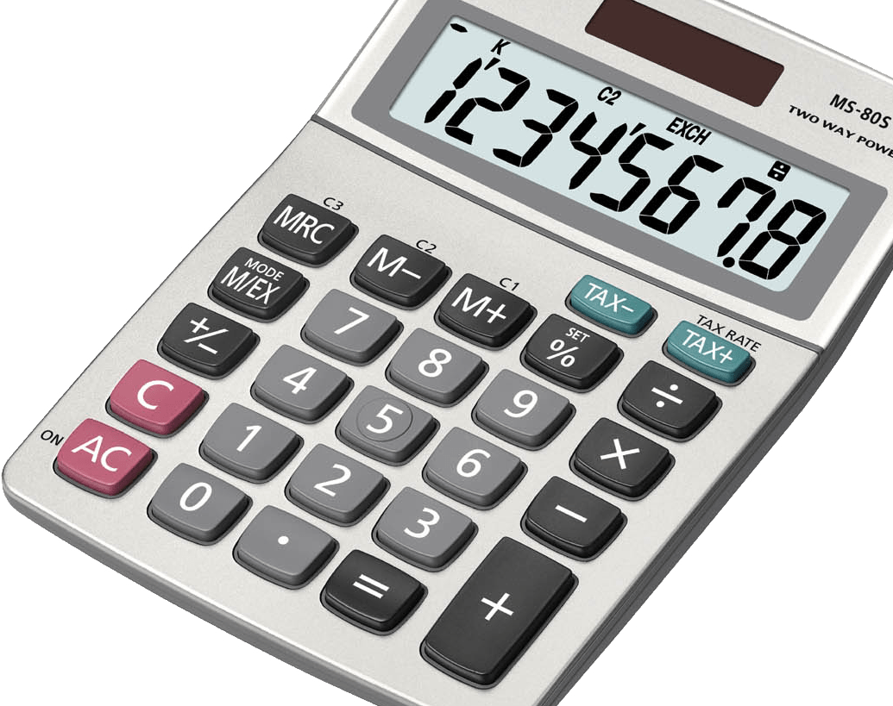
The Ultimate Calculator
3XA3
L01 Group 15
This Photo by Unknown Author is licensed under CC BY-NC
This Photo by Unknown Author is licensed under CC BY-SA

Slide 2

Introduction
The Ultimate Calculator is based on an open-source project found on GitHub.
It is a tool that allows users to solve complex problems that a basic calculator can not easily solve.
Gives users access to a variety of mathematical tools within one simple and easy to use application.
The Ultimate Calculator can also be used without WIFI unlike most answer engines found on the internet.
This Photo by Unknown Author is licensed under CC BY

Slide 3
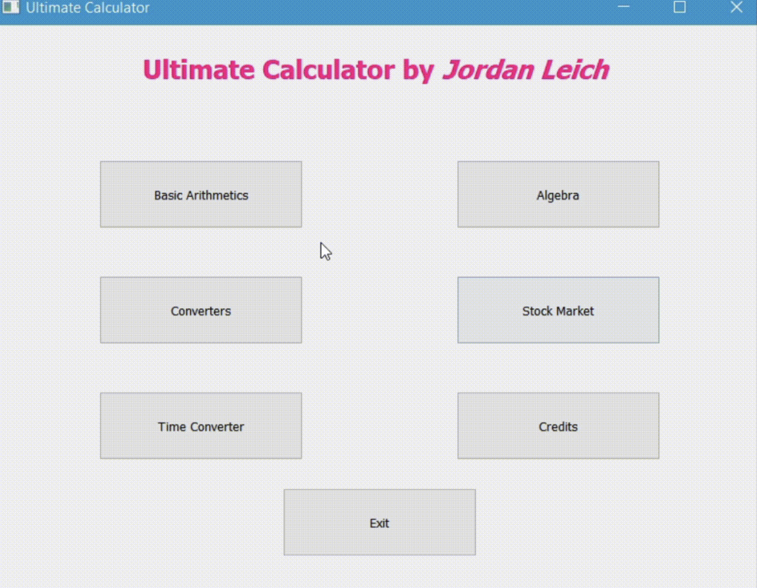
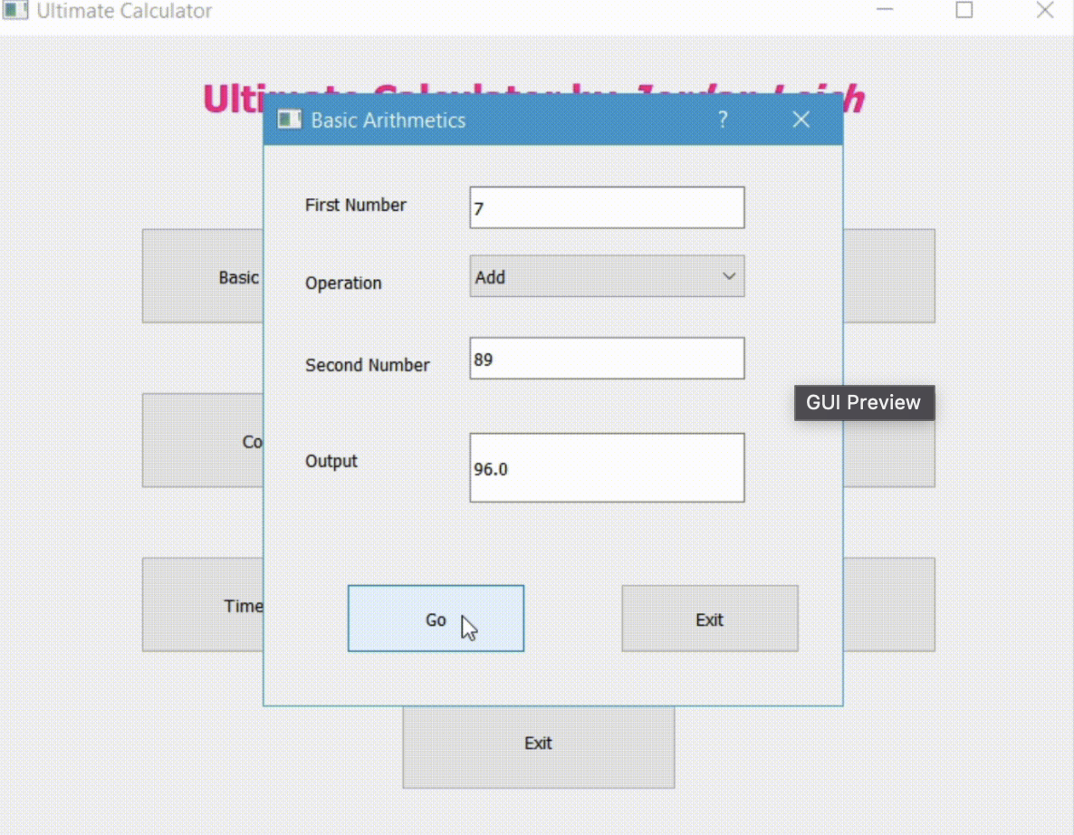
Source Project
The source project has a very generic GUI that shares little resemblance with a calculator.
Minimal error handling was done for most calculations.
No testing was done for the source project.
Source files were poorly modularized.
The source project included several functions, such as basic arithmetic, algebra, and unit conversions.

Slide 4

Implemented Changes
All graphical user interface components of the application have been redesigned and updated to create a coherent and appealing look.
General improvements to the robustness of the application including upgraded error handling, limited character inputs, and read only outputs.
General improvements to the usability of the application including clear input buttons and proper closing of windows.
Modularization of the existing source code along with added modules for new features.
Regarding testing, unit tests have been conducted for the functionality modules and manual tests were conducted to ensure the GUI was functioning properly.

Slide 5

Further Improvements

