Slide 1
High Performance Matrix-Free
Method for Large-Scale FEA
on GPUs
Petros Apostolou, Florian Dugast and Albert To*
Dept. of Mechanical Engineering and Materials Science
University of Pittsburgh
April-02-2020

Slide 2
Outline
Problem Statement
Finite Element System Formulation
Necessity of Matrix-Free Method
State of the Art
CPU Matrix-Free Conjugate Gradient
GPU Matrix-Free Conjugate Gradient
Contribution
Future Research
1-3 Introduction
4-6 Method
7-8 Results

Slide 3
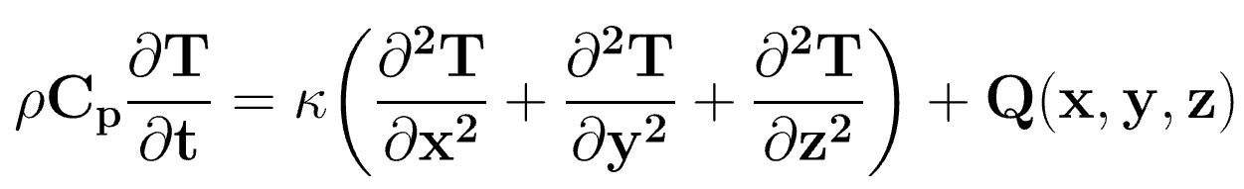
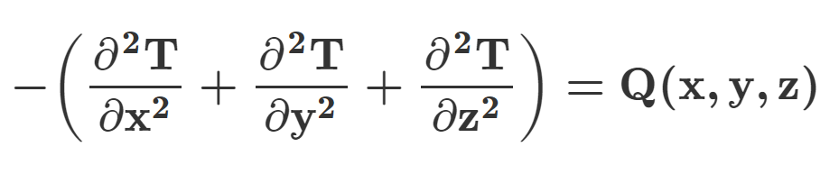
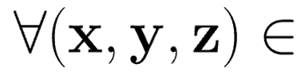

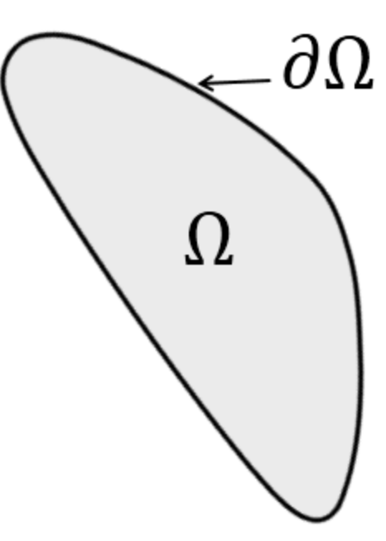
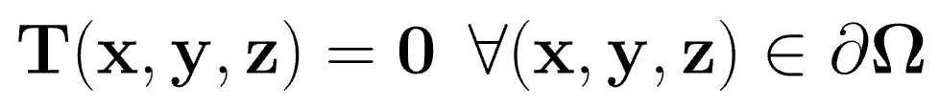
Problem Statement
3D Steady-State Heat Conduction (Isotropic thermal conductivity k) :
0
1
Boundary Conditions (Dirichlet):

Slide 4
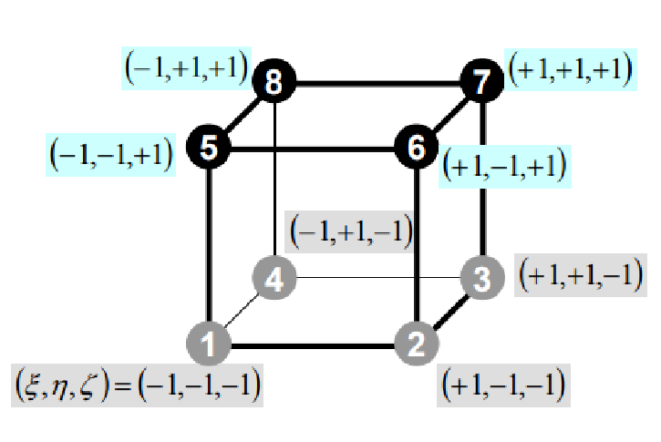

Finite Element System Formulation
“Weak” form of the heat conduction equation (Galerkin method):
N = [N1 N2 … N8]: shape functions for the
8-node finite element (hexahedron) N1 = 1/8 (1-ξ)(1-n)(1-ζ)
[Ke]{Te} = {Fe}: finite element system for ele. e
Ke[8 x 8] = B^{T}B: where B =
K: global conductivity matrix
T: temperature field
F: heat source vector
KT = F

Slide 5
Necessity of Matrix-Free Method
[N x N]
[N x 1]
[N x 1]
K
T
F
Size[K] becomes a major bottleneck for large sizes (e.g. N > 10M):
N becomes λN → [λN x λN] = (λΝ)² → Expensive (λ = 1,2,3,...)
Sparse-matrix storage is NOT enough → Exceeds memory limits
Suggestion:
Matrix-free method allows for larger size domains by avoiding the global matrix assembly ➔ [N x N] is not necessary to be stored or computed

Slide 6
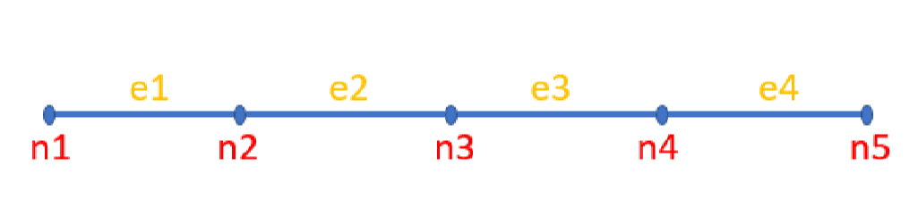
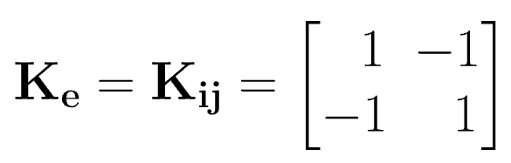
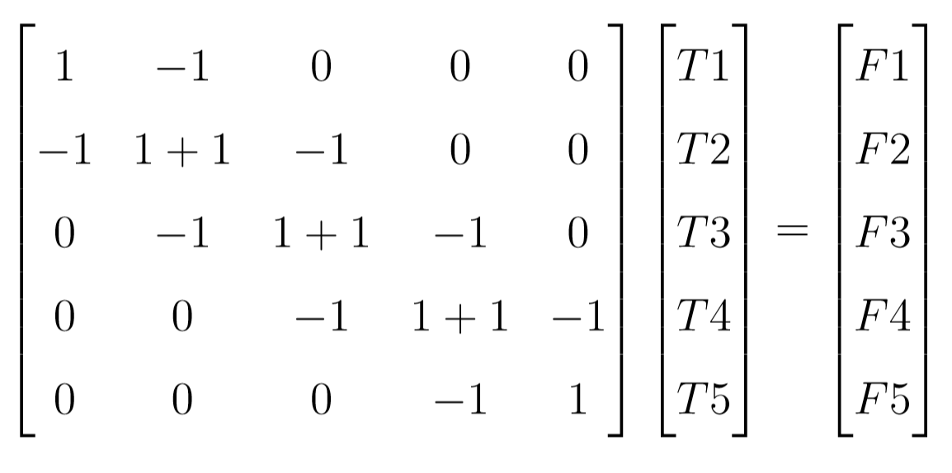
Necessity of Matrix-Free Method
Assuming:
K
T
F
K1
e1
K2
If local to global
nodal values
transfers are given
then instead of K
only Ke is needed!!
K3
e2
e3
K4
e4
Writing the linear finite equation for node 2:

Slide 7
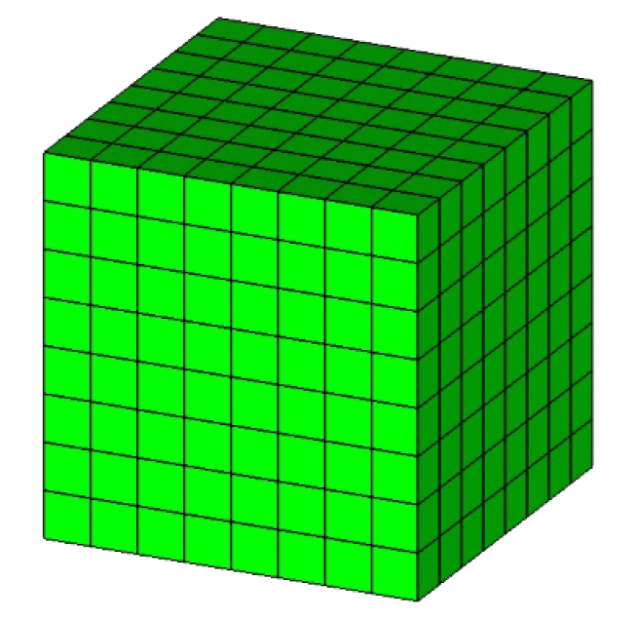
Necessity of Matrix-Free Method
Voxel-based technique in hexahedral mesh:
N
N = [n_{x} x n_{y} x n_{z}] : mesh nodes
id = i + (n_{x} x j) + [(n_{x} x n_{y} ) x k]
node(id+1) = node(id) + 1
row(id+1) = row(id) + 1
slice(id+1) = slice(id) + 1
e → id → edof[id]
n_{y}
slice
row
n_{z}
k
j
n_{x}
i
Regular connectivity facilitates matrix-free methods

Slide 8
State of the Art
Matrix-Free Methods:
Thomas Hughes “An element-by-element solution algorithm for problems of structural and solid mechanics”. Division of Applied Mechanics, Durand Building, Stanford University, Stanford, August 1982, U.S.A. [1st Instance]
J.M.Frutos & D.H.Perez “Efficient matrix-free GPU implementation of Fixed Grid Finite Element Analysis” Department of Structures and Construction, Technical University of Cartagena, May 2015 Spain. [20 x Speed-Up – 1 GPU]
Pros: Significant savings in computational time and memory
Cons: Difficult for Unstructured Mesh and Complex Boundaries

Slide 9


CPU Matrix-Free Conjugate Gradient
reference: https://en.wikipedia.org/wiki/Conjugate_gradient_method
T ← 0 (initial guess)
r ← KT – F (residual)
Update Matrix-Free MV(dst,Ke,src)
Compute Conjugate Direction α
update T = T + a * src
update r = r – a * dst
update r_{norm} = $\sqrt{rTr}$
Update line search and help vectors
Matrix-Free MV
Compute line search
Compute r_{norm}
TRUE
$$2$$
While
[r_{norm} > ε = 10⁻⁶ ]
r_{norm} = ε, KT – F = 0
Convergence

Slide 10
CPU Matrix-Free Conjugate Gradient
Matrix-Free MV(dst, Ke, src):
set dst ← 0
for element in mesh
for rows in Ke[8 x 8]
extract row_{index}
define tmp ← 0
for nodes in element
extract DOF_{index}
tmp = tmp + Ke * src
end
dst = dst + tmp
end
end
! impose Dirichlet BC
for element in mesh
if [element == face]
src ← 0
dst ← 0
end
end
return dst
MFMV consumes 80% out of the total computations

Slide 11
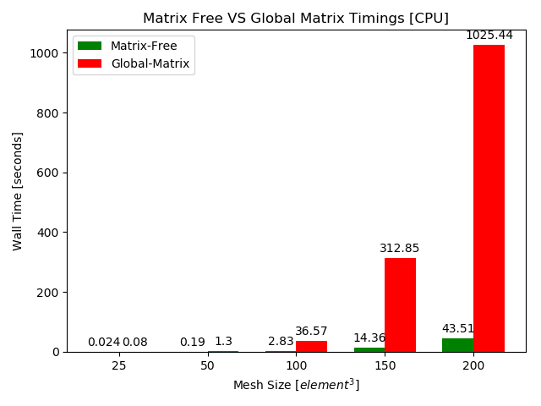
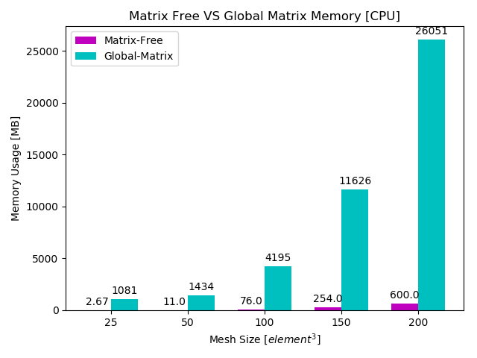
CPU Matrix-Free Conjugate Gradient
Computational Time on CPU:
Memory usage on CPU:
MFCG is 23.84 x times faster than the global matrix assembly solver
MFCG consumes 43.42 x times less memory

Slide 12
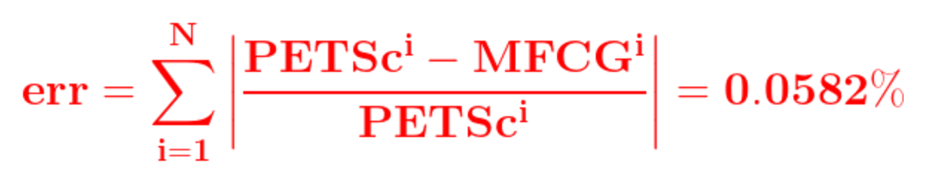
CPU Matrix-Free Conjugate Gradient
Verification of the numerical results with the PETSc library
Ref: https://www.mcs.anl.gov/petsc/
Relative numerical error :
Dirichlet BC: T = 0 is satisfied on boundary faces

Slide 13
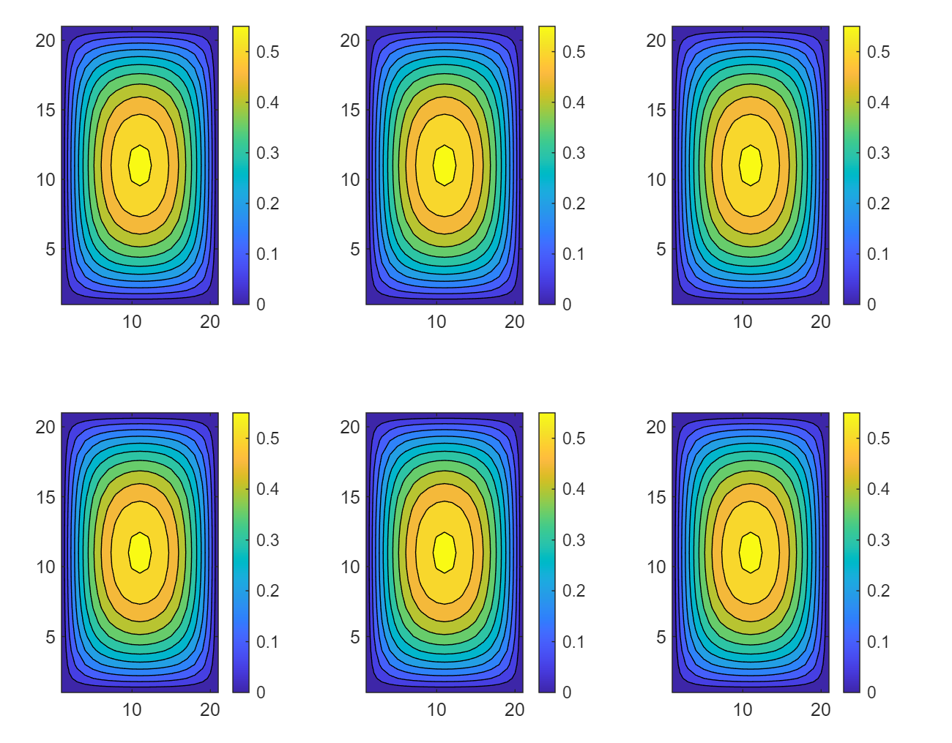
CPU Matrix-Free Conjugate Gradient
Verification of the numerical results with the FreeFem++ library – https://freefem.org/
xy-plane
xz-plane
yz-plane
FreeFem++
SIZE = 20³
MFCG
SIZE = 20³
Good agreement with FreeFemm++ library
3D Symmetric (x,y,z)

Slide 14
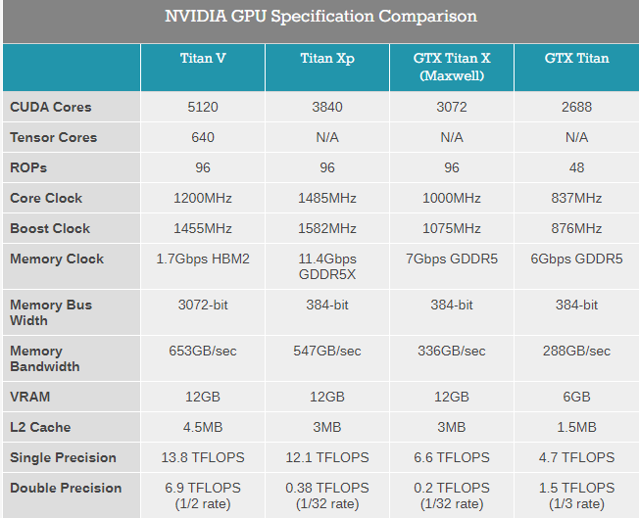
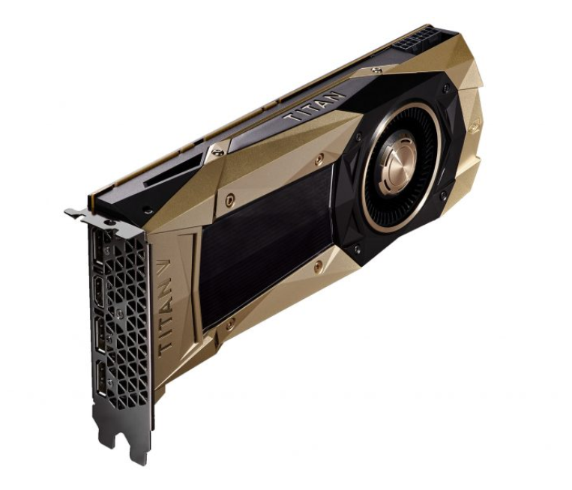
GPU Matrix-Free Conjugate Gradient
5120 cuda cores & 12 GB memory with ~ 7TFLOPS double precision

Slide 15


GPU Matrix-Free Conjugate Gradient
CUDA Thread-Block Architecture:
GPU Grid
BLOCK ID
1
2
3
N
blockIdx.x
1
1
1
threadIdx.x
2
2
2
BLOCKSIZE
256
Typically optimal number of threads
256
256
ELE_BLOCKS = numElems/BLOCKSIZE + 1
NOD_BLOCKS = numNodes/BLOCKSIZE + 1
N =

Slide 16
GPU Matrix-Free Conjugate Gradient
Outline of basic steps for the GPU (CUDA) MFCG algorithm:
Ref: CUDA TOOLKIT: https://docs.nvidia.com/cuda/index.html
Get GPU device cudaGetDevice(ID)
Allocate global memory cudaMallocManaged(…)
Copy host Ke and all vectors to device cudaMemcpy(…HostToDevice)
Matrix-Free MV<<<ELE_BLOCKS,BLOCKSIZE>>>(…)
cuBLAS for linear algebra updates (ddot,daxpy,dnrm2)
UpdateVector<<<NOD_BLOCKS,BLOCKSIZE>>>(…)
Copy T device to host cudaMemcpy(…DeviceToHost)
cudaFree(…)

Slide 17
GPU Matrix-Free Conjugate Gradient
Matrix-free matrix-vector product MFMV(dst,src,Ke)
e = blockIdx.x * BLOCKSIZE + threadIdx.x
SIZE: Number of Mesh Elements
if
(e < SIZE )
Cuda atomicAdd operation:
for rows in Ke[8 x 8]
extract row_{index}
define tmp → 0
for nodes in element
extract DOF_{index}
tmp[node] = tmp[node] + Ke * src
end
sum = tmp[node]
atomicAdd(&dst[DOF_{index} [row]], sum)
end
atomicAdd(&vec,scal)
perform n times:
vec = vec + scal
returns: vec at step n
!atomicAdd handles “races conditions” occurring in SIMD

Slide 18
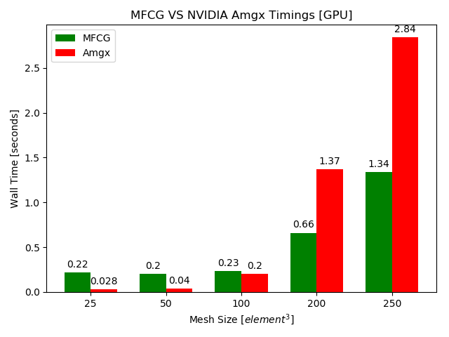
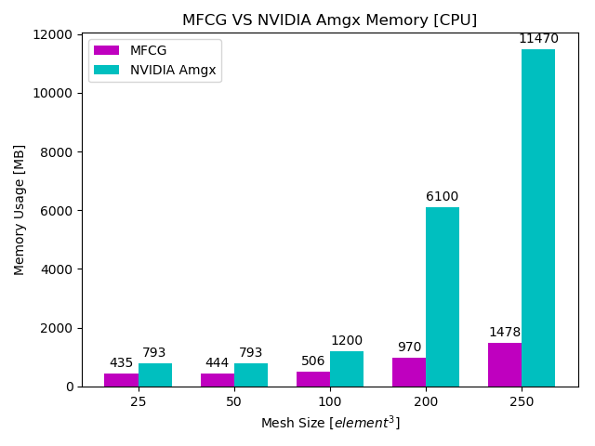
GPU Matrix-Free Conjugate Gradient
Timings of MFCG vs NVIDIA Amgx
Up to Size = 250³:
Memory of MFCG vs NVIDIA Amgx
Up to Size = 250³:
Ref: https://github.com/NVIDIA/AMGX
MFCG is 2.12 x times faster than the NVIDIA Amgx Solver
MFCG consumes 7.76 x times less memory than NVIDIA Amgx

Slide 19
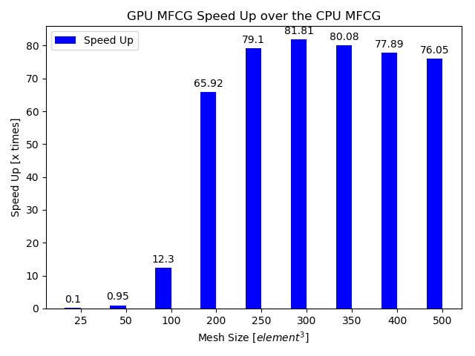
GPU Matrix-Free Conjugate Gradient
Maximum GPU Speed-Up = 81.81 x times for double precision

Slide 20
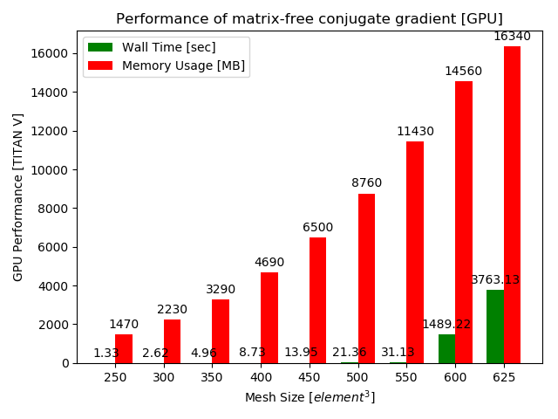
GPU Matrix-Free Conjugate Gradient
out-of memory
in-memory
Maximum mesh size = 550³ elements is computed in Wall Time = 31.31s
GPU overruns for size > 550³ (not recommended)

Slide 21
Contribution
CPU (C) implementation of MFCG method for a Large-Scale FEA of the Steady-State Heat Conduction using the Voxel-Based Technique
GPU (CUDA) implementation of MFCG method for the Acceleration and Scaling of the Large-Scale FEA up to 550³ = 166,375,000 Elements
A Performance Analysis on the Timings and Memory between:
a) the CPU MFCG method and PETSc (global matrix-assembly)
b) the GPU MFCG method and NVIDIA Amgx (global matrix-assembly)
! Both PETSc & Amgx use “Sparse-Matrix Storage” (Non-Zero Storage)

Slide 22
Future Research
Muti-GPU (CUDA) on 4 TITAN V GPUs for Large-Scale Transient Heat-Transfer on Layer-by-Layer Process Simulation for L-PBF
MF-CG → MF-PCG (Matrix-Free Jacobi Preconditioner CG)
Hybrid MPI + Multi-GPU Scheme for High Core Scaling

Slide 23
Questions…
Thank You

Slide 24
High Performance Matrix-Free
Method for Large-Scale FEA
on GPUs
Petros Apostolou, Florian Dugast and Albert To*
Dept. of Mechanical Engineering and Materials Science
University of Pittsburgh
April-02-2020

