Slide 1
Egy lekérdezés végrehajtása
SELECT o1 FROM T1 WHERE o2 = …
Hogyan jutnak el a megfelelő sorokból a mező értékei a klienshez?

Slide 2
Táblaterek és adatfájlok
Egy táblatér egy vagy több adatfájlból áll.
Egy adatfájl pontosan egy táblatérhez tartozik.
Data file 1
Data file 2
USERS tablespace
Notes:
Tablespaces and Data Files
A database is divided into logical storage units called tablespaces, which can be used to group related logical structures together. Each database is logically divided into one or more tablespaces. One or more data files are explicitly created for each tablespace to physically store the data of all logical structures in a tablespace.
Note: You can also create the bigfile tablespaces, which are tablespaces with a single but very large (up to 4 billion data blocks) data file. The traditional smallfile tablespaces (which are the default) can contain multiple data files, but the files cannot be as large. For more information about the bigfile tablespaces, see the Database Administrator’s Guide.

Slide 3




Szegmens, Extens, Blokk
Minden Szegmens egy táblatéren belül van.
A Szegmensek extensekből állnak.
Az Extensek egy adatfájlon belüli szomszédos adatblokkokból állnak.
Az adatblokkok a lemezblokkokra (szektorokra) vannak leképezve.
Segment
Extents
Data blocks
Disk blocks
Notes:
Segments, Extents, and Blocks
Database objects, such as tables and indexes, are stored as segments in tablespaces. Each segment contains one or more extents. An extent consists of contiguous data blocks, which means that each extent can exist only in one data file. Data blocks are the smallest unit of I/O in the database.
When the database requests a set of data blocks from the operating system (OS), the OS maps this to an actual file system or disk block on the storage device. Because of this, you need not know the physical address of any of the data in your database. This also means that a data file can be striped or mirrored on several disks.
The size of the data block can be set at the time of the creation of the database. The default size of 8 KB is adequate for most databases. If your database supports a data warehouse application that has large tables and indexes, then a larger block size may be beneficial.
If your database supports a transactional application where reads and writes are random, then specifying a smaller block size may be beneficial. The maximum block size depends on your OS. The minimum Oracle block size is 2 KB and should rarely (if ever) be used.
You can have tablespaces with different block sizes. However, this should be used only for transportable tablespaces. For details, see the Database Administrator’s Guide.

Slide 4
Logikai és fizikai struktúrák
Logical
Physical
Database
Schema
Tablespace
Data file
Segment
Extent
Oracle data block
OS block
Notes:
Logical and Physical Database Structures
An Oracle database is a collection of data that is treated as a unit. The general purpose of a database is to store and retrieve related information. The database has logical structures and physical structures.
Tablespaces
A database is divided into logical storage units called tablespaces, which group related logical structures together. For example, tablespaces commonly group all of an application’s objects to simplify some administrative operations. You may have a tablespace for application data and an additional one for application indexes.
Databases, Tablespaces, and Data Files
The relationship among databases, tablespaces, and data files is illustrated in the slide. Each database is logically divided into one or more tablespaces. One or more data files are explicitly created for each tablespace to physically store the data of all logical structures in a tablespace. If it is a TEMPORARY tablespace, instead of a data file, then the tablespace has a temporary file.

Slide 5
Hogyan tárolódnak a táblabeli adatok?
Columns
Blocks
Table A
Table B
Rows
Segment
Segment
Table
Tablespace
Row piece
Extent
Notes:
How Table Data Is Stored
When a table is created, a segment is created to hold its data. A tablespace contains a collection of segments. Logically, a table contains rows of column values. A row is ultimately stored in a database block in the form of a row piece. It is called a row piece because under some circumstances the entire row may not be stored in one place. This happens when an inserted row is too large to fit into a single block or when an update causes an existing row to outgrow its current space.

Slide 6
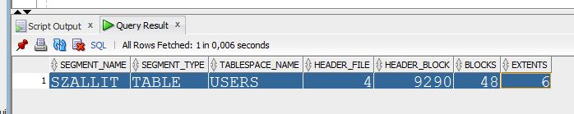
Hol vannak a táblához tartozó adatblokkok?
SELECT segment_name, segment_type, tablespace_name,
header_file, header_block, blocks, extents
FROM dba_segments where owner='NIKOVITS'
AND segment_name='SZALLIT' AND segment_type='TABLE';

Slide 7
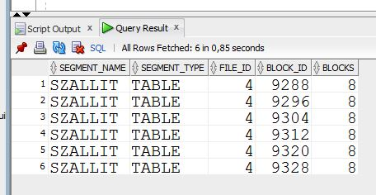
Hol vannak a táblához tartozó adatblokkok?
SELECT segment_name, segment_type,
file_id, block_id, blocks
FROM dba_extents where owner='NIKOVITS'
AND segment_name='SZALLIT' AND segment_type='TABLE';

Slide 8
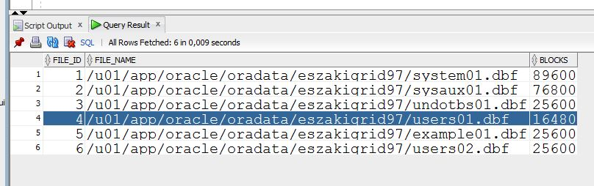
Hol vannak a táblához tartozó adatblokkok?
SELECT file_id, file_name, blocks
FROM dba_data_files;

Slide 9
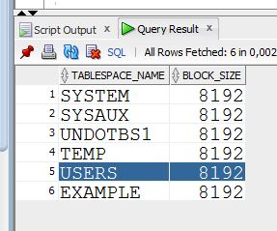
Az adatfájlnak melyik részét kell olvasnunk? (mekkora a blokkok mérete)
SELECT tablespace_name, block_size
FROM dba_tablespaces;

Slide 10
Az adatblokkok tartalma
Block header
Growth
Free space
Row data
Notes:
Database Block: Contents
Oracle data blocks contain the following:
Block header: The block header contains the segment type (such as table or index), data block address, table directory, row directory, and transaction slots of size 23 bytes each, which are used when modifications are made to rows in the block. The block header grows downward from the top.
Row data: This is the actual data for the rows in the block. Row data space grows upward from the bottom.
Free space: Free space is in the middle of the block. This enables the header and the row data space to grow when necessary. Row data takes up free space as new rows are inserted or columns of existing rows are updated with larger values. The examples of events that cause header growth are when the row directory needs more row entries or more transaction slots are required than initially configured. Initially, the free space in a block is contiguous. However, deletions and updates may fragment the free space in the block. The free space in the block is coalesced by the Oracle server when necessary.

Slide 11
Változó hosszúságú rekordok
Mikor lesznek változó hosszúak a rekordok?
Ha a fájl több tábla sorait együtt tárolja
create table t (field1 int, field2 varchar2(n)) -> Varchar mező
Problémák:
A törléskor keletkező lyukak különböző méretűek lesznek
Új sor beszúrásakor megfelelő méretű szabad hely van-e
Megoldási lehetőség: maximális rekordméret alkalmazása
Sok helyet elpazarlunk
Használjunk rekord mutatókat (méretet tároljuk)
Rekord méretek a fejlécben (alul)
Tudjuk a rekordok kezdetét és méretét
Rekord azon: blokkszám, rekord sorszám
...
32
...
N
16
38
N
2
1

Slide 12
Rekordok szerkezete
Fix hosszúságú rekordok
A mezők közvetlenül egymás után vannak tárolva (nincs mutató)
Változó hosszúságú rekordok
Eltolás értékeket tartalmazó tömb
NULL értéket jelöl a nulla hosszúságú mező
f1
f2
f3
f4
Bázis cím (B)
L1
L2
L3
L4
f3 címe = B+L1+L2
f1
f2
f3
f4
Bázis cím (B)
Notes:
Where are the number of fields and data types stored?
Record that grows moves subsequent fields

