Slide 1
Romanian Reddit Depression and Well-being Corpus
Cristea Petru-Theodor
Dilirici Mihai
Militaru Mihai

Slide 2
Introduction
Purpose: Automatic detection of depressive vs. non-depressive content in Romanian Reddit texts
Main features:
Binary classification: Depressive / Non-depressive
Manual annotated
Short standalone sentences
Surse de date:
SCRAPED – Romanian subreddits: Ex. Depresiv: „În 2024 am trecut prin cea mai grea perioadă a vieții mele...” Ex. Non-depresiv: „Când i-am zis la doctorul de familie a pus mâna pe telefon...”
MACHINE TRANSLATION – (to enhance dataset size) translated sentences from English: Ex. Depresiv: „Nu am nimic altceva decât dispreț pentru mine însămi.” Ex. Non-depresiv: „Care sunt unele limite pe care le-ai stabilit cu părinții tăi?

Slide 3
Data Collection & Preprocessing
Data Source:
Reddit – Romanian-speaking subreddits: r/romania, r/CasualRO, r/WomenRO, r/bucuresti, r/brasov, r/cluj, r/iasi, r/MenRO, r/moldova, r/Roumanie
Extraction Method:
Official PRAW API used
Top 15 comments per post (by Reddit score) included
Boolean search query with depression-related keywords: depresie, anxietate, panică, suferință, singurătate, dezamăgire, frică, gânduri negre, PTSD, tristețe, sinucidere, suicidal, angoasă etc.
Sentence Filtering Criteria:
Sentences < 3 words discarded
KeyWords banning (For non depression we banned keywords like suicid)
Duplicates removed
Only posts/comments ≥ 10 words processed

Slide 4
Dataset Overview
Total unique sentences: 4,721
Depressive: 2,221 sentences
Non-depressive: 2,500 sentences
Data distribution
Subreddit | Depressive | Non-depressive
CasualRO | 1,489 | 1,805
WomenRO | 1,182 | 1,523
MenRO | 574 | 1,328
bucuresti | 330 | 783
cluj | 328 | –
iasi | 66 | –
brasov | 19 | –
Roumanie | – | 400
moldova | – | 203

Slide 5
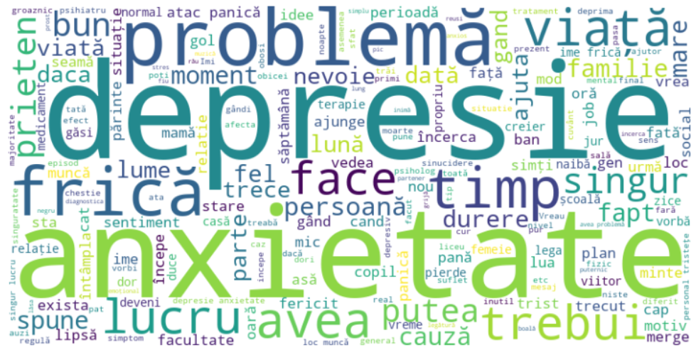
Depresion Samples
Depression
Frica de abandon e reală și profundă,SCRAPED,0
În 2024 am trecut prin cea mai grea perioadă a vieții mele — o depresie care aproape m-a băgat în spital,SCRAPED,0
Nu am nimic altceva decât dispreț pentru mine însumi.,MACHINE_TRANSLATION,0

Slide 6
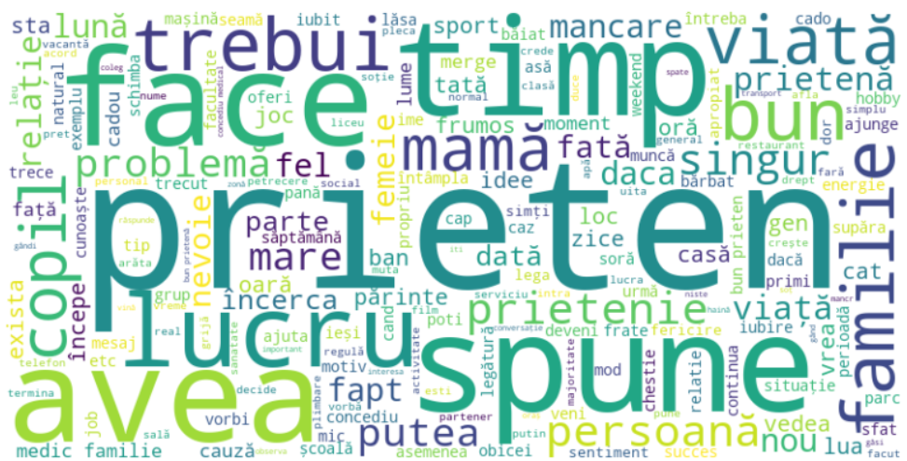
Non depression samples
Non depression
O buna parte din membri USR sunt oameni cu studii superioare care au lucrat numai in privat si vor o tara corecta,SCRAPED,1
"Merg weekendul asta in vama cu inca 2 prieteni, daca o sa fii pe acolo si vrei sa te alaturi si tu, da-mi un dm",SCRAPED,1
Soția mea nu vrea să îi dea Toyota de teamă că o va pierde.,MACHINE_TRANSLATION,1

Slide 7
Linguistic Origin of the Data
Language:
Entire dataset: Romanian sentences only
Data Composition:
70% Natural Romanian: Authored directly by native speakers on Romanian-language subreddits.
30% Machine-Translated Romanian: Originally written in English, translated into Romanian using OpenAI GPT-4.1 via a prompt-based pipeline.
Translation Process:
GPT-4.1 instructed to only return the translated text (no explanations or comments).
Partial manual verification performed to ensure linguistic and contextual accuracy.

Slide 8
Baseline Models & Evaluation Results
Data Preparation:
Labels: 0 = Depressive, 1 = Non-depressive; Train/Test Split: 80/20
Baseline 1 (Word2Vec + SVM)
Accuracy: 69.7%
Issues: High false negatives for depressive class
F1-Score (Macro Avg): 0.69
Baseline 2 (Romanian BERT + SVM)
Accuracy: 85.0%
Balanced detection of both classes
F1-Score (Macro Avg): 0.85
Model | Accuracy | Precision (0/1) | Recall (0/1) | F1-score (0/1)
Word2Vec + SVM | 69.7% | 0.72 / 0.69 | 0.59 / 0.79 | 0.65 / 0.73
Romanian BERT + SVM | 85.0% | 0.85 / 0.85 | 0.82 / 0.88 | 0.84 / 0.86

Slide 9
Limitations & Risks
Annotation Subjectivity:
Manual & semi-automated labeling may introduce human bias
Possible inconsistencies despite clear guidelines
Machine-Translated Data Issues:
30% of data translated via GPT-4.1
Risk of stylistic, lexical, or semantic discrepancies
May impact linguistic patterns and model performance
Platform-Specific Bias:
Data sourced only from Reddit
Results may not generalize to other platforms

Slide 10
Ethical & Licensing Considerations
Data Collection Compliance:
Fully aligned with Reddit’s public data policy
Only public content used; no private/restricted data accessed
Usage Restrictions:
Academic and research use only
No commercial exploitation allowed
Available under open science principles with data protection guarantees
GDPR Compliance:
No personally identifiable information (PII) present
Data anonymized to eliminate sensitive content
Negligible re-identification risk ensured

