Slide 1
Emotion Detection
Cristea Petru-Theodor Jany-Gabriel Ispas

Slide 2
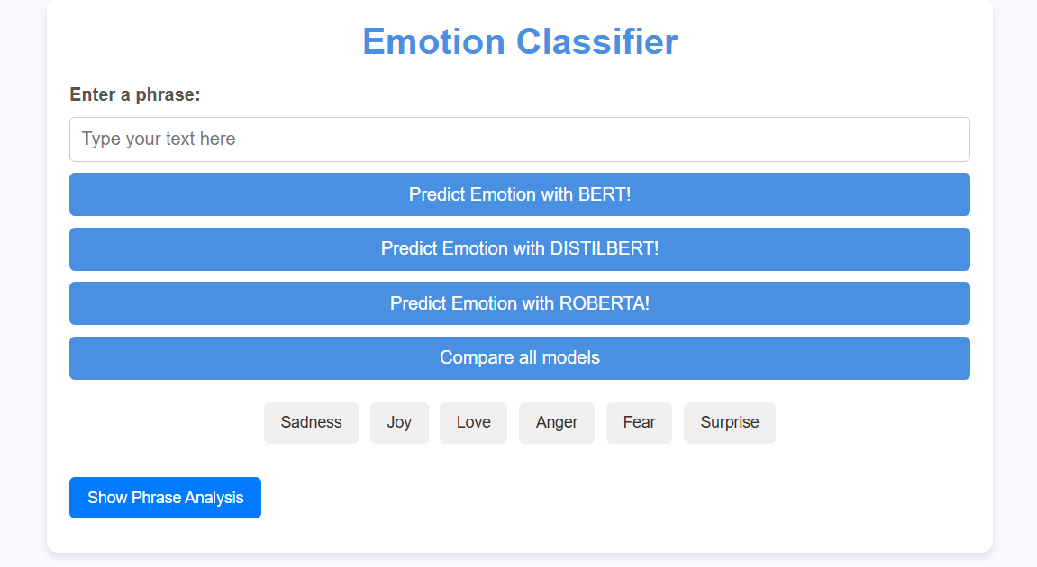
Preview
Our project consists of a web application that uses LLMs to identify an emotion from a text. The emotions recognized are:
Sadness
Joy
Love
Anger
Fear
Surprise
Main features:
Emotion prediction using 3 LLMs trained on a previously studied dataset
Comparisons between the results provided by the 3 LLMs
Visualization of the top 25 adjectives by frequency, considering the importance of adjectives in this task
Morphosyntactic analysis of the sentence using spaCy

Slide 3
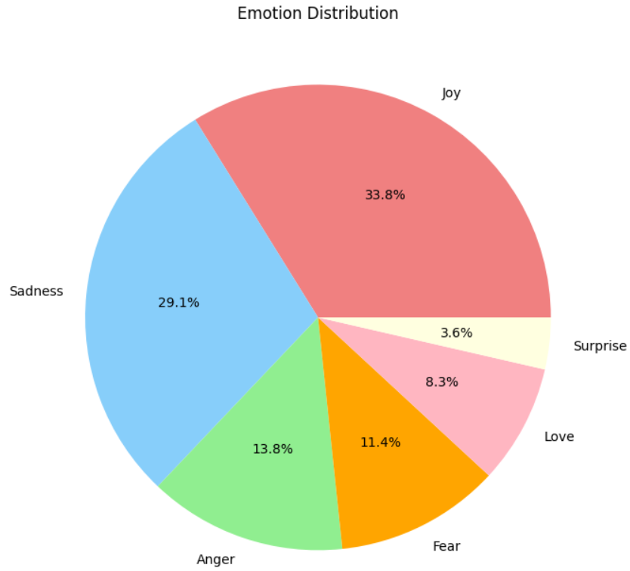
Dataset
A set of English Twitter messages, carefully labeled with six core emotions: anger, fear, joy, love, sadness, and surprise. This dataset provides a valuable tool for studying and analyzing the wide range of emotions conveyed in brief text on social media.
Dataset source: https://www.kaggle.com/datasets/nelgiriyewithana/emotions
Total number of samples: 416,809
Emotion Distribution:
Joy: 141,067 samples (33.8%)
Sadness: 121,187 samples (29.1%)
Anger: 57,317 samples (13.8%)
Fear: 47,712 samples (11.4%)
Love: 34,554 samples (8.3%)
Surprise: 14,972 samples (3.6%)
In the following slides we will present some samples from each emotion

Slide 4

Sadness
I really wonder how you feel on these nights so alone.
I feel a little shamed that I still haven't finished my place and I've had years.
I have a cold and am feeling sorry for myself today.

Slide 5

Joy
I write a crazy mother, I'm feeling pretty fearless.
I feel inspired to make other weird veggie dishes to get the picky men in my life to eat their veggies.
I have dropped a lot of weight and feel more energetic.

Slide 6

Love
I feel when creating a cake, a cookie, anything sweet and above all seeing others enjoy them later.
I feel a stir of longing for that quiet anticipatory time of day when the world hangs in suspension.
I feel what a lovely song with you.

Slide 7

Anger
I was pulling punches and challenged me to up the ante a little bit and make the game feel more dangerous.
I really feel like this will be almost like one of those copywork exercises that I hated in spelling but were obviously effective because I still write something down if I'm not sure how to spell it.
I'm feeling a little cranky.

Slide 8

Fear
I right now who are dealing with death and it causes them to feel frightened, vulnerable, weak, and mortal.
I feel like I am one of those uptight conservative people when I drink because there is no wall holding back how I truly feel and think.
I feel so paranoid about mass destruction, you know.

Slide 9

Surprise
I was feeling weird.
I used to see it in my mom's generation, but now I see my friends also striving for the same. I feel amazed.
I have a feeling no one is surprised that the picture is of Ava?

Slide 10
Preprocessing
re (Regular Expressions): Used for advanced text cleaning tasks like removing URLs, punctuation, digits, extra spaces, and non-alphanumeric characters efficiently.
Removes URLs: Matches and eliminates patterns like http://, https://, or www..
Handles Punctuation: Matches punctuation characters and replaces them with spaces.
Removes Words with Digits: Detects and removes words containing numeric characters.
Cleans Whitespace: Reduces multiple spaces to a single space using regex patterns.
Removes Non-Alphanumeric Characters: Strips characters other than letters, numbers, and spaces.
nltk (Natural Language Toolkit): Provides a predefined list of stopwords for different languages, helping in text preprocessing by filtering out commonly used but non-informative words.
Removes Stopwords: Uses a stopwords list (e.g., for English) to eliminate words like "and," "the," and "is" that do not contribute to the semantic meaning of the text.

Slide 11
Training Models
BERT (Bidirectional Encoder Representations from Transformers):
A large pre-trained transformer model that captures context from both directions (left and right) in a sentence.
Fine-tuned on the labeled emotion dataset for classification tasks.
DistilBERT:
A smaller, more efficient version of BERT that retains 97% of BERT’s performance while being faster and less resource-intensive.
Fine-tuned similarly, allowing for quicker training and lower memory usage, while maintaining competitive performance on emotion classification.
RoBERTa (Robustly optimized BERT approach):
A variant of BERT with modifications in training (e.g., dynamic masking and no Next Sentence Prediction).
RoBERTa is trained for longer periods and with more data, making it potentially more robust for emotion classification.

Slide 12
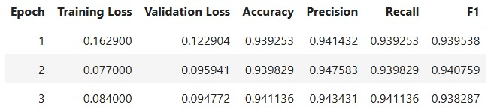
BERT.1
Key notes about BERT:
Transformer-based NLP model
Processes text bidirectionally
Pretrained on large corpora
Generates context-aware embeddings
Training result for each epoch BERT was trained on

Slide 13
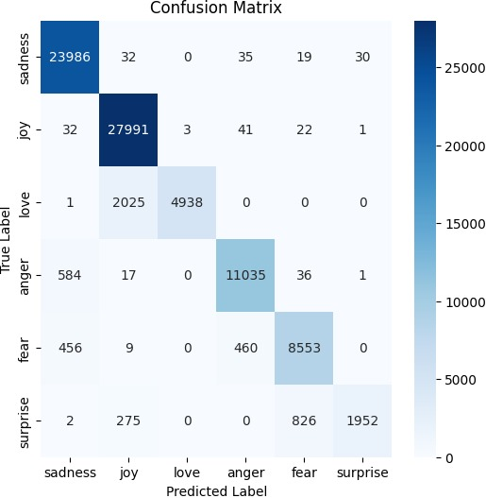
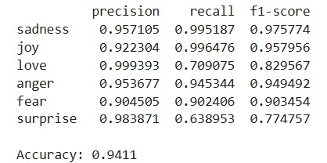
BERT.2
Final results for BERT are here:
Also, for a better visualization of the results found and how the model predicts each emotion, we analyzed the Confusion Matrix too.

Slide 14
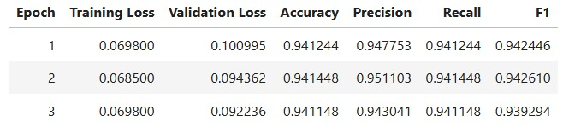
DISTILBERT.1
Key Notes about DistilBERT
Distilled Transformer-Based NLP Model
Faster and More Efficient Version of BERT
Pretrained on Large Corpora
Generates Context-Aware Embeddings with Fewer Parameters
Training result for each epoch DistilBERT was trained on

Slide 15

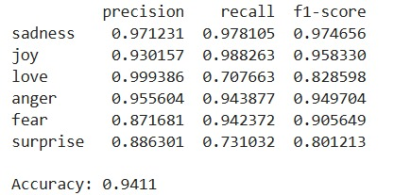
Distilbert.2
Final results for DistilBERT are here:
Also, for a better visualization of the results found and how the model predicts each emotion, we analyzed the Confusion Matrix too.

Slide 16
Roberta.1
RoBERTa: Key Notes
Optimized Transformer-Based NLP Model
Pretrained with More Data and Longer Training
Processes Text Bidirectionally
Generates Context-Aware Embeddings with Robust Performance
Training result for each epoch RoBERTa was trained on

Slide 17

Roberta.2
Final results for RoBERTa are here:
Also, for a better visualization of the results found and how the model predicts each emotion, we analyzed the Confusion Matrix too.

Slide 18
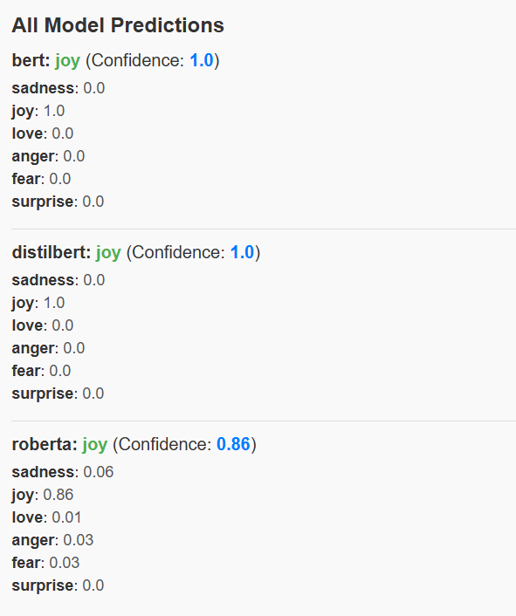
Comparing models
Our application allows prediction with all models to detect differences between them.
For example, for the phrase "Wow! This is so unexpected, I love this gift!" we can see in detail the emotion predicted by each model, making it easier to analyze the capabilities of each model.

Slide 19
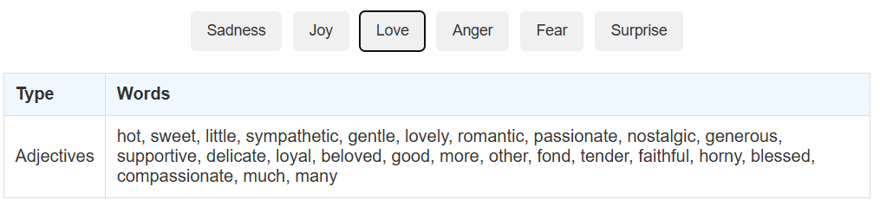
Adjectives
We also considered that adjectives are playing the most important role in predicting the emotion from a phrase, so we extracted top 25 most used adjectives for each label.
Also, if a phrase contains an adjective found in these lists it will be highlighted.

Slide 20
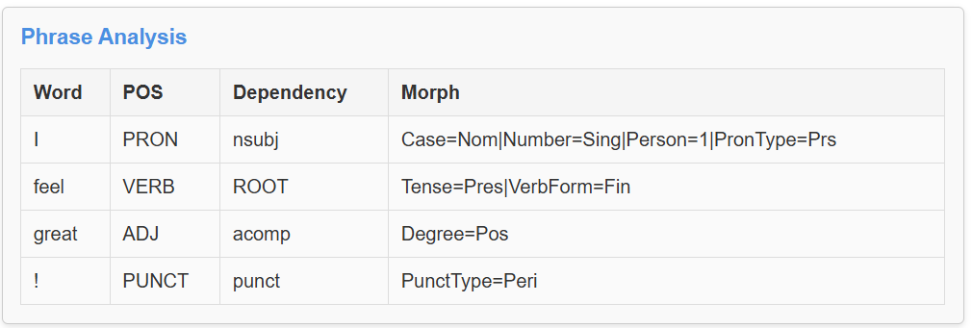
Phrase analysis
We also added a feature for a better visualization of each word property using SpaCy.
We extract details regarding part of speech, syntactic dependency, and morphological features.

Slide 21
Thank you!!!

