Slide 1
New profiles
To be added to sumondo.co

Slide 2
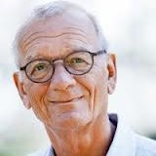
Bo Netterstrom
Medical professional
Bo Netterstrøm, chief physician, Dr. med., Senior Researcher
Dealing with stress treatment programmes i.e. CopeStress (latest publication BioMedResInt 2015) and stress research. Six books on stress. Latest ” Stress og Arbejde” Og ” Kort og Godt om Stress” med Yun Ladegaard og Pernille Rasmussen 2014. Publications on epidemiology in occupational health and psychosocial work environment.
MD 1975, Ph.D. 1983 Dr. Medical Science University of Copenhagen 1993 in Medicine.

Slide 3
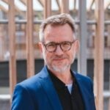
Søren
Medical professional
Søren has 20+ experience in clinical practice as medical specialist doctor. He has passion for strategic business planning, health-tech innovation, and digital transformation within the health care industry. Extensive knowledge and international leadership experience in Medical Assistance and Health Insurance operations. A global commercial mindset with a long track record in presentations supporting sales and marketing.

Slide 4
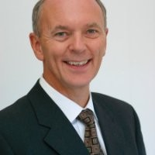
Henrik Harboe
MEDICAL DEVICES ADVISOR
Henrik Harboe, medical devices advisor and member of Board of Directors in several organisations.
World class medical professional with affinity to device development and clinical documentation including transcription of scientific facts into clinically relevant product positioning, marketing and sales.
Master Degree in Medicine from University of Copenhagen, 1978
Licensed physician by The National Health Service of Denmark, 1980

Slide 5
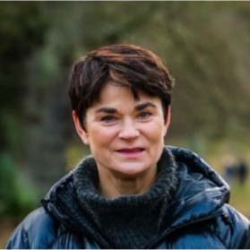
Claudia Kjeldgaard
SALES DIRECTOR
Claudia Kjeldgaard is a performance-oriented sales manager with broad experience in strategic solutions, sales and negotiation in the Nordic region. She has specialized in performance management, coaching, negotiations, sales and communication. Claudia has extensive professional experience from big companies like: Danske Bank, PFA Pension, Tryg, Aon Denmark. Currently she is working as a Sales Director in Gjensidige.
Master Degree in Leadership in Practice from Niels Brock, 2015
Master Degree in Coaching and Organizations from Erhvervsakademi Sjælland, 2014
Masters Degree in Leadership from Niels Brock, 2008

Slide 6
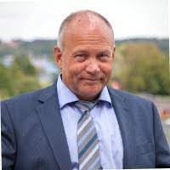
Frank Østergaard
DIRECTOR, EXECUTIVE CUSTOMER SERVICE IBM NORDIC
Frank Østergaard is director of the Customer Success Management organization within IBM. He and his team work to secure that the customers achieve the business objectives from their investments in IBM’s open, hybrid cloud platform and AI solutions. The CSM team works with customers to understand their needs, realize and identify use cases, design and architect solutions based on modernized architectures. Frank has more than 22 years of experience in Senior Leadership positions in Nordic, Europe and EMEA. During his career he has been leading teams from 25 to 250+ people and held budget responsibility of over 100 million USD.

Slide 7
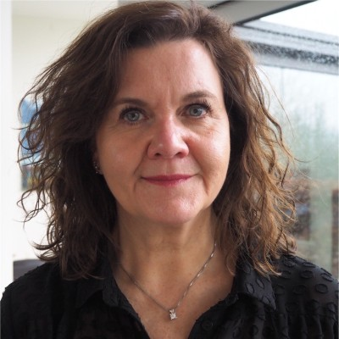
Christina Andersen
SENIOR MANAGER
SALES EXCELLENCE
COLOPLAST
Christina Andersen is an international oriented business leader with high transformation and strategic skills. Christina has 15+ years of pharma leadership experience with prelaunch activities, product launches and market access. She led the transformation of Roche Denmark focusing on creating strong results, high transparency and trust. Changing from a traditional organizational setup into a matrix organization in 2015, and in 2019 she led the transformation and turned Roche into a highly agile organization.
Master Degree in Business Development from Copenhagen Business School, 2020

Slide 8
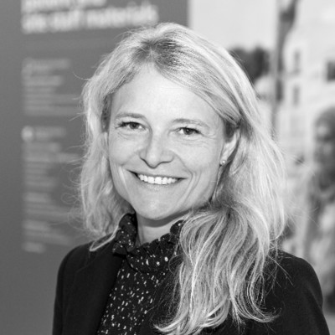
Birgitte Claudius
MD HD
SENIOR MEDICAL LEADER IN LIFE SCIENCE, DRUG DEVELOPMENT AND CHANGE MANAGEMENT
Birgitte Claudius is a medical leader in Life Science with 20+ years of experience from strategic and organisational Leadership, Drug Development, People Management and Change Management. She has a deep understanding of all aspects of planning and executing drug development programmes - clinical trials from phase I-IV. Her therapeutic areas of expertise are Diabetes, Obesity, NASH, respiratory medicine, cardiovascular, oncology and general endocrinology
Master Degree in Medical Science from University of Copenhagen, 2000
Bachelor in Organization and Management, Copenhagen Business School, 2008

Slide 9
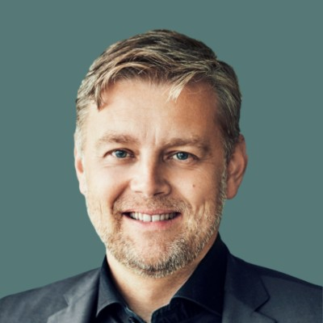
Morten Ronde
LAWYER, LOBBYIST AND ENTREPRENEUR
Morten Ronde is founder and managing partner at Nordic Gambling. He works in the cross-field of politics and regulation and is driven by diving into granular details of a legal issue, or working with a completely new business challenge. He has already built two thriving businesses: The Danish Online Gambling Association (Spillebranchen) and Nordic Gambling where he works with politicians, government regulators, gambling operators and software suppliers. Currently he is working on building Nordic Legal Law Firm, which will be focusing on legal fields outside of the gambling world.
Master Degree in Law from University of Copenhagen, 2000

