Slide 1
Face Mask Detection using Deep Learning
Mask: 99.8%
No Mask: 99.5%
ML Lab Mini Project · MobileNetV2 transfer learning + OpenCV face detection, on photos and live webcam
Illustration of the program's output
Notes:
Introduce the project: given a photo or a live webcam feed, the system finds every face and says whether that person is wearing a mask, with a confidence score. Green box = mask, red box = no mask.

Slide 2
Why automate mask checks?
1
Manual checking doesn't scale
Objective
A guard at the door can't watch every camera or every person all day.
Build an ML system that takes an image or video and, for every face it finds, predicts Mask or No Mask with a confidence score, fast enough for a live webcam.
2
Needed where people gather
Hospitals, labs, offices, airports and public transport still enforce mask rules.
Input
photo / webcam frame
Output
boxes + Mask / No Mask + %
3
Cheap hardware is enough
A normal webcam and a laptop CPU are enough, so no special sensors are needed.
Notes:
Motivation: manual monitoring doesn't scale. Our objective is a cheap, real-time, camera-based classifier. This is a binary image-classification problem combined with object (face) detection.

Slide 3
End-to-end pipeline
1
2
3
4
5
6
Input
Image file or webcam frame (BGR)
Face detection
SSD + ResNet-10
Crop & preprocess
224×224, range −1…1
CNN classifier
MobileNetV2 + custom head
Softmax
P(mask), P(no mask)
Annotate
Box + label + %
cv2.imread / cv2.VideoCapture reads pixels as a H×W×3 array.
OpenCV DNN finds every face and returns a box (x1,y1,x2,y2) with a confidence score.
Each face is cut out, converted BGR→RGB, resized and normalised for MobileNetV2.
Extracts 1,280 visual features, then a small dense head maps them to 2 classes.
Two probabilities that sum to 1. The higher one is the prediction.
Green box for Mask, red for No Mask, drawn back on the original frame.
Stage A: Face detection (OpenCV)
Stage B: Mask classification (TensorFlow / Keras)
Result
Notes:
This is the most important slide. There are two models. Stage A is a pre-trained face detector that only answers 'where are the faces?'. Stage B is our own trained CNN that answers 'is this face masked?'. Splitting the problem this way means our classifier only ever sees tightly cropped faces, which makes it accurate with only about 4,000 training images.

Slide 4
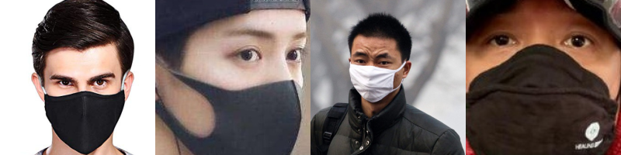
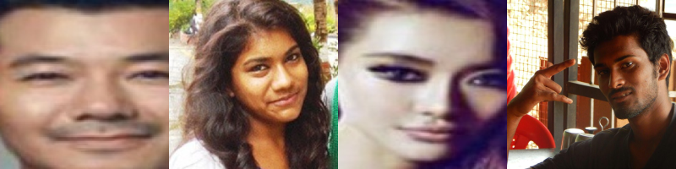
Dataset: 4,092 labelled face images
2,162
With mask
images WITH a mask
1,930
images WITHOUT a mask
80 / 20
Without mask
stratified train / test split
819
held-out test images
Notes:
Open-source dataset (chandrikadeb7/Face-Mask-Detection, MIT licence). It has real photos plus some images with masks added artificially. The two classes are nearly balanced (53% / 47%), so accuracy is a fair metric. We keep 20% (819 images) aside and never train on them. This is the test set used for every number in this deck. 'Stratified' means both splits keep the same class ratio.

Slide 5
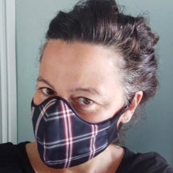
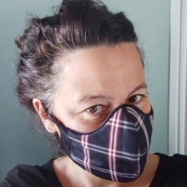
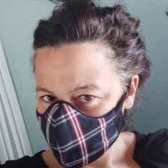
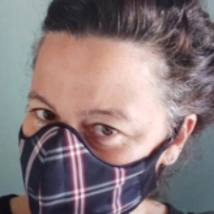
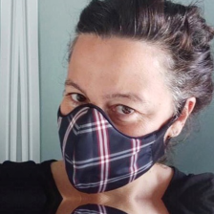
Preprocessing and data augmentation
Read
decode JPG/PNG
Resize
224 × 224 × 3
Augment
train images only
Normalise
x / 127.5 − 1 → [-1, 1]
Batch
32 images per step
Original
Horizontal flip
Rotate ±6% (≈22°)
Zoom ±15%
Shift ±10%
Why augment? Every epoch the model sees randomly flipped, rotated, zoomed and shifted versions of the same faces. This works like a much larger dataset and makes the model robust to head pose and to where the face sits in the crop.
Notes:
Images are resized to 224x224 because that's the input size MobileNetV2 was designed for. preprocess_input rescales pixels from [0,255] to [-1,1], the same range used when it was pretrained on ImageNet. Augmentation layers are part of the model, so they run on the fly during training and are automatically switched off at inference time. The examples shown use exaggerated values so the effect is visible.

Slide 6
Stage A: Finding faces with an SSD detector
ResNet-10 SSD
Frame
any size H × W
blobFromImage
resize 300×300, subtract mean (104,177,123)
Filter
keep confidence ≥ 0.5, scale to pixels, clip
multi-scale feature maps, each predicting boxes
Raw output: 1 × 1 × N × 7
Why a DNN detector, not Haar cascades?
Haar cascades look for the dark/light pattern of the mouth and nose, and a mask hides exactly that. The deep SSD detector still finds faces that are covered, turned or poorly lit.
img id | class | conf | x1 | y1 | x2 | y2
0 | 1 | 0.97 | 0.41 | 0.22 | 0.63 | 0.58
Coordinates are fractions of the frame; we multiply by (W, H, W, H) to get pixels.
Notes:
We do not train the face detector. We use OpenCV's pre-trained Single Shot MultiBox Detector with a ResNet-10 backbone (files in face_detector/). 'Single shot' means one forward pass predicts all boxes at once, from feature maps of several sizes, so it finds both big and small faces. Each detection row has a confidence. We keep rows with confidence of at least 0.5 (adjustable with --confidence).

Slide 7
Stage B: Transfer learning
Step 1: Pretrained by Google on ImageNet (1.28 M images, 1,000 classes)
Conv block 1
edges
Conv block 2
textures
Conv block 3
parts
Conv block 4
objects
1000-class head
dog, car, cup …
thrown away
copy the learned weights
Step 2: Our task, 2 classes and ~3,300 training faces
Why it works:
Features like edges, fabric texture and face shape are general. We reuse them and only learn the final decision, so we need less data and minutes of CPU time instead of days of GPU time.
Conv block 1
edges
Conv block 2
textures
Conv block 3
parts
Conv block 4
objects
New 2-class head
mask / no mask
FROZEN · 2,257,984 weights not updated
TRAINED · 164,226
Notes:
Training a CNN from scratch on 4,000 images would overfit badly. Instead we start from MobileNetV2 trained on ImageNet. Its early layers already detect edges, textures and shapes. We freeze all 2,257,984 of those weights and only train a small new head of 164,226 weights. Only about 7% of the network is trained.

Slide 8
Model architecture, layer by layer
Input
Augmentation
MobileNetV2 base
AvgPool 7×7
Flatten
Dense + ReLU
Dropout 0.5
Dense + Softmax
output shape
224×224×3
224×224×3
7×7×1280
1×1×1280
1280
128
128
2
RGB face
train only
frozen
summarise
to vector
learn combos
regularise
probabilities
0
0
2,257,984
0
0
163,968
0
258
trainable / frozen parameters
Total 2,422,210 parameters · Trainable 164,226 · Frozen 2,257,984 Box height ≈ how much spatial information is left at each stage
Notes:
Read left to right. A 224x224 face goes through MobileNetV2, which shrinks space and grows channels until we have a 7x7 grid of 1,280 features. Average pooling averages each feature over the 7x7 grid, giving one 1,280-number description of the face. A Dense layer with 128 ReLU units learns which feature combinations mean 'mask'. Dropout randomly switches off half of those units during training so the model can't rely on a few of them. The final Dense layer with softmax outputs P(mask) and P(no mask). Parameter counts: Dense(128) = 1280x128 + 128 biases = 163,968; Dense(2) = 128x2 + 2 = 258.

Slide 9
Inside MobileNetV2: the inverted residual block
Input
narrow: e.g. 24 channels
Why it's fast: depthwise-separable convolution
A normal 3×3 conv mixes every input channel with every output channel at once:
cost ∝ 9 · Cin · Cout
Depthwise (spatial) + 1×1 (channel mixing) does the same job in two cheap steps:
cost ∝ 9 · Cin + Cin · Cout
1×1 Conv, expand ×6
→ 144 channels + BatchNorm + ReLU6
3×3 Depthwise Conv
one filter per channel + BN + ReLU6
skip connection
≈ 8–9×
17
3.5 M
1×1 Conv, project
→ 24 channels, linear (no ReLU)
fewer multiply-adds than normal 3×3 convs
inverted residual blocks stacked
parameters in the full network
Add (+)
output = input + block(input)
Result: a small, accurate network that runs in real time on a laptop CPU, which is why we chose it over VGG16 or ResNet-50.
Notes:
MobileNetV2 (Sandler et al., 2018) is built from 'inverted residual' blocks. It expands a thin representation to a wide one, filters it cheaply with a depthwise conv (each channel filtered on its own), then projects back down to thin. The last projection is linear because ReLU on a low-dimensional space destroys information. The skip connection adds the input back, which helps gradients flow (as in ResNet). Depthwise separable convs make it about 8-9x cheaper than standard convs at similar accuracy.

Slide 10
Training setup
Optimizer | Adam, learning rate 1e-4
Loss | Sparse categorical cross-entropy
Batch size | 32
Max epochs | 20
Early stopping | stop if val loss doesn't improve for 4 epochs
Checkpoint | save the model with the best val accuracy
Hardware | laptop CPU, no GPU needed
1. Forward pass
batch of 32 faces
2. Loss
−log P(true class)
×103 steps
per epoch
4. Adam update
w ← w − lr · step
3. Backpropagation
gradients for the head only
After each epoch: evaluate on the test split → save if val accuracy is a new best → stop early if val loss has stopped falling.
Notes:
Cross-entropy loss is -log of the probability the model gave to the correct class: near 0 when it is confident and right, large when it is confident and wrong. Adam is an adaptive gradient-descent optimizer. We use a small learning rate (1e-4) because we're fitting on top of pretrained features. 3,273 training images / 32 per batch = 103 steps per epoch. Early stopping and checkpointing protect against overfitting.

Slide 11
Learning curves: accuracy rises, loss falls
Best validation accuracy 99.2% after 20 epochs. Validation stays at or above training accuracy because dropout and augmentation are only active during training, so the gap is not a sign of overfitting.
Notes:
Training ran for 20 epochs. Validation accuracy was already high after epoch 1 because the pretrained features are so good. The rest of training mostly makes the model more confident, which you can see as the loss keeps falling. If validation loss started rising while training loss fell, that would be overfitting. Early stopping watches for exactly that.

Slide 12
Results on 819 unseen test images
99.2%
99.1%
99.2%
99.1%
Confusion matrix
Predicted
Accuracy
Precision (avg)
Recall (avg)
F1-score (avg)
Mask
No Mask
Mask
429
correct
4
error
Class | Precision | Recall | F1 | Images
Mask | 99.3% | 99.1% | 99.2% | 433
No Mask | 99.0% | 99.2% | 99.1% | 386
Actual
No Mask
3
error
383
correct
Precision: of the faces we called 'Mask', how many really were.
Recall: of the real 'Mask' faces, how many we caught.
F1: harmonic mean of precision and recall (balances both).
Only 7 of 819 test faces were misclassified.
Notes:
All numbers are on the 20% of images held out from training. Accuracy 99.2%. The diagonal of the confusion matrix (green) shows correct predictions; off-diagonal cells are errors. Top-right: masked faces predicted as No Mask; bottom-left: unmasked faces predicted as Mask. Note: the test images come from the same dataset as training, so real-world webcam accuracy will be somewhat lower, especially with unusual masks, lighting or face angles.

Slide 13
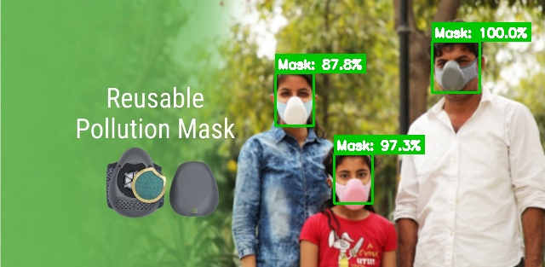
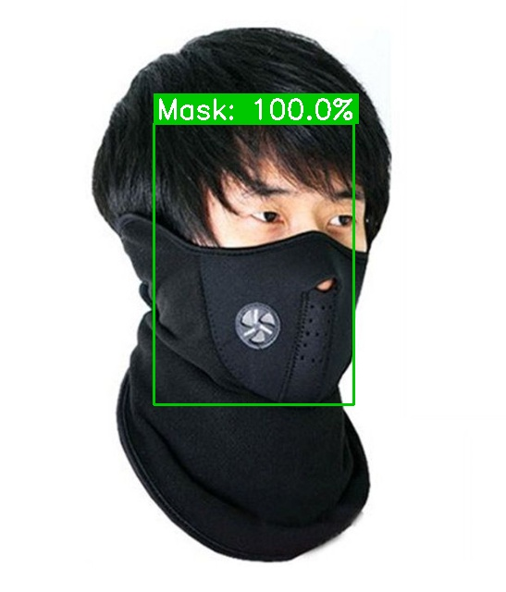
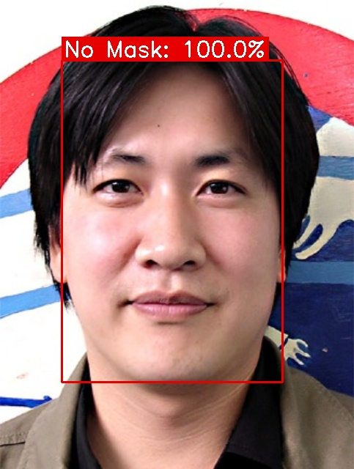
What the output looks like
Real outputs of detect_image.py on held-out test images, which the model never saw during training.
python detect_image.py --image photo.jpg --output result.jpg or live: python detect_video.py
Notes:
These images were annotated by our program. Each face gets a box and a label with the softmax confidence. For the live demo, run detect_video.py and try it with and without a mask, and with a hand over the mouth.

Slide 14
Real-time webcam loop
1. Capture
cap.read() grabs a frame
2. Mirror
cv2.flip so it feels like a mirror
3. Detect faces
SSD → list of boxes
81 ms
per 640×480 frame on this laptop's CPU (detect + classify one face)
≈ 12 FPS
repeat for every frame
press q to quit
6. Show
cv2.imshow window
5. Draw
boxes, labels, FPS
4. Classify
all faces in ONE batch
Why it's fast enough: the SSD detector works on a small 300×300 copy of the frame, MobileNetV2 is designed for mobile phones, and every face in a frame goes through the CNN in one batched call instead of one call per face.
Notes:
detect_video.py runs this loop until you press q. Measured end-to-end latency was about 81 ms per frame on the development laptop (CPU only, one face). Your FPS will depend on the CPU and the number of faces. The FPS counter is drawn on the video.

Slide 15
Project files and how to run it
mllabproject/
├─ dataset/
│ ├─ with_mask/ 2,162 imgs
│ └─ without_mask/ 1,930 imgs
├─ face_detector/ SSD model
├─ models/ trained .keras
├─ train.py train + evaluate
├─ mask_detector.py shared logic
├─ detect_image.py run on a photo
├─ detect_video.py run on webcam
└─ requirements.txt
1
Install
python -m venv .venv
.venv\Scripts\activate
pip install -r requirements.txt
2
Train
python train.py --epochs 20
3
Use it
python detect_image.py --image photo.jpg
python detect_video.py
Notes:
The code is short, about 250 lines. train.py builds and trains the model. mask_detector.py holds the shared detect-and-classify logic. The two detect scripts are thin command-line wrappers around it. Full instructions are in README.md and PROJECT_EXPLANATION.md.

Slide 16
Limitations and future work
Limitations
Future work
1
Only 2 classes, so a mask worn under the nose may still count as 'Mask'
1
Add a third class: 'mask worn incorrectly'
2
Dataset includes some synthetic masks, so real-world accuracy is lower than the test score
2
Fine-tune the top MobileNetV2 layers on more diverse real photos
3
Small, side-on or blurred faces can be missed by the detector
3
Export to TFLite / ONNX for Raspberry Pi or mobile
4
No tracking: every frame is judged on its own, so labels can flicker
4
Streamlit / Flask web app with alerts and a compliance count
Notes:
Being honest about limitations is part of good ML practice. The biggest gap is between test-set accuracy and real-world accuracy: the test set is drawn from the same distribution as training data.

Slide 17
Thank you, any questions?
99.2%
accuracy on unseen test images
164,226
weights trained, the rest reused
Two-stage pipeline · MobileNetV2 transfer learning · 99.2% test accuracy · real-time on CPU
~12 FPS
live webcam on a laptop CPU
Notes:
Summary: we split the problem into detection and classification, reused a pretrained detector, and used transfer learning for the classifier. That gives high accuracy from a small dataset and real-time speed on ordinary hardware.

