Slide 1

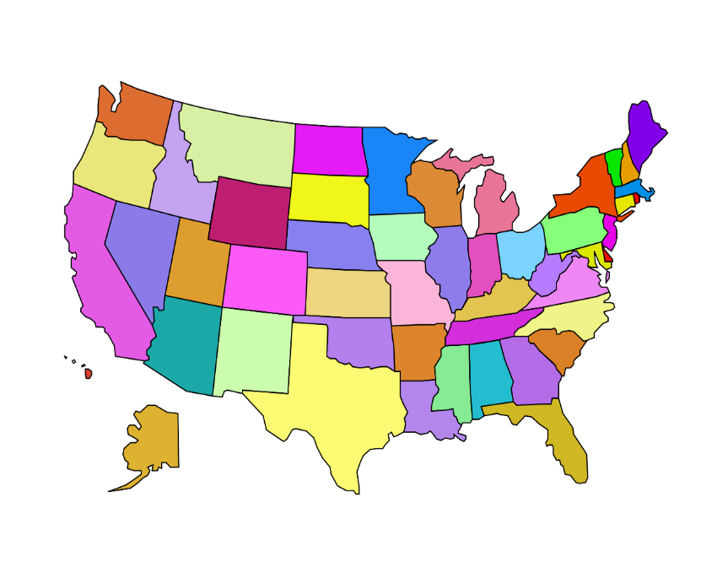
Car Sales Dashboard
Arizona | $ 1,721,411,185
California | $ 1,029,783,872
Colorado | $ 1,593,116,721
Florida | $ 1,323,640,869
Georgia | $ 2,113,499,555
Illinois | $ 1,415,539,861
Indiana | $ 1,681,434,610
Massachusetts | $ 1,544,599,581
Michigan | $ 1,407,731,159
Missouri | $ 1,661,055,001
New Jersey | $ 1,752,474,906
New York | $ 1,574,303,119
North Carolina | $ 1,712,884,201
Ohio | $ 1,416,943,221
Oregon | $ 1,838,257,387
Pennsylvania | $ 1,512,660,833
Tennessee | $ 1,674,426,583
Texas | $ 1,403,625,590
Virginia | $ 1,727,116,436
Washington | $ 2,085,257,761
Total | $ 32,189,762,451
Brand:
Tesla
Region:
West
South
Northeast
Midwest
Summer
Spring
Winter
Fall

