Slide 1
CAWLER ID
Bird Call Identification Pipeline
Bri Martinez
Jake Mooradian
Peyton Cunningham
Stephen Enriquez
Team Cawl · Team #2 · CSPB 3308 Spring 2026
Notes:
Peyton

Slide 2
PROJECT OVERVIEW
What It Does
Pipeline
Cawler ID is a web app that identifies bird species from audio recordings uploaded by the user.
The user uploads an MP3 or WAV file. The pipeline converts it to a mel-spectrogram, scores it against reference recordings, and returns a ranked list of matching species.
Built as a technical proving ground for signal processing, full-stack engineering, and Scrum collaboration.
1 Dataset
reference + test audio from Xeno-canto
Jake Mooradian
2 Spectrogram
librosa mel-spectrogram → 2D numpy array
Bri Martinez
3 Ranker/Classifier
scipy cross-correlation → ranked results (baseline iteration)
pretrained NN → ranked results
(expanded iteration from CC)
Peyton Cunningham &
Jake Mooradian
4 UI
Flask web app → upload → results page
Stephen Enriquez
Notes:
Peyton

Slide 3
TOOLS USED
Python
Excellent
librosa
Excellent
Core language for the entire backend pipeline
Audio loading and mel-spectrogram generation
PostGreSQL
Excellent
numpy
Excellent
Database handling for user profiles and results display text
Array math and spectrogram normalization
Flask
Excellent
Git / GitHub
Excellent
Web server, routing, and HTML rendering
Version control, branching, and PR workflow
Xeno-canto
Excellent
matplotlib
Excellent
Open-source bird call audio dataset
Spectrogram visualization
Notes:
Bri:
"For this project we used a carefully selected set of tools that each played a specific role in our pipeline.
Python serves as the backbone of the entire backend, from data processing to model inference to serving the web app.
For the database, we used PostgreSQL to handle persistent storage, user accounts, bird species profiles, and each user's identification history are all stored and queried through it.
Flask acts as our web server, handling routing between pages and rendering the HTML templates that make up the UI.
On the data science side, librosa is what lets us actually process audio; it loads the bird call recordings and converts them into mel-spectrograms, which are essentially visual fingerprints of sound. NumPy works alongside it for the array math and normalization that prepares those spectrograms for the model. And matplotlib renders those spectrograms as images that users can see on the results page.
Our training data comes from Xeno-canto, an open-source database of bird call recordings from contributors around the world, it gave us the labeled audio we needed to train and test our model.
And finally, Git and GitHub kept the whole team in sync, we used branching and pull requests throughout the semester to manage contributions across all four team members."

Slide 4
DATASET COLLECTION
Audio Collection
Preprocessing — dataset_builder.py
Downloaded from Xeno-canto (xeno-canto.org); recoding source ID retained in filename
5 bird species: American Robin, Common Loon, Mourning Dove, Pine Warbler, Sandhill Crane
8 recordings per bird in data/reference/
1 test recording per bird in data/test/
Formats: MP3 (bird call recordings) and M4A (bespoke background noise control files clipped from bird call recordings)
Loops through all reference audio files
Calls generate_numpy_spec() on each file, same librosa pipeline as Bri's module, with added normalization step
Saves each spectrogram as a .npy file in data/numpy_specs/ preserving the folder structure
Result: pre-converted spectrograms ready for fast training without re-processing audio each run
Notes:
Jake and Peyton
Jake
“this project was significantly more attainable through easy and open-source access to an enormous library of high-quality bird call recordings, which is the xeno-canto project. While sourcing data, I would comb through available bird calls for each species and select the files with the clearest representations of the target call. I then ran a simple shell script that would extract the audio file from the page, along with the common name, scientific name, and entry identification code, which would be saved to the name of the mp3 file in our project directories. Using a shell script transformed a process that could have taken over an hour per bird to something that took half that time at the longest.
Creating the background noise class was a little more labor-intensive. To ensure that the neural network would prefer the correct class for each bird, I spliced audio from our reference files that did not contain the bird calls themselves, so that data would activate the sixth, hidden “background noise” class, rather than disrupt the signaling to the target class. This significantly improved training quality, which is something I will discuss in a later slide.
“To make preprocessing the data easier for the larger volumes needed for model training, I repurposed the same logic that Bri’s spectrogram generator and Peyton’s similarity ranker used for data processing, combining them into one function called dataset_builder. Peyton can tell you more about how numpy arrays were created from audio files”

Slide 5
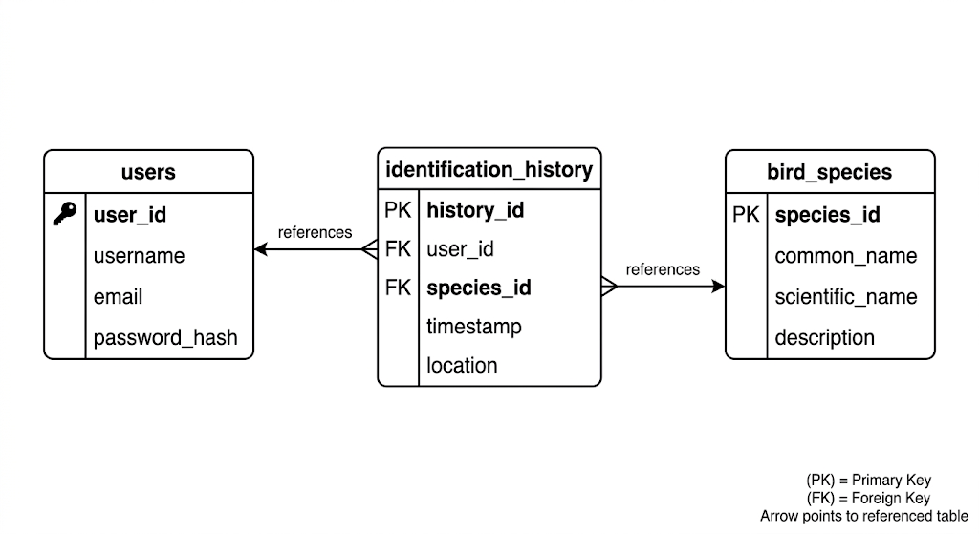
DATABASE
Schema Overview
Table Breakdown
Three tables, designed around the core user flow:
TABLE | KEY COLUMNS
users | id, username, email, password_hash, created_at
bird_species | id, common_name, scientific_name, description, ref_audio_path, ref_image
identification_history | id, user_id (FK), species_id (FK), confidence_score, upload_path, created_at
Design Decisions
Integration with Flask
Passwords stored as hashed strings — never plaintext (pbkdf2:sha256)
ON DELETE CASCADE — deleting a user automatically clears their history
SERIAL PRIMARY KEY — auto-incrementing IDs on every table
UNIQUE constraints on username, email, and scientific name prevent duplicate records
All queries live in database/db.py
Connection configured via environment variables (DB_HOST, DB_NAME, DB_PASSWORD)
Called at three points in the app: login, upload/analyze, history page
Notes:
Bri:
"Our database is built in PostgreSQL and consists of three tables that map directly to the three core features of the app — accounts, bird data, and identification history.
The users table is straightforward. It stores a username, email, and a password hash. Critically, we never store the raw password — it's run through pbkdf2:sha256 before it ever touches the database. We also enforce UNIQUE constraints on both username and email so duplicate accounts can't be created.
The bird_species table acts as our field guide. Each row represents one species and holds its common name, scientific name, a text description, and file paths to the reference audio, spectrogram, and image. This table is what gets queried when the results page displays information about the top match.
The identification_history table is where the two meet. Every time a user uploads a recording and gets a result, a new row is written here with their user ID, the matched species ID, the confidence score from the model, and a path to the uploaded file. Both user_id and species_id are foreign keys, and both use ON DELETE CASCADE — meaning if a user account is ever deleted, their history is automatically cleaned up too.
The three tables form a clean relational structure. identification_history sits in the middle, joining users to species.
On the Flask side, all database access is centralized in the database/db.py folder. Connection settings come from environment variables so credentials are never hardcoded. The database gets touched at three points in the app: during login and registration, when an upload is analyzed and the result is logged, and when a user visits their history page to see past identifications."

Slide 6
SPECTROGRAM GENERATION
1 Load Audio
Loads the raw MP3 or WAV file preserving its native sample rate. Returns a numpy array of audio samples.
librosa.load(audio_path, sr=None)
2 Mel-Spectrogram
Converts audio to a 2D array, 128 frequency bins × time frames. Standardized at n_mels=128 across all files. Called by user query to generate a spectrogram visual from the uploaded file.
librosa.feature.melspectrogram(y, sr, n_mels=128, fmax=8000)
3 Log Scale
Converts power values to decibels. Makes patterns more image-like and consistent across recordings.
librosa.power_to_db(S, ref=np.max)
4 Normalize
Added by Jake in dataset_builder.py. Scales values 0 to 1 before saving as .npy for consistency with neural network training.
(S_db - min) / (max - min)
In Approach 2, output feeds into Jake's dataset_builder.py as pre-saved .npy files rather than passing directly to the ranker
Notes:
Bri:
"My module sits at the start of the pipeline — before anything can be identified, the raw audio needs to be transformed into a format the model can actually work with. That's what the spectrogram generator does.
Step one is loading the audio. We use librosa.load with sr=None, which tells librosa to preserve the file's native sample rate rather than resampling it. This matters because resampling can subtly alter the frequency content of the recording, and we want the model working with the most accurate representation of the sound as possible. The output is a numpy array of audio samples.
Step two is generating the mel-spectrogram. This is the core transformation. We call librosa.feature.melspectrogram with n_mels=128 and fmax=8000. The 128 mel frequency bins were standardized across the entire team so that every spectrogram — whether it's a reference recording or a live upload — has the same shape going into the model. The output is a 2D array: frequency bins on one axis, time frames on the other. Essentially, we've turned a sound into an image.
Step three is converting to log scale using librosa.power_to_db. Raw power values have a huge dynamic range that makes patterns hard to detect. Converting to decibels compresses that range and makes the spectrogram much more image-like and consistent across recordings with different volumes.
Step four is normalization, which was added by Jake in dataset_builder.py. We scale all values to a 0-to-1 range using min-max normalization before saving as .npy files. This ensures the neural network isn't thrown off by absolute amplitude differences between recordings.
There are actually two outputs from this module — a numpy array that feeds into the classifier, and a PNG image rendered with matplotlib using a magma colormap, which is what gets displayed to the user on the results page."

Slide 7
APPROACH 1 AS BASELINE — SIMILARITY RANKER
How the Ranker Works
Why the Neural Network is Better
Ranker (Approach 1)
Neural Network (Approach 2)
Normalize both spectrograms to 0–1 scale
Crop to matching dimensions
Flatten 2D arrays to 1D and run scipy cross-correlation
Peak correlation value = similarity score
Average across all reference recordings per bird
Sort birds by average score — highest first
Accuracy
Raw signal overlap. Recordings with closer mel-bin clusters (monotone) score higher.
Learns mel band frequency for each row. Not affected by harmonic spread.
Speed
Scores against every reference file at runtime which makes it slower as dataset grows.
Trained once. Inference is the same speed regardless of dataset size.
Output
Raw correlation score which means ther is no meaningful upper bound.
Confidence score 0–1 per species via sigmoid output layer.
Result format passed to Stephen's UI:
Robustness
[{"rank": 1, "bird": "american_robin", "score": 26863.4}]
Sensitive to recording length and background noise.
Trained across 8+ varied recordings per species, with control for background noise.
Notes:
Peyton

Slide 8
NEURAL NETWORK + CLASSIFIER
Training — nn.py + nn_trainer.py
Inference — classifier.py
Architecture: 3-layer feedforward network
Input layer: 4096 nodes (128 mel bins × 32 time frames, flattened)
Hidden layer: 18 nodes
Output layer: 6 nodes, one per bird species + one background noise control
Activation: sigmoid at every layer
Training: backpropagation, 3500 epochs, alpha=0.01
Labels: one-hot encoded (e.g. Robin = [1,0,0,0,0])
Weights saved to data/model/bird_nn.npy
Load saved weights from data/model/bird_nn.npy
Convert uploaded audio to mel-spectrogram numpy array via generate_numpy_spec()
Flatten to 4096-dim vector (cropped/padded to 128×32)
Run nn.predict() — forward pass through saved weights
Output: confidence score 0–1 per species
Sort by confidence — highest first
Return same format as Peyton's ranker so Stephen's UI needs no changes
Notes:
Jake
“Once we committed to training a neural network, producing a model with accurate results required a bit of knob-turning through iterative testing. After a few trials, the model that performed best was tuned to these values. The input layer included 4096 features, which is the total matrix of 128 mel bins (a standard representation for audible harmonic frequencies) against 32 time frames (which fit most reference spectrogram durations).
A hidden layer with 18 nodes provided enough room for training and handling larger file sizes, while also not risking overfitting and collapse into dominant classes.
The output layer had 6 nodes, representing our five bird classes and the additional background noise class.
Weights were updated via a “foreward and back” loop over each feature. The feedforward updated weights with sigmoid activation (which also normalized them into a 0-1 range). Next, the array was updated back to front with sigmoid derivative deltas (the “back” in backpropagation) before finally being updated with the dot products of the sigmoid activation times the delta changes, times the learning rate, which is set to the standard 0.01 (the alpha)
To ensure that weight updates for each class remained consistent during training, the labels for each class were one-hot encoded. Once all epochs of this process were run, the result was saved as a full array
This pretrained model is then called once during the “analyze” phase of our user flow. This phase takes the user audio file and runs it once through processing, resulting in a numpy array that the model can compare against. The function nn.predict commits the newly generated aray to one forward pass through the model. After this single pass, the final 6 nodes receive weight signals, and they are returned in order of strength, which can be understood as a “confidence level”

Slide 9
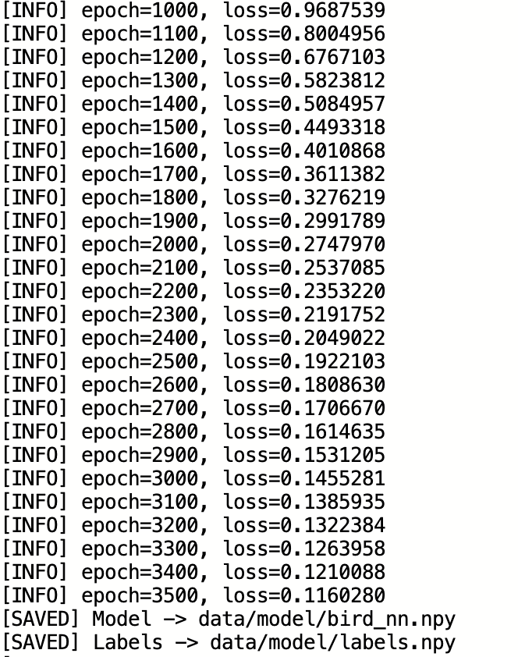
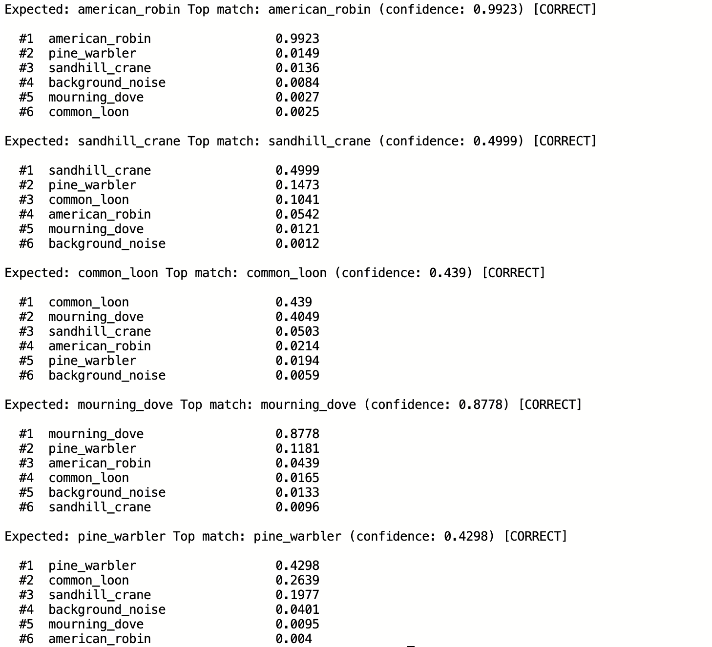
NEURAL NETWORK + CLASSIFIER
Training — nn.py + nn_trainer.py
Inference — classifier.py
Notes:
Jake

Slide 10
FLASK + UI
User Journey
Flask Routes
User visits home page
landing.html
GET /
Landing page
User uploads an audio file
upload.html
GET /upload
Upload form (login required)
User sees results
results.html
POST /analyze
Receives file → runs pipeline → returns results
User explores bird details
bird_details.html
GET /bird/<n>
Species detail page from database
User reviews past searches
user_library.html
GET /library
User's identification history
POST /login
login.html
POST /login
Authenticate user
POST /register
register.html
POST /register
Create account
Notes:
Stephen
User registers or logs in > session starts
User uploads an audio file > /upload
App analyzes the file > /analyze
User sees results > spectrogram + ranked matches
User explores bird details > /bird/<name>
User reviews past identifications > /library
User uploads audio on /upload page
Flask saves file to static/uploads/
Confidence scores displayed instead of raw correlation values
Top result logged to Postgres identification_history
User library shows past identifications with confidence scores

Slide 11
CHALLENGES
Module Integration
Algorithm Accuracy
Getting four independently built modules to integrate cleanly across different file structures and Python path configurations required establishing clear interface contracts early. Each teammate needed to know exactly what to pass in and what to expect back.
Increasing training data to 8 samples per target bird along with adding a hidden “background noise” class trained on spliced segments from the target bird samples significantly improved the quality of training. While there are still issues with overfitting, and some of the class distinction (represented by confidence scores) is lower than preferred, the model is able to accurately classify test bird calls that were not included in training data.
Team Communication
Environment Setup
Not all teammates took time to fully understand the full pipeline before meetings, which sometimes led to confusion surfacing as conflict rather than productive discussion. Decisions about architecture were challenged by teammates who didn't yet understand how the modules depended on each other.
Python path resolution and missing dependencies (librosa, matplotlib, Flask) caused significant early friction. Establishing a requirements.txt and consistent run commands resolved this, but it delayed integration testing. Our database is supported by PostGreSQL, which requires separate hosting alongside the flask app. Installation varies between operating systems, which can delay integration testing.
Notes:
Bri:
“There were four main challenges that we ran into during this project.
Module Integration was probably our biggest technical hurdle. We had four independently built modules — the database, spectrogram generator, similarity model, and UI — each developed in different file structures with different assumptions about how data would be passed around. Getting them to talk to each other cleanly required us to establish clear interface contracts and make sure every teammate knew exactly what inputs to expect and what outputs to produce.
Algorithm Accuracy was an ongoing challenge throughout the project. We started with a cross-correlation approach to compare spectrograms, but accuracy wasn't where we needed it. We improved things significantly by adding background noise samples to the training data and increasing our reference recordings per bird. The model still performs better on bird calls that were included in training, so there's room to grow there.
Team Communication was a softer challenge but a real one. Not everyone had visibility into the full pipeline at all times, which occasionally led to decisions being made in isolation rather than collaboratively. It reinforced how important it is to keep the whole team aligned — not just on what you're building, but on how it connects to everyone else's work.
And finally, Environment Setup caused more friction than expected. Python version differences, missing dependencies like librosa and matplotlib, and PostgreSQL requiring separate installation from the Flask app meant that getting a consistent dev environment across all four machines took real effort and wasn't always smooth.
These challenges pushed us to communicate more intentionally and write more modular, well-documented code."

Slide 12
TEAM RETROSPECTIVE
Went Well
Didn't Work
Improve
Modular pipeline design let teammates build independently
Git branching and PR workflow kept the codebase clean
Clear interface contracts between modules
Pipeline runs end to end with real audio
requirements.txt and documentation reduced onboarding friction
Some teammates were still getting familiar with full pipeline, which made early discussions challenging
Uncertainty about larger project structure occasionally led to misunderstandings about file changes
Some architectural concerns surfaced later in the process, which created some rework
Distinction between certain class types wasn’t always consistent. Some correct IDs are low-confidence
Invest more time upfront ensuring everyone understands the full architecture before sprint work begins
Use commit history as a shared, objective record of contributions
Raise architectural disagreements earlier rather than mid-sprint
More granular oversight (manual cropping) of reference files may improve training quality
Notes:
Stephen
-The clarity of distinction between class types is inconsistent. Some correct IDs are low-confidence

Slide 13
LIVE DEMO
Cawler ID
Bird Call Identification Pipeline
1 Upload an audio file (MP3 or WAV)
2 Pipeline converts audio → mel-spectrogram → similarity scores
3 Results page returns ranked bird species matches
python ui/app.py → localhost:5000
Notes:
Jake

