Slide 1
CS 490 Spring 2019 Big Spatial Data Systems
Peyton Puckett

Slide 2
Week of February 11th
Goal: UI Webserver running locally

Slide 3
Notes
Latests Version of Java and Scala
Verify file path (no special characters)
From Daniel (Update build.sbt with two lines of code)
See Github for code
Updates to readme with version updates and build instructions

Slide 4
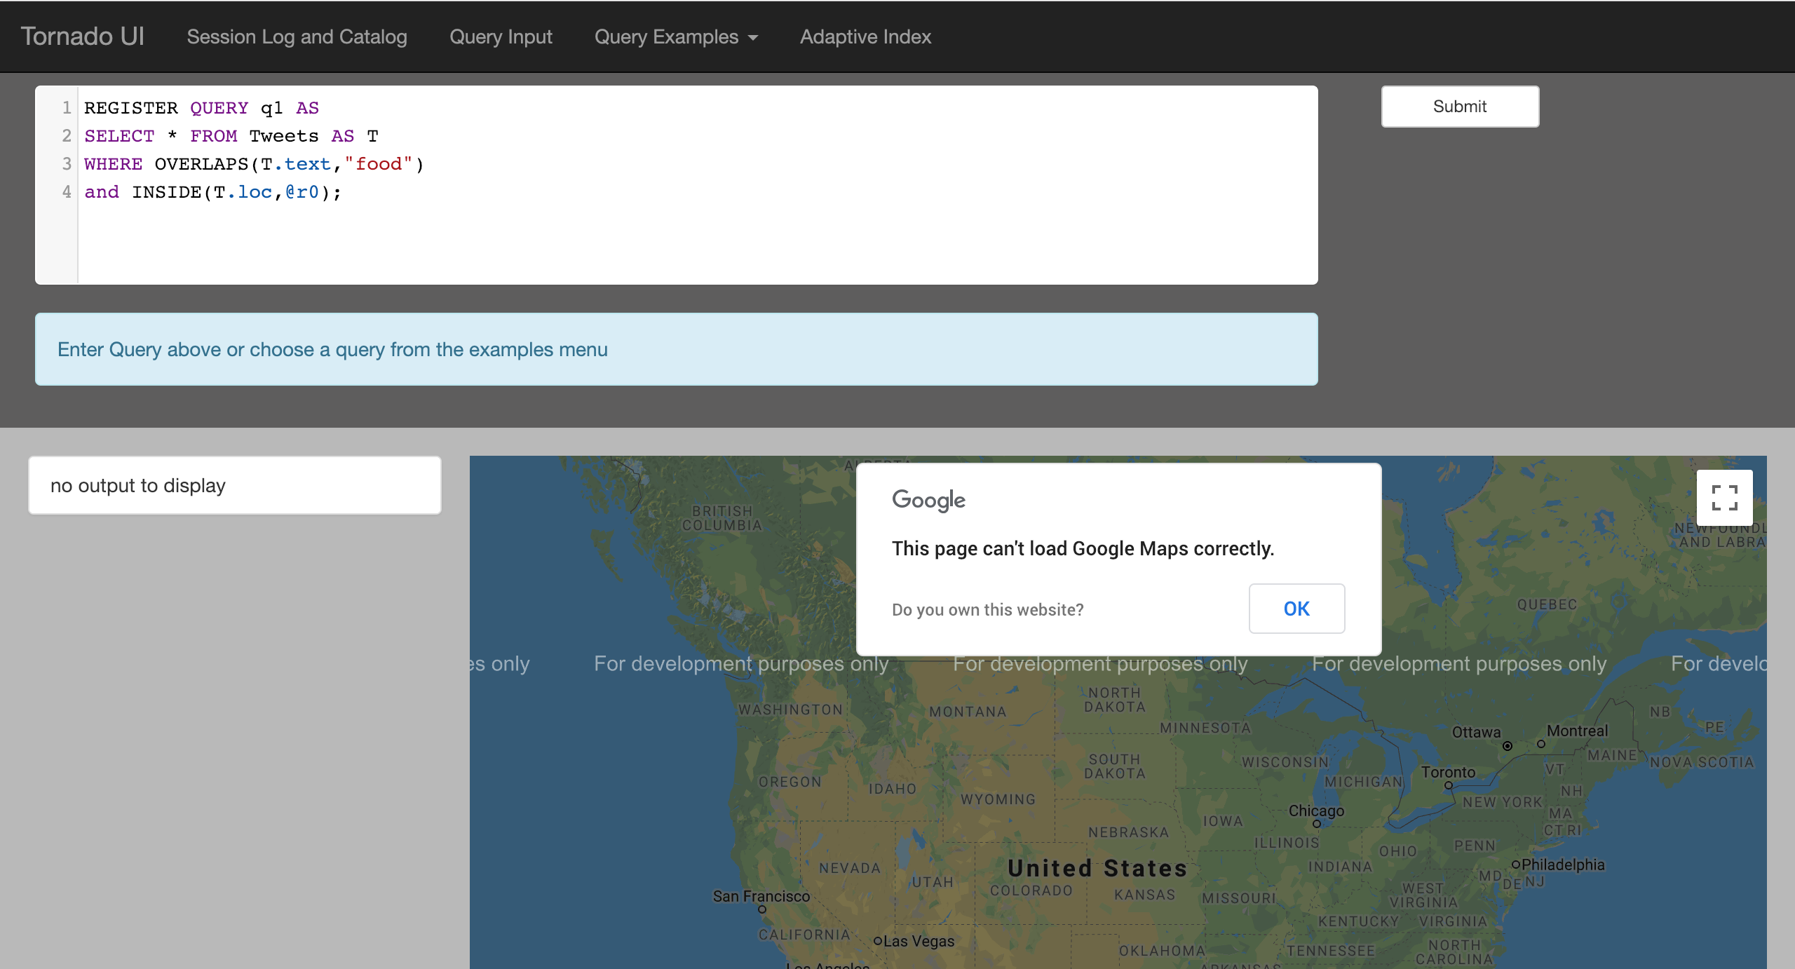
Local Webserver
Google Maps Error
Likely due to API Quota Reached
Quota resets (not a big issue)

Slide 5
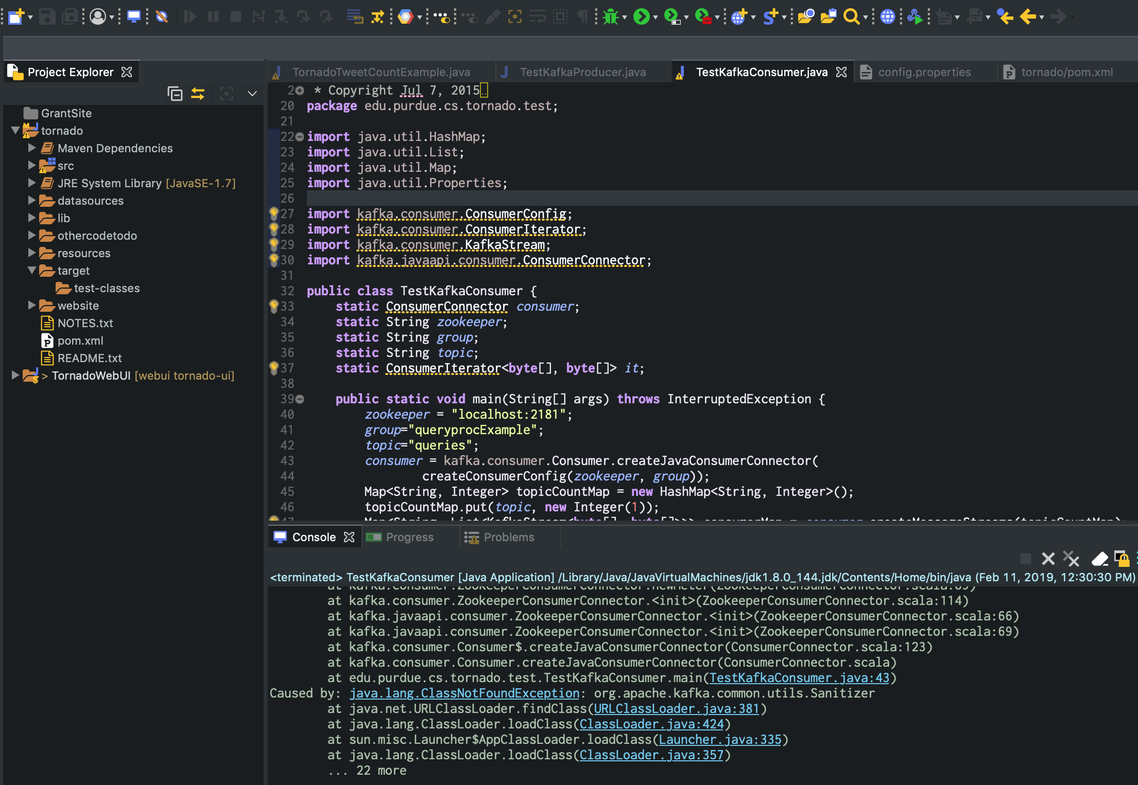
Version
Kafka (2.1.0)
Java 8
Scala

Slide 6
Questions?
Email: ppucket@purdue.edu
PurdueDB Github: https://github.com/purduedb/
Personal Github: https://github.com/PeytonNP/

Slide 7
Week of February 18th
Goal: UI Webserver running locally

Slide 8
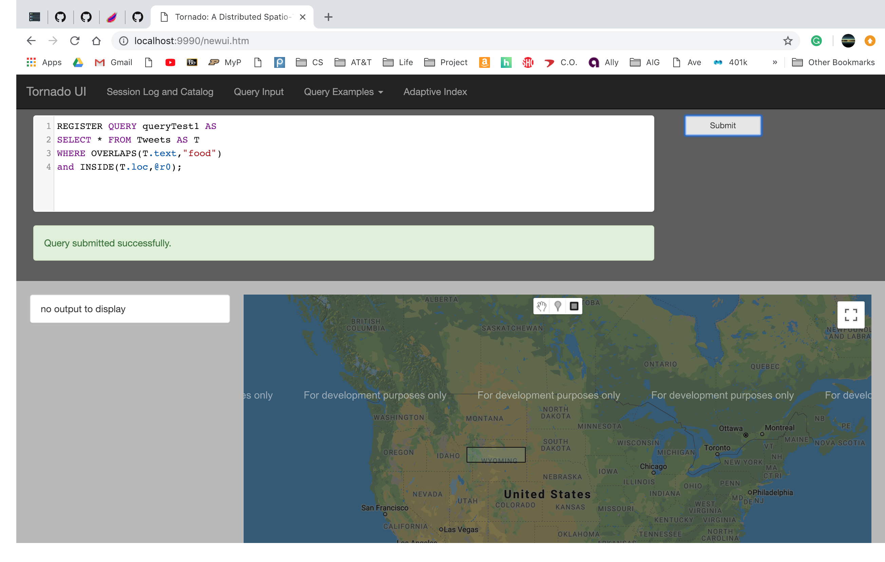
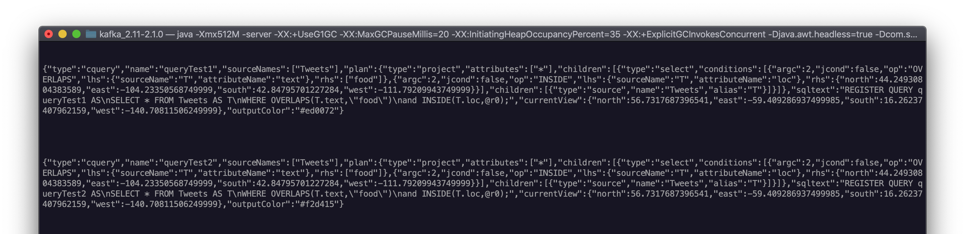
Consuming Queries

Slide 9
Questions?
Email: ppucket@purdue.edu
PurdueDB Github: https://github.com/purduedb/
Personal Github: https://github.com/PeytonNP/

Slide 10
Week of February 25th
Note: Missed meeting

Slide 11
Questions?
Email: ppucket@purdue.edu
PurdueDB Github: https://github.com/purduedb/
Personal Github: https://github.com/PeytonNP/

Slide 12
Week of March 4th
Goal: Tornado UI Topology

Slide 13
Old Tornado Demo
Originally in Bitbucket
Ahmed sent code via dropbox
Copied to git: https://github.com/PeytonNP/OldTornadoDemo
TestMain.java
consumes queries submitted via the UI and transforms them into query objects via the topic “queries” in Kafka

Slide 14
Questions?
Email: ppucket@purdue.edu
PurdueDB Github: https://github.com/purduedb/
Personal Github: https://github.com/PeytonNP/

Slide 15
Week of March 11th
Goal: New TornadoUITopology
Note: Spring Break No Meeting

Slide 16
Week of March 18th
Goal: KafkaSpout and TornadoUITopoplogy

Slide 17
Goals
Read sample tweets files
LFS vs HDFS
Read queries from UI
Convert to Query object
Output back to UI
Using kafka Producer

Slide 18
Spouts that read from LFS
FileSpout
AtlasParserSpout
QueriesFileSystemSpout
QueriesFileSystemSpoutHotSpots
TweetFSSpout
TweetFSSpoutHotSpots
TweetFSSpoutSlow
TornadoTweetCountExample (query spout)
TornadoTweetCountExample (tweet spout)

Slide 19
TornadoTweetCountExample.java
Tweet Spout
Query Spout
TweetFSSpout
QueriesFileSystemSpout
config
config
LFS_TWEET_FILE_PATH
LFS_TWEET_FILE_PATH
temp.csv
temp.csv

Slide 20
Process
UI
Submit Query
Consume via Kafka Spout
Produce via KafkaProducer on topic “output”
Process Query
Transform to Query Object

Slide 21
Questions?
Email: ppucket@purdue.edu
PurdueDB Github: https://github.com/purduedb/
Personal Github: https://github.com/PeytonNP/

Slide 22
Week of March 25th
Goal:

Slide 23
Questions?
Email: ppucket@purdue.edu
PurdueDB Github: https://github.com/purduedb/
Personal Github: https://github.com/PeytonNP/

Slide 24
Week of April 1st
Goal:

Slide 25
Questions?
Email: ppucket@purdue.edu
PurdueDB Github: https://github.com/purduedb/
Personal Github: https://github.com/PeytonNP/

Slide 26
Week of April 8th

Slide 27
TornadoUITopology
Tornado
To Do
Submit query via UI
Consume query via KafkaConsumer
Used KafkaBolt in SpatioTextualTopologyBuilder
- Error using bolt (random)
Produce output via KafkaProducer
Messages are sent to the producer
Messages not visible in UI
UI – check version compatibility (scala)
Still works, new warnings
KafkaBolt Error
Note: Storm official release 1.2.2
Likely moved to another package in future updates:
KafkaConsumer
KafkaProducer
KafkaBolt

Slide 28
Questions?
Email: ppucket@purdue.edu
PurdueDB Github: https://github.com/purduedb/
Personal Github: https://github.com/PeytonNP/

Slide 29
Week of April 15th
Goal:

Slide 30
Questions?
Email: ppucket@purdue.edu
PurdueDB Github: https://github.com/purduedb/
Personal Github: https://github.com/PeytonNP/

Slide 31
Week of April 22nd
Goal:

Slide 32
Questions?
Email: ppucket@purdue.edu
PurdueDB Github: https://github.com/purduedb/
Personal Github: https://github.com/PeytonNP/

Slide 33
Week of April 29th
Goal:

Slide 34
Questions?
Email: ppucket@purdue.edu
PurdueDB Github: https://github.com/purduedb/
Personal Github: https://github.com/PeytonNP/

