Slide 1
Peyton Puckett CS 490 - Spring 2019 Big Spatial Data Systems

Slide 2
Week of February 4th
Webserver running locally

Slide 3
Notes
Latest version of Java and Scala
No special characters in path
Add two lines to build.sbt (From Daniel)
Google Maps API Request Quota Exceeded
Update instructions on README

Slide 4
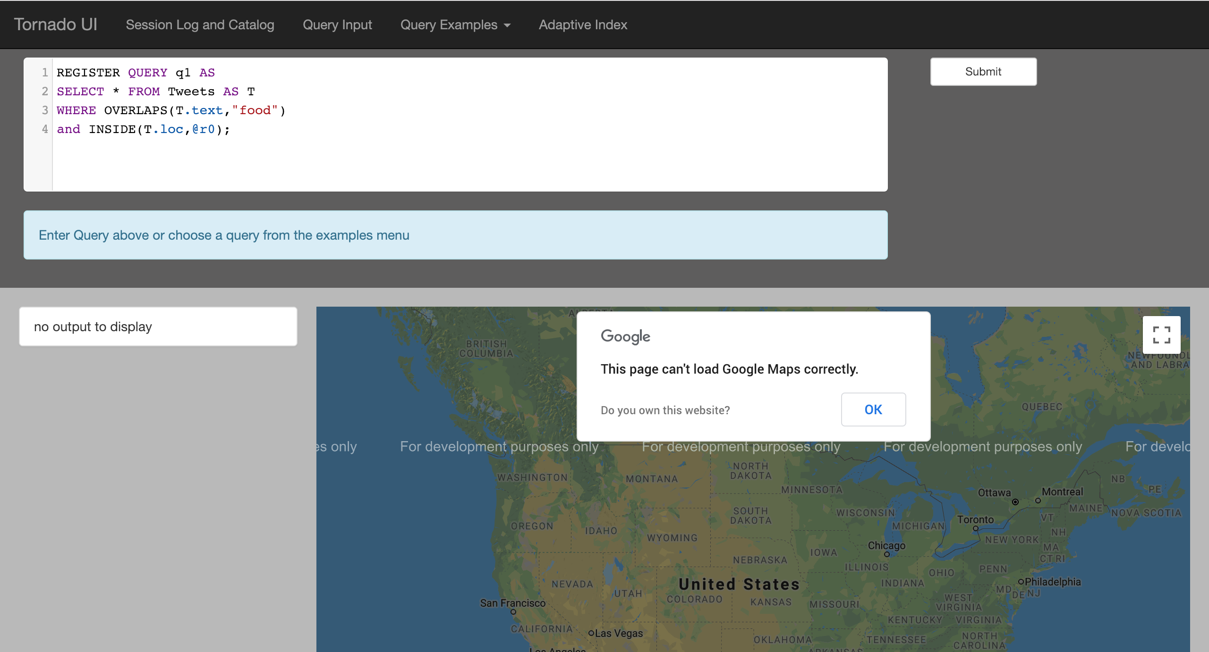
Localhost Webserver
Google Maps Error
- API Quota Exceeded

Slide 5
Questions?
Email: ppucket@purdue.edu
Github: @PeytonNP

Slide 6
Week of February 11th
Main Objective

Slide 7
Questions?
Email: ppucket@purdue.edu
Github: @PeytonNP

Slide 8
Week of February 18th
Main Objective

Slide 9
Questions?
Email: ppucket@purdue.edu
Github: @PeytonNP

Slide 10
Week of February 25th
Main Objective

Slide 11
Questions?
Email: ppucket@purdue.edu
Github: @PeytonNP

Slide 12
Week of March 4th
Main Objective

Slide 13
Questions?
Email: ppucket@purdue.edu
Github: @PeytonNP

Slide 14
Week of March 11th
Main Objective

Slide 15
Questions?
Email: ppucket@purdue.edu
Github: @PeytonNP

Slide 16
Week of March 18th
Main Objective

Slide 17
Questions?
Email: ppucket@purdue.edu
Github: @PeytonNP

Slide 18
Week of March 25th
Main Objective

Slide 19
Questions?
Email: ppucket@purdue.edu
Github: @PeytonNP

Slide 20
Week of April 1st
Main Objective

Slide 21
Questions?
Email: ppucket@purdue.edu
Github: @PeytonNP

Slide 22
Week of April 8th
Main Objective

Slide 23
Week of April 15th
Main Objective

Slide 24
Questions?
Email: ppucket@purdue.edu
Github: @PeytonNP

Slide 25
Week of April 22nd
Main Objective

Slide 26
Questions?
Email: ppucket@purdue.edu
Github: @PeytonNP

Slide 27
Week of April 29th
Main Objective

Slide 28
Questions?
Email: ppucket@purdue.edu
Github: @PeytonNP

Slide 29
Week of May 6th
Main Objective

Slide 30
Questions?
Email: ppucket@purdue.edu
Github: @PeytonNP

