Slide 1
CS 490 – Spring 2019 Big Spatial Data Systems
Peyton Puckett
Final Presentation

Slide 2
Project Goals
Restore functionality of Tornado
Up to date with Kafka, Zookeeper, etc.
Process for each query:
Submit Query via UI
Produce Output using Kafka
Show Result in UI
Consume Query using Kafka
Transform Query and Process Using Tornado

Slide 3
Background
Papers
Adaptive Processing of Spatial-Keyword Data Over a Distributed Streaming Cluster
FAST: Frequency-Aware Indexing for Spatio-Textual Data Streams
Tornado: A Distributed Spatio-Textual Stream Processing System
Terminology
Kafka/Zookeeper
Storm
Tornado

Slide 4
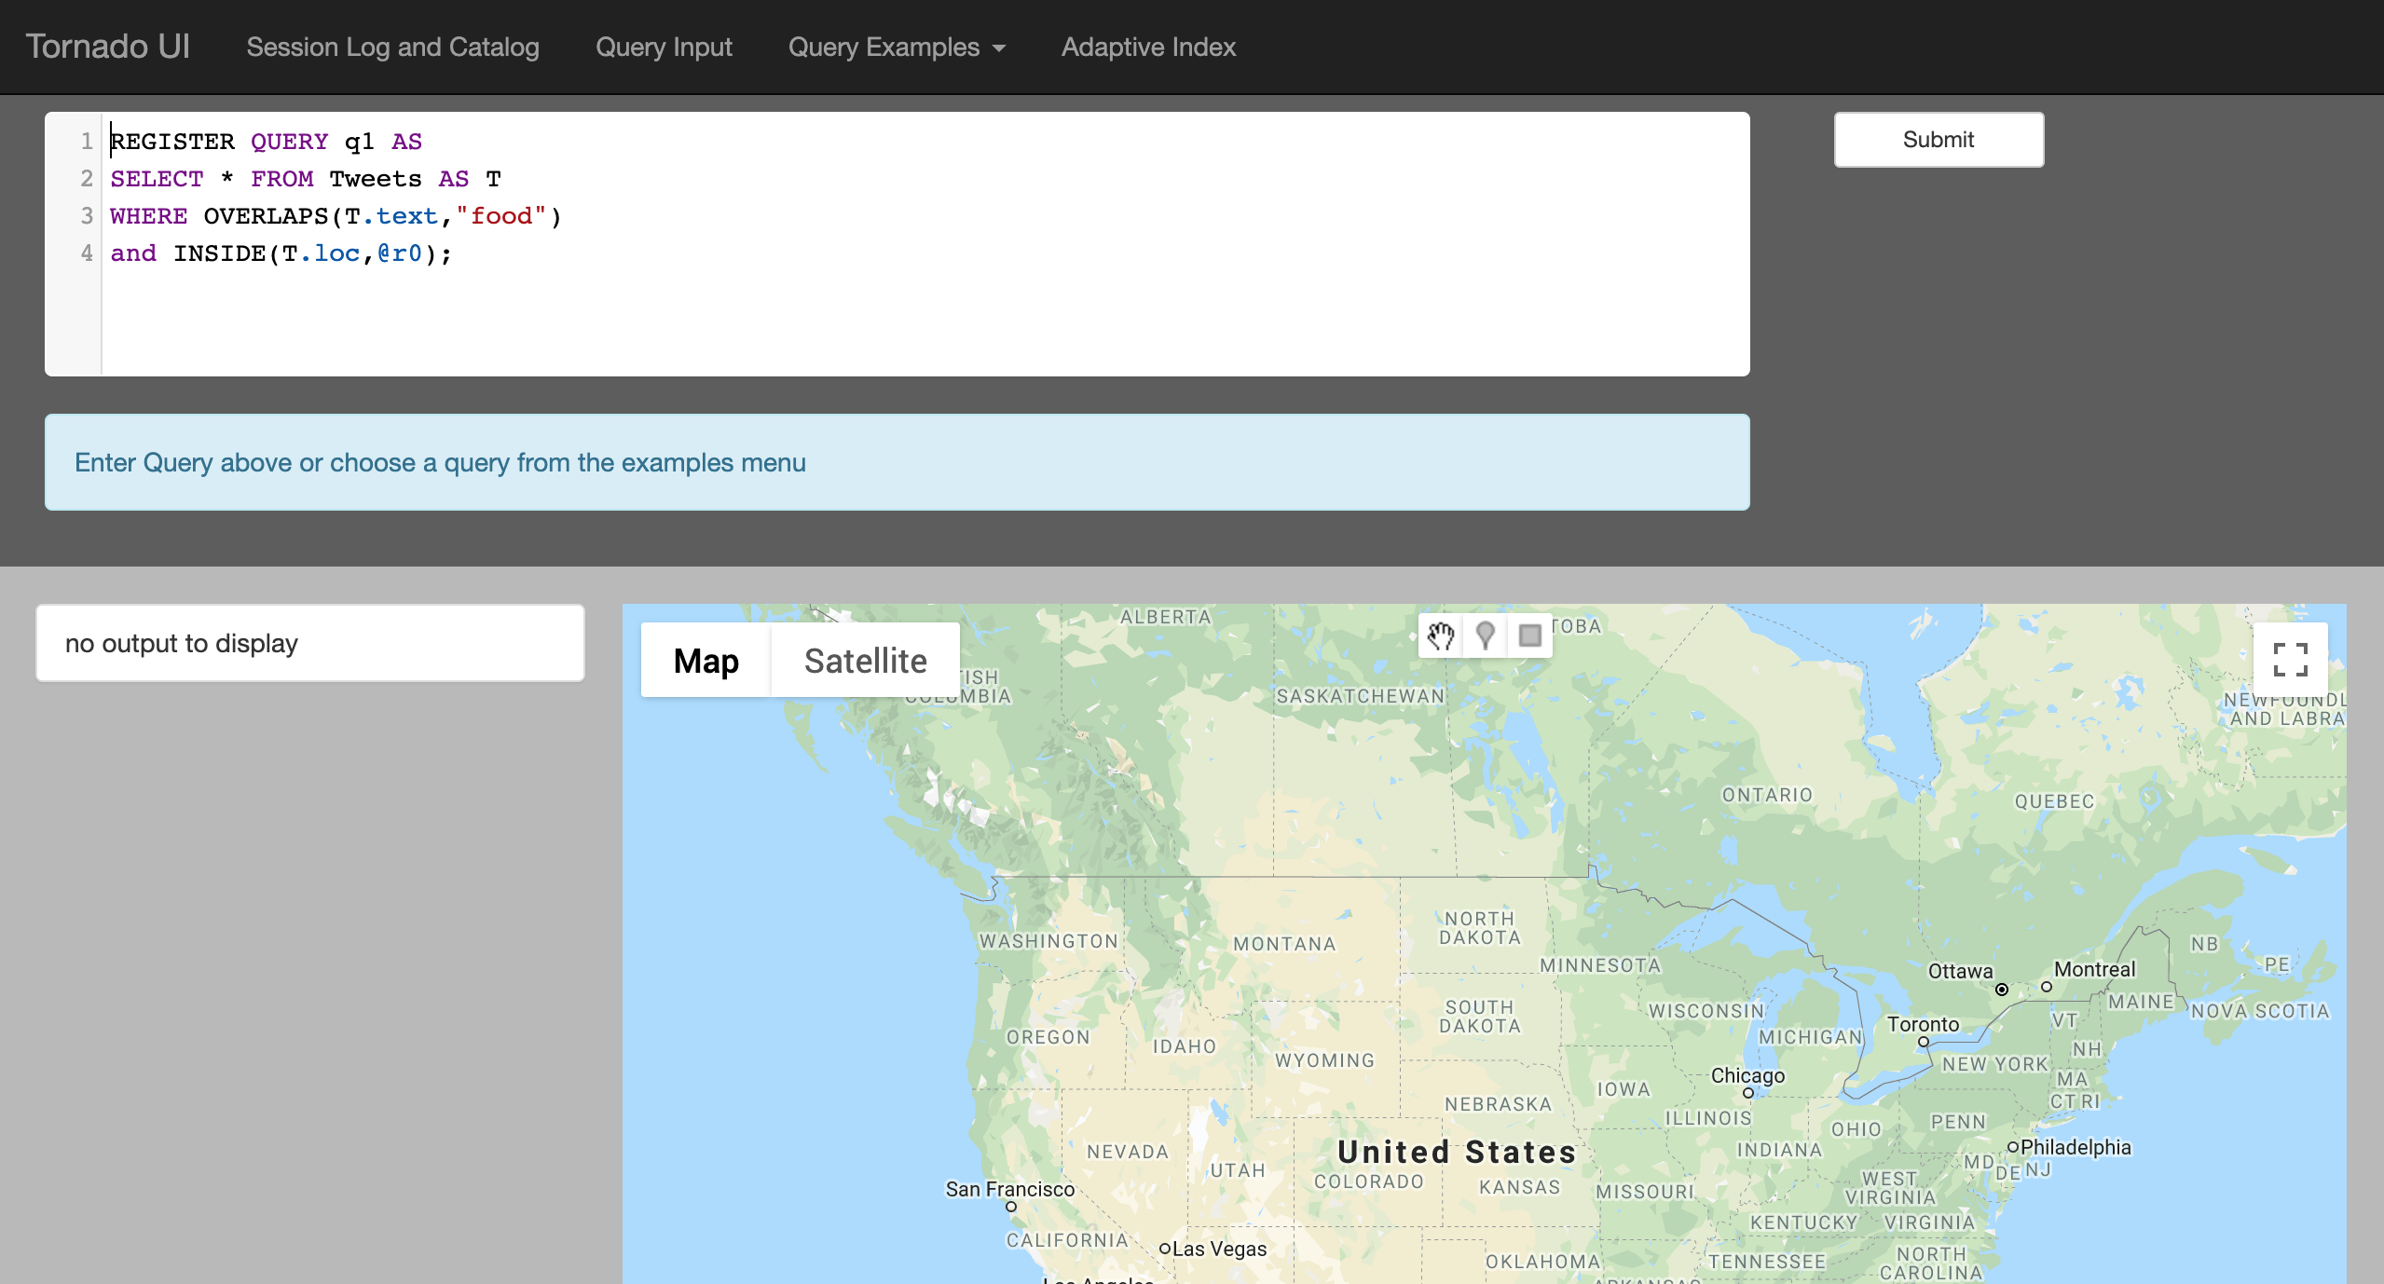
TornadoUI on LocalHost
Small Modification to build.sbt: https://github.com/purduedb/tornado-ui

Slide 5
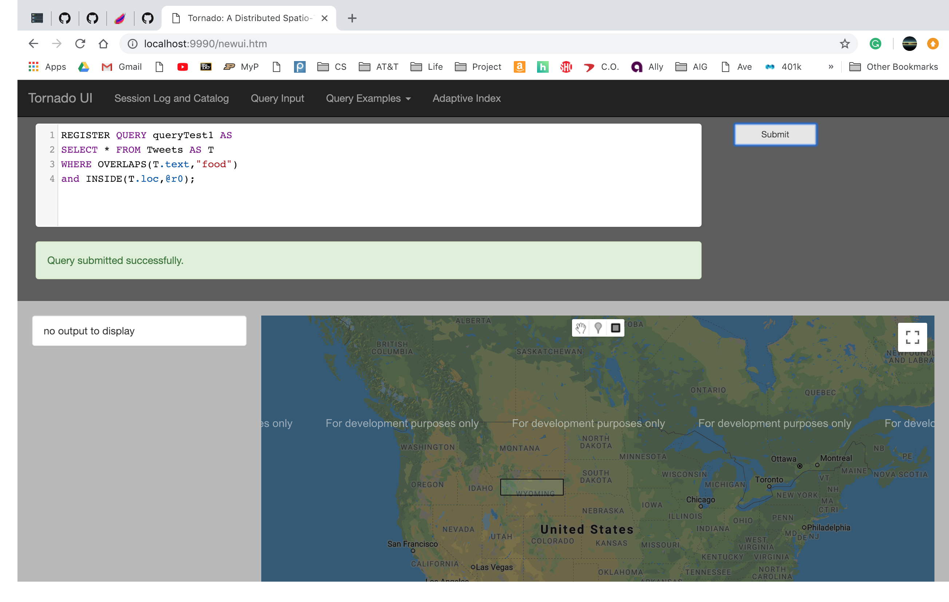
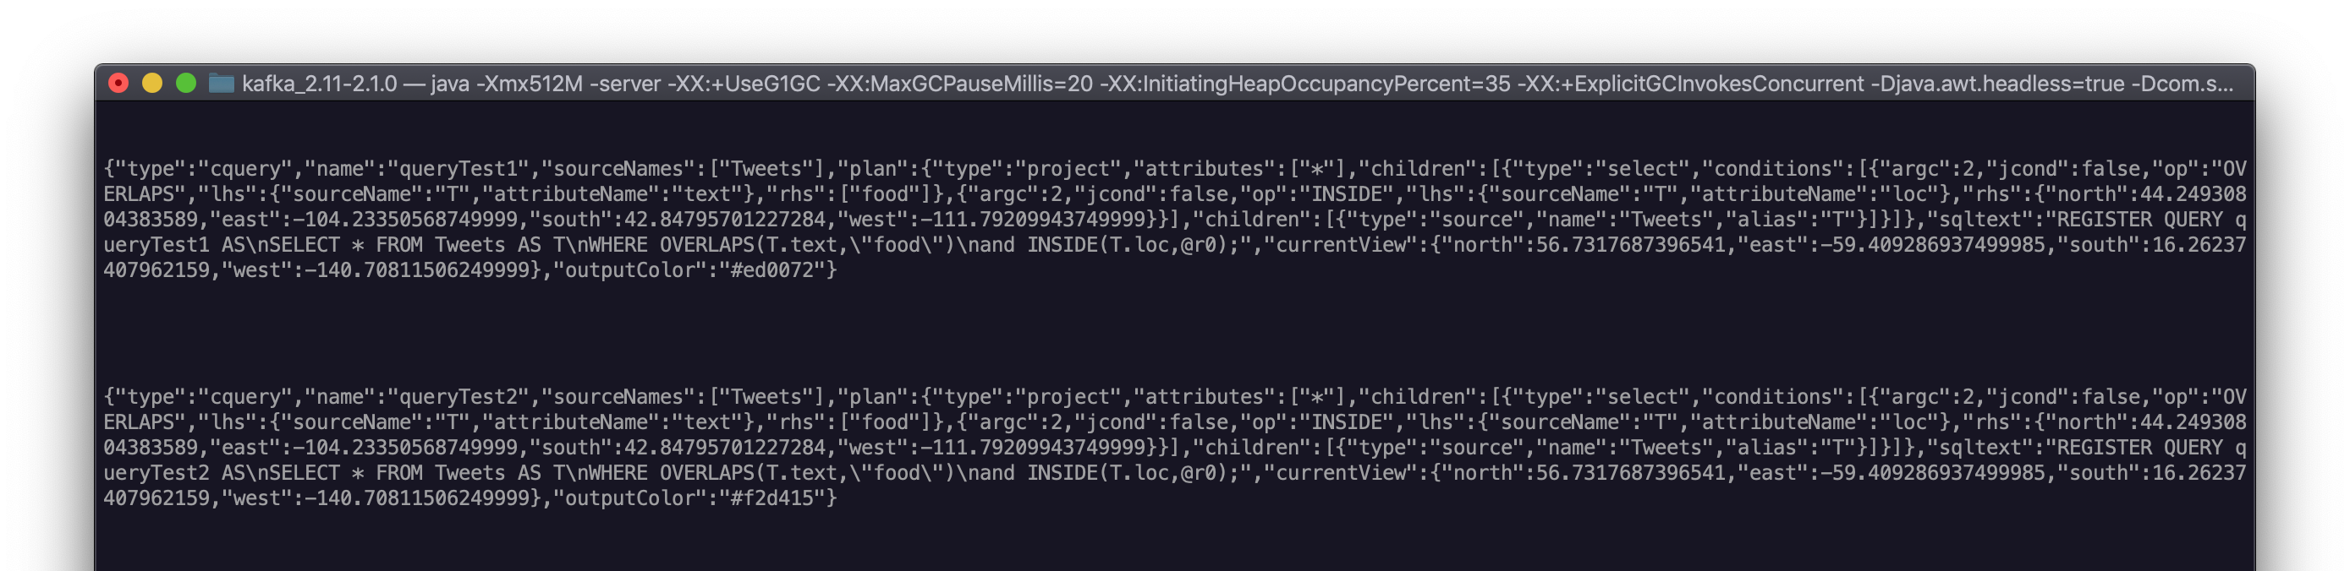
UI Communicating With Kafka Topics
Modified application.conf: https://github.com/purduedb/tornado-ui/blob/tornadoui/README.md

Slide 6
Examples
TornadoTweetCountExample.java
TestMain.java
Already in purduedb repo
No issues running example, working as expected
Code Ahmed sent via Dropbox
Old working tornado demo
Expected Behavior:
Submit query from UI
Consume via KafkaSpout
Submit to Tornado
Process Query
Return output to UI

Slide 7
TornadoUITopology
3 Approaches
Using current project setup
Older versions of frameworks
Utilized KafkaSpout and KafkaProducer
Using updated frameworks
Utilized basic Consumer and Producer in updated Storm-Kafka integration
Using updated frameworks
Utilized KafkaSpout and KafkaProducerBolt
Notes:
3 approaches, not initial thought process. Tried 3 different ways to get around the problem of getting the results back to UI.

Slide 8
1. Using current implementation (Similar to TestMain.java Example)
Submit Query via UI
Produce Output using Kafka Producer
Show Result in UI
Consume Query using Kafka Spout
Transform Query and Process Using Tornado
2. Using updated frameworks (Consumer and Producer)
Submit Query via UI
Produce Output using Producer
Show Result in UI
Consume Query using Consumer
Transform Query and Process Using Tornado
3. Using updated frameworks (KafkaSpout and KafkaProducerBolt)
Submit Query via UI
Produce Output using Kafka ProducerBolt
Show Result in UI
Consume Query using Kafka Spout
Transform Query and Process Using Tornado

Slide 9
Currently
Submit Query via UI
Produce Output using Kafka
Show Result in UI
Consume Query using Kafka
Transform Query and Process Using Tornado
Updates in PurdueDB Repos (As pull requests)
https://github.com/purduedb/tornadostreaming
https://github.com/purduedb/tornado-ui
Any small modifications are noted in README files
Any version changes are noted in READMEs and emailed to Ahmed

