Slide 1
Peyton Puckett CS 490 - Spring 2019 Big Spatial Data Systems

Slide 2
Week of February 4th
Webserver running locally

Slide 3
Notes
Latest version of Java and Scala
No special characters in path
Add two lines to build.sbt (From Daniel)
Google Maps API Request Quota Exceeded
Update instructions on README

Slide 4
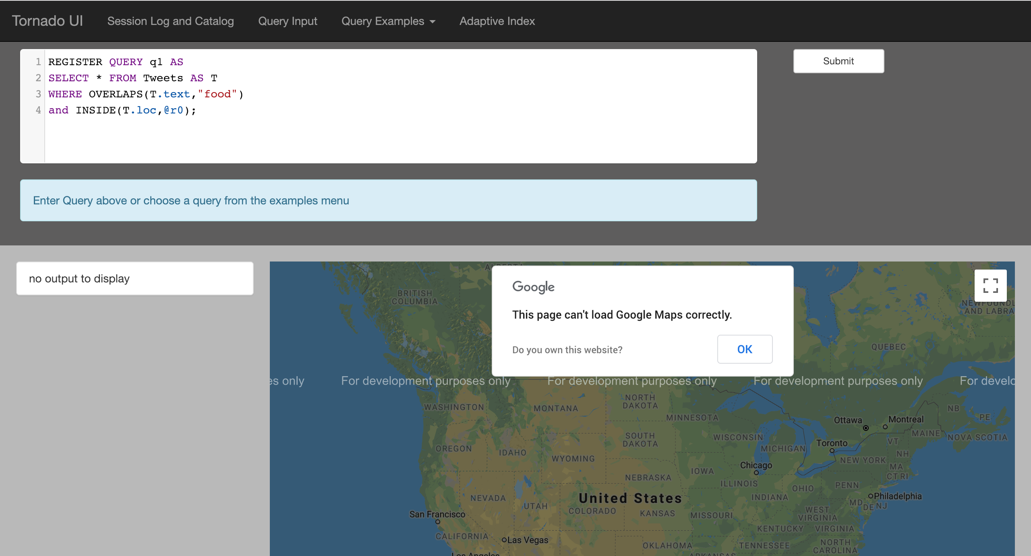
Localhost Webserver
Google Maps Error
- API Quota (Resets)

Slide 5
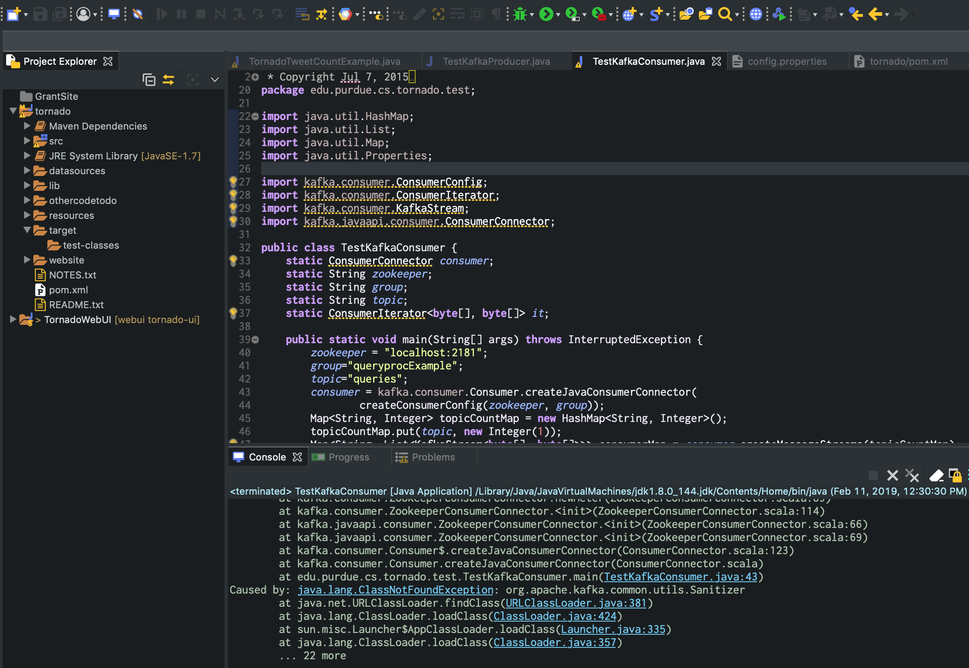
Kafka Version Java Version

Slide 6
Questions?
Email: ppucket@purdue.edu
Github: @PeytonNP

Slide 7
Week of February 11th
Main Objective

Slide 8
Questions?
Email: ppucket@purdue.edu
Github: @PeytonNP

Slide 9
Week of February 18th
Main Objective

Slide 10
Questions?
Email: ppucket@purdue.edu
Github: @PeytonNP

Slide 11
Week of February 25th
Main Objective

Slide 12
Questions?
Email: ppucket@purdue.edu
Github: @PeytonNP

Slide 13
Week of March 4th
Main Objective

Slide 14
Questions?
Email: ppucket@purdue.edu
Github: @PeytonNP

Slide 15
Week of March 11th
Main Objective

Slide 16
Questions?
Email: ppucket@purdue.edu
Github: @PeytonNP

Slide 17
Week of March 18th
Main Objective

Slide 18
Questions?
Email: ppucket@purdue.edu
Github: @PeytonNP

Slide 19
Week of March 25th
Main Objective

Slide 20
Questions?
Email: ppucket@purdue.edu
Github: @PeytonNP

Slide 21
Week of April 1st
Main Objective

Slide 22
Questions?
Email: ppucket@purdue.edu
Github: @PeytonNP

Slide 23
Week of April 8th
Main Objective

Slide 24
Week of April 15th
Main Objective

Slide 25
Questions?
Email: ppucket@purdue.edu
Github: @PeytonNP

Slide 26
Week of April 22nd
Main Objective

Slide 27
Questions?
Email: ppucket@purdue.edu
Github: @PeytonNP

Slide 28
Week of April 29th
Main Objective

Slide 29
Questions?
Email: ppucket@purdue.edu
Github: @PeytonNP

Slide 30
Week of May 6th
Main Objective

Slide 31
Questions?
Email: ppucket@purdue.edu
Github: @PeytonNP

