Slide 1
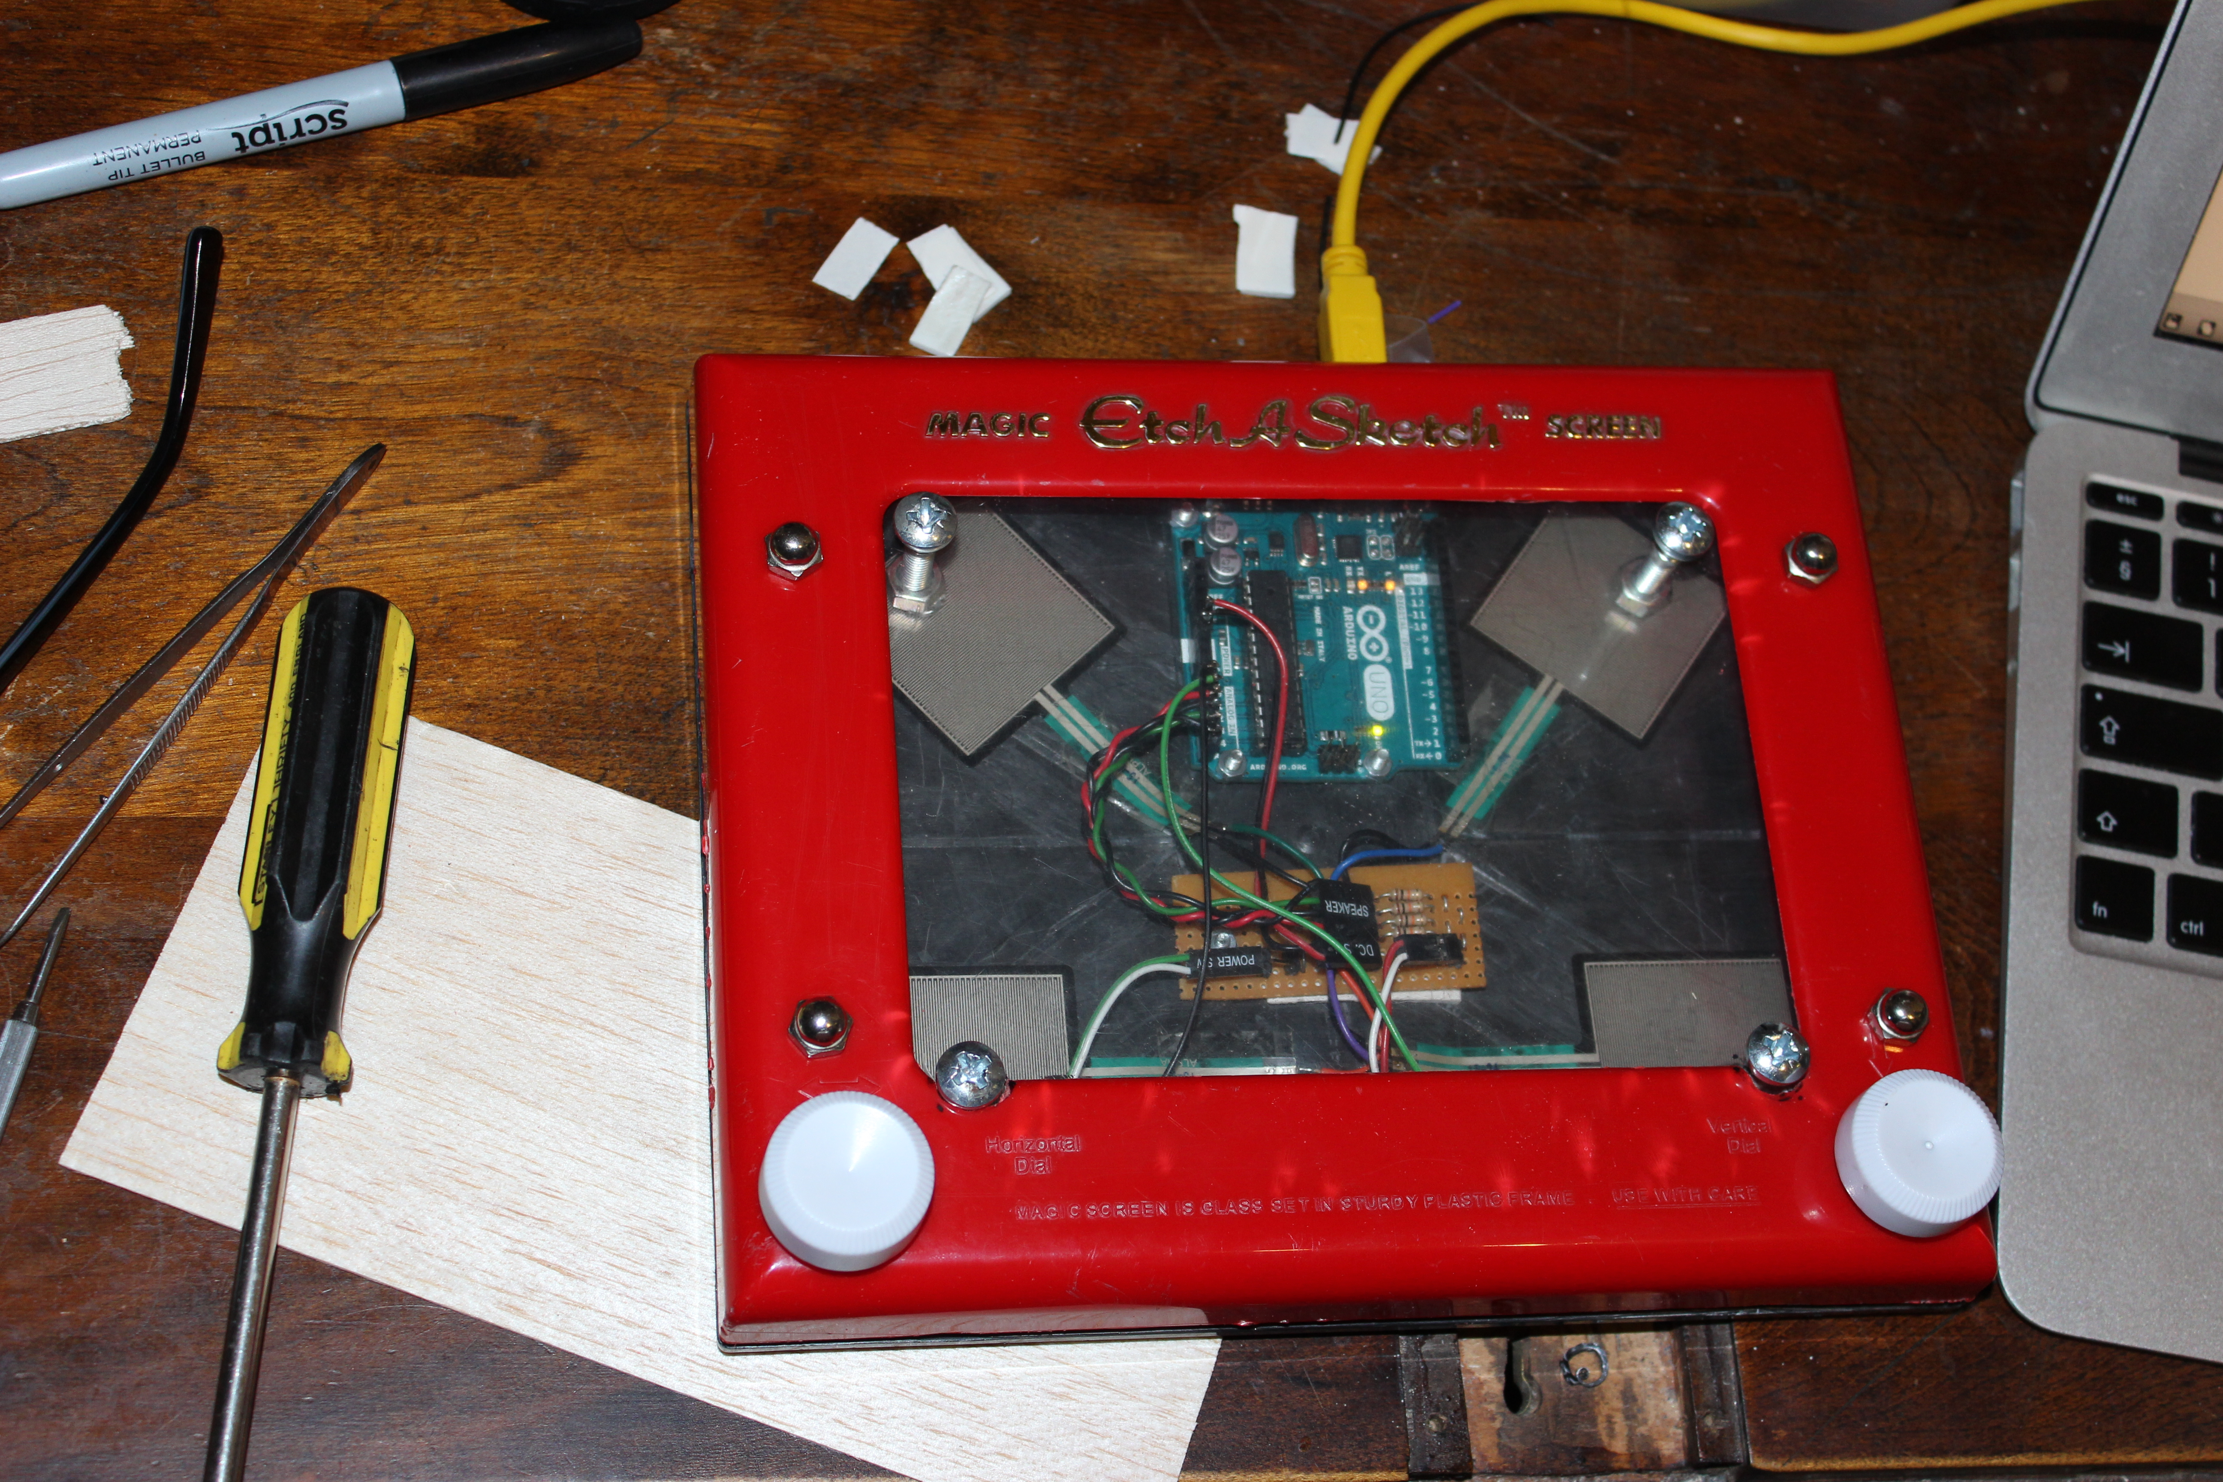
IDMT Cruft Fest Project
Etch-a-Sketch Max Controller
Sam Perry - EC16039

Slide 2
What is it?
Pressure sensitive controller for Max
Apply pressure to the screen to control parameters in Max via an Arduino
Max based granular synthesizer
Pressure screen and potentiometers are mapped to synthesizer parameters

