Slide 1


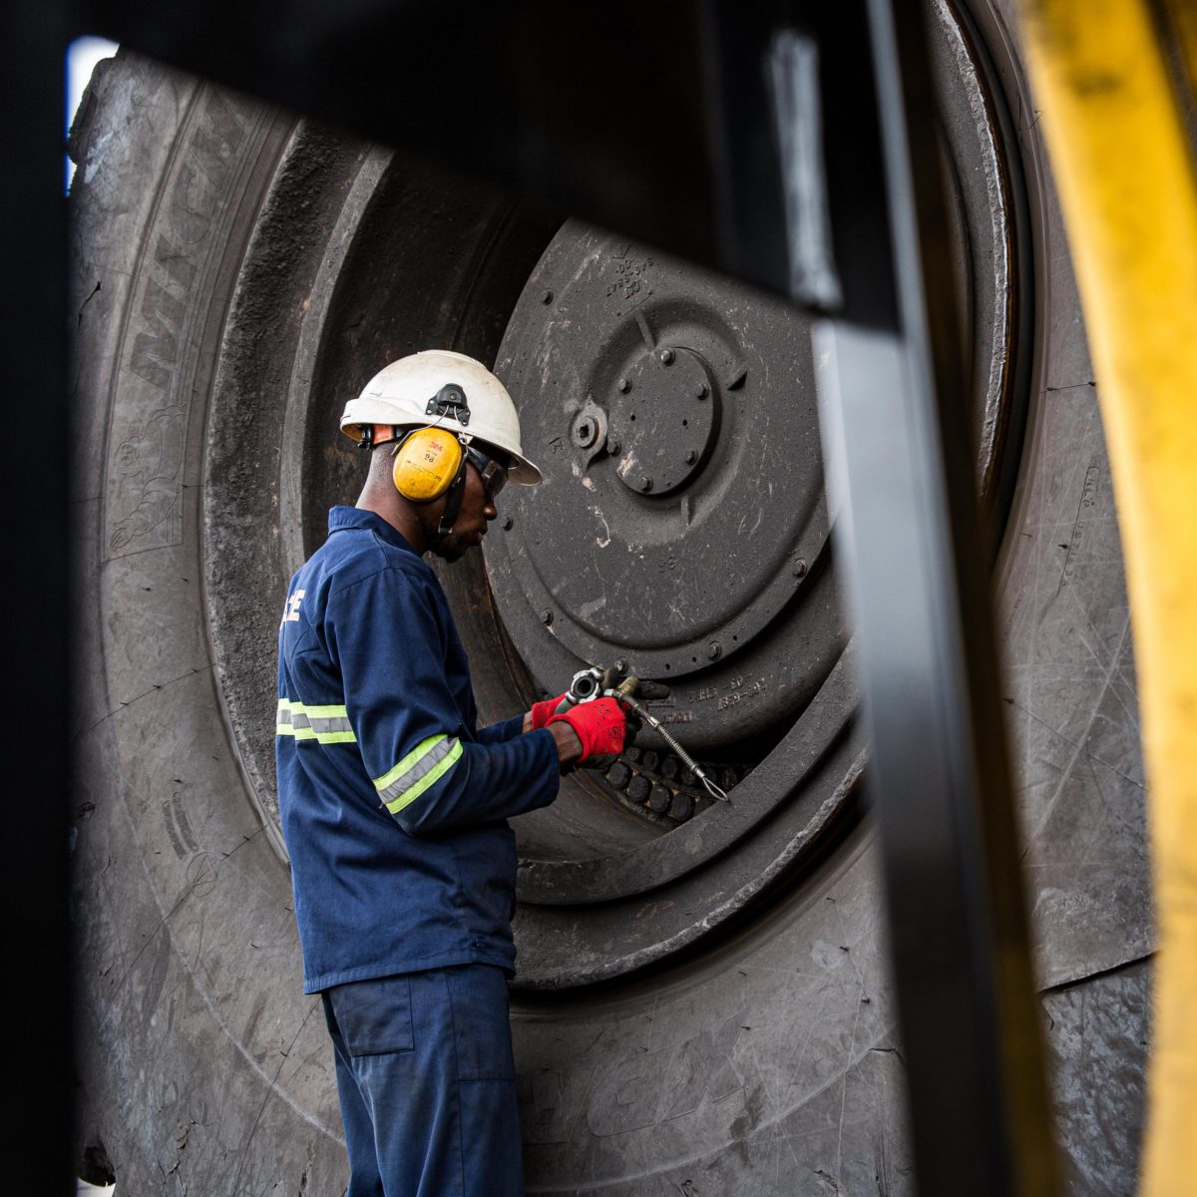

Contact us at:
lebogang@lebili.co.za
+27 79 948 3076
www.lebili.com
Onsite Service
In the dynamic and demanding world of mining, the performance and longevity
of your tires are critical. Unplanned downtime and accidents can have
significant consequences. That's why our On-Site Mining Tire Check Services
are your dedicated partner in ensuring tire safety, longevity, and performance
right at your mining site.
Why onsite service
Minimize downtime
Safety assurance
Cost Efficiency
Customize solution
Stand 1189 unit A kadoma street Steelpoort industrial park

