Slide 1


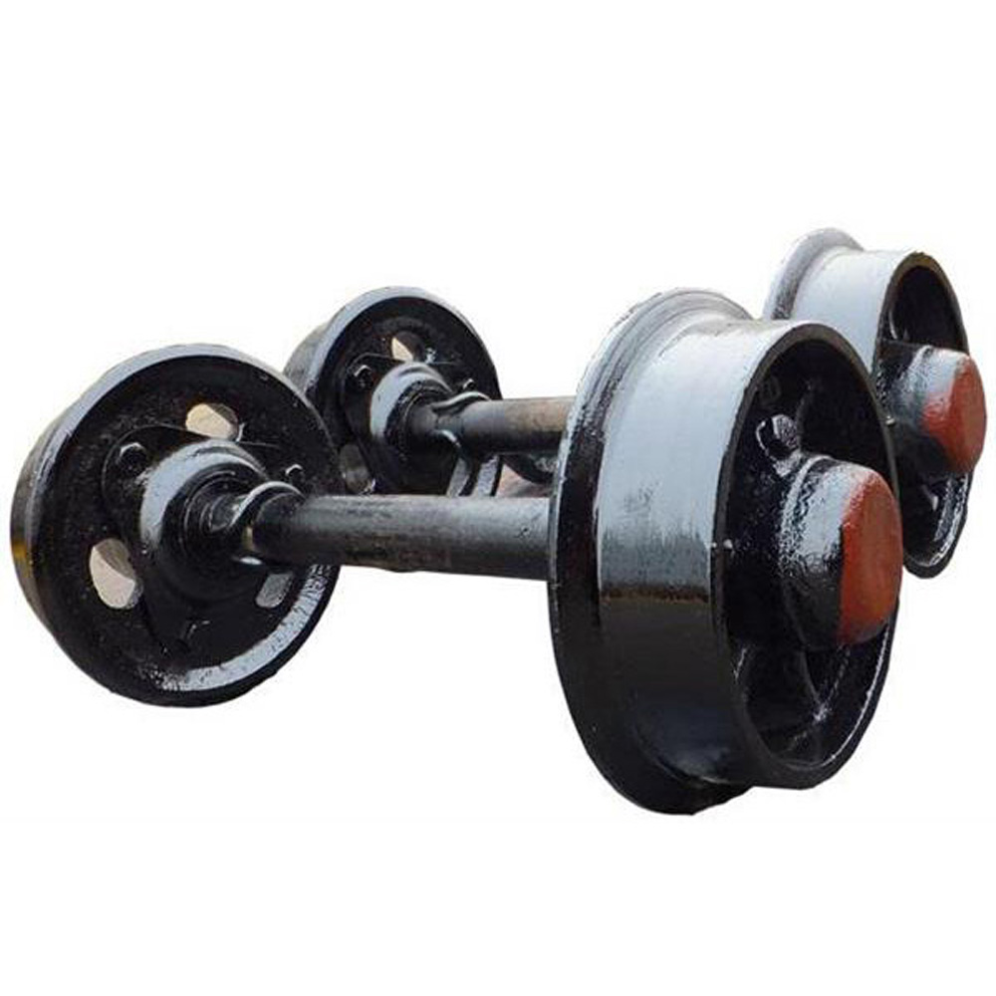

Contact us at:
lebogang@lebili.co.za
+27 79 948 3076
www.lebili.com
Rim Engineering
Discover the cutting-edge world of Rim Engineering and elevate your wheel experience to new heights. Our innovative solutions are designed to provide enhanced performance, durability, and style for your vehicles. Welcome to the future of wheel technology! Our solution is built to
Improved Heat Dissipation
Enhanced Safety
Have unmatched Durability
Performance Enhancement
Rim engineering solution:
Alloy wheel
Rim repair and refinishing
Consultation service
Stand 1189 unit A kadoma street Steelpoort industrial park

